Slide 1
Cereal

Slide 2
N^2
Start by removing each cow, resimulate

Slide 3
How to get N?
What if we start from the back?
Then every cow we add is MORE important than any previous cow.
We need to “kick a cow” out.

Slide 4

Kick Cow Out
1 2
1 2
1 2
1 2

Slide 5


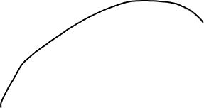
Kick Cow Out
1 2
1 2
1 2
1 2

Slide 6
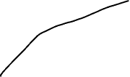



Kick Cow Out
1 2
1 2
1 2
1 2

Slide 7



Kick Cow Out
1 2
1 2
1 2
1 2

Slide 8



Kick Cow Out
1 2
1 2
1 2
1 2

Slide 9


Kick Cow Out
1 2
1 2
1 2
1 2

Slide 10
Kick Cow Out
1 2
1 2
1 2
1 2

