Slide 1
Repeating array DD processing sample
2021/Nov/21
Shigeru Yamamoto

Slide 2
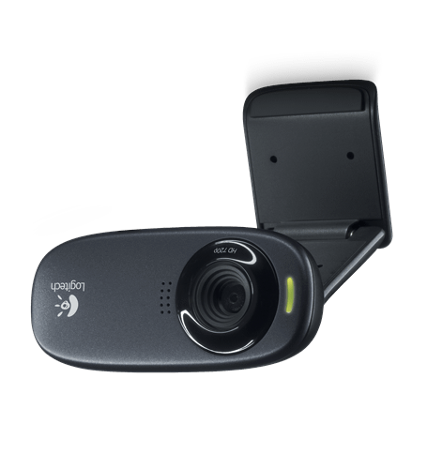
Processing flow
Extract distance of edge
Determine majority of pattern pitch
Pitch histogram
Frame
Binarize
Defect Detection
Subtraction
Shrink
Display on Picture

