Slide 1
MDA681: Project
AUTOMATED DIABETICS RECTINOPATHY DETECTION SYSTEM
Student
Shigha velloth - 2282475
Department of Statistics and Data Science CHRIST(Deemed to be University) Bangalore, India
Guide
Dr: Monisha Singh
Department of Statistics and Data Science CHRIST(Deemed to be University) Bangalore, India

Slide 2
Contents
1. PROJECT DOMAIN
PROBLEM STATEMENT AND OBJECTIVE
DATASET DESCRIPTIONS
LANGUAGE OR TOOLS USED

Slide 3
DATA PREPROCESSING STEPS
MODEL BUILDING
DEPLOYMENT OF MODE
RESULTS AND DISCUSSIONS

Slide 4
1.PROJECT DOMAIN What is Diabetics Retinopathy? India is said to be the diabetic capital of the world by 2030 with over 80 million people affected by it. Diabetic Retinopathy is caused due to diabetic mellitus. Retinopathy is a medical condition that affects the retina, which is the light-sensitive tissue located at the back of the eye.

Slide 5
In diabetic retinopathy, prolonged high blood sugar levels cause damage to the blood vessels in the retina. Over time, this damage can lead to various abnormalities in the retina, including: Microaneurysms: Small bulges in the blood vessels of the retina. Hemorrhages: Leakage of blood from damaged blood vessels into the retina. Exudates: Deposits of fluid and lipids that leak from damaged blood vessels. Neovascularization: Abnormal growth of new blood vessels on the surface of the retina, which are fragile and prone to leakage.

Slide 6
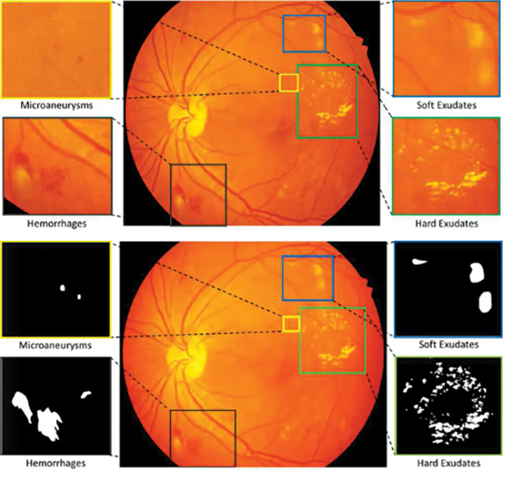

Slide 7
These abnormalities can impair vision and, if left untreated, can lead to serious complications such as retinal detachment and permanent vision loss. If identified early, this is a blindness which can be avoided. The manual process of periodic DR diagnosis and detection for necessary treatment, is time consuming and unreliable due to unavailability of resources and expert opinion.

Slide 8
One of the key reasons for the importance of early diagnosis lies in the availability of effective treatment options. Detecting diabetic retinopathy at an early stage allows for the implementation of various treatment modalities aimed at managing the condition and preventing its progression. These treatments may include laser therapy, intraocular injections, or surgical interventions. Early intervention not only preserves vision but also reduces the likelihood of requiring more invasive procedures in advanced stages of the disease.

Slide 9
2.PROBLEM STATEMENT
In a landscape where numerous systems for diabetic retinopathy detection exist, the need for innovation persists. Leveraging the power of Convolutional Neural Networks (CNNs) and modern web technologies, I aim to develop a streamlined solution for diabetic retinopathy detection accessible to a broader audience. By creating a user-friendly interface using Streamlit, I intend to democratize access to advanced diabetic retinopathy screening, overcoming barriers such as complexity, cost, and limited availability of trained professionals.

Slide 10
OBJECTIVE:
The project aims to develop a deep learning system for diabetic retinopathy detection using convolutional neural networks (CNNs). By leveraging CNN architectures like DenseNet, the model will accurately classify the severity of diabetic retinopathy in retinal images. Through a user-friendly interface powered by Streamlit, healthcare professionals can upload images for instant predictions. The focus lies on optimizing model performance, validating against clinical standards, and ensuring interpretability for real-world applicability.

Slide 11
3.DATASET DESCRIPTION
Dataset :Diabetic Retinopathy Classification Dataset
Source:
The dataset is sourced from EyePACS and is available on Kaggle.
EyePACS is a platform for storing and analyzing retinal images for diabetic retinopathy screening
The Diabetic Retinopathy Classification Dataset is a collection of retinal images obtained from patients with varying degrees of diabetic retinopathy (DR). Each image is rated by a clinician on a scale of 0 to 4, indicating the severity of diabetic retinopathy present.

Slide 12
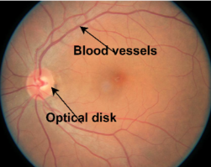
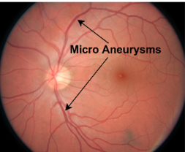
Classes:
0 - No DR: Images in this category show no signs of diabetic retinopathy.
1 - Mild: Images in this category exhibit mild diabetic retinopathy.

Slide 13
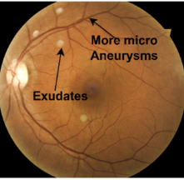
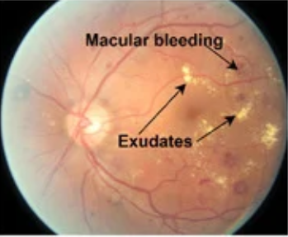
2 - Moderate: Images in this category show moderate diabetic retinopathy .
3 - Severe: Images in this category indicate severe diabetic retinopathy.

Slide 14
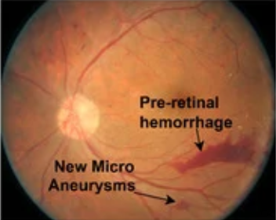
4 - Proliferative DR: Images in this category depict proliferative diabetic retinopathy, the most severe form of the condition .

Slide 15
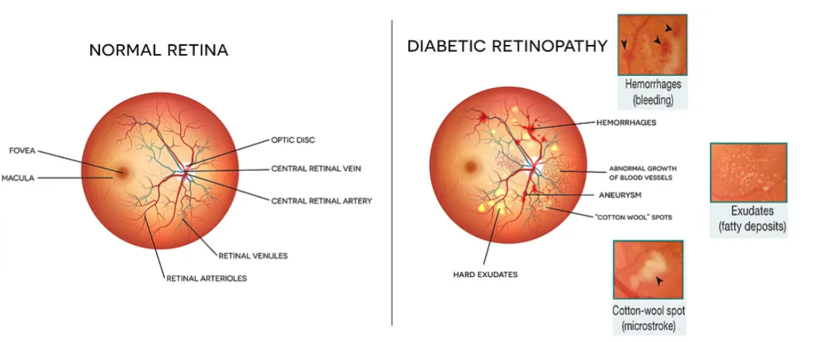
Difference between No DR and Diabetics DR

Slide 16
4. LANGUAGE OR TOOLS USED
Programming Language:
Python: The dataset will be processed, analayzed, and used for model training using Python programming language. Python offers a rich ecosystem of libraries and frameworks for machine learning and deep learning tasks.

Slide 17
Deep Learning Framework:
TensorFlow: TensorFlow, an open-source deep learning framework developed by Google, was utilized for building and training deep neural network models. Its high-level APIs and computational efficiency were leveraged to develop sophisticated models for diabetic retinopathy detection.

Slide 18
Deployment Framework:
Streamlit: For deploying the trained model as a web application, Streamlit will be utilized. Streamlit is an open-source Python library used for building interactive web applications for data science and machine learning projects. It enables easy integration of machine learning models into web-based interfaces without requiring extensive web development knowledge.

Slide 19
5. DATA PREPROCESSING STEPS:
Data Splitting:
Split the dataset into training, and test sets. The training set is used to train the model, the, and the test set is used to evaluate the final model performance on unseen data.
Image Loading and Resizing:
Load each image from the dataset subset and resize it to a uniform size suitable for model input. Make sure to maintain separate lists or arrays to store the preprocessed images for each subset.

Slide 20
Data Augmentation
These techniques are employed to increase the diversity and robustness of the dataset by creating variations of existing images. In the context of retinal images for diabetic retinopathy classification, common augmentation techniques include:
Rotation: Rotating images from a certain angle to simulate variations in orientation.
Horizontal and Vertical Flipping: Flipping images horizontally or vertically to introduce mirror reflections.
Scaling: Resizing images to different scales to simulate variations in image size.
Translation: Shifting images horizontally or vertically to simulate changes in position.
Brightness and Contrast Adjustment: Modifying brightness and contrast levels to simulate changes in lighting conditions.

Slide 21
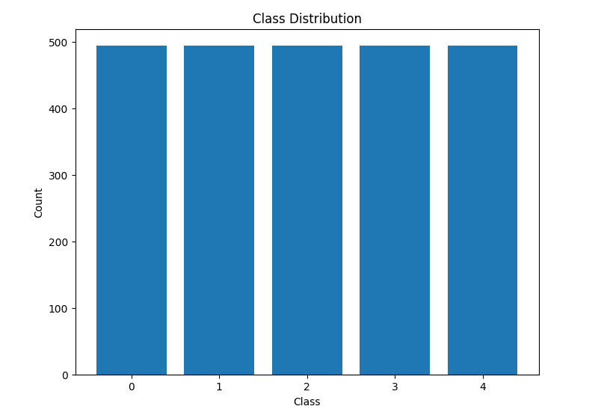
Checking for Class Imbalance:

Slide 22
6. MODEL BUILDING
DenseNet:
Here used transfer learning approach using DenseNet121 as the base model for a custom classification task.
DenseNet121
DenseNet121 is a convolutional neural network architecture proposed by Gao Huang, Zhuang Liu, Laurens van der Maaten, and Kilian Q. Weinberger in their paper titled "Densely Connected Convolutional Networks". It is a variant of the DenseNet family, which is known for its densely connected layers and efficient parameter usage.

Slide 23
DenseNet121 is a convolutional neural network architecture that has shown excellent performance in image classification tasks. In this implementation, we leverage a pre-trained DenseNet121 model trained on the ImageNet dataset. We remove the top classification layers and add custom layers suited to our specific task. By fine-tuning the model, we aim to leverage the pre-trained features while adapting the network to our dataset, enhancing its ability to classify images accurately.
Our trained model achieved an impressive accuracy of 90% on both the training and test datasets, indicating its robust performance.

Slide 24
Fine-tuning
The process involves adjusting the parameters of the pre-trained model to better fit the new data or task, typically by continuing the training process with a smaller learning rate .Using techniques like Dropout regularization can help mitigate overfitting during fine-tuning.
Dropout layer from the TensorFlow Keras library is a regularization technique commonly used in neural networks to prevent overfitting by randomly setting a fraction of input units to zero during training.

Slide 25
Model Evaluation:
loss: 0.2449: This is the value of the training loss. It represents how well the model is performing on the training data at the current epoch. Lower values indicate better performance. In this case, the training loss is 0.2449
accuracy: This is the training accuracy, which indicates the proportion of correctly classified samples in the training data. It is a measure of how well the model is learning from the training data. In this case, the training accuracy is 90% of the training samples are classified correctly by the model.
Test Accuracy: 90%

Slide 26
Sequential CNN Architecture:
The Sequential CNN architecture is a fundamental and widely used model for image classification tasks, including diabetic retinopathy detection. In a Sequential model, layers are arranged sequentially, with each layer passing its output to the next layer in the sequence. However, its linear structure may limit its ability to capture complex patterns and relationships in images compared to more sophisticated architectures like ResNet or DenseNet.

Slide 27
Utilizes a Sequential model for simplicity and ease of understanding.
Consists of convolutional layers followed by max-pooling layers for feature extraction.
Batch normalization layers are added to normalize the activations of each layer.
Dropout layers are included to prevent overfitting by randomly dropping a fraction of input units.
Utilizes the ReLU activation function for the convolutional layers and softmax activation for the output layer.
Optimized using the Adam optimizer with a learning rate of 1e-4.
Categorical cross-entropy loss function is used for multi-class classification.
Model performance is evaluated using accuracy as the metric.
Despite the designed architecture, the model achieved a relatively low accuracy of 20% on the test dataset.

Slide 28
ResNet50
The ResNet50 architecture stands out as a profound advancement in convolutional neural networks (CNNs), particularly notable for its depth and efficacy in image classification tasks. Developed by Microsoft Research, ResNet50 introduces the concept of residual learning, addressing the challenge of vanishing gradients encountered in training very deep networks. Its ability to capture intricate patterns and subtle details is instrumental in identifying pathological changes associated with different stages of diabetic retinopathy.

Slide 29
Base Model: ResNet50's base model comprises a series of convolutional layers organized into blocks, with each block containing multiple convolutional layers followed by batch normalization and ReLU activation functions.
Skip Connections: ResNet50 introduces skip connections or shortcut connections that skip one or more layers, enabling the model to learn residual mappings. These connections mitigate the vanishing gradient problem and allow for the training of very deep networks.
Bottleneck Blocks: ResNet50 utilizes bottleneck blocks, which consist of three convolutional layers: 1x1, 3x3, and 1x1 convolutions. These blocks reduce the computational complexity while maintaining representational power.

Slide 30
Custom Top Layers: In this code snippet, custom top layers, including a Global Average Pooling layer and Dense layers, are added on top of the ResNet50 base model. The Dense layers perform classification based on the features extracted by the convolutional base.
Global Average Pooling: After the convolutional layers, a Global Average Pooling layer is added to aggregate spatial information from the feature maps into a single vector. This helps in reducing the number of parameters and avoiding overfitting.
Output Layer: The output layer consists of a Dense layer with softmax activation, which produces class probabilities for multi-class classification tasks.
The model achieved a training accuracy of 77%, indicating that it learned well from the training data.

Slide 31
7.Deployment of the model
Streamlit serves as a powerful tool for deploying machine learning models with ease and efficiency. As an open-source app framework tailored for Python, Streamlit offers a user-friendly interface that simplifies the development and deployment of interactive data science applications. With Streamlit, developers can create intuitive web-based applications using simple Python scripts, eliminating the need for complex front-end development. Its seamless integration with popular machine learning libraries such as TensorFlow enables rapid prototyping and deployment of ML models.

Slide 32
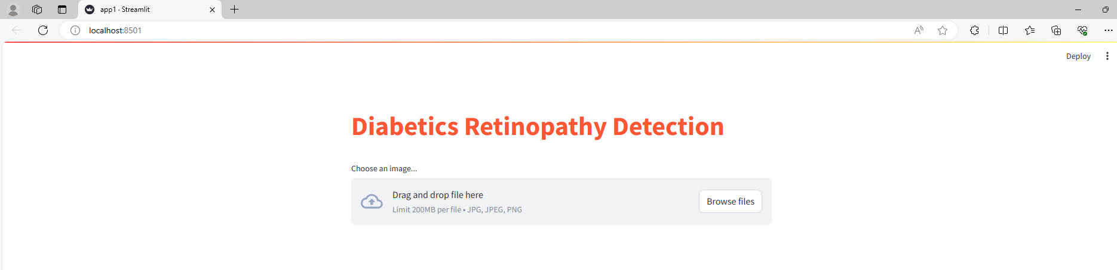

Slide 33
8. RESULT AND DISCUSSIONS
The developed user interface (UI) for diabetic retinopathy detection represents a significant advancement in ophthalmic care, offering a sophisticated platform for early detection, assessment, and management of diabetic retinopathy. By seamlessly integrating technology into clinical practice, the UI has the potential to revolutionize diabetic retinopathy screening and contribute to improved patient outcomes and vision health

Slide 34
Real-time Prediction: The user interface for diabetic retinopathy detection harnesses the power of state-of-the-art machine learning algorithms to provide rapid and accurate predictions of diabetic retinopathy severity levels. Upon image upload, the interface initiates real-time processing of the retinal image data, leveraging sophisticated convolutional neural networks (CNNs) to extract intricate features indicative of diabetic retinopathy pathology.

Slide 35
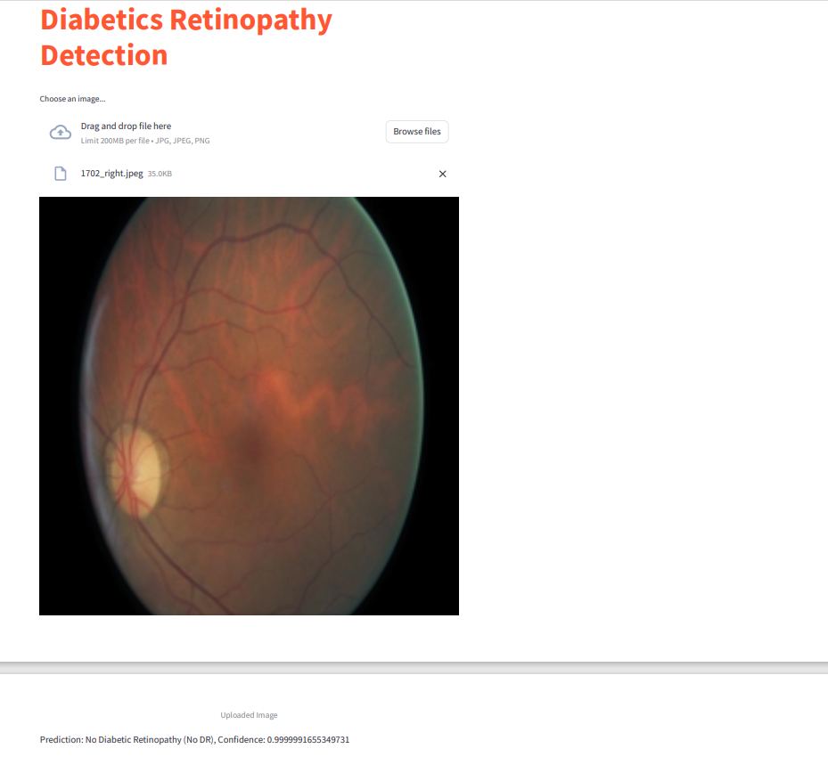

Slide 36
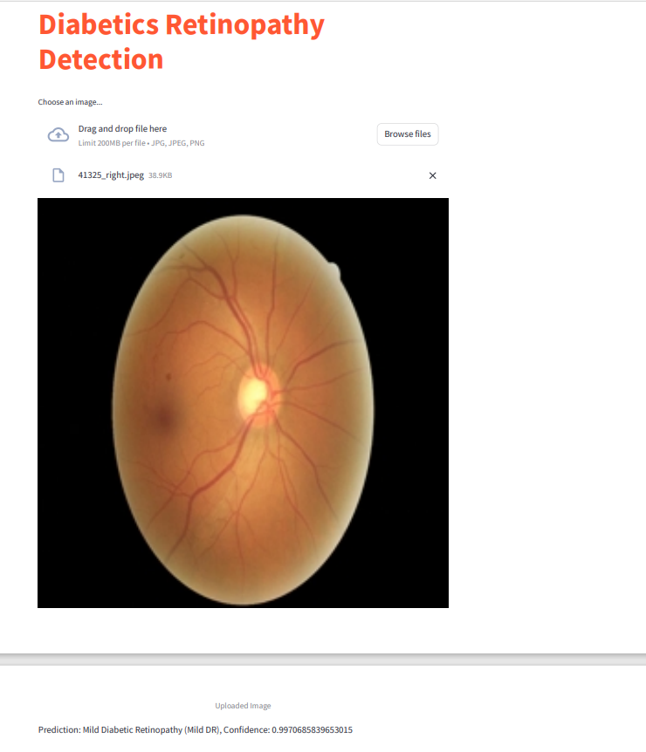

Slide 37
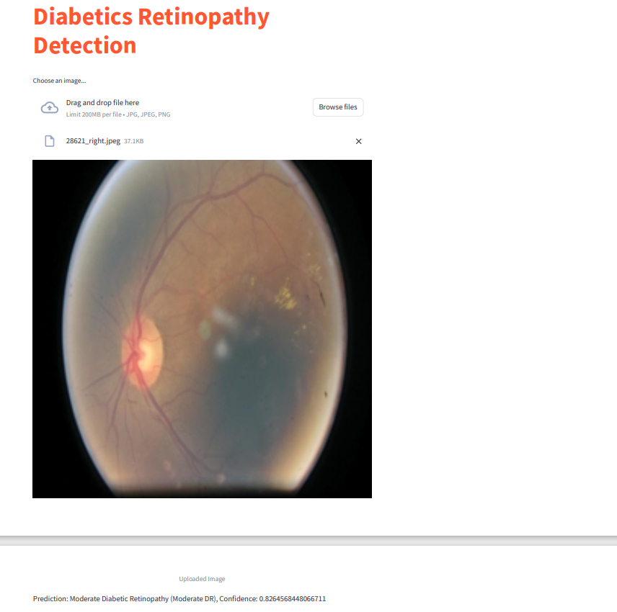

Slide 38
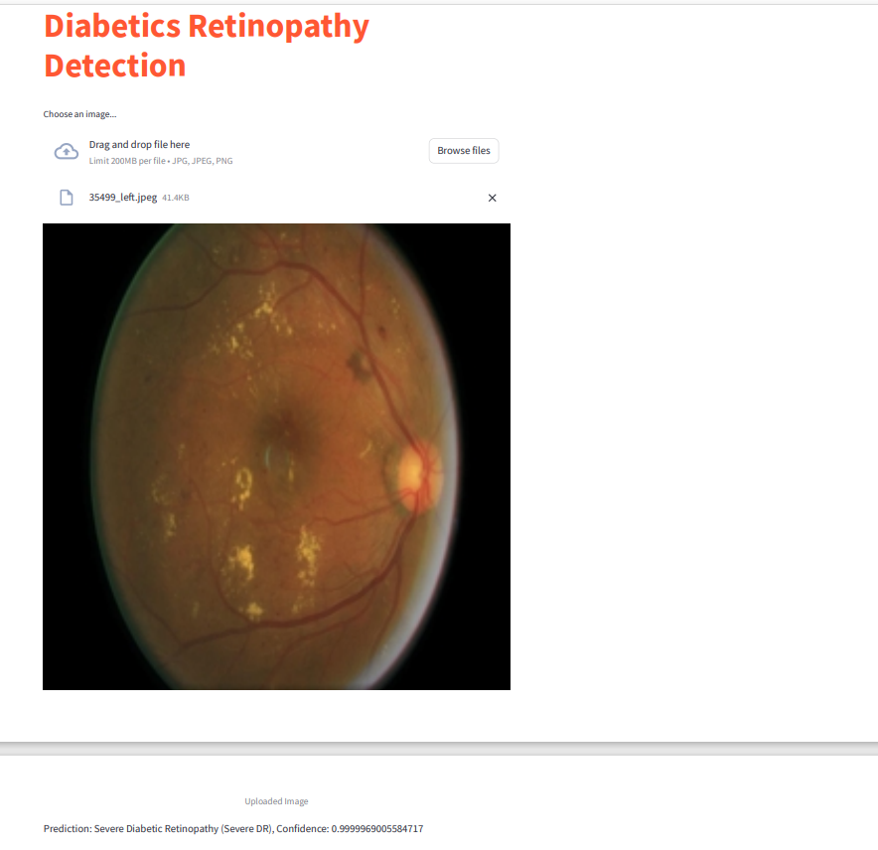

Slide 39
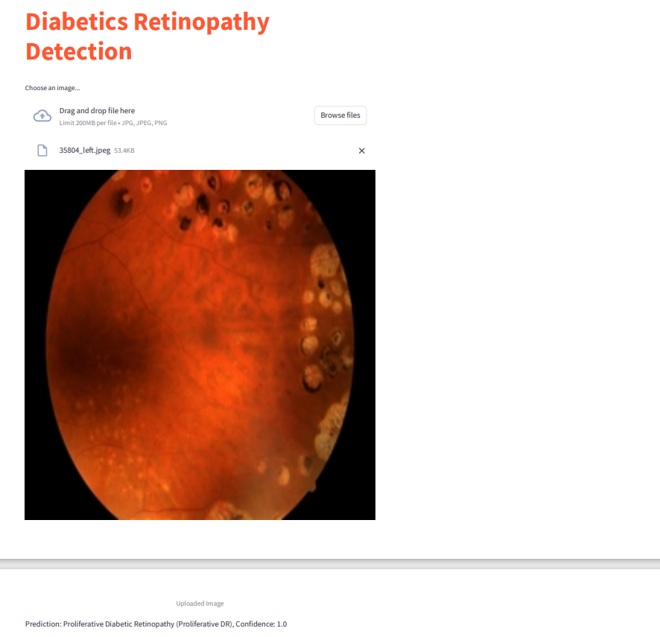

Slide 40
Clinical Implications: The implementation of the UI carries significant implications for clinical practice, particularly in the early detection and management of diabetic retinopathy. By providing healthcare professionals with efficient tools for retinal image analysis, the UI streamlines diagnostic workflows and enhances diagnostic accuracy.

Slide 41
Limitations
1. Image Quality Dependency: The performance of the user interface for diabetic retinopathy detection is contingent upon the quality of retinal images uploaded by users. Poor image quality, such as low resolution or inadequate focus, may hinder the accuracy of predictions and lead to misinterpretation of results. Addressing this limitation requires educating users on optimal imaging techniques and implementing preprocessing algorithms to enhance image clarity and consistency.

Slide 42
Future Direction
Incorporating Additional Data Sources: Integrate additional data sources, such as patient demographic information, medical history, or genetic markers, to enhance the model's predictive capabilities and provide more personalized risk assessments for diabetic retinopathy.
Clinical Validation: Conduct rigorous clinical validation studies to assess the model's performance in real-world healthcare settings. Collaborate with ophthalmologists and medical professionals to validate the model's accuracy, reliability, and usability in clinical practice.

Slide 43
Real-Time Deployment: Develop strategies for real-time deployment of the model in clinical settings, such as integration with existing electronic health record (EHR) systems or mobile health applications. By enabling real-time screening and diagnosis of diabetic retinopathy, we can facilitate timely interventions and improve patient outcomes.
Collaborative Partnerships: Foster collaborative partnerships with healthcare institutions, research organizations, and industry stakeholders to facilitate data sharing, model validation, and knowledge exchange. By leveraging collective expertise and resources, we can accelerate progress towards more effective diabetic retinopathy detection and management strategies.

Slide 44
REFERENCES
Moin, K., Shrivastava, M., Mishra, A., Jena, L., & Nayak, S. (2022). Diabetic Retinopathy Detection Using CNN Model. In Ambient Intelligence in Health Care (pp. Page numbers). Springer Nature Singapore.
S. Dua, N. Kandiraju and H. W. Thompson, "Design and implementation of a unique blood-vessel detection algorithm towards early diagnosis of diabetic retinopathy", International Conference on Information Technology: Coding and Computing (ITCC'05), vol. II, no. 1, pp. 26-31, 2005.

Slide 45
H. Jiang, K. Yang, M. Gao, D. Zhang, H. Ma and W. Qian, "An Interpretable Ensemble Deep Learning Model for Diabetic Retinopathy Disease Classification", 2019 41st Annual International Conference of the IEEE Engineering in Medicine and Biology Society (EMBC), pp. 2045-2048, 2019.
Mukesh Krishnan, M., Thanga Ramya, S., Kirubanathavalli, K., Lalitha, S., Diofrin, J., & Vadivel, M. (2021). Deep Learning Approaches for Detecting Diabetic Retinopathy using CNN Models. IEEE.

Slide 46
Thank you

