Slide 1
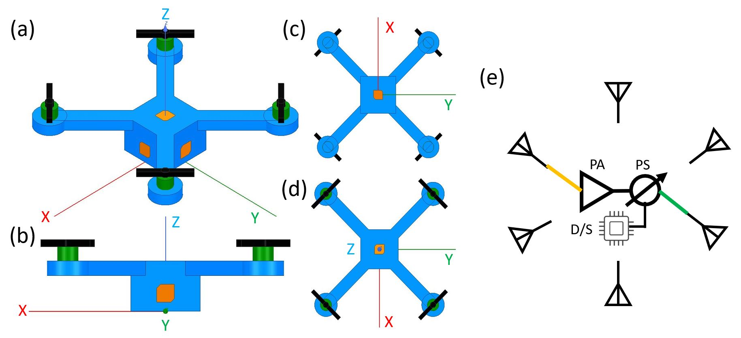


SRPArray for Agricultural Application
Feb.
March
April
May
June
Device Selection
Circuits Integration
Experiments
Submission to ISAP2021
Algorithm Improvement
Embedded System
RF Components
DAQ
RF Circuits
Audio Amplifier
Embedded System
Non-Radiative Test
Chamber Test
1x2 SRPArray
More elements
Better Positioning Resolution
P-Band (750 MHz) Radar
Biomass
Soil Moisture
Wireless Power Transfer (750MHz)
Temperature
Chemical Composition
PH value
Soil
P-Band Powered Sensor

