Slide 1

General Trees
Make Money Fast!
Stock
Fraud
Ponzi
Scheme
Bank
Robbery
© 2010 Goodrich, Tamassia
Trees
Notes:
Trees

Slide 2
What is a Tree
In computer science, a tree is an abstract model of a hierarchical structure
A tree consists of nodes with a parent-child relation
Applications:
  Organization charts
  File systems
  Function invocation in programming
Computers”R”Us
Sales
Manufacturing
R&D
US
International
Laptops
Desktops
Europe
Asia
Canada
© 2010 Goodrich, Tamassia
Trees

Slide 3
Tree Terminologies
Root: node without parent (A)
Internal node: node with at least one child (A, B, C, F)
External node (a.k.a. leaf): node without children (E, I, J, K, G, H, D)
Ancestors of a node: parent, grandparent, grand-grandparent, etc.
Depth (or level) of a node: number of ancestors
Height of a tree: maximum depth of any node
Descendant of a node: child, grandchild, grand-grandchild, etc.
Subtree: tree consisting of a node and its descendants
A
B
C
D
E
F
G
H
I
J
K
Subtree
© 2010 Goodrich, Tamassia
Trees

Slide 4
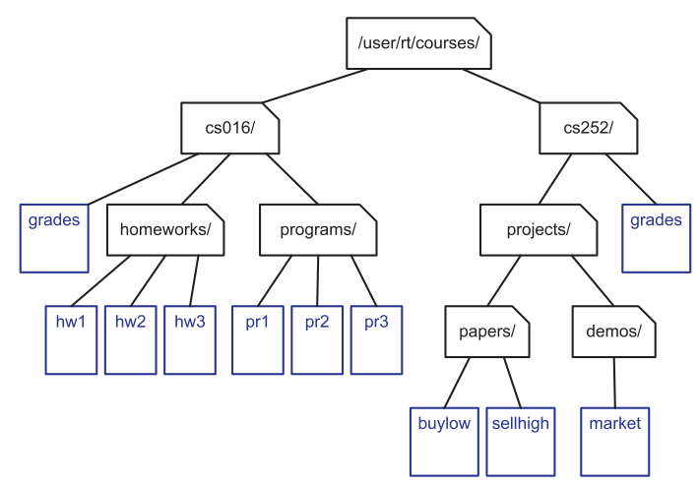
Examples of Trees
File system
  Internal nodes: directories (folders)
  External nodes: files
© 2010 Goodrich, Tamassia
Trees

Slide 5
Tree ADT
We use positions to access nodes
Generic methods:
  integer size()
  boolean empty()
Accessor methods:
  position root()
  list<position> positions()
Position-based methods:
  position p.parent()
  list<position> p.children()
Query methods:
  boolean p.isRoot()
  boolean p.isExternal()
Additional update methods may be defined for specific applications
position = pointer
list = linked list or vector
© 2010 Goodrich, Tamassia
Trees

Slide 6
Preorder Traversal
A traversal visits the nodes of a tree in a systematic manner
Preorder traversal: a node is visited before its descendants
Application: print a structured document
Algorithm preOrder(v)
  visit(v)
  for each child w of v
  preorder (w)
1
Make Money Fast!
2
5
9
1. Motivations
2. Methods
References
3
4
6
7
8
1.1 Greed
1.2 Avidity
2.1 Stock
Fraud
2.2 Ponzi
Scheme
2.3 Bank
Robbery
© 2010 Goodrich, Tamassia
Trees

Slide 7
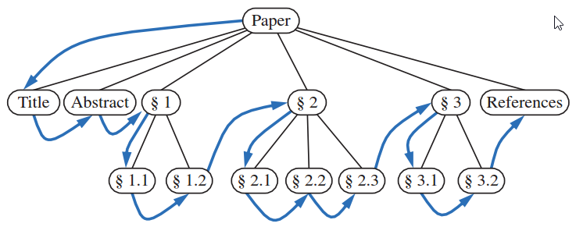
Preorder Traversal: Example
© 2010 Goodrich, Tamassia
Trees

Slide 8
Postorder Traversal
Postorder traversal: a node is visited after its descendants
Application: compute space used by files in a directory and its subdirectories
Algorithm postOrder(v)
  for each child w of v
  postOrder (w)
  visit(v)
9
cs16/
8
3
7
homeworks/
programs/
todo.txt
1K
1
2
4
5
6
h1c.doc
3K
h1nc.doc
2K
DDR.cpp
10K
Stocks.cpp
25K
Robot.cpp
20K
© 2010 Goodrich, Tamassia
Trees

Slide 9
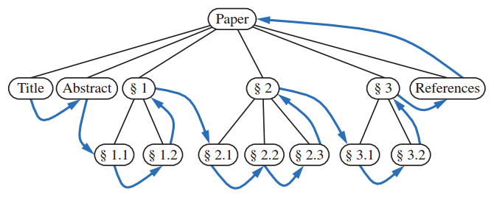
Postorder Traversal: Example
© 2010 Goodrich, Tamassia
Trees

Slide 10
Comparison
Preorder
Euler Tour Traversal
  Preorder: Visit a node at the first sight
  Postorder: Visit a node at the last sight
Postorder
B
E
F
I
J
K
© 2010 Goodrich, Tamassia
Trees

Slide 11
Iterative Implementation of Preorder Traversal
Steps
  Push the root to the stack
  Pop the stack and visit it
  Push the children in a reverse order (via the use of another stack)
  Repeat 2) and 3) until the stack is empty
© 2010 Goodrich, Tamassia
Trees

Slide 12
Iterative Implementation of Preorder Traversal: Demo
A
A
Stack
B
C
D
E
F
G
H
I
J
K
Preorder:
© 2010 Goodrich, Tamassia
Trees

Slide 13
Iterative Implementation of Preorder Traversal: Demo
A
B
C
D
B
C
D
By using
another stack
E
F
G
H
I
J
K
Preorder: A
© 2010 Goodrich, Tamassia
Trees

Slide 14
Iterative Implementation of Preorder Traversal: Demo
A
E
F
C
D
B
C
D
E
F
G
H
I
J
K
Preorder: A B
© 2010 Goodrich, Tamassia
Trees

Slide 15
Iterative Implementation of Preorder Traversal: Demo
A
F
C
D
B
C
D
E
F
G
H
I
J
K
Preorder: A B E
© 2010 Goodrich, Tamassia
Trees

Slide 16
Iterative Implementation of Preorder Traversal: Demo
A
I
J
K
C
D
B
C
D
E
F
G
H
I
J
K
Preorder: A B E F
© 2010 Goodrich, Tamassia
Trees

Slide 17
Iterative Implementation of Preorder Traversal: Demo
A
J
K
C
D
B
C
D
E
F
G
H
I
J
K
Preorder: A B E F I
© 2010 Goodrich, Tamassia
Trees

Slide 18
Iterative Implementation of Preorder Traversal: Demo
A
K
C
D
B
C
D
E
F
G
H
I
J
K
Preorder: A B E F I J
© 2010 Goodrich, Tamassia
Trees

Slide 19
Iterative Implementation of Preorder Traversal: Demo
A
C
D
B
C
D
E
F
G
H
I
J
K
Preorder: A B E F I J k
© 2010 Goodrich, Tamassia
Trees

Slide 20
Iterative Implementation of Preorder Traversal: Demo
A
G
H
D
B
C
D
E
F
G
H
I
J
K
Preorder: A B E F I J k C
© 2010 Goodrich, Tamassia
Trees

Slide 21
Iterative Implementation of Preorder Traversal: Demo
A
H
D
B
C
D
E
F
G
H
I
J
K
Preorder: A B E F I J k C G
© 2010 Goodrich, Tamassia
Trees

Slide 22
Iterative Implementation of Preorder Traversal: Demo
A
D
B
C
D
E
F
G
H
I
J
K
Preorder: A B E F I J k C G H
© 2010 Goodrich, Tamassia
Trees

Slide 23
Iterative Implementation of Preorder Traversal: Demo
A
B
C
D
E
F
G
H
I
J
K
Preorder: A B E F I J k C G H D
© 2010 Goodrich, Tamassia
Trees

Slide 24
Iterative Implementation of Preorder Traversal: Demo
A
B
C
D
E
F
G
H
Done!
I
J
K
Preorder: A B E F I J k C G H D
© 2010 Goodrich, Tamassia
Trees

Slide 25
Iterative Implementation of Postorder Traversal
Steps
  Push the root node to stack1 .
  Pop a node from stack 1, and push it to stack 2.
  Then push its children sequentially to stack 1.
  Repeat step 2) and 3) until stack 1 is empty.
  Pop all nodes from stack 2 to obtain the traversal in postorder.
© 2010 Goodrich, Tamassia
Trees
Notes:
Trees

Slide 26
Iterative Implementation of Postorder Traversal: Demo
A
A
B
C
D
E
F
G
H
I
J
K
Stack 1
Stack 2
© 2010 Goodrich, Tamassia
Trees

Slide 27
Iterative Implementation of Postorder Traversal: Demo
A
D
C
B
A
B
C
D
E
F
G
H
I
J
K
Stack 1
Stack 2
© 2010 Goodrich, Tamassia
Trees

Slide 28
Iterative Implementation of Postorder Traversal: Demo
A
C
B
D
A
B
C
D
E
F
G
H
I
J
K
Stack 1
Stack 2
© 2010 Goodrich, Tamassia
Trees

Slide 29
Iterative Implementation of Postorder Traversal: Demo
A
H
G
B
C
D
A
B
C
D
E
F
G
H
I
J
K
Stack 1
Stack 2
© 2010 Goodrich, Tamassia
Trees

Slide 30
Iterative Implementation of Postorder Traversal: Demo
A
G
B
H
C
D
A
B
C
D
E
F
G
H
I
J
K
Stack 1
Stack 2
© 2010 Goodrich, Tamassia
Trees

Slide 31
Iterative Implementation of Postorder Traversal: Demo
A
B
G
H
C
D
A
B
C
D
E
F
G
H
I
J
K
Stack 1
Stack 2
© 2010 Goodrich, Tamassia
Trees

Slide 32
Iterative Implementation of Postorder Traversal: Demo
A
F
E
B
G
H
C
D
A
B
C
D
E
F
G
H
I
J
K
Stack 1
Stack 2
© 2010 Goodrich, Tamassia
Trees

Slide 33
Iterative Implementation of Postorder Traversal: Demo
A
K
J
I
E
F
B
G
H
C
D
A
B
C
D
E
F
G
H
I
J
K
Stack 1
Stack 2
© 2010 Goodrich, Tamassia
Trees

Slide 34
Iterative Implementation of Postorder Traversal: Demo
A
J
I
E
K
F
B
G
H
C
D
A
B
C
D
E
F
G
H
I
J
K
Stack 1
Stack 2
© 2010 Goodrich, Tamassia
Trees

Slide 35
Iterative Implementation of Postorder Traversal: Demo
A
I
E
J
K
F
B
G
H
C
D
A
B
C
D
E
F
G
H
I
J
K
Stack 1
Stack 2
© 2010 Goodrich, Tamassia
Trees

Slide 36
Iterative Implementation of Postorder Traversal: Demo
A
E
I
J
K
F
B
G
H
C
D
A
B
C
D
E
F
G
H
I
J
K
Stack 1
Stack 2
© 2010 Goodrich, Tamassia
Trees

Slide 37
Iterative Implementation of Postorder Traversal: Demo
A
E
I
J
K
F
B
G
H
C
D
A
B
C
D
E
F
G
H
I
J
K
Stack 1
Stack 2
© 2010 Goodrich, Tamassia
Trees

Slide 38
Iterative Implementation of Postorder Traversal: Demo
A
E
I
J
K
F
B
G
H
C
D
A
B
C
D
E
F
G
H
By popping all elements in stack 2
I
J
K
Stack 1
Stack 2
Postorder: E I J K F B G H C D A
© 2010 Goodrich, Tamassia
Trees

Slide 39
Other Traversal
Breadth-first traversal (level-order traversal)
  Idea: Visit all the nodes at depth d before visiting the nodes at depth d+1
  Implementation: Using a queue
A
B
C
D
level-order traversal:
A B C D E F G H I J K
E
F
G
H
I
J
K
© 2010 Goodrich, Tamassia
Trees

Slide 40
Breadth-first Traversal: Demo
A
Front
End
Queue
B
C
D
A
E
F
G
H
Output:
I
J
K
© 2010 Goodrich, Tamassia
Trees

Slide 41
Breadth-first Traversal: Demo
A
Queue
B
C
D
BCD
E
F
G
H
Output: A
I
J
K
© 2010 Goodrich, Tamassia
Trees

Slide 42
Breadth-first Traversal: Demo
A
Queue
B
C
D
CDEF
E
F
G
H
Output: AB
I
J
K
© 2010 Goodrich, Tamassia
Trees

Slide 43
Breadth-first Traversal: Demo
A
Queue
B
C
D
DEFGH
E
F
G
H
Output: ABC
I
J
K
© 2010 Goodrich, Tamassia
Trees

Slide 44
Breadth-first Traversal: Demo
A
Queue
B
C
D
EFGH
E
F
G
H
Output: ABCD
I
J
K
© 2010 Goodrich, Tamassia
Trees

Slide 45
Breadth-first Traversal: Demo
A
Queue
B
C
D
FGH
E
F
G
H
Output: ABCDE
I
J
K
© 2010 Goodrich, Tamassia
Trees

Slide 46
Breadth-first Traversal: Demo
A
Queue
B
C
D
GHIJK
E
F
G
H
Output: ABCDEF
I
J
K
© 2010 Goodrich, Tamassia
Trees

Slide 47
Breadth-first Traversal: Demo
A
Queue
B
C
D
HIJK
E
F
G
H
Output: ABCDEFG
I
J
K
© 2010 Goodrich, Tamassia
Trees

Slide 48
Breadth-first Traversal: Demo
A
Queue
B
C
D
IJK
E
F
G
H
Output: ABCDEFGH
I
J
K
© 2010 Goodrich, Tamassia
Trees

Slide 49
Breadth-first Traversal: Demo
A
Queue
B
C
D
JK
E
F
G
H
Output: ABCDEFGHI
I
J
K
© 2010 Goodrich, Tamassia
Trees

Slide 50
Breadth-first Traversal: Demo
A
Queue
B
C
D
K
E
F
G
H
Output: ABCDEFGHIJ
I
J
K
© 2010 Goodrich, Tamassia
Trees

Slide 51
Breadth-first Traversal: Demo
A
Queue
B
C
D
E
F
G
H
Output: ABCDEFGHIJK
Breadth-first traversal!
I
J
K
© 2010 Goodrich, Tamassia
Trees

Slide 52
Quiz
A general tree is shown
  Preorder?
  Postorder?
  Level order?
A
B
C
D
E
F
G
H
I
J
K
© 2010 Goodrich, Tamassia
Trees

