Slide 1

Multi-function bluetooth pedometer based on 9-axis sensor
Team 5
105061254 林士平
105061222 黃楠峻

Slide 2
Algorithm
開始
找峰谷值
參數定義和初始化
False
出現一對
峰谷值
True
讀取感測器加速度值
計算最大值-最小值
加速度濾波
三軸合一
False
最大值-最小值 > 閾值
加速度濾波
True
步數加一，
並將參數重新初始化
找局部最大最小值

Slide 3
Method
1. Collect signal from sensor
2. Signal Analysis in Matlab
3. Algorithm simulation in Matlab
4. Implement Algorithm in Arduino

Slide 4
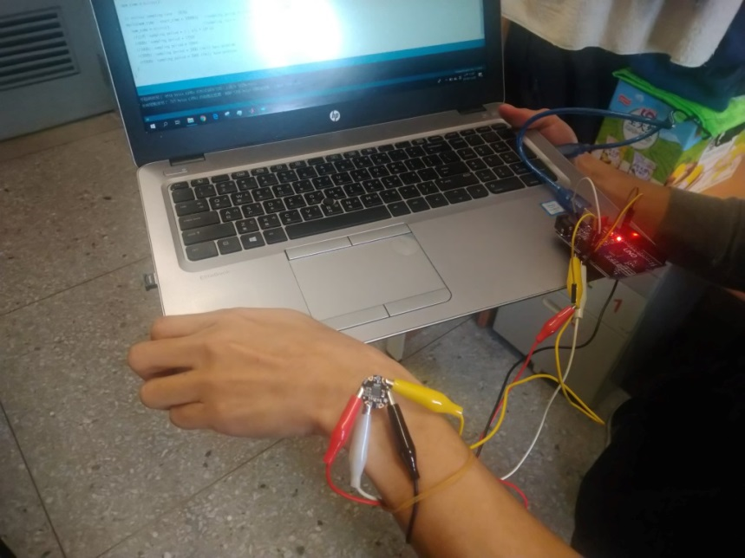
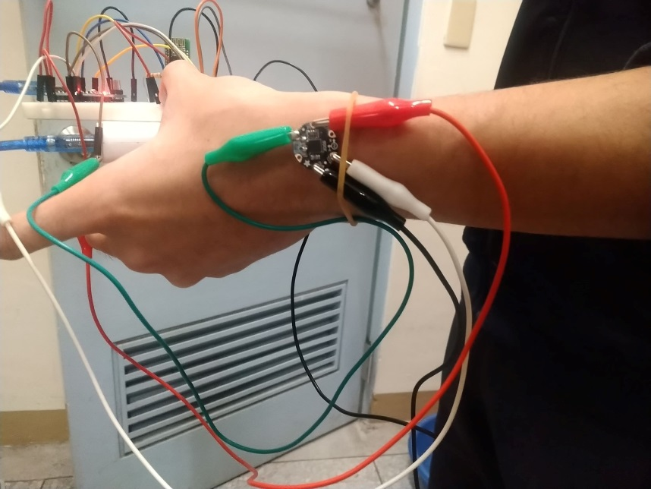
Collect Signal
Strategy
Obtain signal from accelerometer through ADC of Arduino
board (similar to Unit 1)

Slide 5
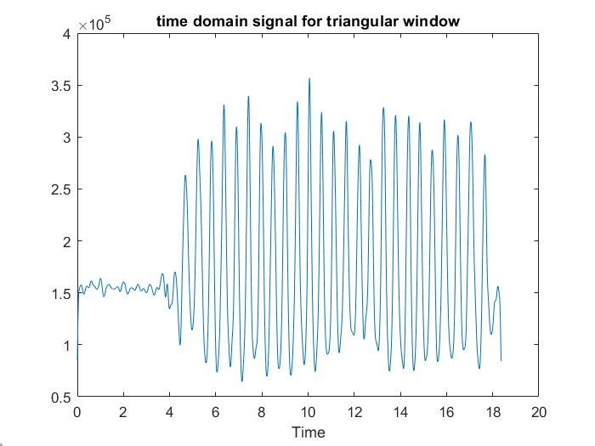
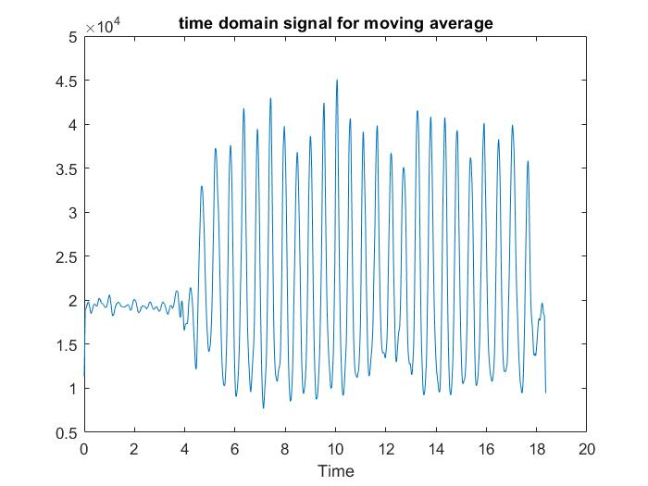
Signal Analysis
Triangular filter vs. Moving average

Slide 6
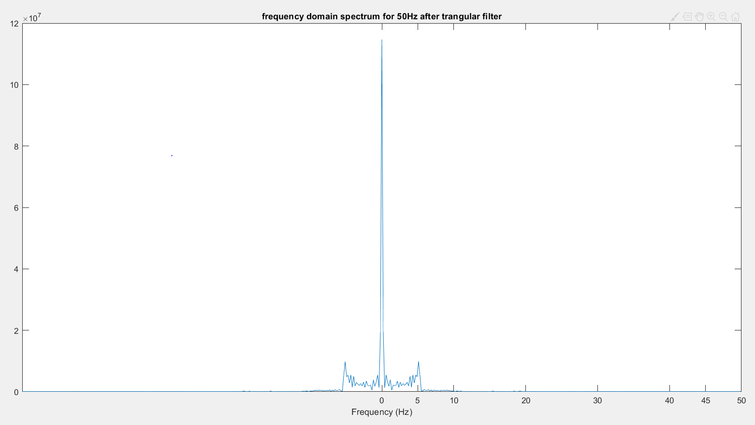
Signal Analysis
Frequency domain of signal after triangular filtering

Slide 7
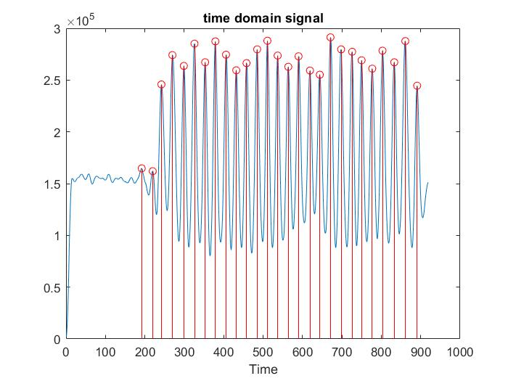
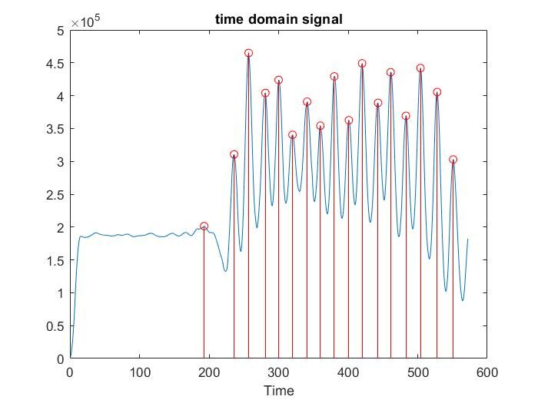
Algorithm simulation
Step of walk and run
Walk
Run

Slide 8
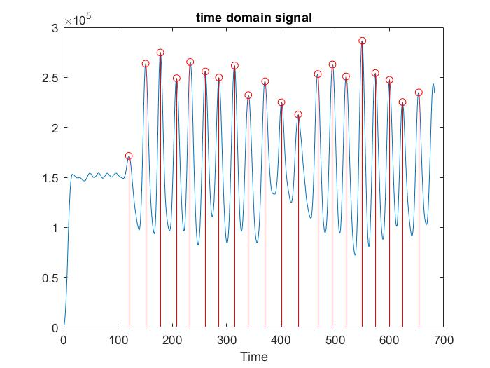
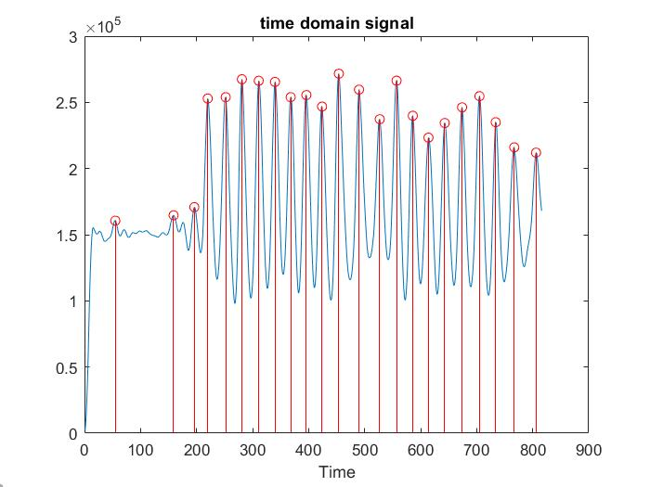
Algorithm simulation
Step of downstairs and upstairs
Downstairs
Upstairs

Slide 9
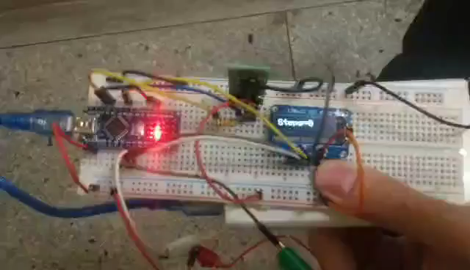
Implementation
Video

