Slide 1

NSU STUDY PORTAL
Group 3 members :
Monirul Islam Mahmud (2011839042)
md. Shihab Reza (1931229642)
Hafeza akter (1922175042)

Slide 2

Introduction and Motivation
Why this website ???
Simple. We NSU’ers are lacking of -
Complaint Submission Portal for NSU
Proper site to take ‘Notes’ or save ‘Homework’ or ‘To-do’
Discussion Forum for NSU’ers

Slide 3
Problems and Opportunity:
A lot of Students lack a proper platform where they can submit their complaints to NSU authorities, a Proper site to take ‘Notes’ or save ‘Homework’ or ‘To-do’, and also a proper discussion portal .
So, we introduced the NSU Study Portal which is a website-based platform where they can have a proper discussion portal, complain portal, and features for saving their notes, homework, or to do.

Slide 4


Technologies:

Slide 5
Features
Signup & Login
User Profile
Take Class Notes
Save Homework
Book Search
Wiki Search
Complaint Submit
Discussion Forum

Slide 6
Expected User Experience
The User interface of the system will be user friendly.
The system must be flexible. Should be easily modified.
Platform Independent.
The system will be secured and will respect the users privacy.
System Admin can access any type of data.

Slide 7
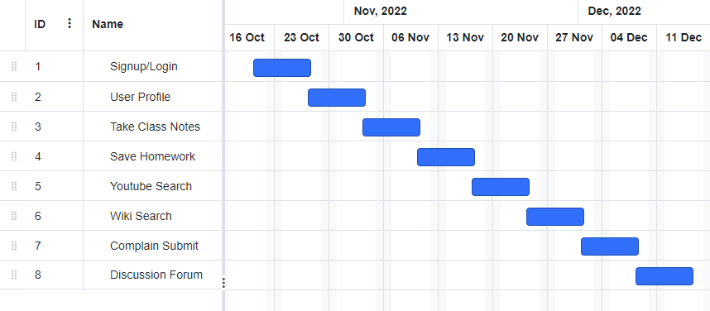
Gantt Chart:

Slide 8
Roles & Responsibilities:
Md. Shihab Reza – YouTube search, Take Notes & Homework Save.
Monirul Islam Mahmud – Discussion Forum, Wikipedia search & Complain Portal.
Hafeza Akter – Signup/Login, User Profile & Admin Panel.

Slide 9
Thank you!

