Slide 1
Analyzing Trading Behavior & Performance
Big Data
Key Insights on Customer Activity, RM Performance, and Geographic Trends

Slide 2
Overview
Geographic Performance Overview
Trading Insights Dashboard
Customer & RM Performance Insights

Slide 3
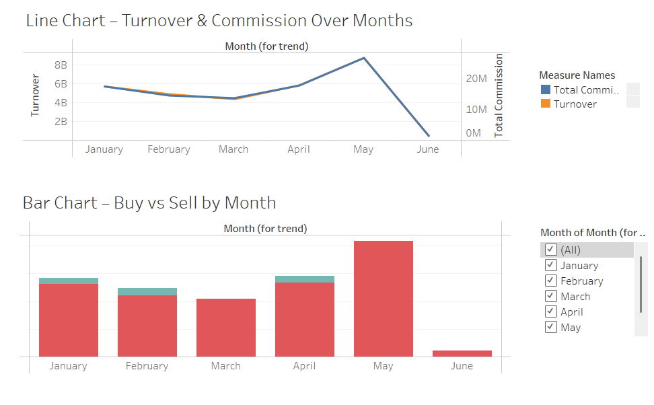
Trading Insights Dashboard

Slide 4
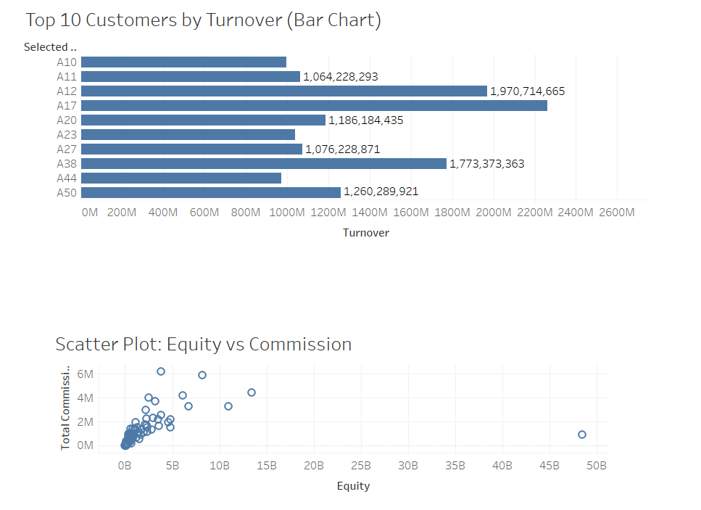
Customer & RM Performance Insights Dashboard

Slide 5
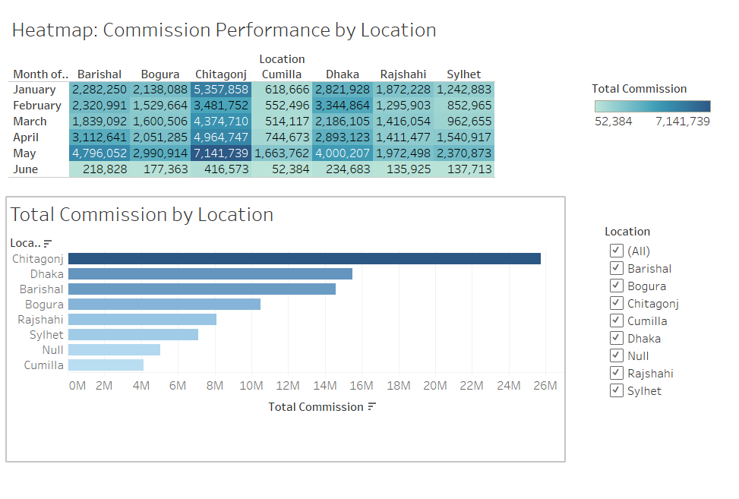
Geographic Performance Overview Dashboard

Slide 6
Thank You

