Slide 1
A Landscape view from the remoteness of Bangladesh
Prepared by,
Fayaz, Fahim 16-32748-3
Kazi Shakawat Absar 18-36913-1
Alam, Nazmul 17-34473-2
Uddin Shihab 17-34216-1
Notes:
© Copyright PresentationGo.com – The free PowerPoint template library

Slide 2
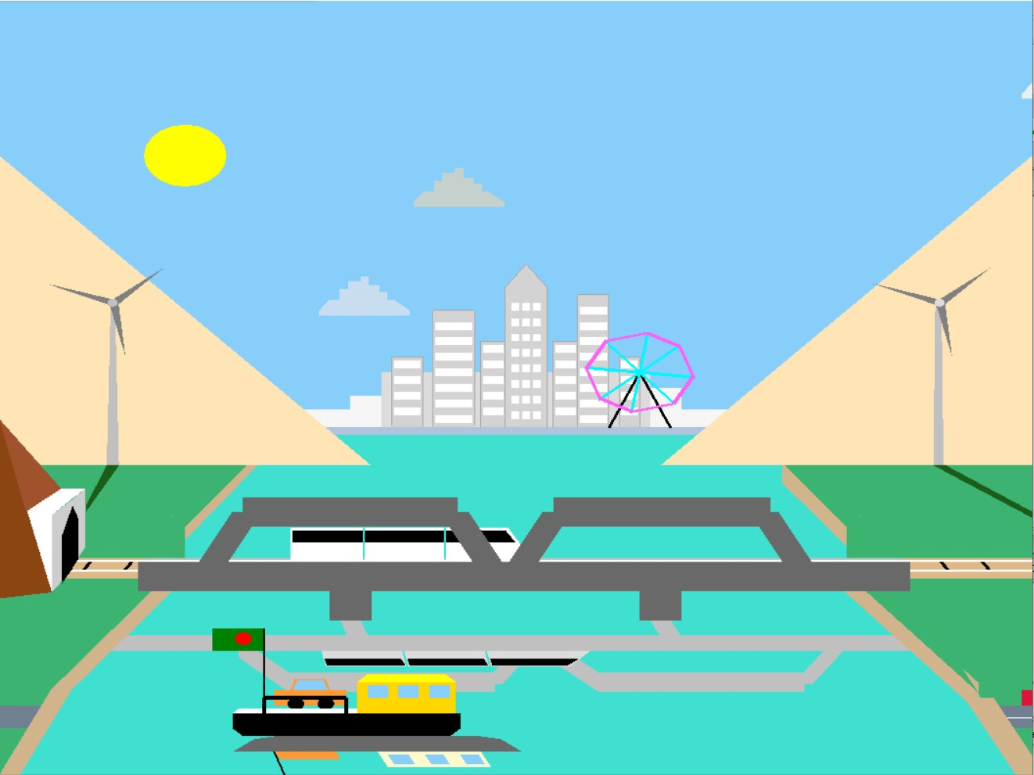
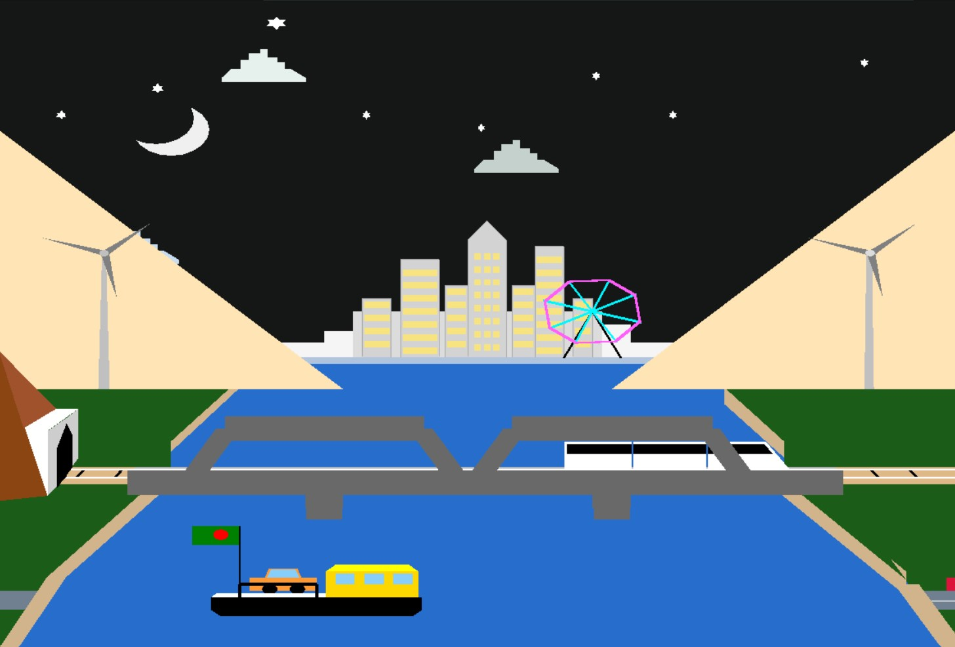
scenario based project
Day mode & Night Mode
Day to night effect

Slide 3
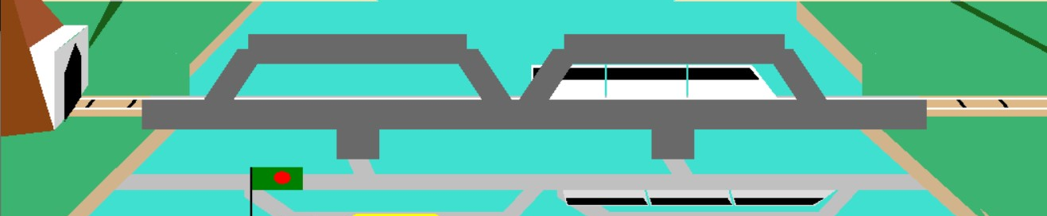
Train
Can move, stop, speed up, speed down
train’s reflection on the river
Keypress action – Stop[Q], Start[W], Speed [E], Speed [R]
Notes:
© Copyright PresentationGo.com – The free PowerPoint template library

Slide 4
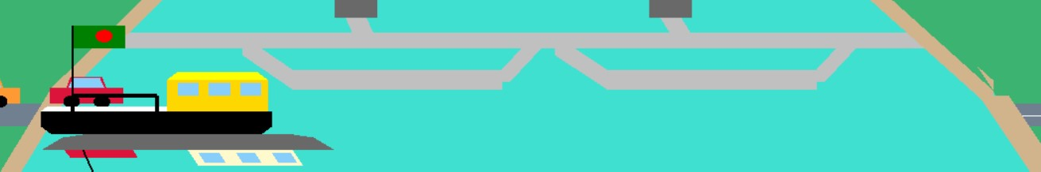

Ferry Boat
Car drives on, car drives off the ferry
Ferry moves one side to another on the river
Flag changes side when ferry passes the car from one side to another
Object’s reflection on the river.
Notes:
© Copyright PresentationGo.com – The free PowerPoint template library

Slide 5


Static object example
River bank
Tunnel
Bridge & it’s reflection
Railline
Mountain
Cityscape
River
Notes:
© Copyright PresentationGo.com – The free PowerPoint template library

Slide 6
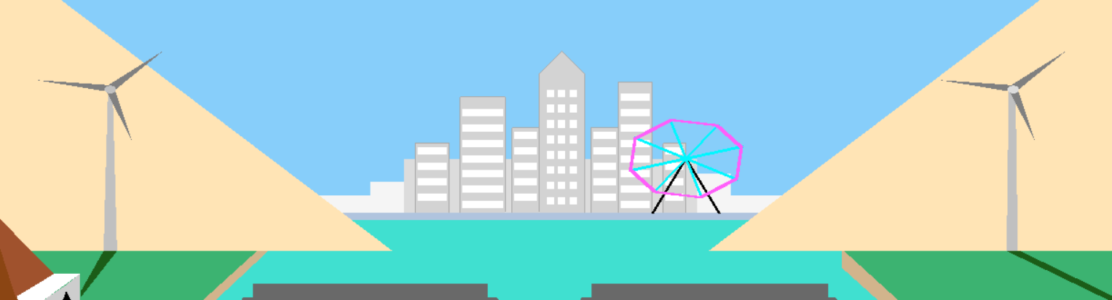
Windmill
Windmill can rotate anticlockwise
Windmill reflection on the river bank
No reflection at night view
Notes:
© Copyright PresentationGo.com – The free PowerPoint template library

Slide 7
Windmill
Night View
No reflection of windmill on the river bank
Notes:
© Copyright PresentationGo.com – The free PowerPoint template library

Slide 8

Ferris Wheel
Rotate clockwise

Slide 9

Ferris Wheel
Night Mode Ferris Wheel

Slide 10

Cloud
Cloud can move
Cloud can be stopped moving
Keypress action- D[move cloud], A[pause cloud]

Slide 11
Night View
Sun goes and moon comes up
Some static star added
Everything’s color become darker
Building’s window color changes for night view
All the reflection’s are gone

Slide 12
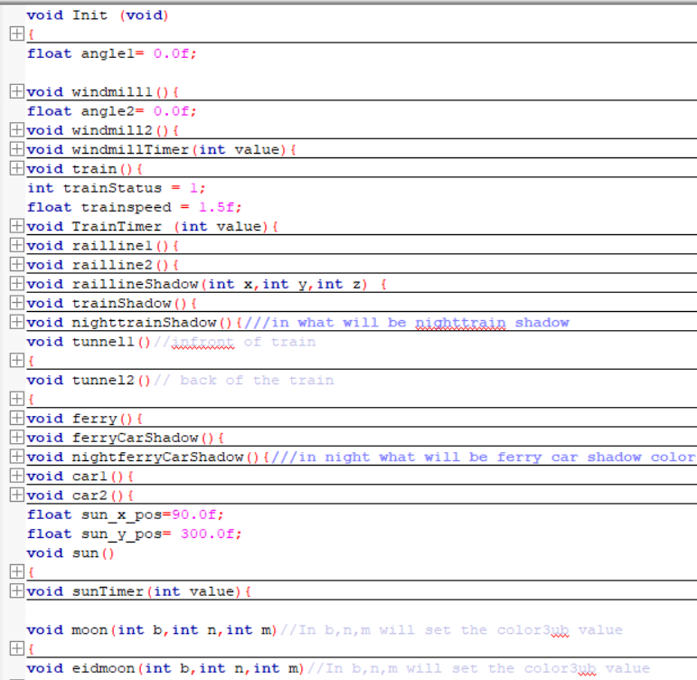
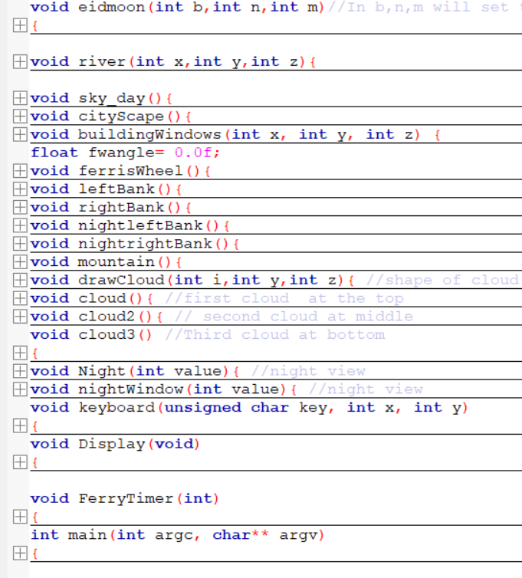
Code Overview

Slide 13
Thank You

