Slide 1
Assignment Video presentation
Big Data Analytics Technologies
F.M. Shiham
239179G

Slide 2
MapReduce and Apache Spark
Apache Spark is an open-source, lightning-fast big data framework which is designed to enhance the computational speed.
Hadoop MapReduce, read and write from the disk, as a result, it slows down the computation.
While Spark can run on top of Hadoop and provides a better computational speed solution.

Slide 3
Comparison between MapReduce vs Apache Spark
Factors | Spark | Hadoop MapReduce
Speed | 100 times faster than MapReduce | Faster than traditional system
Written In | Scala | Java
Data Processing | Batch / real-time / iterative / interactive / graph | Batch Processing
Ease of Use | Compact & easier than Hadoop | Complex & lengthy
Caching | Cashes the data in memory & enhances the system performance | Doesn’t support of caching of data

Slide 4
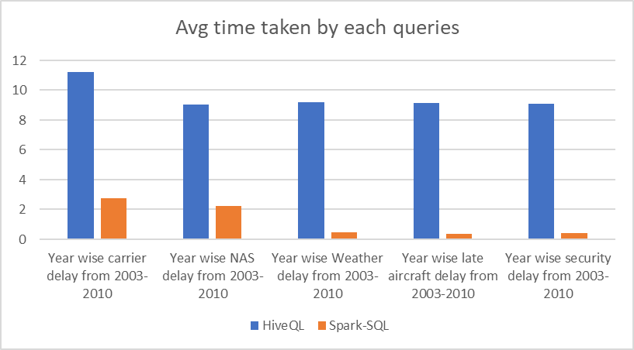
https://github.com/ShihamFM23/UoM_MapReduce-vs-Spark.git

