Slide 1



A Comprehensive Investigation of Machine Learning Models for Estimating Daily Snow Water Equivalent (SWE) over the Western U.S.
Shiheng Duan and Paul Ullrich
University of California, Davis
2021 AGU Fall Meeting

Slide 2
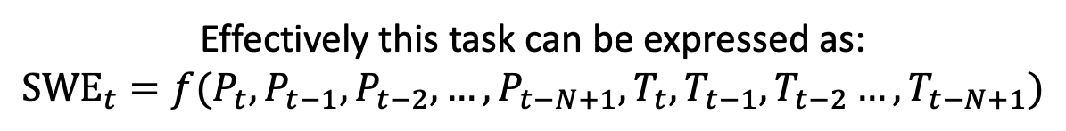
Previous work on SWE estimation
From reanalysis datasets: ANN model or random forest
From precipitation: cGAN
From precipitation and snow-related variables: LSTM
Not all models can be used for projections.
Idea: Use machine learning (deep learning) models for both SWE prediction and projection.
The models should be able to handle time dependency.
The models should mainly use atmospheric forcings for the projection purpose.
Effectively this task can be expressed as:
$${\text{SWE}}_{t}=f(P_{t},P_{t−1},P_{t−2},…,P_{t−N+1},T_{t},T_{t−1},T_{t−2}…,T_{t−N+1})$$
Notes:
First here is a brief introduction of previous work on SWE estimation. There has been research using ANN and Random forest as a bias correction tool. They used SWE reanalysis data and get a better estimation in this post-processing method. From a physics aspect, there is a paper using conditional generative adversarial network, or cGAN, to translate precipitation to SWE. And from a time series task, there is a paper using LSTM or long-short term memory model to simulate the SWE amount. They used precipitation and other snow-related variables. These models can achieve a good performance, but not all of them can be used for projection.
Here, our idea for this work is to use machine learning, specifically, deep learning models for both SWE prediction and projection. As a good prediction model, we want the model to handle time dependency. As a good projection model, we want the model to only use atmospheric variables as input. With that being said, we have the following formula to represent this task. The snow water equivalent at time t, is a function of precipitation, temperature, and other variables from previous time steps.

Slide 3
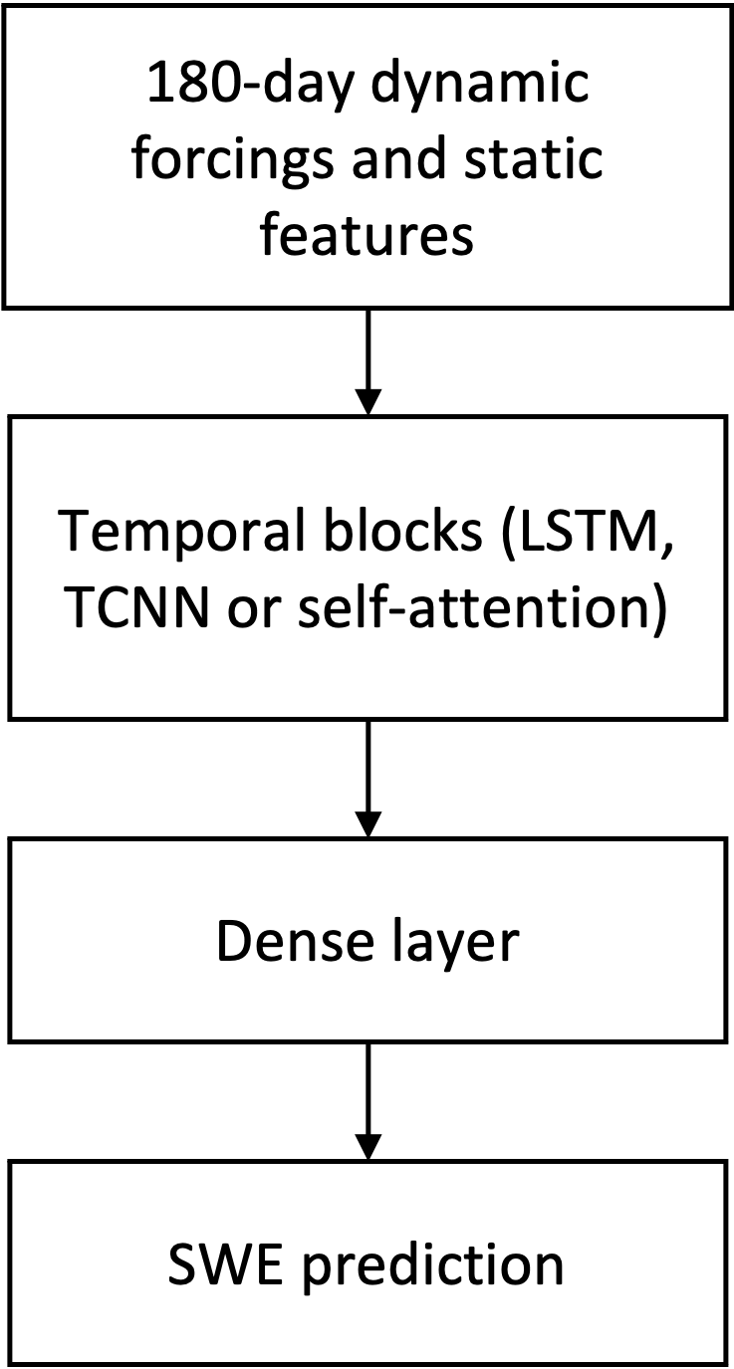
General Architecture
Dynamic input variables: precipitation, temperature (min and max), solar radiation, specific humidity (min and max), relative humidity, vapor deficit and wind speed;
Static input variables: latitude, longitude, elevation, diurnal anisotropic heat index (DAH) and solar radiation aspect index (TRASP).
Output variable: SWE
Input window size: 180 days.
Models: Long-Short Term Memory (LSTM), Temporal Convolution Neural Network (TCNN), and Self-Attention model (Attention).
Figure: A flow chart depiction of our models.
Notes:
Here is the general architecture of our model. We used atmospheric variables from gridMET as input and SWE observational data from SNOTEL stations as the target. We have the dynamic input, including precipitation, temperature, solar radiation, specific humidity, relative humidity, vapor deficit and wind speed. We also used static features, such as latitude, longitude, elevation, diurnal anisotropic heat index and solar radiation aspect index. The input time window is set to 180 days. We have used and compared three different deep learning models.
The flow chart shows the general model architecture.

Slide 4






















Deep Learning Models for Time Series
Temporal Convolutional Neural Network (TCNN)
Long-Short Term Memory (LSTM)
Self-Attention
c¹
c²
c³
c⁴
$$b^{1}$$
b¹
b²
b³
b⁴
$$α_{1,1}$$
×
$$α_{1,2}$$
×
$$α_{1,3}$$
×
$$α_{1,4}$$
×
H
H
H
H
b¹
b²
b³
b⁴
$$α_{1,1}^{′}$$
$$α_{1,2}^{′}$$
$$α_{1,3}^{′}$$
$$α_{1,4}^{′}$$
$$q^{1}$$
$$k^{1}$$
$$v^{1}$$
$$k^{2}$$
$$v^{2}$$
$$k^{3}$$
$$v^{3}$$
$$k^{4}$$
$$v^{4}$$
a¹
a²
a³
a⁴
a¹
a²
a³
a⁴
$$a^{1}$$
$$a^{2}$$
$$a^{3}$$
$$a^{4}$$
Figure: Our machine learning model architectures.
Notes:
Here I will introduce the architecture for each deep learning model. The first one is the LSTM model. This is a typical LSTM cell. We have input from a1 to a4 and the numbers are for time steps. The information from a1 goes to this H and generate the output b1. B2 gets the information from a2 and h, and this h has the information from a1. And it is the same story for b3 and b4. So in this way, LSTM can handle a time series and keep necessary information from previous time steps. But the problem is that to get the value of b4, you need to wait until the completion of b3 since this H requires the inputs from previous time step. So one could parallel multiple LSTM cells, but for one LSTM cell, it is hard for parallel computation.
Then we have the TCNN model. In this model, each triangle represents a CNN kernel. The b1 has the information from a1 and a2, and b2 covers a1, a2 and a3. So for each layer, it can covers a small window from the inputs. By stacking multiple layers, we can get the information of the whole time series. Unlike LSTM cells, the computation of CNN kernels is independent. You can calculate b1234 in the same time.
The last one is a self-attention model. Here with input of a1234, it calculates q, query, k, key, and v, value. From q and k, we have the alpha prime and through a softmax operation, we get the alpha terms, which is also called attention scores. The final output is a weighted sum of v and the weight is these attention scores. Attention model focuses on the correlations in the input time series.

Slide 5
Training, Testing and Validation
581 SNOTEL stations are used to train the model. The variables are normalized with the mean and standard deviation from all the stations.
Hyperparameters are determined with the validation data.
Train each model 10 times and get the ensemble mean prediction.
Training time with 1 RTX2080Ti GPU:
LSTM 5 hours
TCNN 10 hours
Attention 26 hours
Experiment Settings
Loss function | Mean squared error
Training | 1980-10-01 to 1999-09-30
Validation | 1999-10-01 to 2008-09-30
Testing | 2008-10-01 to 2018-09-30
Notes:
As for our model settings, we used 581 SNOTEL stations in the western of CONUS. All the variables are normalized with the mean and standard deviation from all the stations. The model is trained with training data and hyperparameters are determined with the validation performance. The loss function is set to mean squared error and we used nash-suctliffe model efficiency coefficient, or R square score to quantify the model performance. Since the initial weight can affect the model performance, we trained each model 10 times and the following results are based on this ensemble method.
As a reference, it takes 5 hours to train the LSTM with 1 RTX 2080TI GPU, 10 hours for the TCNN model and 26 hours for the Attention model.

Slide 6
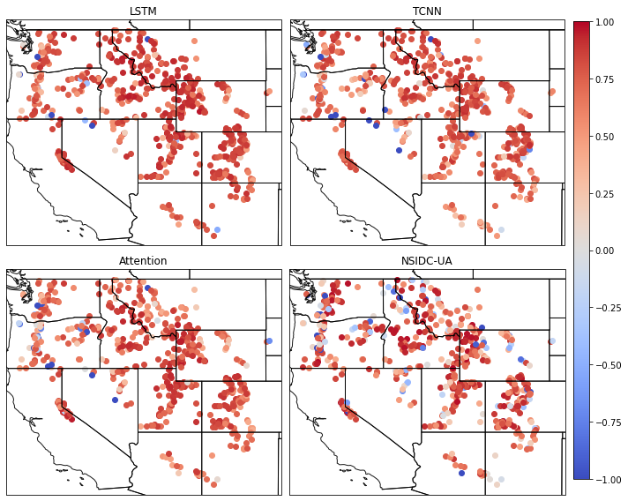
SNOTEL Prediction Results
Quantify the performance by Nash-Sutcliffe model efficiency coefficient (NSE) or R square score.
Across all Western U.S. SNOTEL stations, the median NSE values for LSTM, TCNN and Attention are 0.909, 0.878 and 0.874, respectively.
For comparison, the NSIDC-UA dataset has a median NSE value as 0.861.
Figure: Prediction result from deep learning models and NSIDC UA dataset.
Notes:
Here is the prediction results for SNOTEL stations. To compare with a physical-based model, we selected the NSIDC UA university of Arizona dataset as our reference. Overall, the median NSE value for LSTM is 0.909, and 0.878 for TCNN and 0.874 for Attention model. The UA dataset as a median value as 0.861. So our deep learning models can achieve even better performance if we compare the median NSE values.

Slide 7
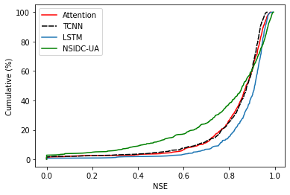
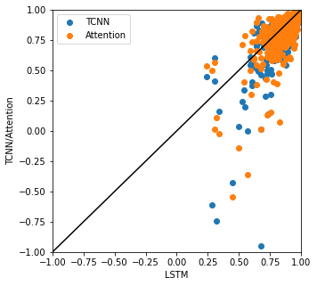
Prediction Results
LSTM performance is the best: Highest median NSE value and more concentrated distributions over high NSE value regimes.
TCNN and Attention are similar, although Attention is better at high NSE value ranges.
NSIDC-UA dataset has more stations in low NSE regions compared with the deep learning models.
There is a strong correlation among NSE values from different deep learning models. Pearson correlation is 0.945 between LSTM and TCNN and 0.818 between LSTM and Attention.
Figure: Probability distribution of NSE values (top) and correlation between NSE values (bottom).
Notes:
It is even better when we compare the distribution of the NSE values. On the top right panel, you can see the probability of NSE values. LSTM model is the best. It has the largest distribution over high NSE value regimes. TCNN and Attention models are similar and it is hard to separate them. The attention model is slightly better at high NSE value ranges. Compared with the deep learning models, NSIDC-UA dataset has more stations in the low NSE regimes.
Besides the distribution, we found a strong correlation among these machine learning models. Here we show the pearson correlation values. It suggests that these models tend to have a similar behavior. The good stations are always good for different models.

Slide 8
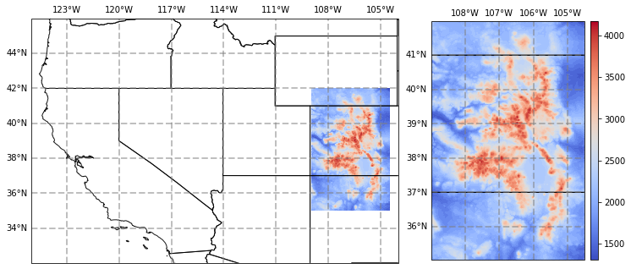
Extrapolation
Use the model trained on SNOTEL observations to generate a gridded SWE estimate.
The statistical features of both input and output variables will be different. Models are in extrapolation regime.
To deal with extrapolation, we focus on the seasonality of SWE instead of the actual SWE amount. Seasonality is calculated as the fraction of SWE with respect to the historical maximum SWE.
Figure: Rocky Mountain Domain (left) and elevation (right).
Notes:
With this prediction model, we want to generalize our model to create a gridded SWE product, like the NSIDC-UA dataset. For this purpose, we selected Rocky mountain area, which is shown in this map here. And you can see the elevation on the right. The problem is that we trained our model with SNOTEL stations, which are all in the high elevation areas. It can not be directly used for low elevation area and this is an extrapolation problem. So, we changed the target from SWE to SWE seasonality, which is the fraction of SWE with respect to the historical maximum SWE. And this seasonality is a quantity with a roughly range from 0 to 1. Next I will show you the extrapolation results in the Rocky Mountain area.

Slide 9
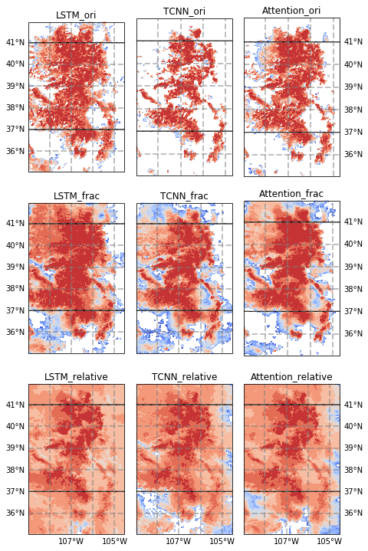
Extrapolation
The seasonality itself improves the generalization.
By training another set of models, the generalization performance is much better.
We lose the information of the actual SWE but gain the information over a wider spatial domain. No free lunch.
Figure: Extrapolation results.
Notes:
The colors here represents the NSE values when compared with the NSIDC-UA dataset. It shows the agreement between machine learning model and physical-based model. The color range is from -1 to 1.
The top row shows the original model. It is directly applied to the Rocky mountain area. As you can see there are lots of area with a NSE value lower than -1, showing the machine learning model cannot generate a reliable SWE estimation.
The middle row shows the seasonality from the original model. It shows that although the ML model doesn't make sense in these area, the seasonality or the temporal tendency is captured and it agrees with the physical model.
The final row is the result from another set of models. We retrained our model with the target as the SWE percentage or SWE seasonality. This time the models generally agree with the physical model and this simple transformation works for all the machine learning models.
With that, we lose the information of the actual SWE but get more information over a wider spatial area. To get back to the actual SWE amount, we need a prior knowledge of the historical maximum SWE amount over this area, either from a physical-based model, or from another ML model with the target as the maximum SWE.

Slide 10
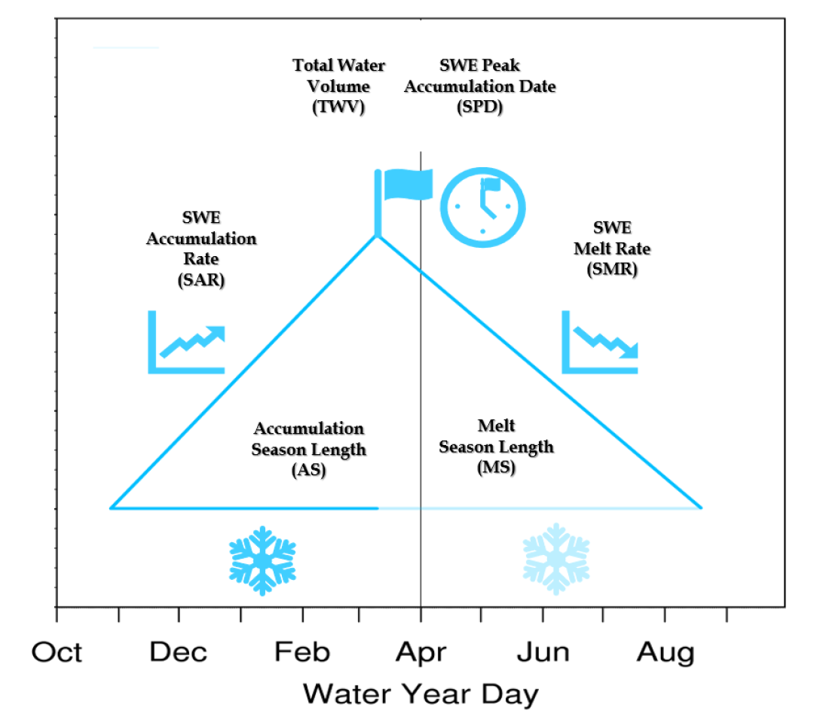
Projection
Continue with the SWE percentage and analyze the response of SWE to climate change.
Use LOCA dataset as forcings. Select CESM-CAM5, CNRM-CM5, EC-EARTH, GFDL-ESM2M, HadGEM2-ES, and MIROC5.
From the SWE seasonality, we used following metrics to assess the snowpack change.
Figure: Our SWE Triangle Multi-Metric Framework (Rhoades et al., 2018)
Metric | Units | Assessment thresholds
Snowpack accumulation start date (SAD) | Days since Oct 1st | Day when SWE > 10% of maximum SWE
Snowpack peak accumulation date (SPD) | Days since Oct 1st | Day of maximum SWE
Complete melt date (CMD) | Days since Oct 1st | Day when SWE < 10% of maximum SWE
Snow season length | Number of days | Sum of days from SAD to CMD
Notes:
So, for now, we have a good prediction model and it can generate a gridded dataset. We continue to use it for future projection. We used LOCA dataset as our forcings here. LOCA provides downscaled CMIP5 climate datasets and we selected these climate models. Although we can only get the SWE seasonality, we still can use these metrics from this 2018 paper to show the climate change impact on snowpack.

Slide 11
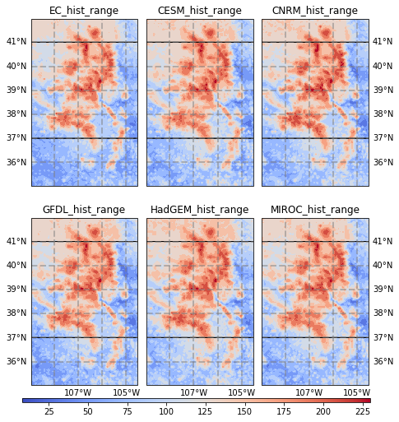
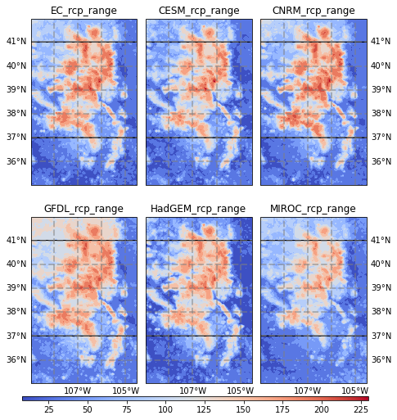
Projection Results
Figure: Historical (left) and RCP8.5 (right) projections of snow season length (days).
Notes:
Here we show some figures for the snow season length as an example. The left is for historical period and left for the end of the century with RCP8.5 scenario. It is clear that the snow season length will decrease with climate change and it seems the lower elevation area is more sensitive.

Slide 12
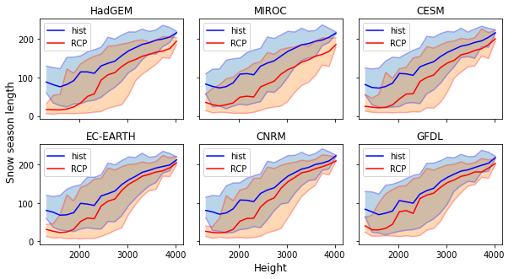
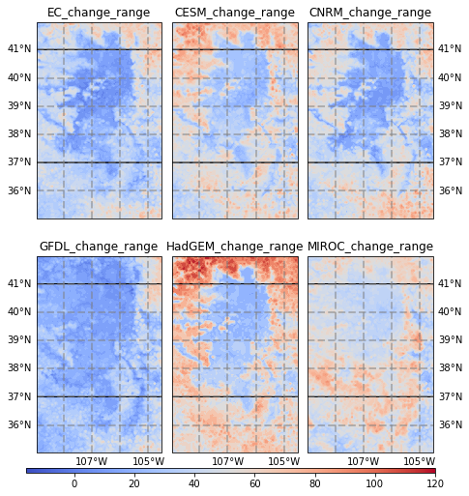
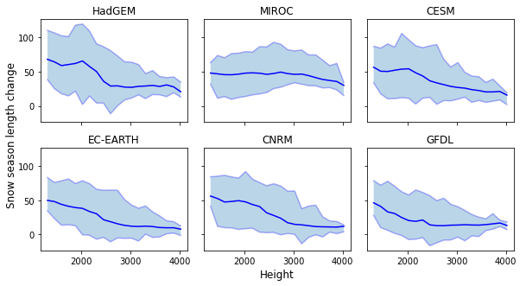
Projection Results
Figure: Snow season length changes in the future (left) and the height dependency (right).
Notes:
And in this figure is much clear. Here we show the decrease in the snow season length. And the height dependency is on the right. It shows that the higher elevation tends to have a longer snow season for both historical and future period. The lower elevation has more sensitivity to the climate change.

Slide 13
Future Work
Couple with a physical-based model to address extrapolation problems;
Data assimilation from satellite-based products for low-elevation area;
Explainable AI method to analyze the physical impactors;
Generalize to a wider area;
Projections with CMIP6 models when LOCA data is available.
Notes:
As for our next steps, we want to try to couple our ML model with physical-based models to see if we can solve the extrapolation problem. Also for the low-elevation area, since there is no observational data, satellite data could be a good choice to increase our training samples. And we will use some explainable AI methods to analyze the sensitivity of input variables. When the CMIP6 data is available, we can generate the updated SWE dataset with our models.

Slide 14

Thanks
We would like to acknowledge the helpful discussion with Chaopeng Shen, Wen-Ping Tsai from Pennsylvania State University, David John Gagne from NCAR, Mark Risser, Alan Rhoades and Chris Paciorek from Lawrence Berkeley National Laboratory.
The computational platform used for this study is the Tempest GPU cluster at UC Davis. We also thank the Computational and Information System Lab for access to the Casper cluster through the Advanced Study Program at NCAR.
Any further questions or suggestions, please contact at shiduan@ucdavis.edu
Notes:
We would like to thank our colleagues for their help. The computational resources is from UC Davis, and we also used NCAR Casper supercomputer through the ASP program. If you have any questions or ideas, please contact me at shiduan@ucdavis.edu
Thanks for listening.

