Slide 1



A Comprehensive Investigation of Machine Learning Models for Estimating Daily Snow Water Equivalent (SWE) over the Western U.S.
Shiheng Duan, Paul Ullrich
University of California, Davis
2021 AGU Fall Meeting

Slide 2
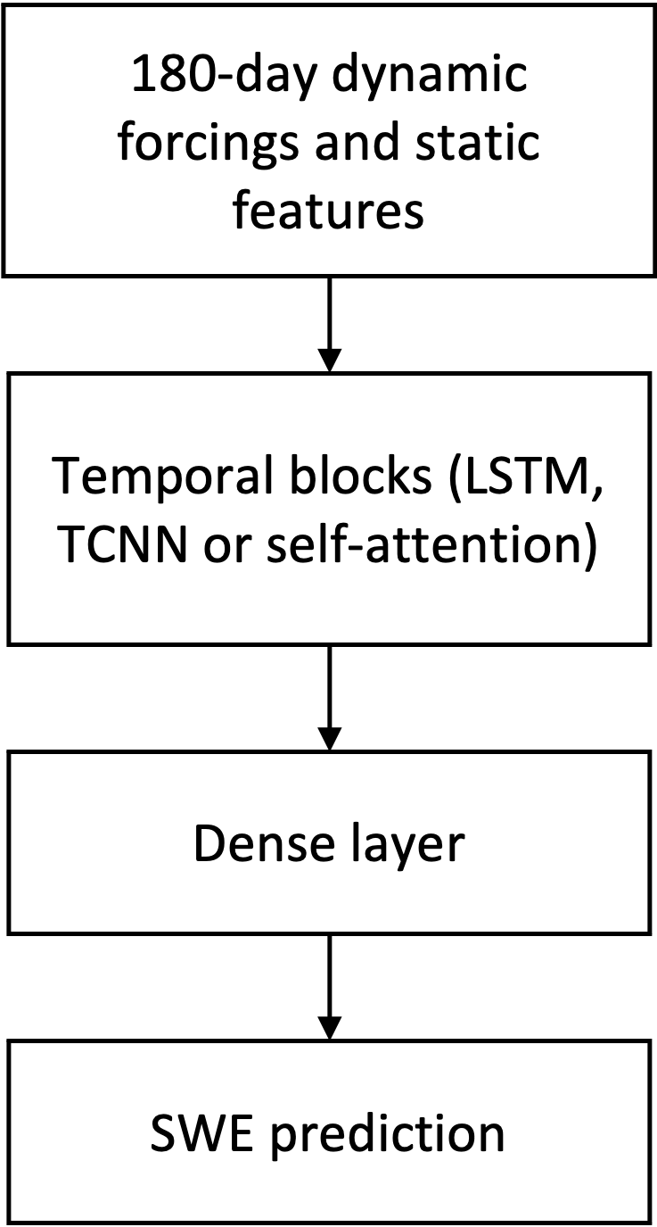
General Architecture
Dynamic inputs: precipitation, temperature (min and max), solar radiation, specific humidity (min and max), relative humidity, vapor deficit and wind speed;
Static inputs: latitude, longitude, elevation, diurnal anisotropic heat index (DAH) and solar radiation aspect index (TRASP);
Output variable: SWE;
Input window size: 180 days;
Models: Long-Short Term Memory (LSTM), Temporal Convolution Neural Network (TCNN), and Self-Attention model (Attention).
Experiment Settings
Loss function | Mean squared error
Training | 1980-10-01 to 1999-09-30
Validation | 1999-10-01 to 2008-09-30
Testing | 2008-10-01 to 2018-09-30
Figure: flow chart of our models.

Slide 3
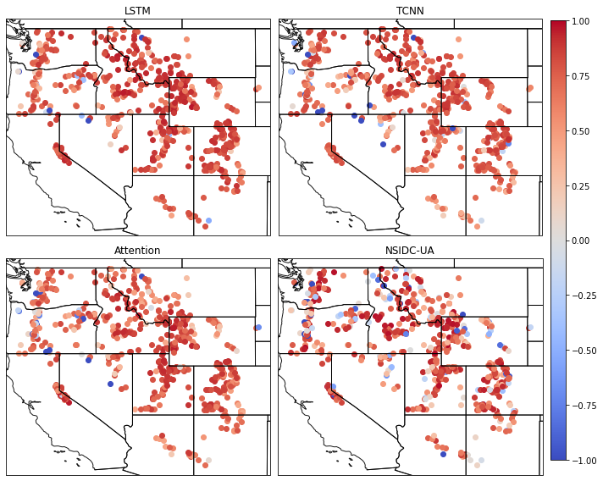
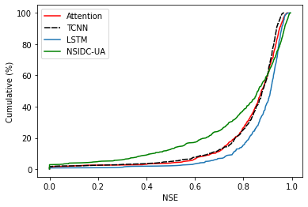
SNOTEL Prediction Results
Model | Median NSE
LSTM | 0.909
TCNN | 0.878
Attention | 0.874
NSIDC-UA | 0.861
Figure: Prediction result from deep learning models and NSIDC UA dataset (left) and probability distribution of NSE values (right).

Slide 4
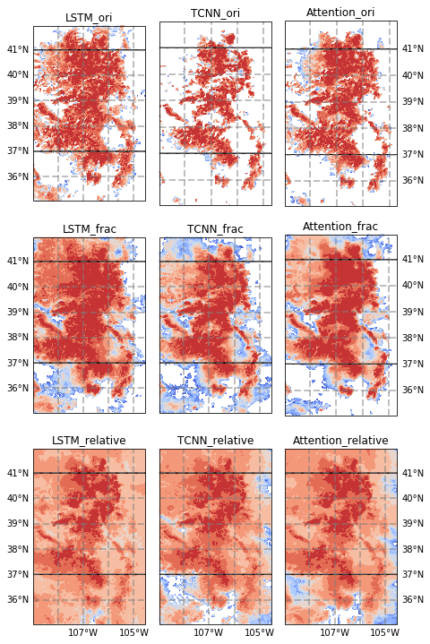
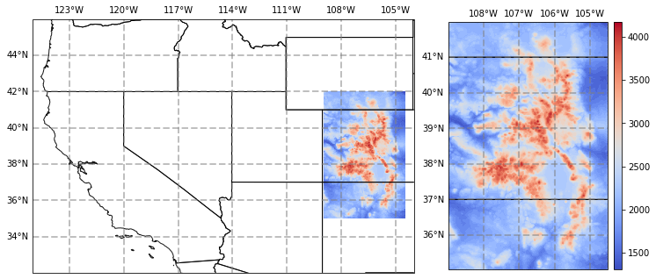
Extrapolation
Figure: Rocky Mountain Domain (left) and elevation (right).
The seasonality itself will improve the generalization.
By training another set of models, the generalization performance is much better.
Figure: Extrapolation NSE values against NSIDC dataset.

Slide 5
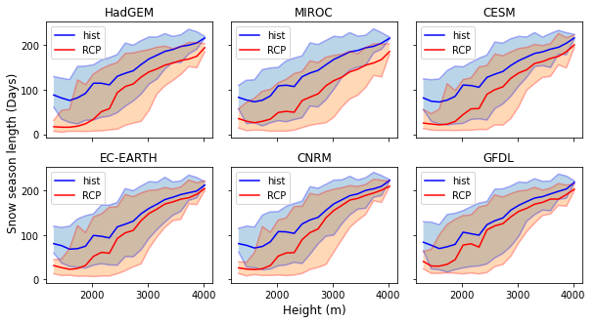
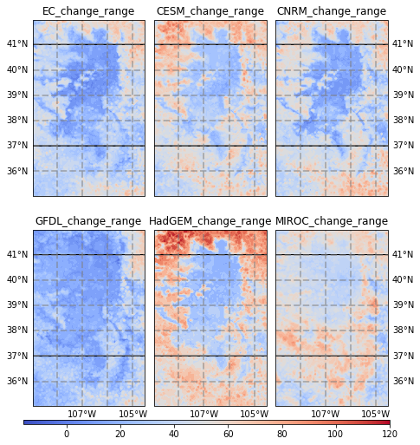
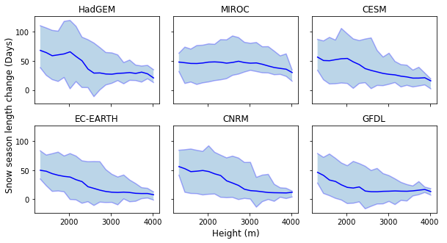
Projection Results
Figure: Snow season length changes in the future (left) and the height dependency (right).

Slide 6

Thanks
We would like to acknowledge the helpful discussion with Chaopeng Shen, Wen-Ping Tsai from Pennsylvania State University, David John Gagne from NCAR, Mark Risser, Alan Rhoades and Chris Paciorek from Lawrence Berkeley National Laboratory.
The computational platform is Tempest GPU cluster at UC Davis. We also thank the Computational and Information System Lab for access to the Casper cluster through the Advanced Study Program at NCAR.
Any further questions or suggestions, please contact at shiduan@ucdavis.edu

