Slide 1


Using Convolutional Neural Networks for Streamflow Prediction and Projection
Shiheng Duan
April 14, 2021

Slide 2
Previous work and motivation
Physical model and data-driven model: Hydrological models are slow and neural networks can be accelerated by GPU. Long-short memory (LSTM) model has been applied to hydrology prediction.
Streamflow Prediction and Projection: Prediction models with streamflow as input predictors can help improve the accuracy but cannot be used for projection.
LSTM can capture temporal features, but training is slow. CNN has been used for time series tasks in computer science.
Can we use CNN to replace LSTM and design a projection (prediction) model?

Slide 3
LSTM vs CNN
Problem to solve: Take input predictor series (meteorology forcing), generate one output (flow rate).
c¹
c²
c³
c⁴
b¹
b²
b³
b⁴
H
H
H
H
b¹
b²
b³
b⁴
a¹
a²
a³
a⁴
a¹
a²
a³
a⁴
Notes:
We tested five different models. Linear regression is the baseline. All neural networks for nonlinear relationships. Gated and CNN are for temporal features.

Slide 4
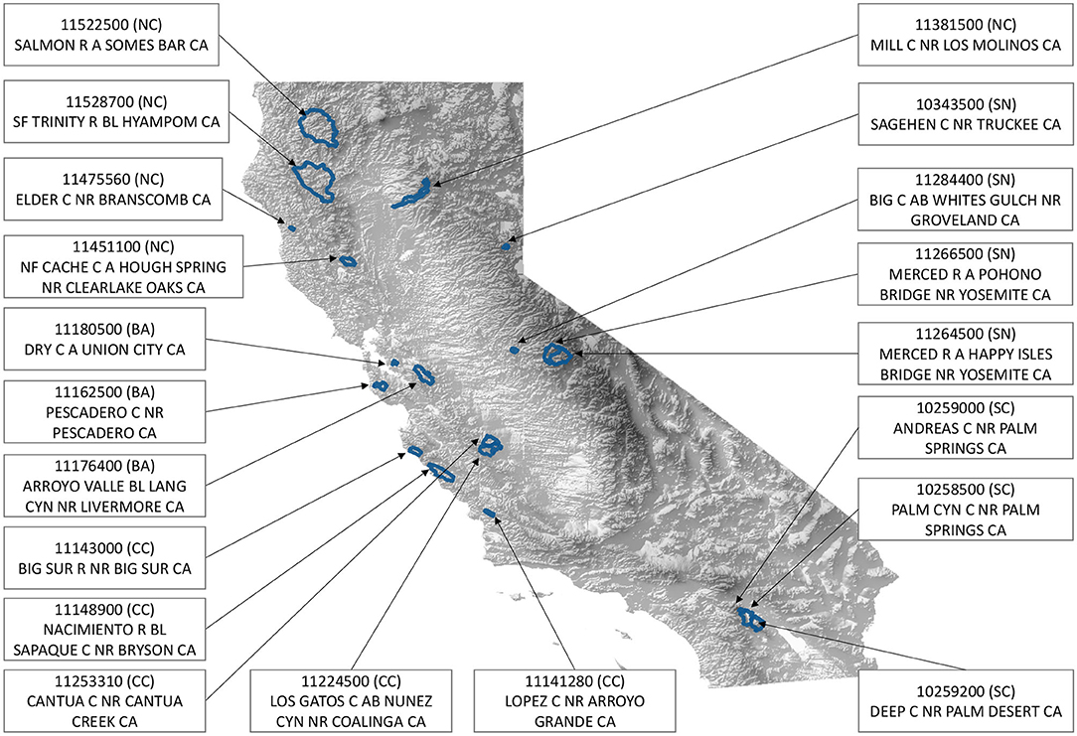


Projection setup
We selected 20 basins in California from CAMELs dataset (Catchment Attributes for Large-Samples Studies). Projection forcing data is from LOCA (Localized Constructed Analogs), which provides downscaled data from four climate models (CanESM2, MIROC5, HadGEM2-ES and CNRM-CM5)
$Q_{t}=F(P_{t}, P_{t−1},…,P_{t−364},T_{t}, T_{t−1},…,T_{t−364},S_{t}, S_{t−1},…,S_{t−364})$
Local model is trained separately for each basin. There are 9636 training samples and 2419 testing samples. NSE (Nash-Sutcliffe coefficient) is used to evaluate the performance. The loss function is set to 1-NSE.

Slide 5
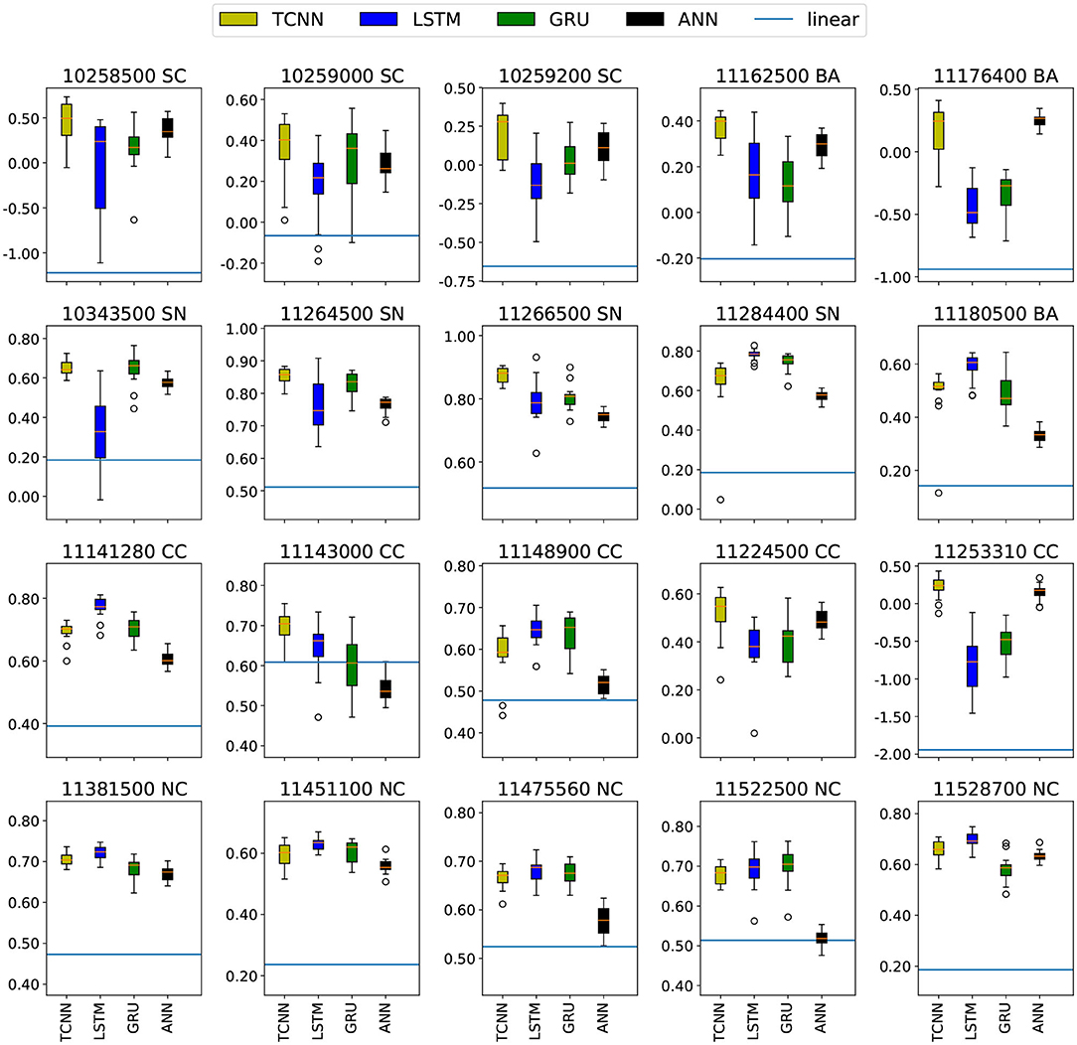
Prediction Result
Ensemble: train each model 10 times.
Generally, TCNN and LSTM is better than linear regression and ANN.
TCNN can achieve comparable performance to LSTM.
Model | Training time (s)
TCNN | 77
Stacked LSTM | 150
One-layer LSTM (256) | 220
One-layer LSTM (370) | 380

Slide 6
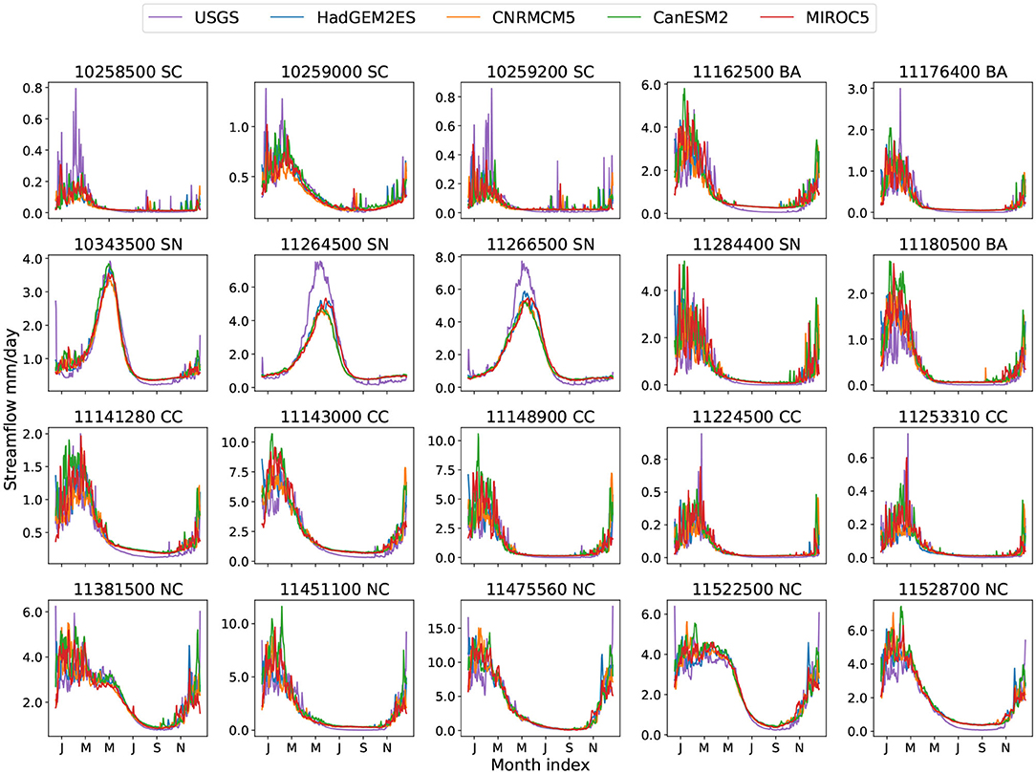
Projection Result
Historical climatology shows the result forced by LOCA historical data. Compared with USGS observations, most basins tend to match well.

Slide 7
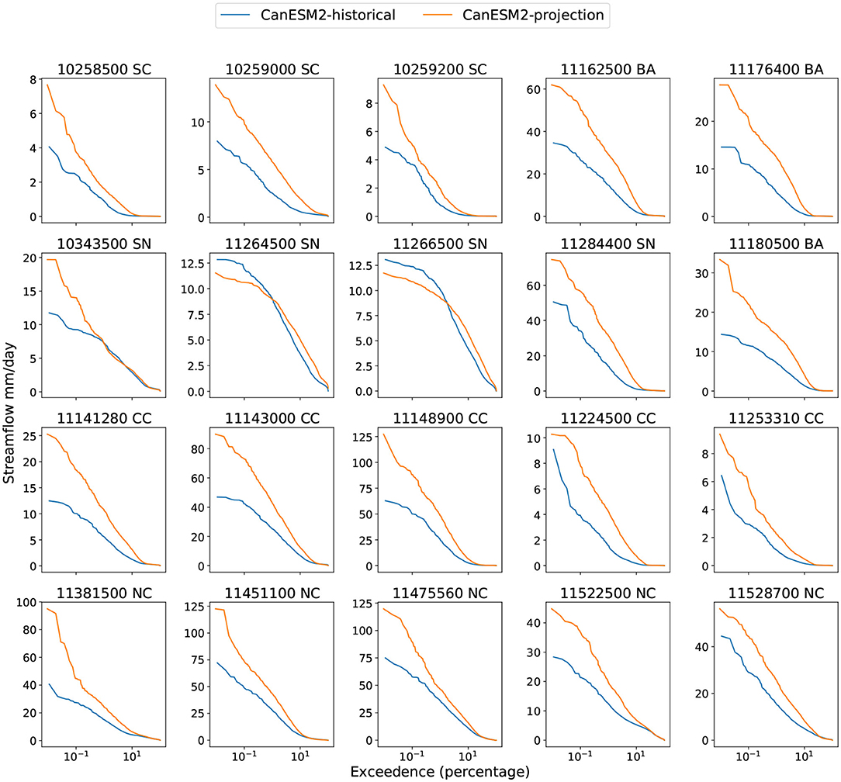
Projection Result
Projection FDC (flow duration curve) shows the result forced by LOCA data at the end of the century.
The x axis is the probability and y axis is the flow rate. In general, large flow rate corresponds to low probability.
The projections generally indicate that higher streamflow become more probable, and the peak flow rate will be higher, except for SN.

Slide 8
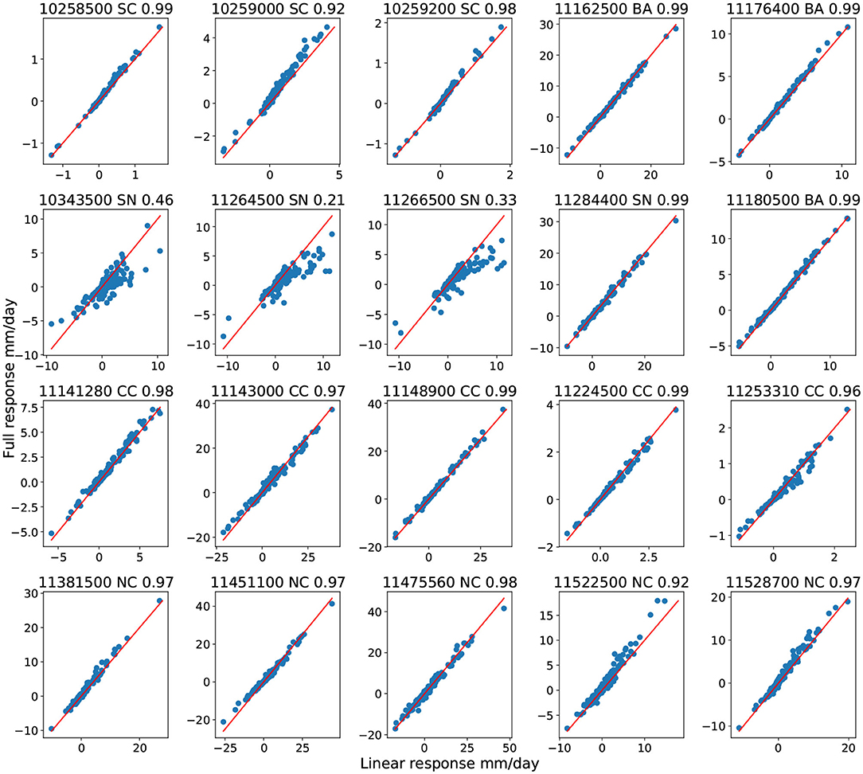
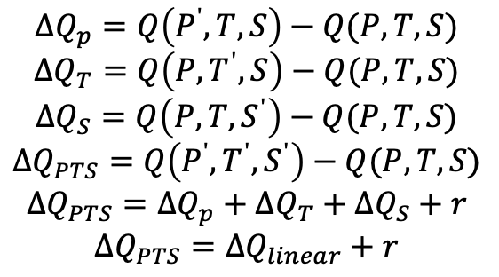
Projection Decompose
The change in streamflow can be decomposed into response of precipitation, solar radiation and temperature.
$$ΔQ_{p}=Q\left(P^{ʹ},T,S\right)−Q(P,T,S)$$
$$ΔQ_{T}=Q\left(P,T^{ʹ},S\right)−Q(P,T,S)$$
$$ΔQ_{S}=Q\left(P,T,S^{ʹ}\right)−Q(P,T,S)$$
$$ΔQ_{PTS}=Q\left(P^{ʹ},T^{ʹ},S^{ʹ}\right)−Q(P,T,S)$$
$$ΔQ_{PTS}=ΔQ_{p}+ΔQ_{T}+ΔQ_{S}+r$$
$$ΔQ_{PTS}=ΔQ_{linear}+r$$
To reduce noise from daily streamflow, the monthly averaged streamflow is used for decomposition.

Slide 9
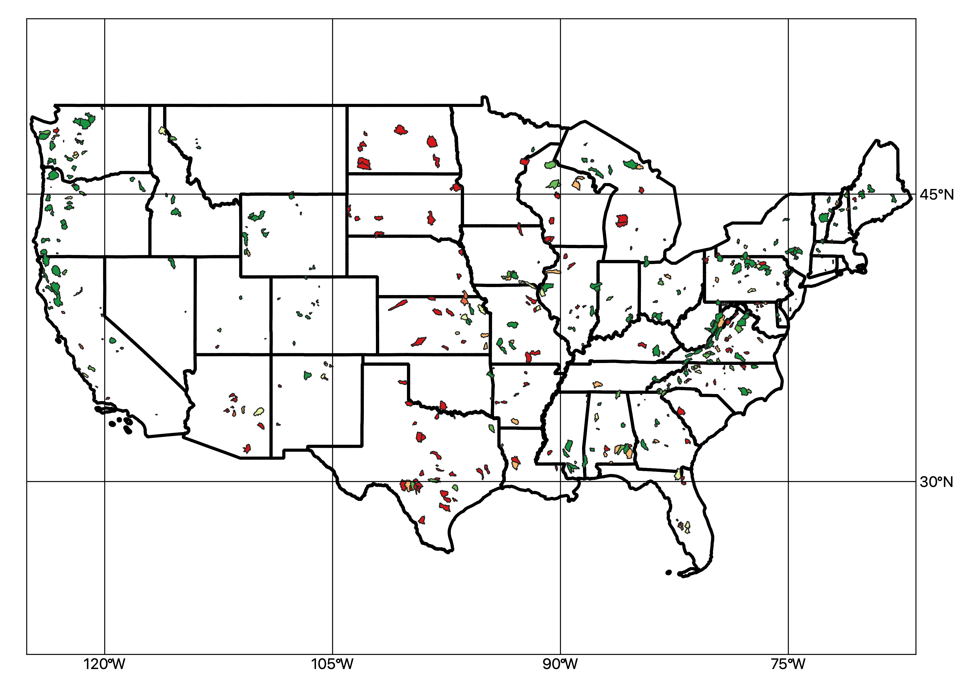
Prediction intercomparison
Local model can not be too complex because of limited available samples.
With more forcing data, the prediction accuracy will increase.
We intend to compare TCNN, self-attention with LSTM in continental scale.
All models are trained with precipitation, temperature (min and max), vapor pressure from three different forcing sets.

Slide 10
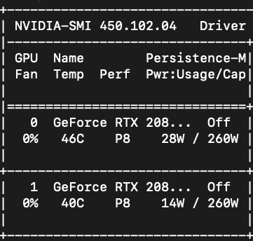
Future work
Find out the reason of poor performance in Great Plain.
Use machine learning algorithms for precipitation analysis.
The Milton Award funding is used for a new GPU (RTX 2080Ti) which can accelerate ML models.

Slide 11
Questions
Thank you

