Slide 1
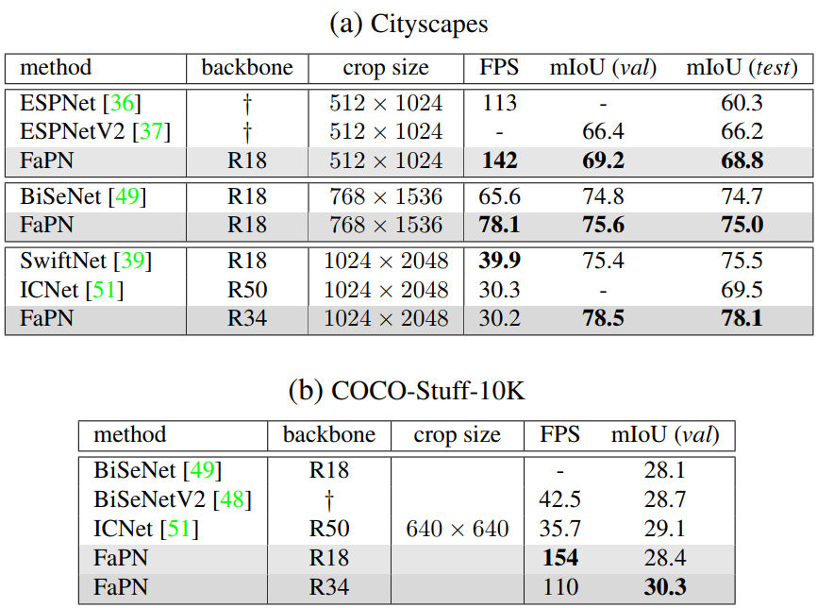
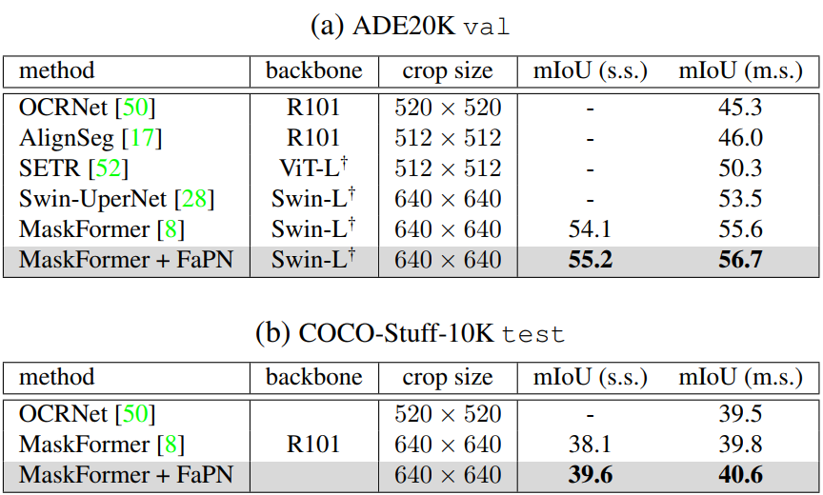
Semantic segmentation with MaskFormer
Real-time semantic segmentation

