Slide 1
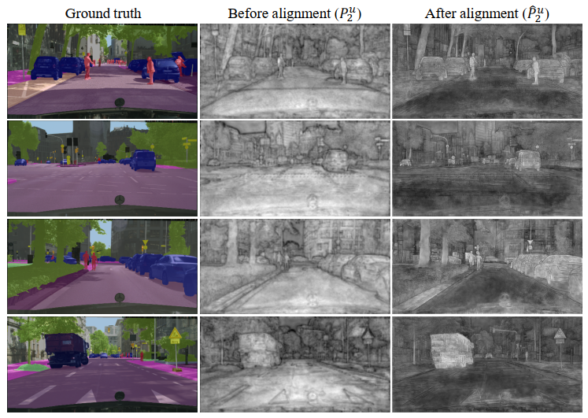
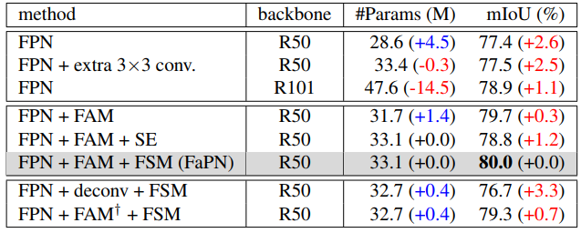

Ablation study
Semantic segmentation over boundaries
Feature visualization

