Slide 1


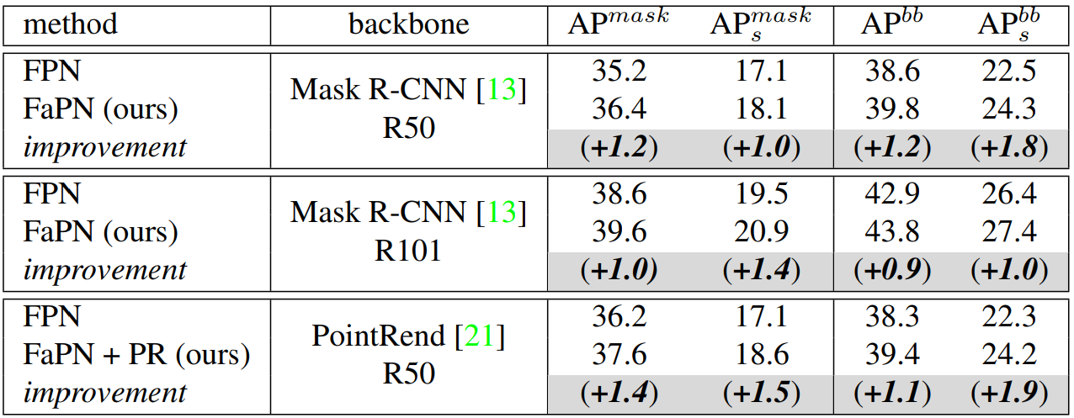
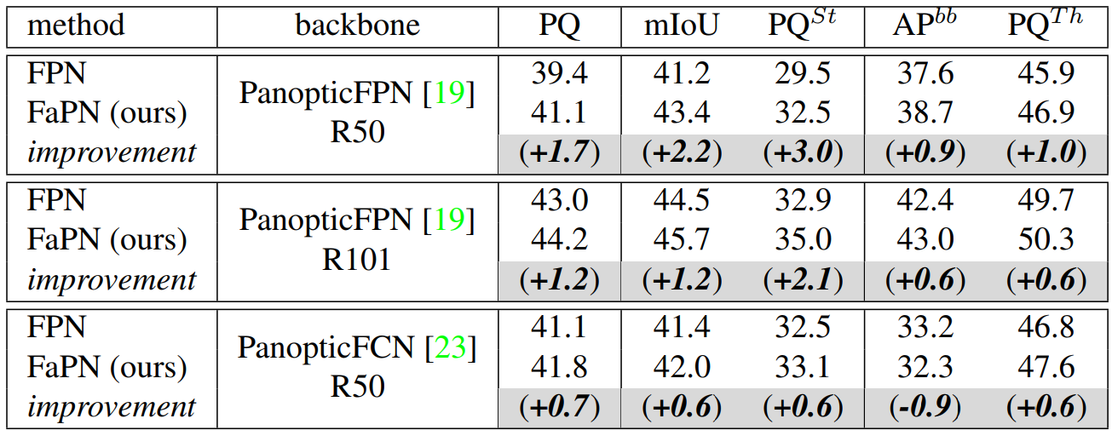
Object detection
Semantic segmentation
Instance segmentation
Panoptic segmentation

