Slide 1
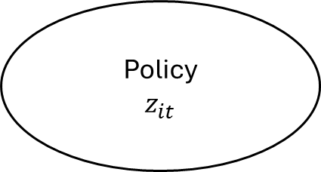
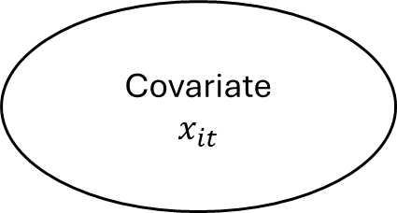

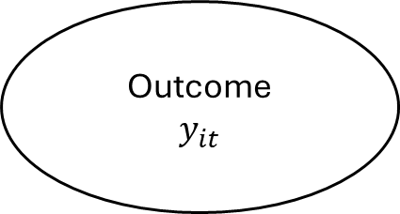
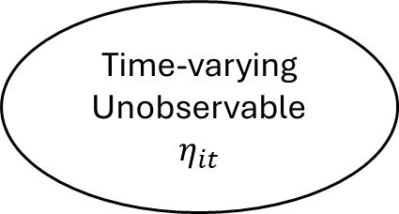
Time-varying Unobservable
$$η_{it}$$
Covariate
$$x_{it}$$
Policy
$$z_{it}$$
Outcome
$$y_{it}$$
Effect of Interest
$$β$$
Notes:
An assumption is that the dynamic relationship of x to z mirrors the dynamic relationship of \eta to z

Slide 2


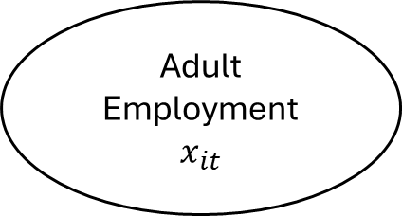


Adult Employment
$$x_{it}$$
Labor Demand
$$η_{it}$$
Minimum Wage Policy
$$z_{it}$$
Youth Employment
$$y_{it}$$
Effect of Interest
$$β$$

