Slide 1
Real-time Weather Forcasting using Autonomous Deep Learning
Shijia Yan

Slide 2

Motivation
Traditionally weather forcasting through physical simulations(NWP) needs huge amount of computing power
Machine learning applications can achieve relatively high accuracy while using much less resources – suitable for online service
Architecture | Reference | Recent Developments
convolutional neural network (CNN) | AlexNet (Alex et al. 2012) VGG (Simonyan & Zisserman, 2013) ResNet (He et al. 2015) GoogleLeNet (Szegedy et al. 2015) | VGG (Shi et al. 2018 [66]) ResNet (Pothineni et al. 2019 [68]) Vgg, ResNet (Wen et al. 2020 [70]) Inception blocks (Kleinert et al. 2021 [72])
long short-term memory network (LSTM) | RNN (Bengio et al. 1994) LSTM (Gómez et al. 2003) | LSTM (Qing & Niu, 2018) PhyDNet (Le Guen, 2020)
variational autoencoder (VAE) | Vanilla VAE, 2013 | None
generative adversarial neural network (GAN) | Vanilla GAN (Goodfellow et al., 2014) | MD-GAN (Xiong, 2018) conditional GAN (Schmidt et al. 2020)

Slide 3





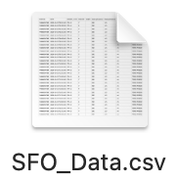

Workflow overview
Frontend
Website
D3 Visualization
Flask
Autonomous DL Core
Weather API
Backend
Result
Best Model (h5)
Data Collected

Slide 4
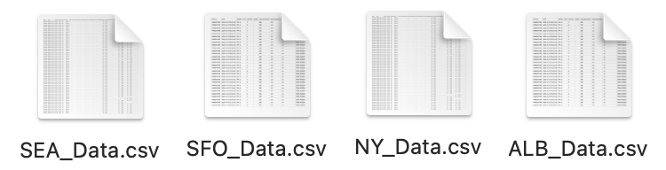
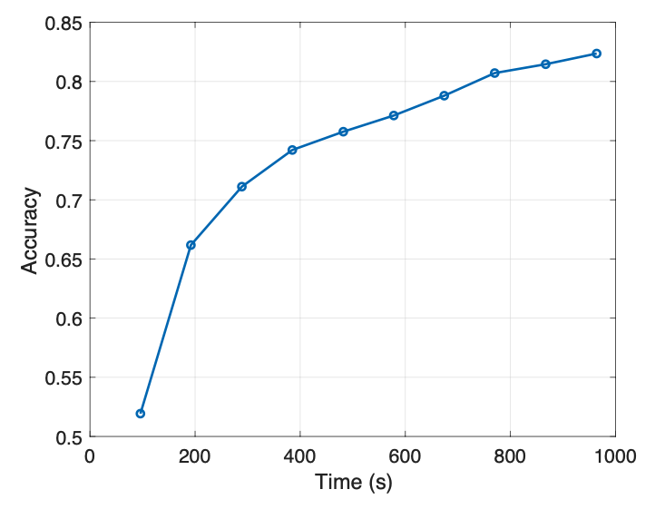
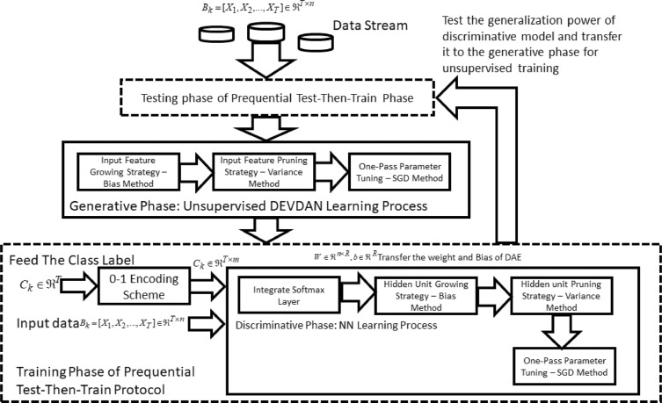

Deep Learning Core
Implemented DEVDAN with weather data(originally in Matlab, rebuilt in Python 2.7)
Training dataset: NOAA historical data, 3 years, 20 locations, more than 20,000 days of data
Weather data: daily reported data, consisting of precipitation, snow, wind, sea-level pressure, cloud
Data chunk: 14-days each chunk
Best model saved in .h5, ready for prediction

Slide 5

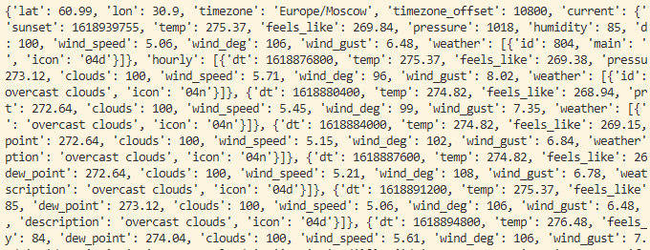

Data Fetching
Send Query
APIs
7-day weather data
Visualcrossing provides 1000 free results per day with 50 years of history
Open Weather only provides past 5 days data for free
API key was obtained by creating account at these websites
Data was then stored and filtered to only high-low temperature, wind, cloud, precipitation and pressure
Use tf.Session() from keras to load model and generate prediction results

Slide 6
Challenges
Challenges:
Volume: large amount of data from weather history for training.
Data filtering using python, stored in csv file → ready for training
Store pre-trained model into .h5, avoid training on-the-fly with whole dataset
Velocity: long training time
Use pre-trained model to generate prediction results
Update model by training new models in the background once in a while
Variety: worldwide locations coverage
Hard to obtain worldwide weather data
Data in most US cities are available through multiple API websites

Slide 7
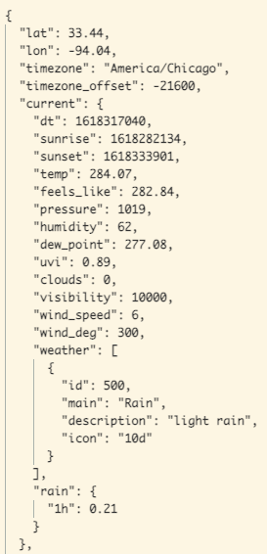
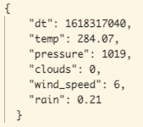


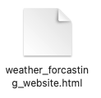
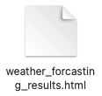
Online Forcasting
numpy
np.array
tf.Session()
model.predict()
Also normalizing all data to [0,1]
e.g.: temp data normalized with range (100,350) (K)
One-hoc vector:
[‘Sunny’, ‘Cloudy’, ‘Rainy’, ‘Foggy’, ’Snowy’]
Typical response from OpenWeather
Data extracted in json()
model = load_model(‘best_model.h5')
Tensorflow

Slide 8
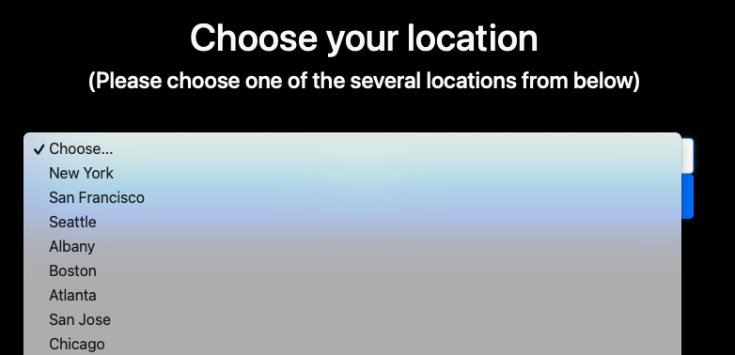
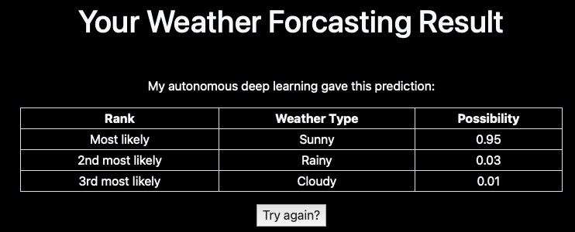
Weather Forcasting Page
User select
Fetch data
Obtain Prediction Result
Load Result
Render result.html
Jump to result.html
I haven’t complete the code using D3.js so we’re stuck with this ☹

Slide 9
Places for improvements
Result visualization with D3: creating interactive chart page
Construct higher-dimentional data to improve prediction accuracy
Obtain data from more sources
Develop into online Autonomous ML Platform for various other applications
Q & A

