Slide 1
A Model for Estimating Percentage of Body Fat
STAT 628 Module 2
GROUP 4 SHIJIE CHEN, YUMAN WU, SHUANGYU WANG

Slide 2
Introduction
In this project, our group will come up with a simple, robust, and accurate model to estimate percentage of body fat using clinically available measurements.
The model is based on a real data set of 252 men with measurements of their percentage of body fat and various body circumference measurements.
Data Cleaning
Fit Models
Detect Outliers
Model Interpretation
Conclusion

Slide 3
Data Cleaning
PBF(%) = 495/DENSITY - 450
In the first comparison group, the 96th and 48th observation have significant differences between input and predicted PBF, and the 182nd observation has impossible PBF, so we deleted them.
Index | BODY FAT | bf_predict
96 | 17.3 | 0.3684833
48 | 6.4 | 14.1350211
76 | 18.3 | 14.0915057
182 | 0 | -3.6116873

Slide 4
Data Cleaning
ADIPOSITY=0.4536✕WEIGHT/(HEIGHT✕0.0254)^2
In the second comparison group, the 42nd, 163rd and 221st observations have significant differences between input and predicted adiposity and we deleted them as outliers.
Index | ADIPOSITY | bmi_predict | WEIGHT | HEIGHT
42 | 29.9 | 165.62101 | 205 | 29.5
163 | 24.4 | 27.40739 | 184.25 | 68.75
221 | 24.5 | 21.67843 | 153.25 | 70.5
156 | 21.6 | 21.29397 | 171.5 | 75.25

Slide 5
Model Fitting
Model 1:
we borrowed some idea from US Army, they have a formula for men to calculate body fat, it is like:
PBF ~ log (Waist-Neck) + log(Height)
Because we do not have data of waist, we use abdomen instead of waist. The estimated model is
PBF=-9.237✕logHEIGHT-NECK+54.345✕log(ABDOMEN)-194.573

Slide 6
Model Fitting
Model 2:
log regression model. Model 1 requires 3 variables. We tried to dismiss NECK and found that the results were even better. The estimated model is
PBF=60.17✕log(ABDOMEN)-41.37✕log(HEIGHT)-77.08
Model 3:
linear regression model. We limited the number of predictors within five to get simple model. By exhaustive method we list all the combinations of measurements and found the best-performing models with highest adjusted R-square in different predictor numbers. Then we got a linear regression model with five predictors:
PBF=-0.239✕WEIGHT+0.6994✕HEIGHT+1.2496✕ADIPOSITY
+0.8199✕ABDOMEN-1.1357✕WRIST-74.3198

Slide 7
Cross Validation
From the results, we could ﬁnd model 2 and 3 have a better performance with higher adjusted R-square than model 1 while model 3 is slightly better than model 2 due to slightly lower standard error of MSE. However, model 2 only has two variables, which is more simple. So we adopted model 2. The average adjusted R-square is 0.7151, which implies this log regression model can averagely explain 71.51% of the deviation of the observed values from the mean.
 | Avg_adj_r_square | Avg_mse | Sd_mse
Model 1 | 0.6778 | 4.0393 | 0.7092
Model 2 | 0.7151 | 4.2525 | 0.2698
Model 3 | 0.7236 | 3.8491 | 0.2364

Slide 8
Model Selection
Through fitting and comparing models, our final proposed models to predict PBF is:
PBF=60.17✕log(ABDOMEN)-41.37✕log(HEIGHT)-77.08
That means, for example, a man with an abdomen circumference of 90 cm and a height of 77 inches is expected to have a PBF of 60.17✕log(90)-41.37✕log(77)-77.08=13.97( unit:%).
Its 95% prediction interval is [5.82% ，22.13%]

Slide 9
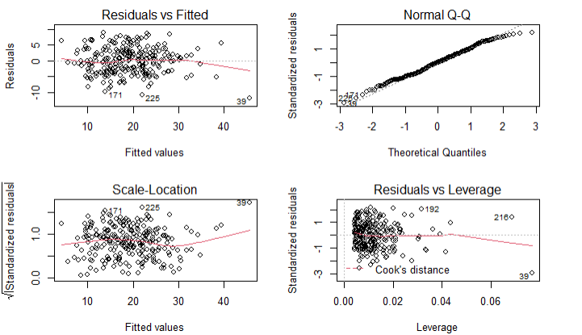
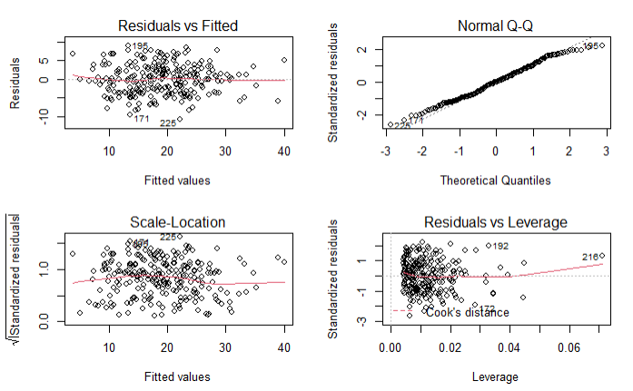
Model Diagnoistics
We used Leverage plot and looked for extreme samples; See Fig 1, we found the 39th observation is an extreme sample and we removed this outlier. After rerunning the diagnostics checks, we found Fig 2.

Slide 10
Strength and Weakness
Strength: Our model is simple, while giving a fairly good R square.
Weakness：Better prediction ability for inputs within a limited range. For example, when Abdomen is around 67, the PBF is close to 0, which is unreasonable.

Slide 11
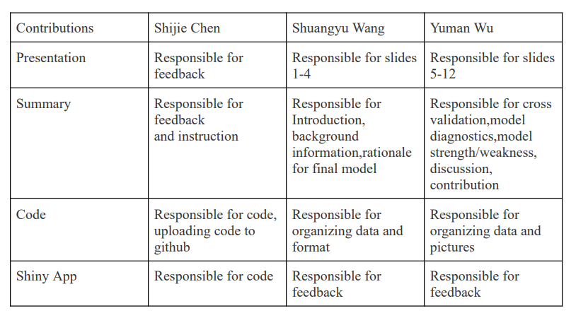
Contribution

Slide 12
Shiny App
Link:
https://mxjc6p-shijie-chen.shinyapps.io/body_fat/

Slide 13
The End
Thanks for listening!

