Slide 1
MongoDB
Aggregation Framework
1 / 33

Slide 2
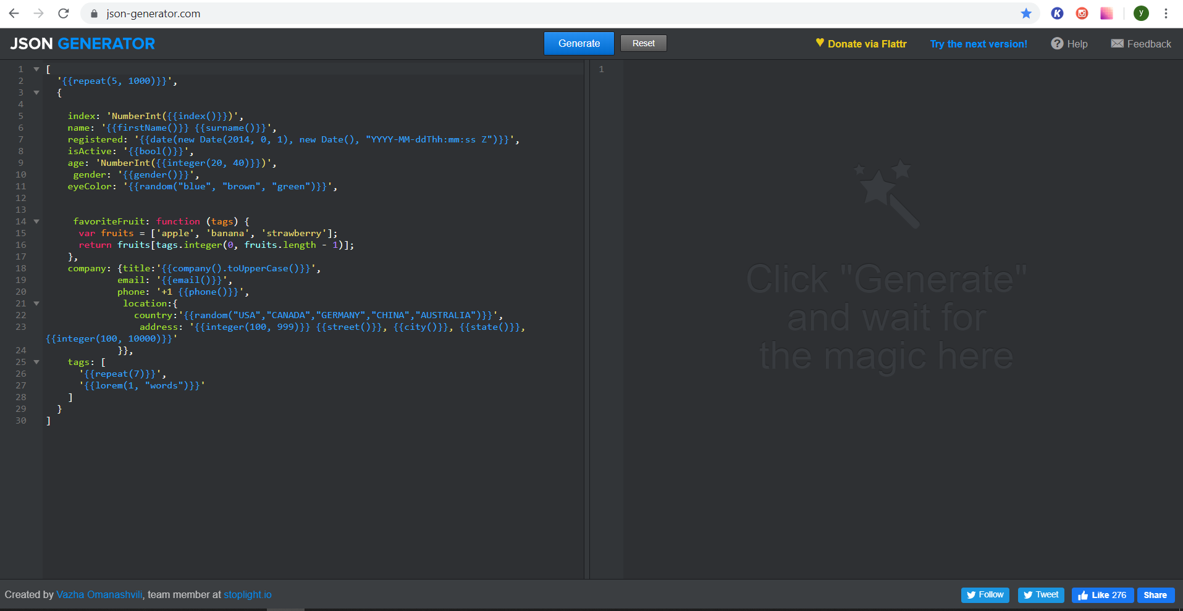
JSON Generator
2 / 33

Slide 3

NoSQL Booster
3 / 33

Slide 4
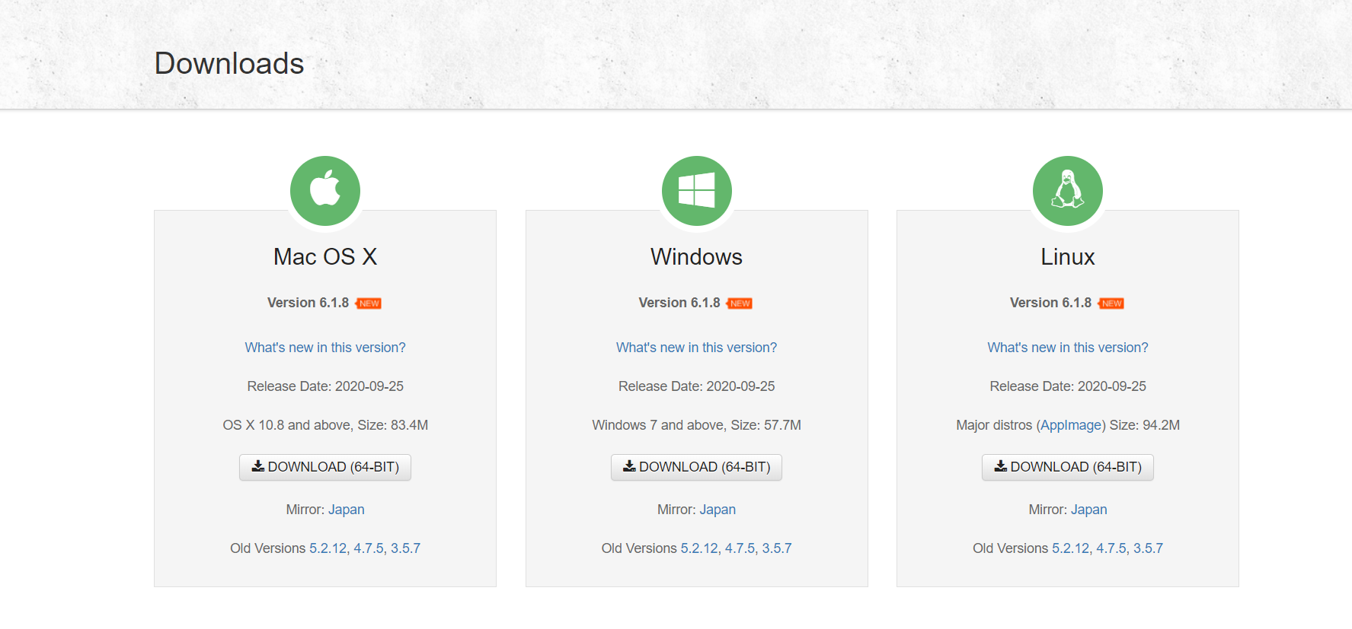
NoSQL Booster
4 / 33

Slide 5
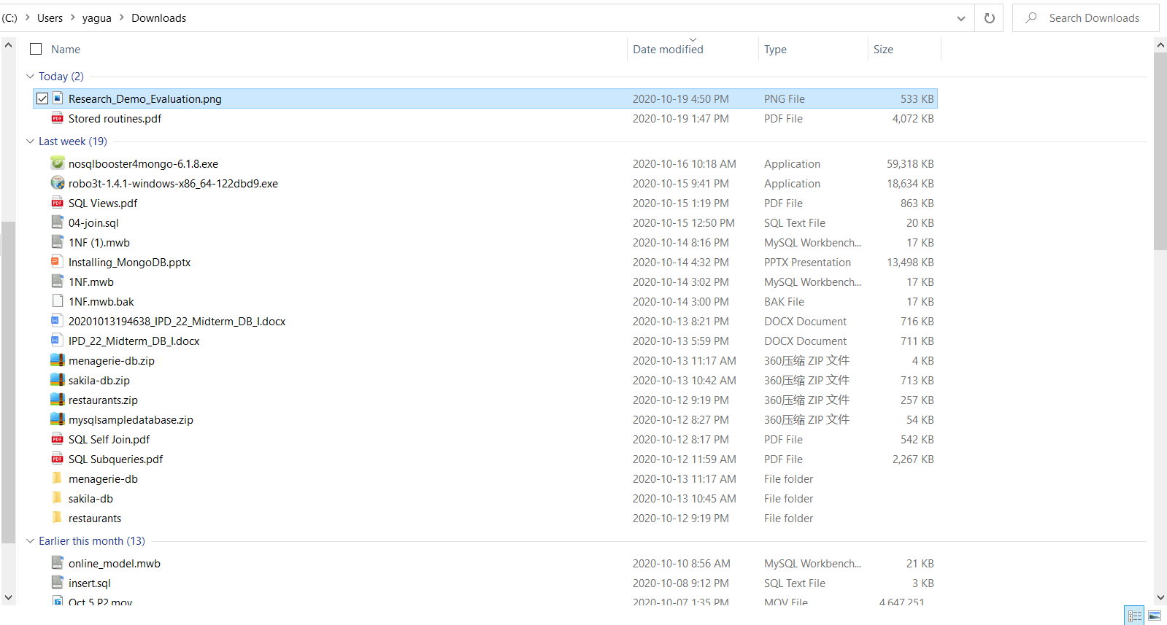
NoSQL Booster
5 / 33

Slide 6
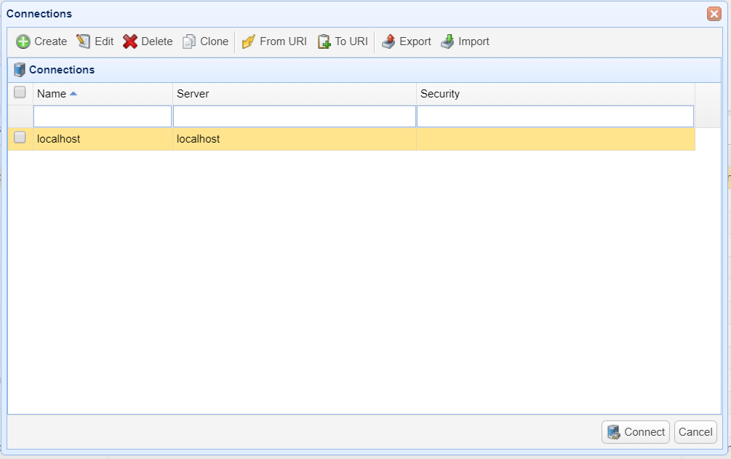
NoSQL Booster
6 / 33

Slide 7
Aggregation Method
Aggregation pipeline
Map-Reduce
Single Purpose Aggregation Operations
7 / 33

Slide 8
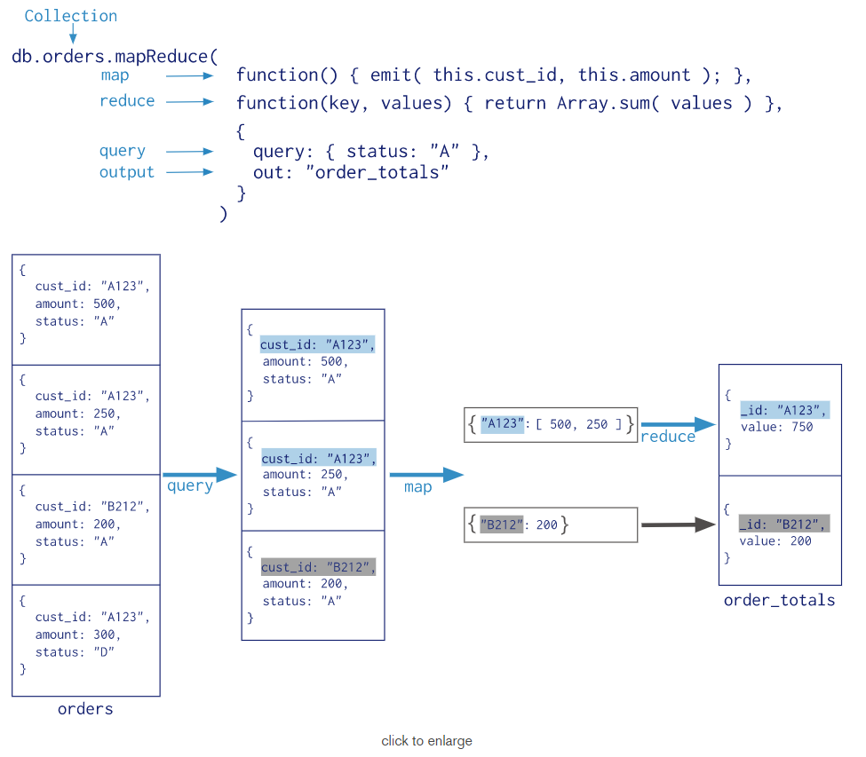
Map-Reduce
MongoDB Map-Reduce is a data processing paradigm for constricting large amount of data into useful aggregated results. It can optionally have a finalize stage.
Map-Reduce uses JavaScript to perform its operations including the finalize operation.
less efficient and more complex operation as compared to the aggregation pipeline in MongoDB.
8 / 33

Slide 9
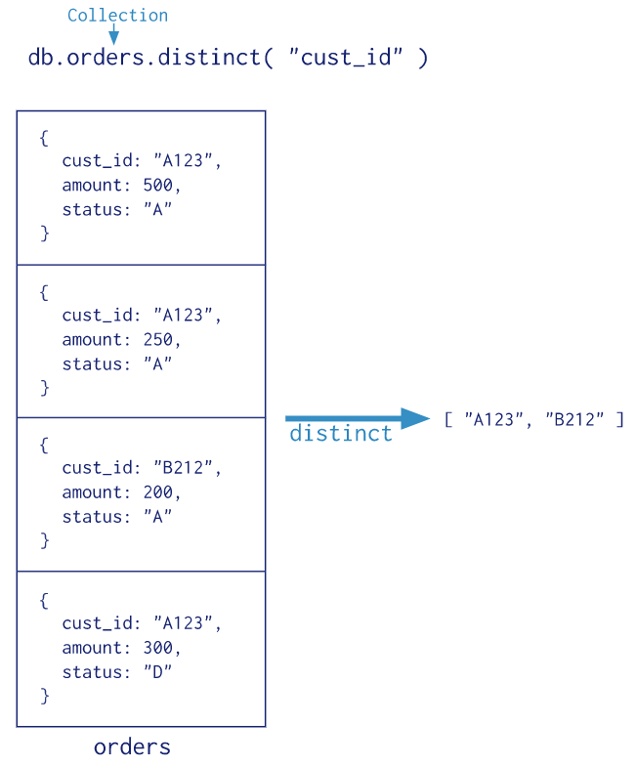
Single Purpose Aggregation Operations
MongoDB also provides some operations aggregating documents from a single collection. For example, db.collection.distinct()
Lack flexibility and capabilities of the aggregation pipeline and map-reduce.
9 / 33

Slide 10
Aggregation Pipeline
Document 1
{ … }
Document 2
{ … }
Document 3
{ … }
…
Document N
{ … }
Match
…
Document 5
{ … }
Document 10
{ … }
Document M
{ … }
Group
…
New Document
{ … }
New Document
{ … }
10 / 33

Slide 11
Aggregation Pipeline
A framework for data processing modeled on the concept of data processing pipeline.
Consisting of stages. Each stage transforms the documents as they pass through the pipeline.
Multi-stage pipeline transforms documents into aggregated results.
11 / 33

Slide 12
Aggregate Syntax
Documents during aggregation process pass through the stages
db.<collection>.aggregate([
<stage1>,
<stage2>,
…
<stageN>
])
12 / 33

Slide 13
Aggregation Stage
Each stage starts from the stage operator prepended by dollar sign
{ $<stageOperator> : { } }
Example
{ $match: { age: {$gt: 28} } }
{ $group: {_id: “$gender”} }
{ $sort: { count: -1} }
13 / 33

Slide 14
Aggregation Stage
https://docs.mongodb.com/manual/meta/aggregation-quick-reference/#object-expression-operators
Stages | Functionality
$match | Filters documents by certain query.
$group | Groups input documents by a specified identifier expression.
$project | Reshapes each document in the collection.
$sort | Reorders the document stream by a specified sort key.
$count | Returns a count of the number of documents.
$limit | Limits number of documents.
$skip | Skips certain number of documents.
$unwind | Deconstructs an array field to a document of each element.
$out | Writes the resulting documents to another collection.
14 / 33

Slide 15
Aggregation Expressions
Expression refers to the name of the field in input documents
“$<fieldName>”
Example:
{ $group: {_id: “$age”} }
{ $group: {_id: “$company.location.country”} }
{ $group: { _id: “$name”, total: {$sum: “$price”} } }
15 / 33

Slide 16
$match stage
Matches specific documents using query
Note
Match stage uses standard MongoDB queries and supports all query operators.
{ $match: { <query> } }
Example:
{ $match: { gender : “female” } }
{ $match: { age : {$gt: 25 } } }
{ $match: { “company.location.country”: “CANADA” } }
{ $match : { $and: [ {gender: “male”}, {age: {$gt: 25 } } ] } }
16 / 33

Slide 17
$group stage
Groups input documents by certain expressions
Note
_id is Mandatory field
{ $group: { _id: <expression>, <field1>: {<accumulator1> : <expression1> }, …} }
Example:
{ $group: { _id : “$gender” } }
{ $group: { _id : {age: “$age”, gender:”$gender”} } }
{ $group: { _id : “$company.location.country” } }
{ $group: {
_id: “$eyeColor”,
colorCount: { $sum: 1 }
}}
17 / 33

Slide 18
$count stage
Counts number of input documents
{ $count: “<title>”}
Example:
{ $count: “allDocumentsCount”}
18 / 33

Slide 19
$sort stage
Sorts input documents by certain field(s)
{ $sort: { <field1>: <-1 | 1>, <field2>: <-1 | 1>} }
Example:
Notes
<field>: 1 Ascending order
<field>: -1 Descending order
{ $sort: {age: -1} }
{ $sort: {age: 1, gender: 1} }
19 / 33

Slide 20
$project stage
Includes, Excludes or adds new field(s)
{ $project: { <field1>: <1>, <field2>: <0>, <newField1>: <expression>…} }
Example:
Notes
<field>: 1 Included
<field>: 0 Excluded
{ $project: {name:1, “company.title”:1} }
{ $project: {_id: 0, name: 1, age: 1} }
{ $project: {eyeColor: 0, age: 0} }
{ $project: {name: 1, newAge: “$age”} }
20 / 33

Slide 21
$limit & $skip stages
Outputs first N documents from the input
{ $limit: <positive integer>}
Skips over the specified number of documents
{ $skip: <positive integer>}
Example:
{ $limit: 100}
{ $skip: 10}
21 / 33

Slide 22
$unwind stage
Splits each document with specified array to
several documents – one document per array element
{ $unwind: <arrayReferenceExpressoin>}
Example:
{ $unwind: “$tags”}
22 / 33

Slide 23
Unwind Stage Logic
Document 1
{ … tags: [“first”,”second”,”third”]…}
UNWIND
Document 1
{ …tags: ”first” }
Document 2
{ …tags: ”second” }
Document 3
{ …tags: ”third” }
23 / 33

Slide 24
$out stage
Writes resulting documents to the MongoDB collection
{ $out: “<outputCollectionName>” }
Notes
$out stage must be the last stage in the pipeline
2. If output collection doesn’t exist, it
will be created automatically
Example:
{ $out: “newCollection” }
24 / 33

Slide 25
Accumulators
https://docs.mongodb.com/manual/reference/operator/aggregation/
$avg
$sum
$min
$max
Note
Most accumulators are used only in the $group stage
25 / 33

Slide 26
Accumulators Logic($sum Example)
Document 1
…
quantity: 10
age:25
Document 2
…
quantity: 5
age:25
Document 3
…
quantity: 30
age:25
Document 4
…
quantity: 20
age:25
Input
GROUP
Output
10 + 5 + 30 + 20
Document 1
…
total:65
age:25
26 / 33

Slide 27
Accumulator Syntax
Accumulators maintain state for each group of the documents
{ $<accumulatorOperator>: <expression>}
Example:
{ $sum: “$age” }
{ $avg: “$age” }
{ $max: “$age” }
27 / 33

Slide 28
$sum Accumulator
Sums numeric values for the documents in each group
{ $sum: <expression | number> }
Example:
{ total: { $sum: “$age” } }
{ count: { $sum: 1} }
Simple way to count number of documents in each group
28 / 33

Slide 29
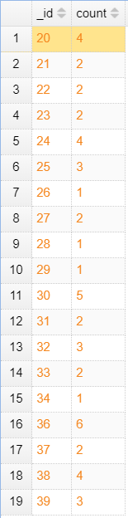
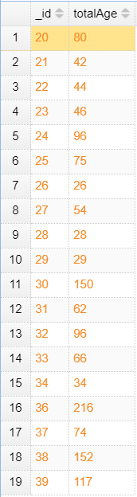
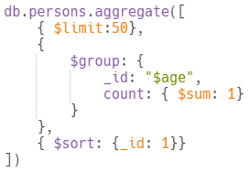
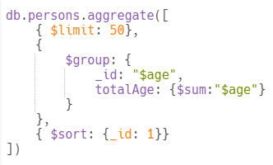
$sum Accumulator
29 / 33

Slide 30
$avg Accumulator
Calculates average value of the certain values in the documents for each group
{ $avg: <expression> }
Example:
{ avgAge: { $avg: “$age” } }
30 / 33

Slide 31
Unary Operators
https://docs.mongodb.com/manual/reference/operator/aggregation/#boolean-expression-operators
Note
Unary operators are usually used in the $project stage
In the $group stage Unary operators can be used only in conjunction with Accumulators
$type | $or
$lt | $gt
$and | $multiply
31 / 33

Slide 32
$type Unary Operator
Return BSON type of the field’s value
{ $type: <expression> }
Example:
{ $type: “$age” }
{ $type: “$name” }
{ $type: “$tags” }
{ $type: “$company” }
32 / 33

Slide 33
Thank you!
Teammembers: German Alonso, Shijun, Yaguang, Zongqi, Zhaohai
33 / 33

