Slide 1
MongoDB
Data Modeling(II)
Meng Zhaohai

Slide 2
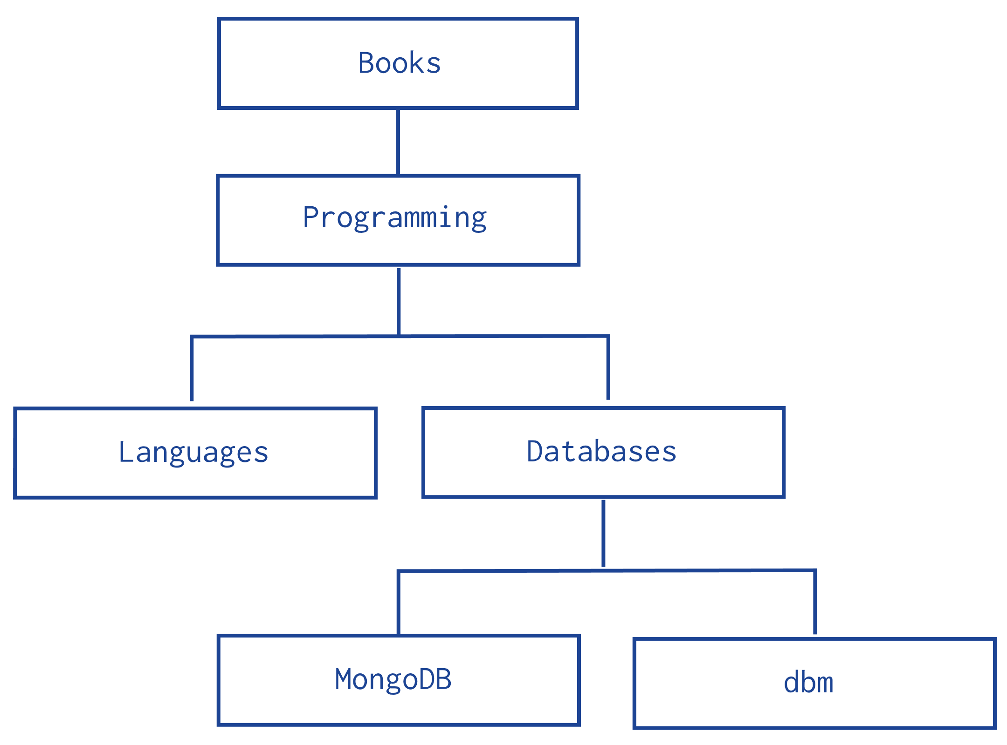
Model Tree Structures

Slide 3
Model Tree Structures
1. Model Tree Structures with Parent References
Presents a data model that organizes documents in a tree-like structure by storing references to “parent” nodes in “child” nodes.
2. Model Tree Structures with Child References
Presents a data model that organizes documents in a tree-like structure by storing references to “child” nodes in “parent” nodes.
3. Model Tree Structures with an Array of Ancestors
Presents a data model that organizes documents in a tree-like structure by storing references to “parent” nodes and an array that stores all ancestors.
4. Model Tree Structures with Materialized Paths
Presents a data model that organizes documents in a tree-like structure by storing full relationship paths between documents. In addition to the tree node, each document stores the _id of the nodes ancestors or path as a string.
5. Model Tree Structures with Nested Sets
Presents a data model that organizes documents in a tree-like structure using the Nested Sets pattern. This optimizes discovering subtrees at the expense of tree mutability.

Slide 4
1. Model Tree Structures with Parent References
The Parent References pattern stores each tree node in a document; in addition to the tree node, the document stores the id of the node’s parent.
db.categories.insertMany( [
{ _id: "MongoDB", parent: "Databases" },
{ _id: "dbm", parent: "Databases" },
{ _id: "Databases", parent: "Programming" },
{ _id: "Languages", parent: "Programming" },
{ _id: "Programming", parent: "Books" },
{ _id: "Books", parent: null }
] )

Slide 5
1. Model Tree Structures with Parent References
The query to retrieve the parent of a node is fast and straightforward:
db.categories.findOne( { _id: "MongoDB" } ).parent
You can create an index on the field parent to enable fast search by the parent node:
db.categories.createIndex( { parent: 1 } )
You can query by the parent field to find its immediate children nodes:
db.categories.find( { parent: "Databases" } )

Slide 6
2. Model Tree Structures with Child References
The Child References pattern stores each tree node in a document; in addition to the tree node, document stores in an array the id(s) of the node’s children.
db.categories.insertMany( [
{ _id: "MongoDB", children: [] },
{ _id: "dbm", children: [] },
{ _id: "Databases", children: [ "MongoDB", "dbm" ] },
{ _id: "Languages", children: [] },
{ _id: "Programming", children: [ "Databases", "Languages" ] },
{ _id: "Books", children: [ "Programming" ] }
] )

Slide 7
2. Model Tree Structures with Child References
The query to retrieve the immediate children of a node is fast and straightforward:
db.categories.findOne( { _id: "Databases" } ).children
You can create an index on the field children to enable fast search by the child nodes:
db.categories.createIndex( { children: 1 } )
You can query for a node in the children field to find its parent node as well as its siblings:
db.categories.find( { children: "MongoDB" } )

Slide 8
3. Model Tree Structures with an Array of Ancestors
The Array of Ancestors pattern stores each tree node in a document; in addition to the tree node, document stores in an array the id(s) of the node’s ancestors or path.
db.categories.insertMany( [
{ _id: "MongoDB", ancestors: [ "Books", "Programming", "Databases" ], parent: "Databases" },
{ _id: "dbm", ancestors: [ "Books", "Programming", "Databases" ], parent: "Databases" },
{ _id: "Databases", ancestors: [ "Books", "Programming" ], parent: "Programming" },
{ _id: "Languages", ancestors: [ "Books", "Programming" ], parent: "Programming" },
{ _id: "Programming", ancestors: [ "Books" ], parent: "Books" },
{ _id: "Books", ancestors: [ ], parent: null }
] )

Slide 9
3. Model Tree Structures with an Array of Ancestors
The query to retrieve the ancestors or path of a node is fast and straightforward:
db.categories.findOne( { _id: "MongoDB" } ).ancestors
You can create an index on the field ancestors to enable fast search by the ancestors nodes:
db.categories.createIndex( { ancestors: 1 } )
You can query by the field ancestors to find all its descendants:
db.categories.find( { ancestors: "Programming" } )

Slide 10
4. Model Tree Structures with Materialized Paths
The Materialized Paths pattern stores each tree node in a document; in addition to the tree node, document stores as a string the id(s) of the node’s ancestors or path.
db.categories.insertMany( [
{ _id: "Books", path: null },
{ _id: "Programming", path: ",Books," },
{ _id: "Databases", path: ",Books,Programming," },
{ _id: "Languages", path: ",Books,Programming," },
{ _id: "MongoDB", path: ",Books,Programming,Databases," },
{ _id: "dbm", path: ",Books,Programming,Databases," }
] )

Slide 11
4. Model Tree Structures with Materialized Paths
You can query to retrieve the whole tree, sorting by the field path:
db.categories.find().sort( { path: 1 } )
You can use regular expressions on the path field to find the descendants of Programming:
db.categories.find( { path: /,Programming,/ } )
You can also retrieve the descendants of Books where the Books is also at the topmost level of the hierarchy:
db.categories.find( { path: /^,Books,/ } )
To create an index on the field path use the following invocation:
db.categories.createIndex( { path: 1 } )

Slide 12
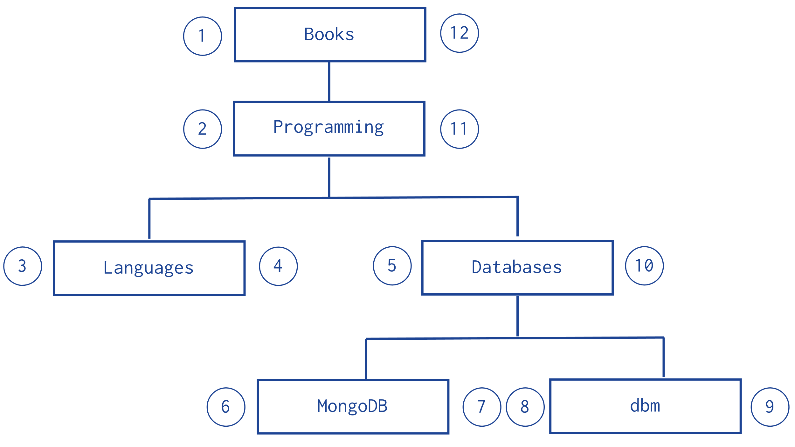
5. Model Tree Structures with Nested Sets
The Nested Sets pattern stores each tree node in a document; in addition to the tree node, document stores the id of node’s parent, the node’s initial stop in the left field, and its return stop in the right field.
db.categories.insertMany( [
{ _id: "Books", parent: 0, left: 1, right: 12 },
{ _id: "Programming", parent: "Books", left: 2, right: 11 },
{ _id: "Languages", parent: "Programming", left: 3, right: 4 },
{ _id: "Databases", parent: "Programming", left: 5, right: 10 },
{ _id: "MongoDB", parent: "Databases", left: 6, right: 7 },
{ _id: "dbm", parent: "Databases", left: 8, right: 9 }
] )

Slide 13
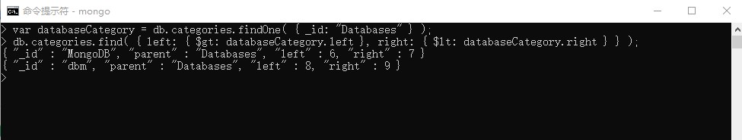
5. Model Tree Structures with Nested Sets
You can query to retrieve the whole tree, sorting by the field path:
var databaseCategory = db.categories.findOne( { _id: "Databases" } );
db.categories.find( { left: { $gt: databaseCategory.left }, right: { $lt: databaseCategory.right } } );

Slide 14
Model Specific Application Contexts
1. Model Data for Atomic Operations
Illustrates how embedding fields related to an atomic update within the same document ensures that the fields are in sync.
2. Model Data to Support Keyword Search
Describes one method for supporting keyword search by storing keywords in an array in the same document as the text field. Combined with a multi-key index, this pattern can support application’s keyword search operations.
3. Model Data for Schema Versioning
Describes one method for schema iteration without downtime.
4. Model Monetary Data
Describes two methods to model monetary data in MongoDB.
5. Model Time Data
Describes how to deal with local time in MongoDB.
6.
Describes how to deriveModel Computed Data a value from source data and store that value in a database.

Slide 15
1. Model Data for Atomic Operations
{
_id: 123456789,
title: "MongoDB: The Definitive Guide",
author: [ "Kristina Chodorow", "Mike Dirolf" ],
published_date: ISODate("2010-09-24"),
pages: 216,
language: "English",
publisher_id: "oreilly",
available: 3,
checkout: [ { by: "joe", date: ISODate("2012-10-15") } ]
}

Slide 16
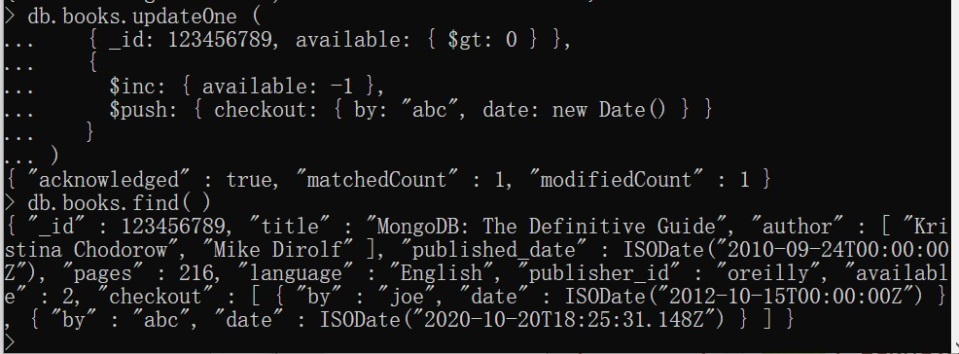
db.books.updateOne (
{ _id: 123456789, available: { $gt: 0 } },
{
$inc: { available: -1 },
$push: { checkout: { by: "abc", date: new Date() } }
}
)

Slide 17
2. Model Data to Support Keyword Search
{ title : "Moby-Dick" ,
author : "Herman Melville" ,
published : 1851 ,
ISBN : 0451526996 ,
topics : [ "whaling" , "allegory" , "revenge" , "American" ,
"novel" , "nautical" , "voyage" , "Cape Cod" ]
}
This pattern describes one method for supporting keyword search using MongoDB to support application search functionality, that uses keywords stored in an array in the same document as the text field. Combined with a multi-key index, this pattern can support application’s keyword search operations.
db.volumes.createIndex( { topics: 1 } )
db.volumes.findOne( { topics : "voyage" }, { title: 1 } )

Slide 18
3. Model Data for Schema Versioning
// users collection
{
"_id": "<ObjectId>",
"galactic_id": 123,
"name": "Darth Vader",
"contact_method": {
"work": "503-555-0210",
"home": "503-555-0220",
"twitter": "@realdarthvader",
"skype": "AlwaysWithYou"
},
"schema_version": "2"
}
// users collection
{
"_id": "<ObjectId>",
"galactic_id": 123,
"name": "Anakin Skywalker",
"phone": "503-555-0000",
}

Slide 19
4. Model Monetary Data
Numeric Model
Using the Decimal BSON Type
the IEEE 754 decimal128 decimal-based floating-point numbering format.
Using a Scale Factor
Non-Numeric Model
Using two fields for the monetary value:
one field, encode the exact monetary value as a non-numeric data type; e.g., BinData or a string.
the second field, store a double-precision floating point approximation of the exact value.

Slide 20
5. Model Time Data
Use Buckets for Time-Series Data
A common method to organize time-series data is to group the data into buckets where each bucket represents a uniform unit of time such as a day or year. Bucketing organizes specific groups of data to help:
Discover historical trends,
Forecast future trends, and
Optimize storage usage.

Slide 21
Use Buckets for Time-Series Data
{
"_id": 1,
"sensor_id": 12345,
"start_date": ISODate("2019-01-31T10:00:00.000Z"),
"end_date": ISODate("2019-01-31T10:59:59.000Z"),
"measurements": [
{
"timestamp": ISODate("2019-01-31T10:00:00.000Z"),
"temperature": 40
},
{
"timestamp": ISODate("2019-01-31T10:01:00.000Z"),
"temperature": 40
},
...
{
"timestamp": ISODate("2019-01-31T10:42:00.000Z"),
"temperature": 42
}
],
"transaction_count": 42,
"sum_temperature": 1783
}
// temperatures collection
{
"_id": 1,
"sensor_id": 12345,
"timestamp": ISODate("2019-01-31T10:00:00.000Z"),
"temperature": 40
}
{
"_id": 2,
"sensor_id": 12345,
"timestamp": ISODate("2019-01-31T10:01:00.000Z"),
"temperature": 40
}
{
"_id": 3,
"sensor_id": 12345,
"timestamp": ISODate("2019-01-31T10:02:00.000Z"),
"temperature": 41
}
...

Slide 22
6. Model Computed Data
// screenings collection
{
"theater": "Alger Cinema",
"location": "Lakeview, OR",
"movie_title": "Reservoir Dogs",
"num_viewers": 344,
"revenue": 3440
}
{
"theater": "City Cinema",
"location": "New York, NY",
"movie_title": "Reservoir Dogs",
"num_viewers": 1496,
"revenue": 22440
}
{
"theater": "Overland Park Cinema",
"location": "Boise, ID",
"movie_title": "Reservoir Dogs",
"num_viewers": 760,
"revenue": 7600
}
// movies collection
{
"title": "Reservoir Dogs",
"total_viewers": 2600,
"total_revenue": 33480,
...
}

Slide 23
Data Model Reference
Manual references
DBRefs

Slide 24
Data Model Reference
Manual References
original_id = ObjectId()
db.places.insert({
"_id": original_id,
"name": "Broadway Center",
"url": "bc.example.net"
})
db.people.insert({
"name": "Erin",
"places_id": original_id,
"url": "bc.example.net/Erin"
})

Slide 25
Data Model Reference
DBRefs
Format
DBRefs have the following fields:
$ref
The $ref field holds the name of the collection where the referenced document resides.
$id
The $id field contains the value of the _id field in the referenced document.
$db
Optional.
Contains the name of the database where the referenced document resides.
Only some drivers support $db references.

Slide 26
Driver Support for DBRefs
Driver | DBRef Support | Notes
C | Not Supported | You can traverse references manually.
C++ | Not Supported | You can traverse references manually.
C# | Supported | Please see the C# driver page for more information.
Haskell | Not Supported | You can traverse references manually.
Java | Supported | Please see the Java driver page for more information.
Node.js | Supported | Please see the Node.js driver page for more information.
Perl | Supported | Please see the Perl driver page for more information.
PHP | Not Supported | You can traverse references manually.
Python | Supported | Please see the PyMongo driver page for more information.
Ruby | Supported | Please see the Ruby driver page for more information.
Scala | Not Supported | You can traverse references manually.

Slide 27
https://docs.mongodb.com/manual/tutorial/model-tree-structures-with-parent-references/
Reference

