Slide 1

动画

Slide 2
Git工作流
V1.0
Bug出现！
V1.1
V2.0
V3.0
master
Bug!
Pass!
hotfix
Pass!
release
develop
finish!
feature_goldstyle
finish!
feature_game

Slide 3

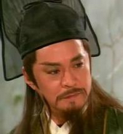
Git工作流
分支实战
origin/Master
origin/Master
origin/featureA
Push
Push
Pull
Merge
Master
Master
featureA
featureA

Slide 4


