Slide 1
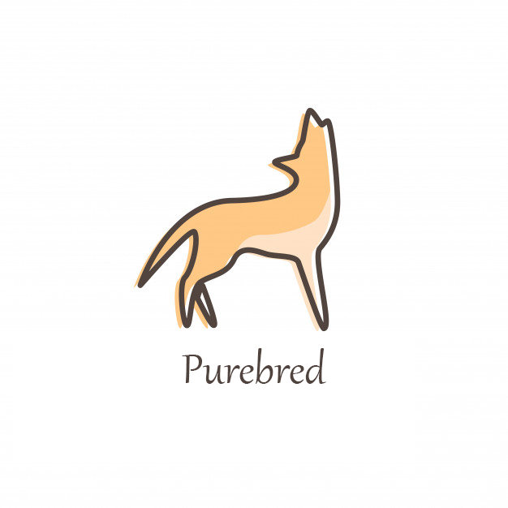

Slide 2
Comment garantir la pureté d’une lignée de chien ?

Slide 3
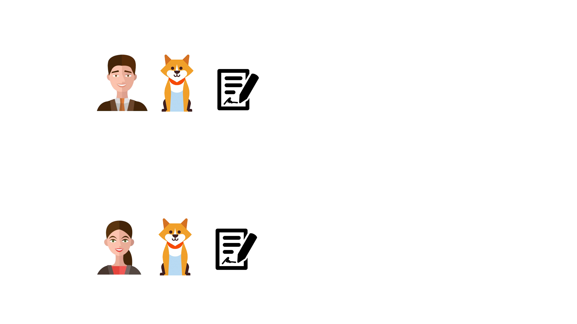
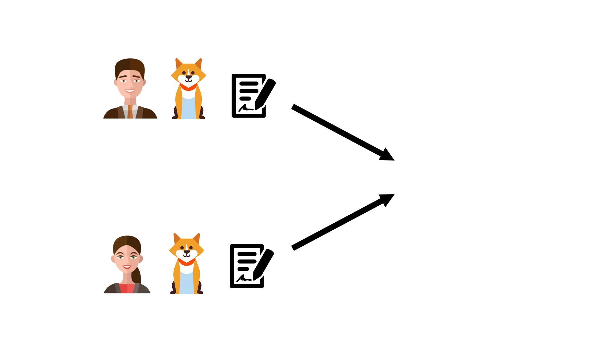
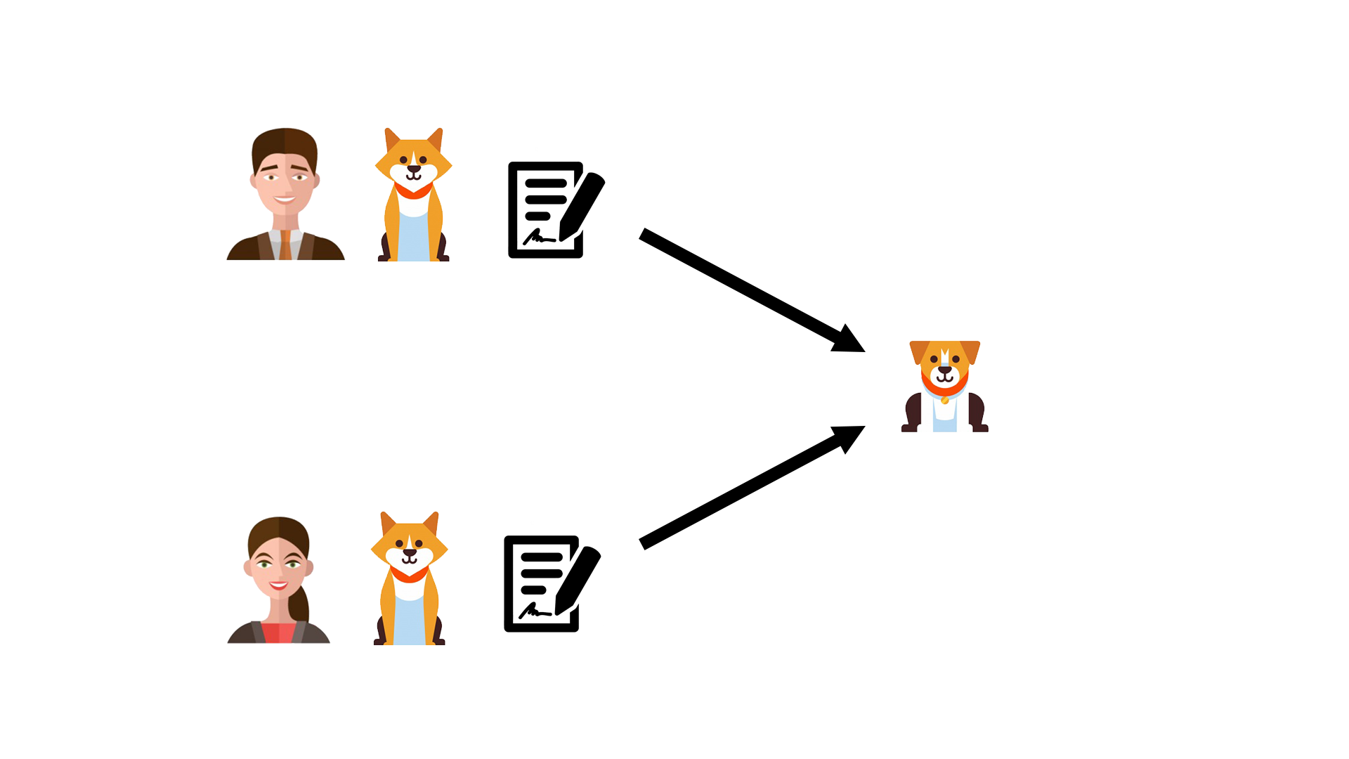
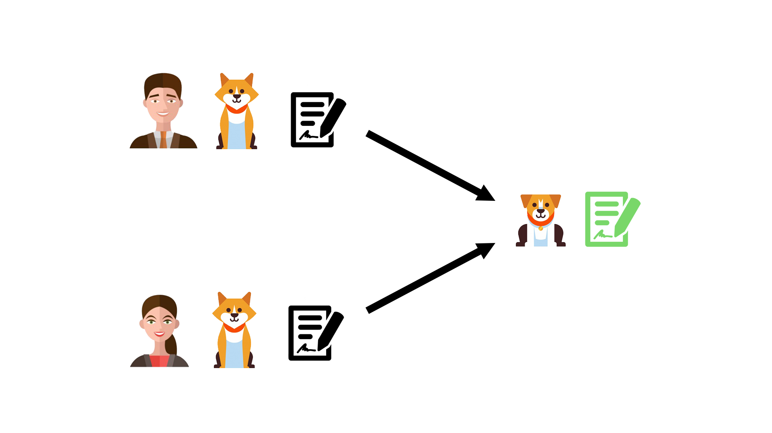

Slide 4
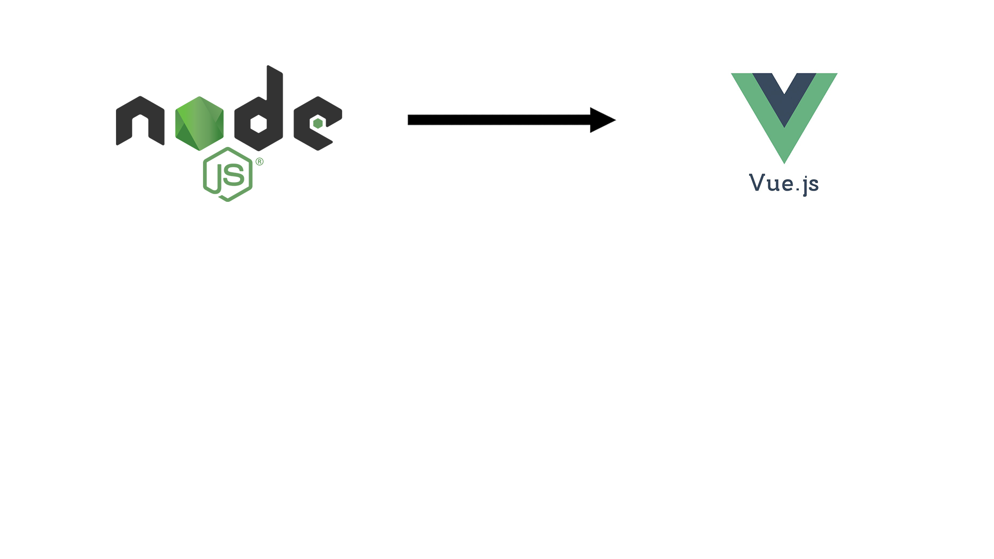
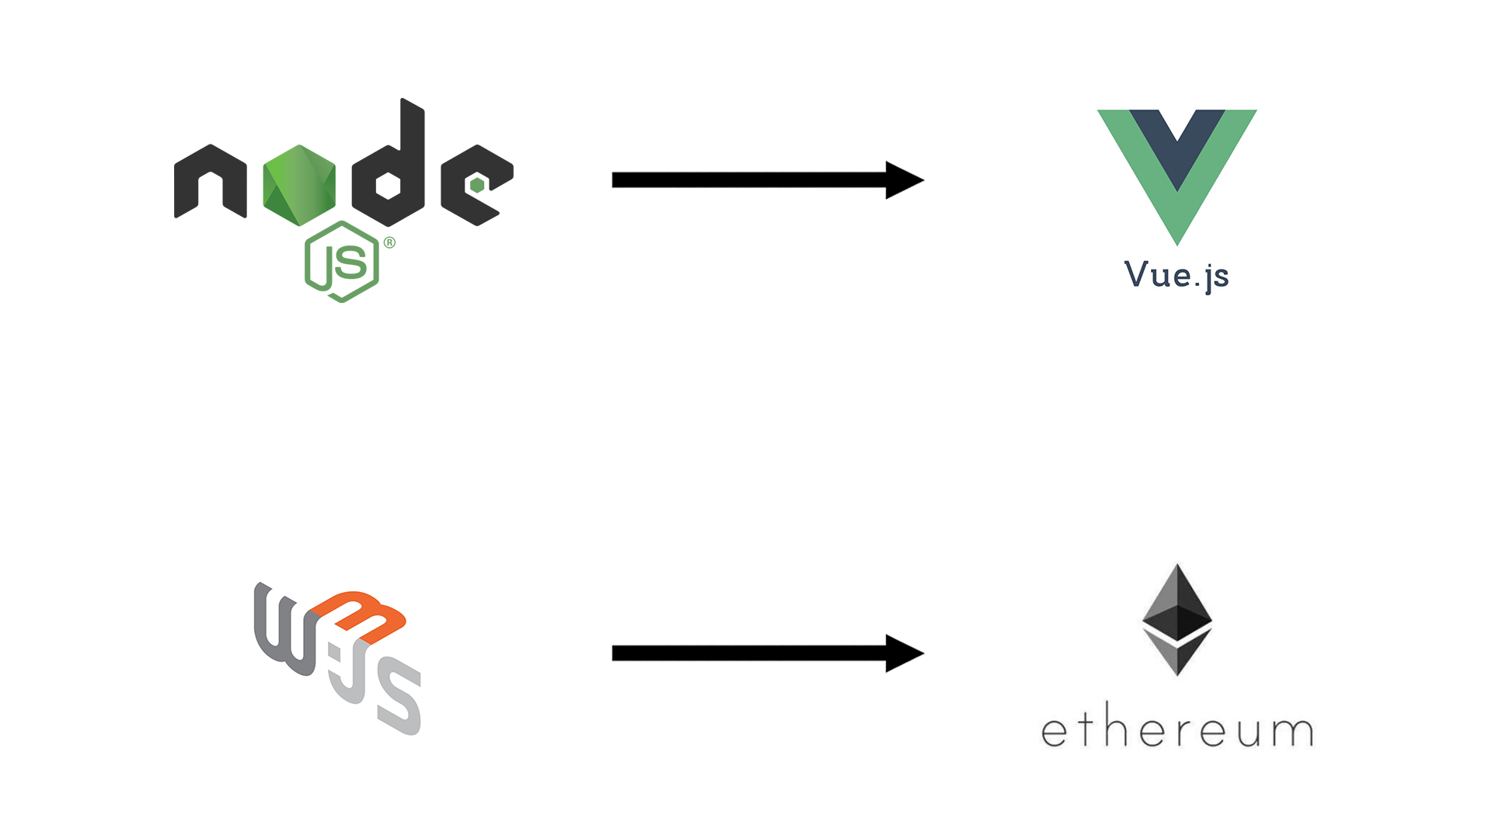

Slide 5
Smart Contrat
pragma solidity ^0.4.15;
import "./lib/Strings.sol";
contract FamilyTree {
address owner;
event FamilyCreated(address fromAddress, bytes18 name);
event FamilyMemberAdded(address fromAddress, bytes18 name, bytes6 gender);
function addFamilyMember(bytes18 name, bytes6 gender, int128 dateOfBirth, int128 dateOfDeath) public returns (int128 id) {
FamilyNode storage node = familyNodes[nextNodeId];
node.name = name;
node.gender = gender;
node.dateOfBirth = dateOfBirth;
node.dateOfDeath = dateOfDeath;
node.noOfChildren = 0;
emit FamilyMemberAdded(msg.sender, name, gender);
numberOfFamilymembers++;
return nextNodeId++;
}
https://github.com/Shikanime/purebred

Slide 6
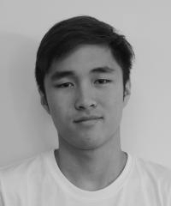
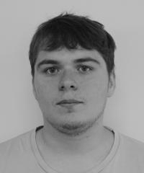
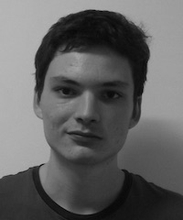
Notre équipe

