Slide 1
Apache WebServer

Slide 2
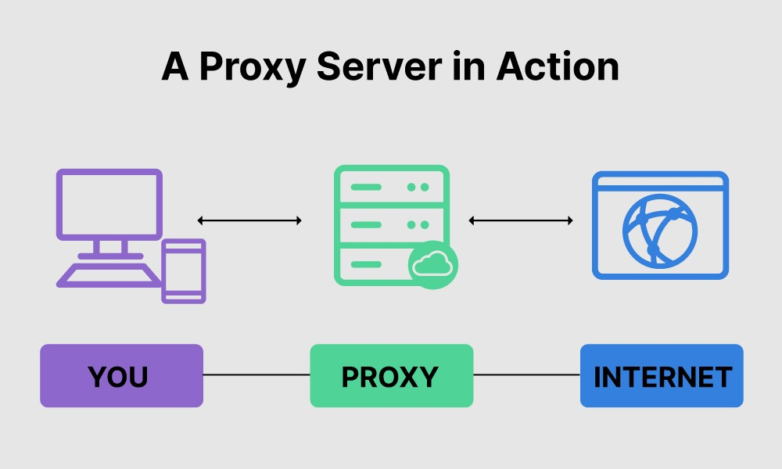
About Proxy Server
A proxy server is a system or router that provides a gateway between users and the internet.
It helps prevent cyber attackers from entering a private network.
Benefits:
Enhanced security.
Unblock Websites.
Performance

Slide 3
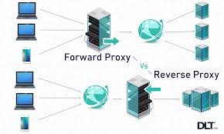
Types of Proxy Servers
Forward Proxy
Reverse Proxy

Slide 4
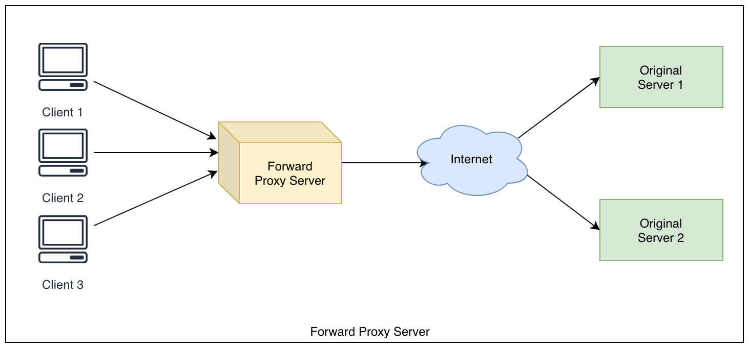
Configure Apache as a Forward Proxy
An ordinary proxy (also called a forward proxy) is an intermediate server that sits between the client and the origin server.
The client is configured to use the forward proxy to access other sites

Slide 5
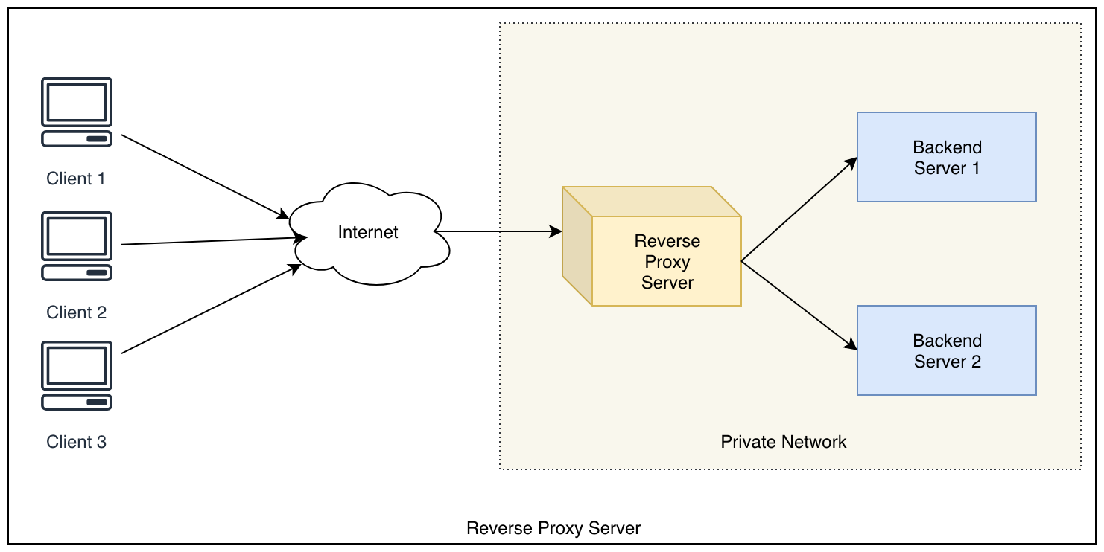
Configure Apache as a Reverse Proxy
A reverse proxy is a type of proxy server that takes HTTP(S) requests and transparently distributes them to one or more backend servers.
It acts as a server-side firewall as it helps to protect original servers.

