Slide 1

Unlocking Value Through Data Analysis
Graded Project – Power BI
By Shikha Shah.
Hero Vired – ABADS – Batch 10

Slide 2
PROJECT OVERVIEW
Analysing Airbnb's Operations For Informed Decision-making
This presentation has been prepared to offer a comprehensive understanding of airbnb's operations, providing valuable insights that can help in making informed strategic decisions and drive success.

Slide 3
PROJECT GOALS
Assessing District Location Scores.
Examining Host Response Time Impact.
Visualizing Airbnb Listing Prices.
Analysing Composite Scores.
Calculating Listing Age and Host Tenure.
Property Type Price Analysis.
Comprehensive City Insights Report

Slide 4
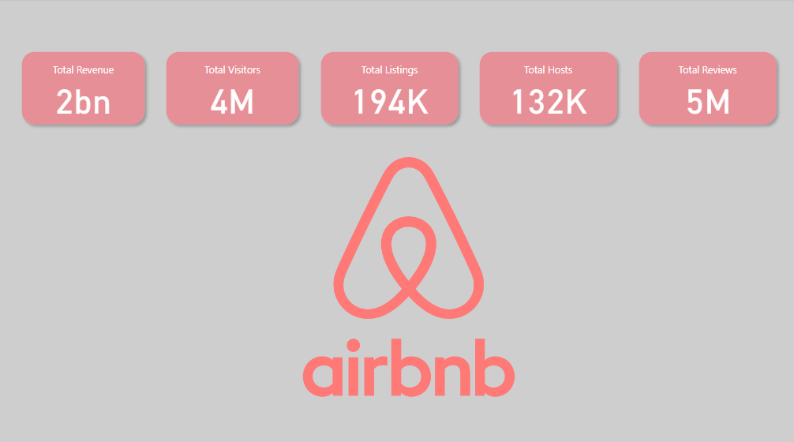

Slide 5
Assessing District Location Scores

Slide 6
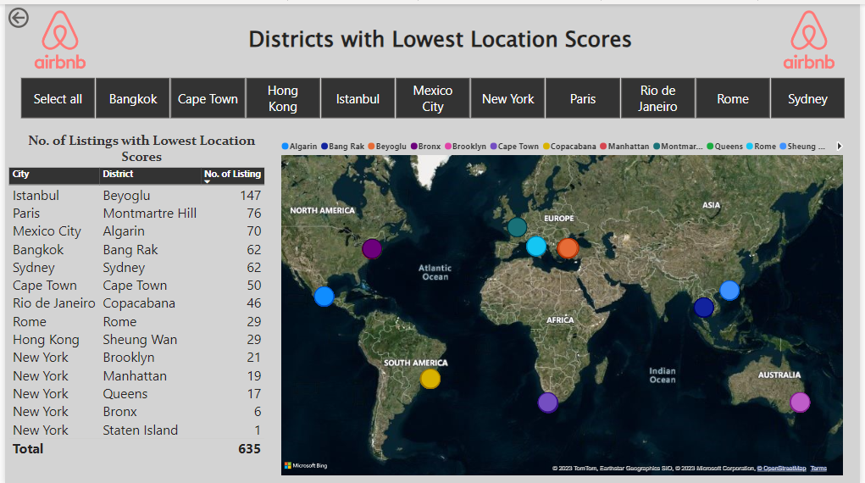
Assessing District Location Scores

Slide 7
Assessing District Location Scores.
The lowest score for location is 2 out of 10.
Istanbul has the highest number of listings with lowest location scores, followed by Paris.
Of all the cities Rome & Hong Kong have least number of Listings with poor location scores.
Of all the districts Staten Island – New York has only 1 listing with poor location scores.

Slide 8
Examining Host Response Time Impact

Slide 9
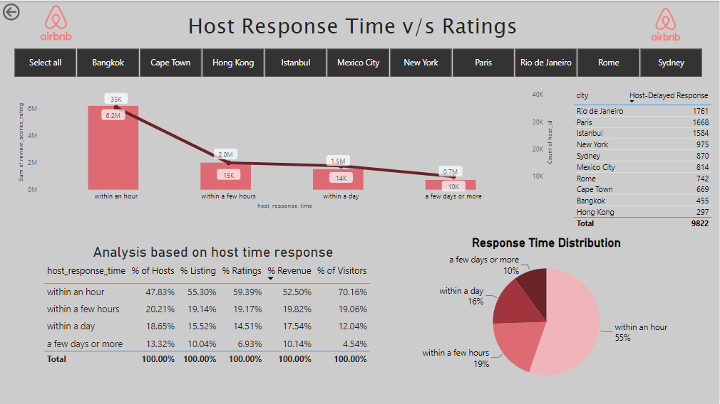
Examining Host Response Time Impact

Slide 10
Examining Host Response Time Impact
Rio De Janeiro has the highest no. of Hosts taking few days to respond as compared to the no. of such hosts in other cities, closely followed by Paris.
48% of total hosts respond quickly i.e within an hour, and they contribute to 52% of total revenue and serviced 70% of total visitors

Slide 11
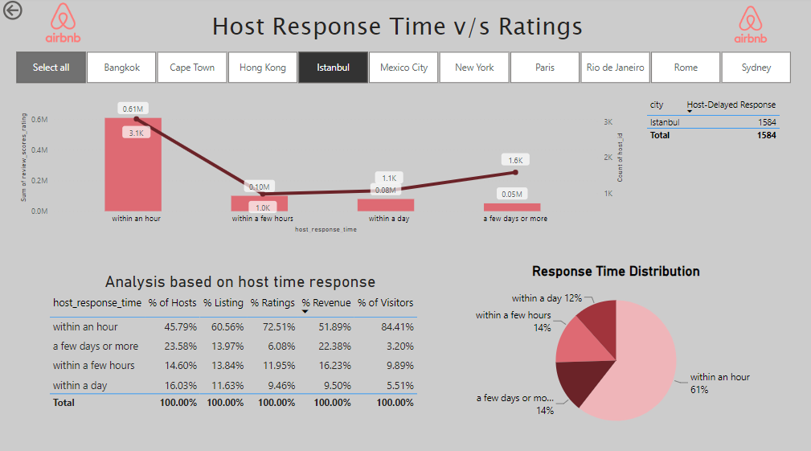
Assessing District Location Scores.
Of all the cities Istanbul has the highest % (23%) of hosts whose response time is “few days or more”. Followed by Hong Kong @ 22% of total hosts in Hong Kong.

Slide 12
Visualizing Airbnb Listing Prices

Slide 13
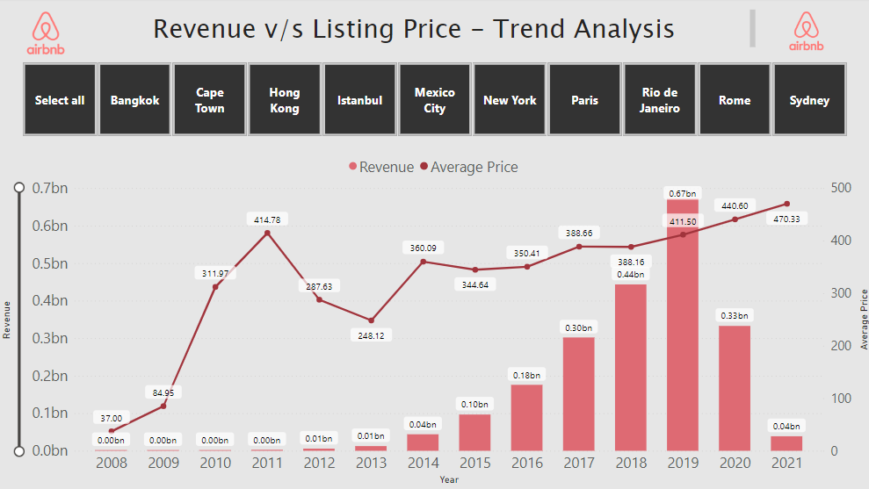
Visualizing Airbnb Listing Prices

Slide 14
Visualizing Airbnb Listing Prices
There is steady growth in revenue from year 2014 to 2019.
Impact of covid can be seen in revenue of year 2020 & 2021.

Slide 15
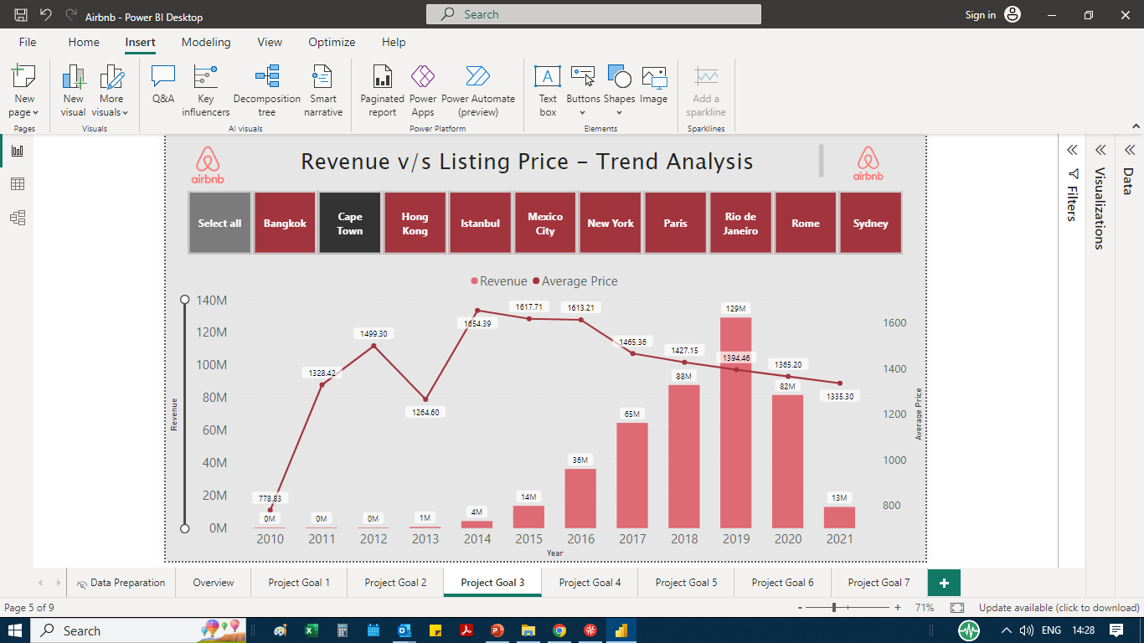
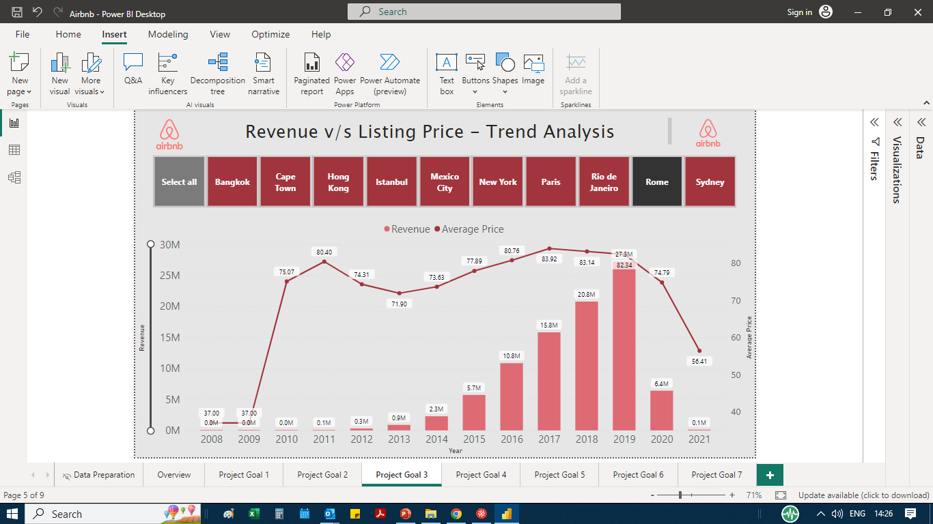
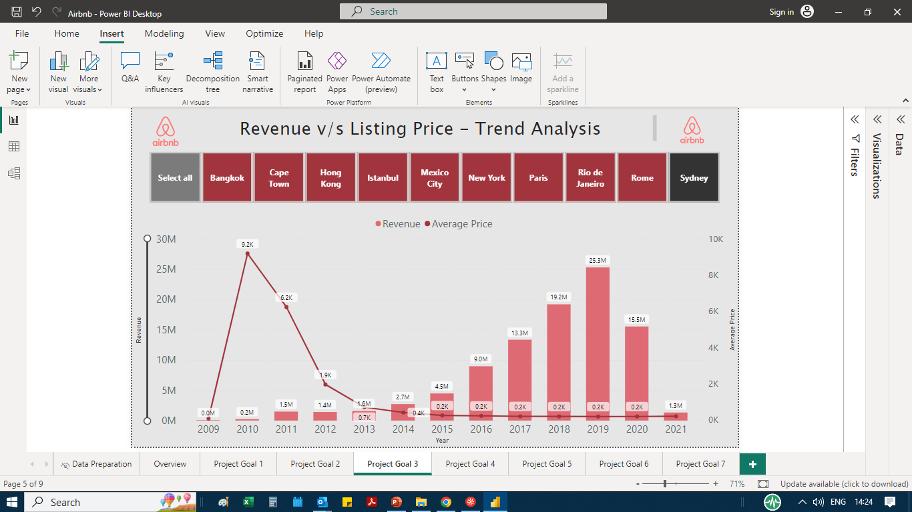
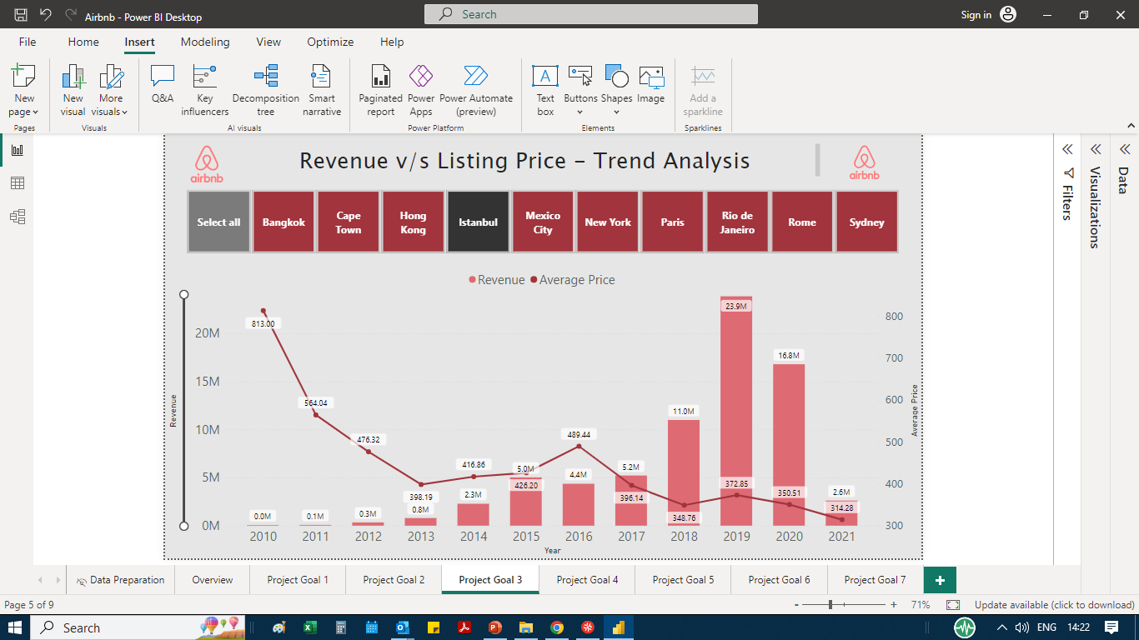
Visualizing Airbnb Listing Prices

Slide 16
Visualizing Airbnb Listing Prices

Slide 17
Visualizing Airbnb Listing Prices
The average price trend of Bangkok, Hong Kong, Istanbul and Sydney is inverse when compared to the trend of other cities.

Slide 18
Analysing Composite Scores

Slide 19
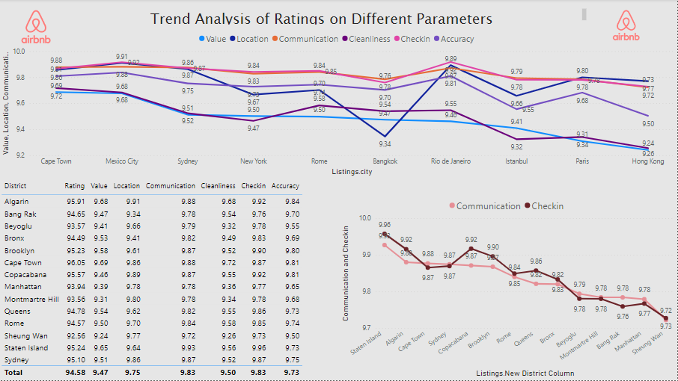
Analysing Composite Scores

Slide 20
Analysing Composite Scores
Host Communication plays an important role in visitor’s check-in experience.

Slide 21
Calculating Listing Age and Host Tenure

Slide 22
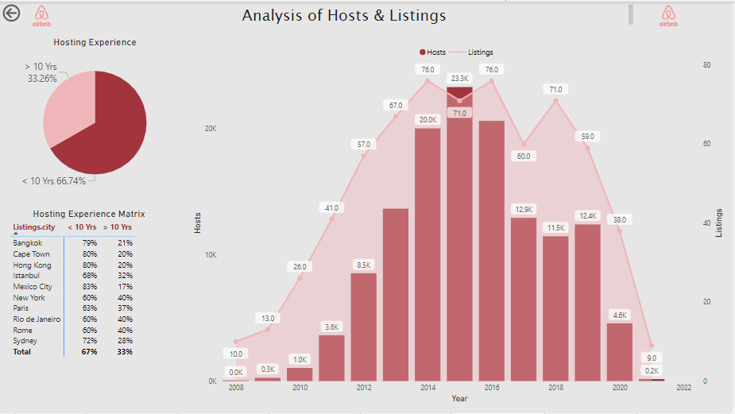
Calculating Listing Age and Host Tenure

Slide 23
Calculating Listing Age and Host Tenure
33% of total host have hosting tenure of more than 10 years.
City wise distribution of the same can be seen in the table given below.
From trend chart we can see the rise in no of hosts and rise in corresponding listings from 2008 to 2019 and then a sudden drop in 2020

Slide 24
Property Type Price Analysis

Slide 25
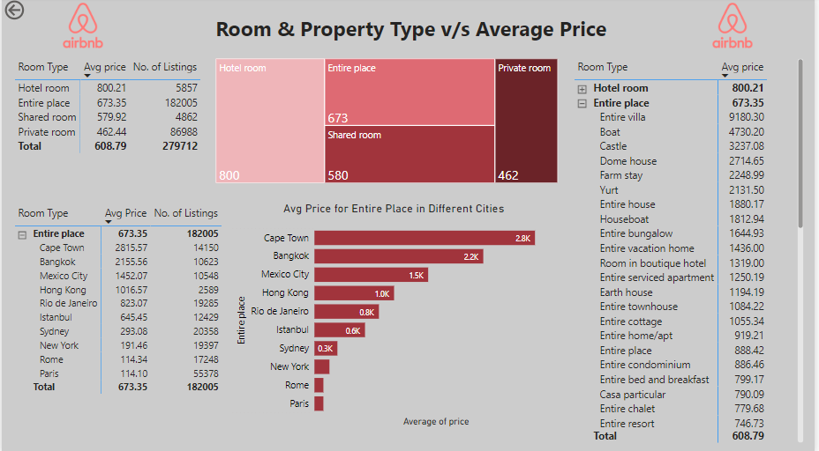
Property Type Price Analysis

Slide 26
Property Type Price Analysis
Average prices for various room types can be seen from this report.
With respect to Room Type : Entire Place, - Cape town has the highest priced listings.
Property type for such listings is visible in another table.

Slide 27
Comprehensive City Insights Report

Slide 28
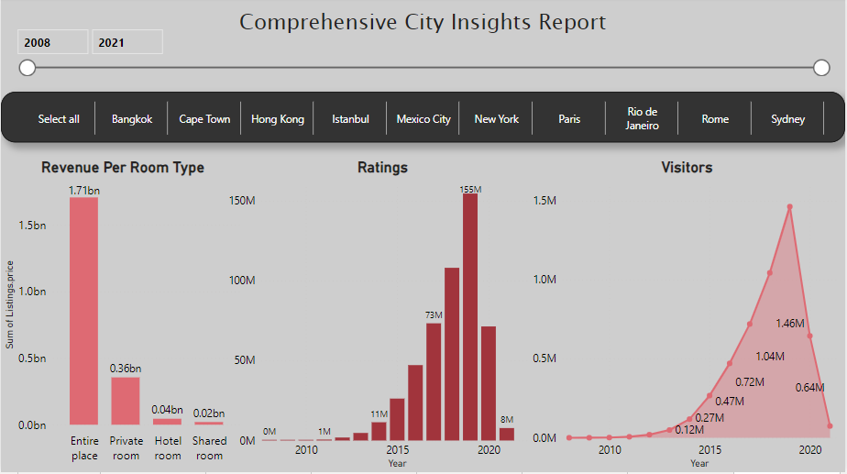
Comprehensive City Insights Report

Slide 29
Comprehensive City Insights Report
Impact of Covid can be easily seen in the Ratings & Visitors graph.
Entire Place is the highest revenue grosser for Airbnb followed by private room.

Slide 30
☺ THANK YOU ☺
I hope this presentation served its purpose of providing valuable insight on the data.
Comments & Suggestions are highly awaited.

