Slide 1
GenAI Payment Dispute Resolution
Team 3: Shikha & Badal
Data & AI

Slide 2
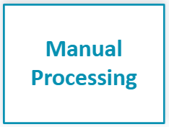
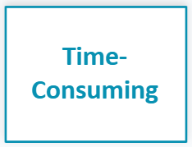

Problem Statement
• Payment processors handle thousands of disputes daily
• Manual review is time-consuming and labor-intensive
• Inconsistent decision-making across dispute handlers
• Average resolution time: 7-14 days
• High operational costs due to manual workload

Slide 3
Solution Overview
• Automated analysis of complaint descriptions using Natural Language Processing
• Intelligent fraud risk detection with Machine Learning models
• Generative AI-powered investigation summaries and recommendations
Key Benefits
• Reduce resolution time from days to minutes
• Improve fraud detection consistency
• Lower operational costs through automation

Slide 4
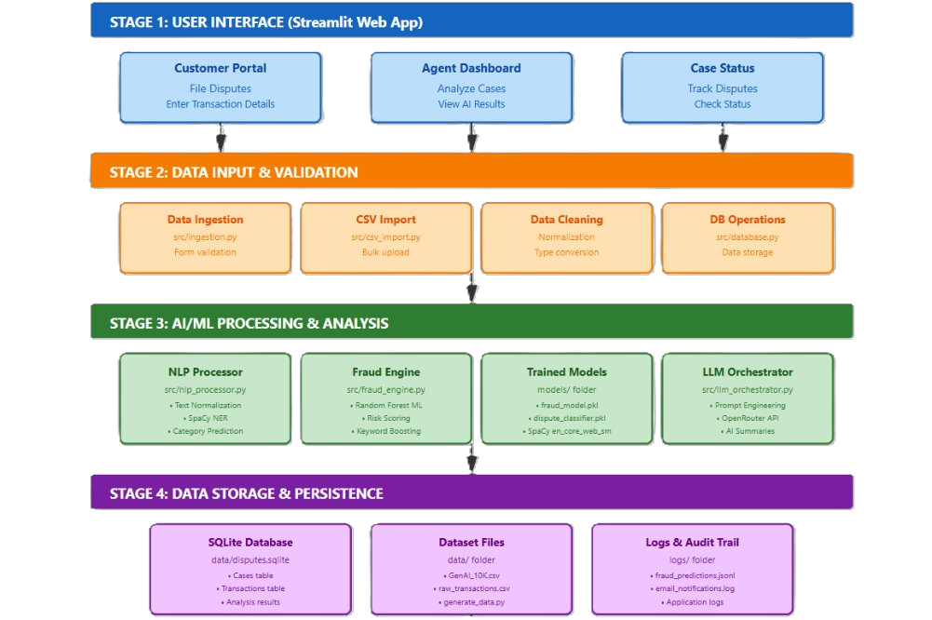
System Architecture

Slide 5
Technology Stack
Python: Core programming language for all components
Streamlit: Interactive web interface for agent dashboard
Pandas & NumPy: Data processing and numerical computation
spaCy: Natural Language Processing (NLP) for text analysis
Scikit-learn: Machine learning models for classification and fraud detection
OpenRouter LLM: Advanced language model for investigation summaries
SQLite: Lightweight database for dispute records and case management

Slide 6
Data Overview
10,000
9
Dispute Records
Dispute Categories
Dataset Columns
Transaction ID ​​
Customer ID​
Amount​
Transaction Date ​
Dispute ​
Dispute Category​
​
2023
Date Range

Slide 7
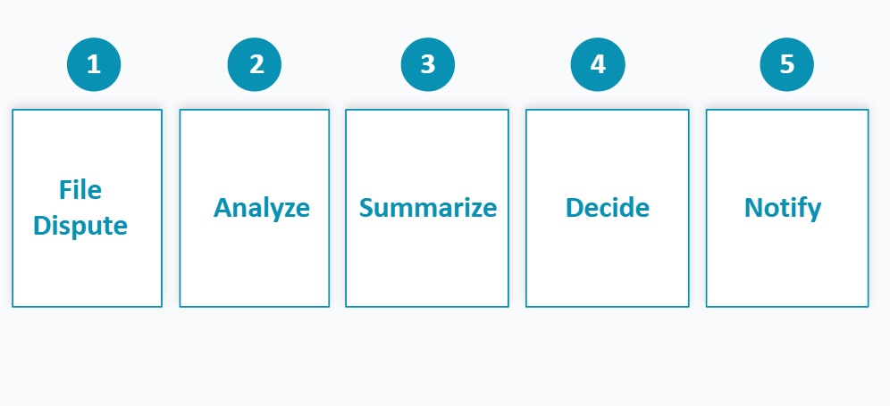
Pipeline Walkthrough

Slide 8
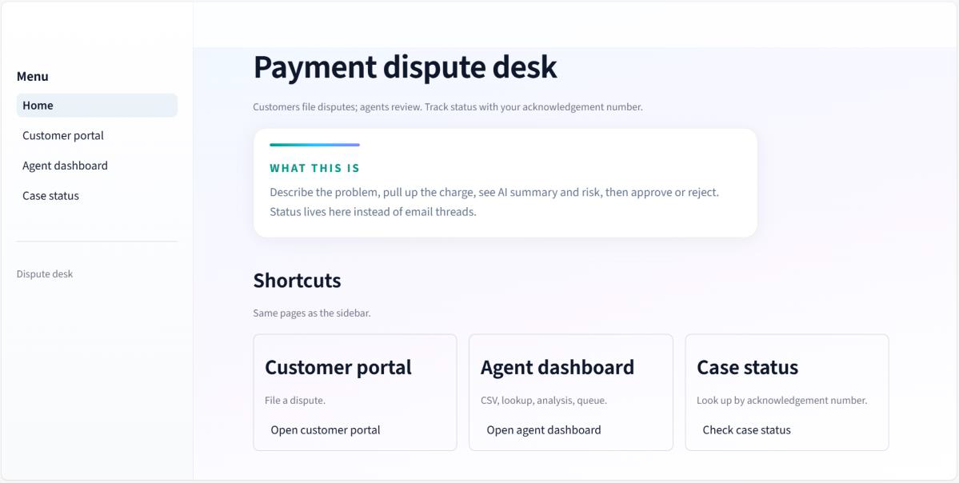
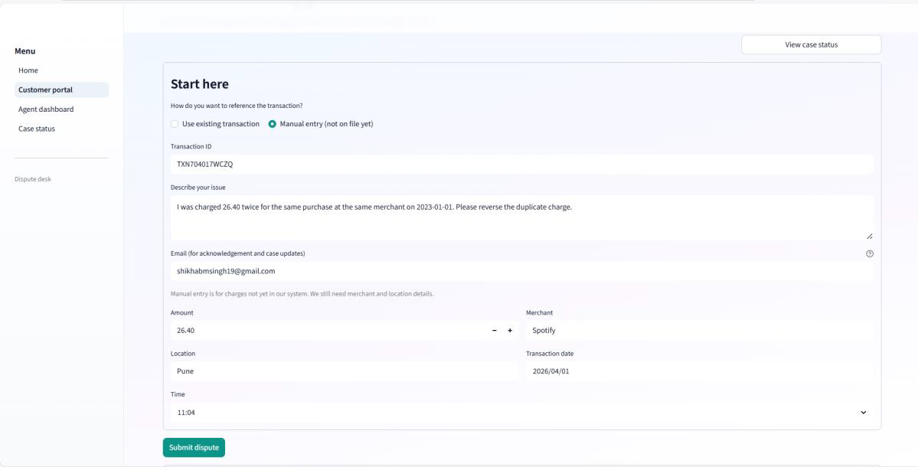
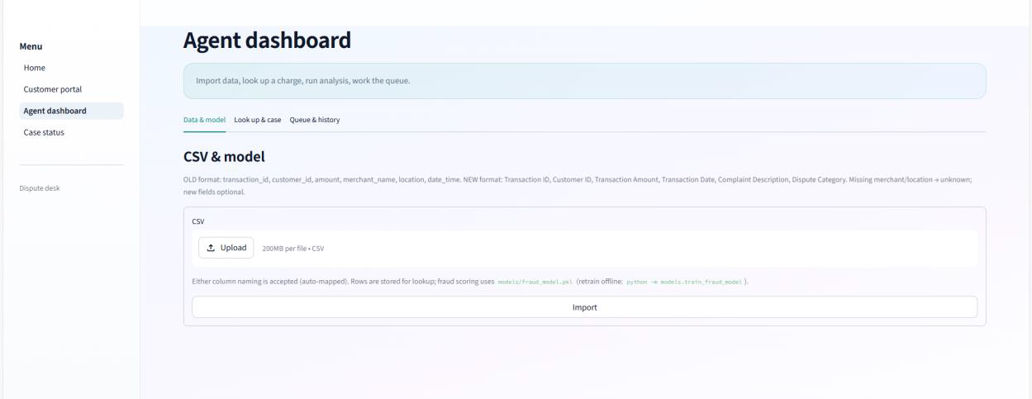
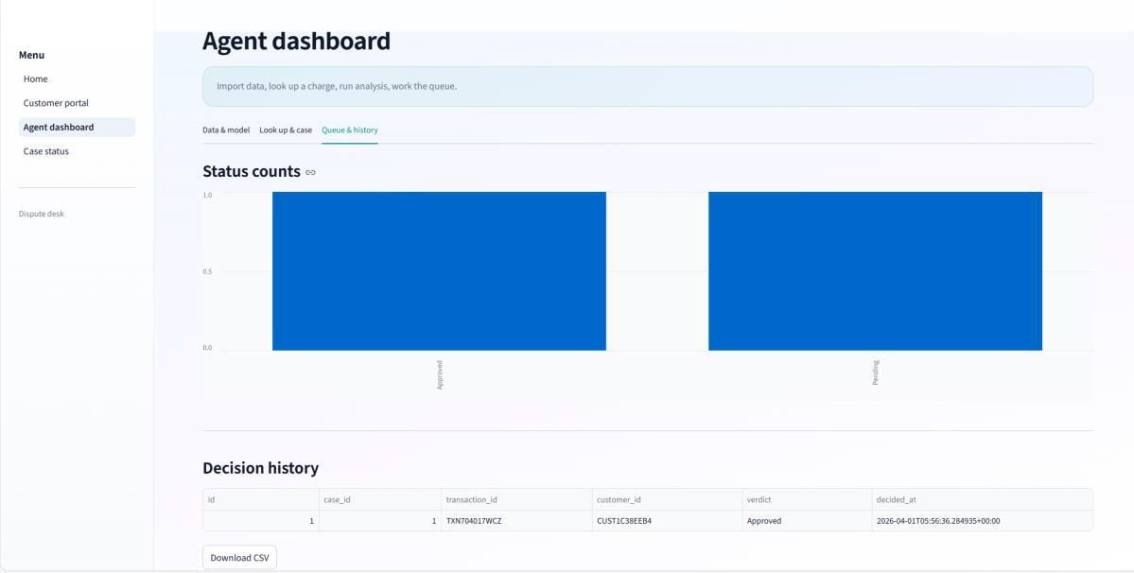

Slide 9
Fraud Risk Detection Model
Random Forest
Accuracy
81.2%
Precision
80.1%
Recall
84.6%
F1-Score
0.825
ROC-AUC
0.841

Slide 10
Edge Cases & Error Handling
Duplicate dispute request for same transaction ID → Check existing records before insert, block duplicates
Incomplete data → Validate required fields, show error message
Negative or zero transaction amount → Apply validation rule (amount > 0), reject input
Null values in fields → Use NOT NULL constraints, handle with default values
Wrong date format → Validate date format, convert or reject invalid input
Timeout during processing → Set timeout limit, retry request or show “Try again” message

Slide 11
Challenges Faced & Resolutions
Understanding project architecture design → Broke system into layers (UI, backend, database)
Working with external API (LLM integration) → Studied API usage and tested with sample requests
Ensuring smooth user navigation → Organized pages and added proper menu options
Understanding real-world dispute process → Studied banking workflow and designed system accordingly
Mapping user input to correct transaction → Implemented proper linking using transaction ID

Slide 12
Key Learnings
Technical Expertise Gained
System Design Insights
• ML pipelines with scikit-learn integration
• Integration of multiple AI/ML techniques
• NLP with spaCy for entity recognition
• Importance of data quality foundation for accuracy
• Fraud detection and risk scoring patterns
• End-to-end system thinking vs. isolated models

Slide 13
Future Improvements
Integrate with cloud services for scalability
Add security features
multiple languages for complaint analysis
Add voice input for complaints
Enable mobile app version of the system
Advanced fraud pattern detection

Slide 14
Transforming Dispute Resolution Through AI
Faster • Smarter • User Friendly
Thank You

