Slide 1
FACE RECOGNITION USING WEIGHTED SPARSE REPRESENTATION
Raheen Mazgaonkar
Shikha Mehta

Slide 2
MOTIVATION
Face recognition is one of the most intensively investigated topics in biometrics.
Law enforcement agencies over the world use biometric software to scan faces in CCTV footage and identify persons of interest in the field
Border control deployments use face recognition to verify the identities of travelers
We can also find many consumer applications in our day-to-day lives based on facial recognition, like selfie-based authentication on smartphones

Slide 3
PROBLEM STATEMENT
The identification of faces in face recognition has been addressed through different approaches according to –
chosen representation
design of the classification method
We will be focusing on Weighted Sparse Representation based Classification (WSRC), which involves –
implementing Sparse Representation based Classification (SRC)
improving it to integrate the locality structure of the data
From experimental results, we will evaluate the performance of WSRC in identifying human faces when compared with Nearest Neighbors, Nearest Feature Subspace, and SRC alone

Slide 4
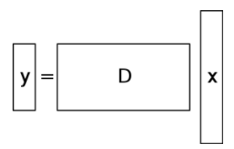
What we know
Sparse linear representations (i.e. x) w.r.t. overcomplete dictionary (D) of base vectors can be computed by convex optimization when the optimal representation is sufficiently sparse.
We therefore seek the sparsest solution x which is equal to solving the l⁰-minimization problem.
If the solution x₀ sought above is sparse enough, the solution of the l⁰-minimization problem (NP Hard) is equal to the solution given by l¹-minimization (P).

Slide 5
SPARSity in face recognition
In the context of face recognition, we represent the test sample (y) in an overcomplete dictionary (A) whose base elements are the training samples themselves.
A valid test sample y can be sufficiently represented as a linear combination of training samples of the same class as itself.
This representation is naturally sparse if the total number of object classes k is reasonably large, involving only a small fraction of the overall training database.

Slide 6
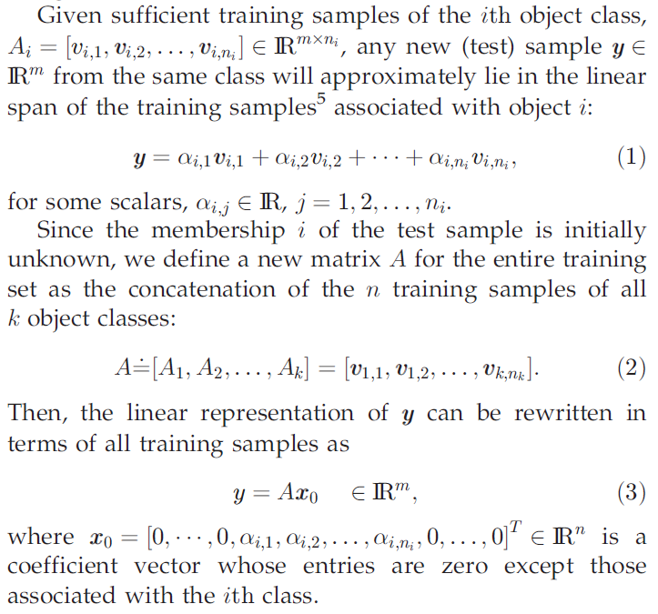

Slide 7
SOLUTION VIA L1-MINIMIZATION
m is typically less than n, making the system y = Ax underdetermined.
The more sparse the recovered x₀ is, the easier it will be to accurately determine the identity of the test sample y.
Therefore, we seek the sparsest solution to y = Ax.
Whenever y = Ax for some x with less than m/2 non-zeros, x is the unique sparsest solution.
To solve for this x in polynomial time, we use the following l¹-minimization

Slide 8
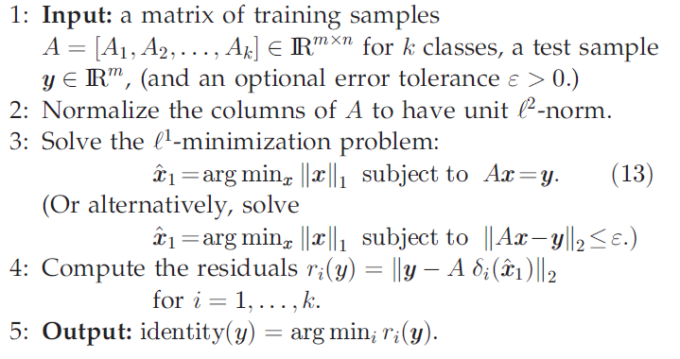
SPARSE REPRESENTATION BASED CLASSIFICATION (src)

Slide 9
ROLE OF FEATURE EXTRACTION
In traditional face recognition algorithms, choice of feature extraction technique plays an important role
This has led to development of various feature extraction methods such as eigen faces and fisher faces
In comparison, for SRC the choice feature space is not critical as long as the dimension of the feature space is large enough
However, applying feature extraction techniques reduces the data dimensions and thus reduces the computational cost.

Slide 10
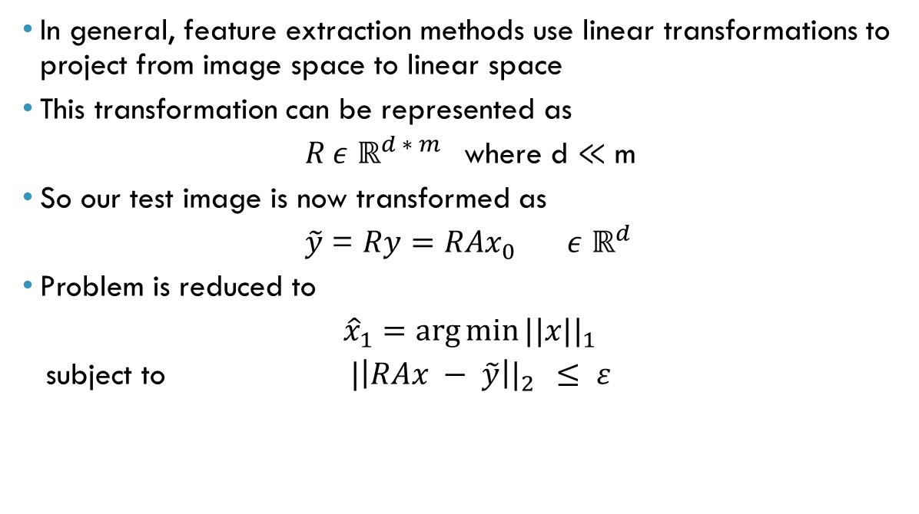
ROLE OF FEATURE EXTRACTION
In general, feature extraction methods use linear transformations to project from image space to linear space
This transformation can be represented as
$R ε {\text{ℝ}}^{d ∗ m }$ where d $≪$ m
So our test image is now transformed as
$\tilde{y}$ = $Ry=RAx_{0}$ $ε {\text{ℝ}}^{d }$
Problem is reduced to
${\hat{x}}_{1}=\arg{\min{{||x||}_{1}}}$
subject to ${|\left|RAx − \tilde{y}\right||}_{2 } ≤ ε$

Slide 11
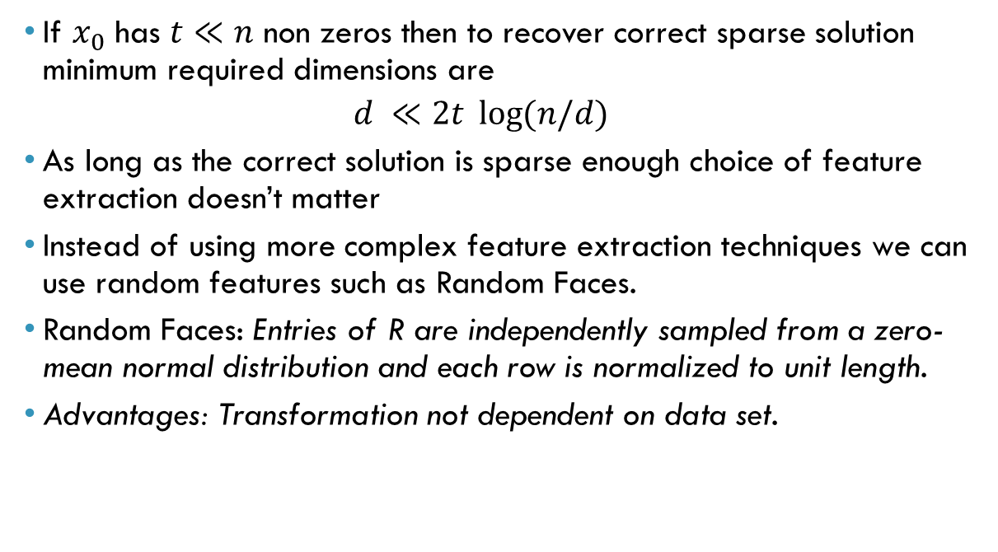
ROLE OF FEATURE EXTRACTION
If $x_{0}$ has $t≪n$ non zeros then to recover correct sparse solution minimum required dimensions are
$$d ≪2t \log{(n/d)}$$
As long as the correct solution is sparse enough choice of feature extraction doesn’t matter
Instead of using more complex feature extraction techniques we can use random features such as Random Faces.
Random Faces: Entries of R are independently sampled from a zero-mean normal distribution and each row is normalized to unit length.
Advantages: Transformation not dependent on data set.
Notes:
Consider a transform matrix R ∈ ℝd×m whose entries are independently sampled from a zero-mean normal distribution, and each row is normalized to unit length. The row vectors of R can be viewed as d random faces in ℝ^{m}

Slide 12
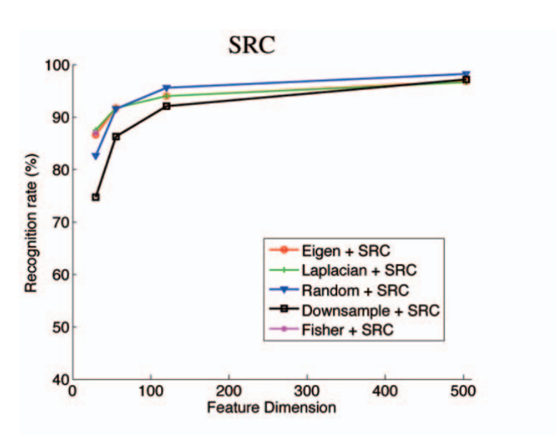
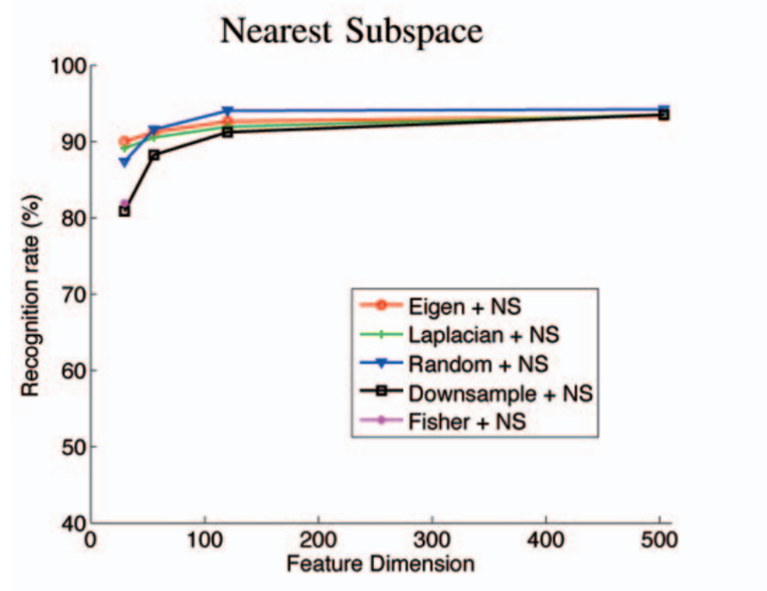
WHY WEIGHTED SRC?
If number of linear measurements is not large enough then SRC doesn’t perform well
Experimental Results: Yale Database B

Slide 13


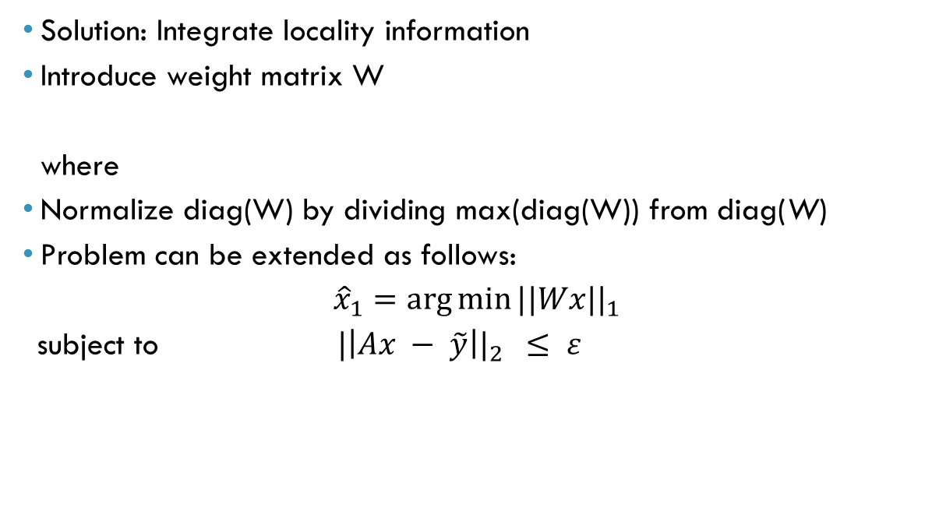
WEIGHTED SPARSE REPRESENTION BASED CLASSIFICATION (WSRC)
Solution: Integrate locality information
Introduce weight matrix W
where
Normalize diag(W) by dividing max(diag(W)) from diag(W)
Problem can be extended as follows:
${\hat{x}}_{1}=\arg{\min{{||Wx||}_{1}}}$
subject to ${|\left|Ax − \tilde{y}\right||}_{2 } ≤ ε$
Notes:
A larger dist(y,xic) indicates a farther distance between y and xic, it can well characterize the similarity between the test sample and training data.

Slide 14
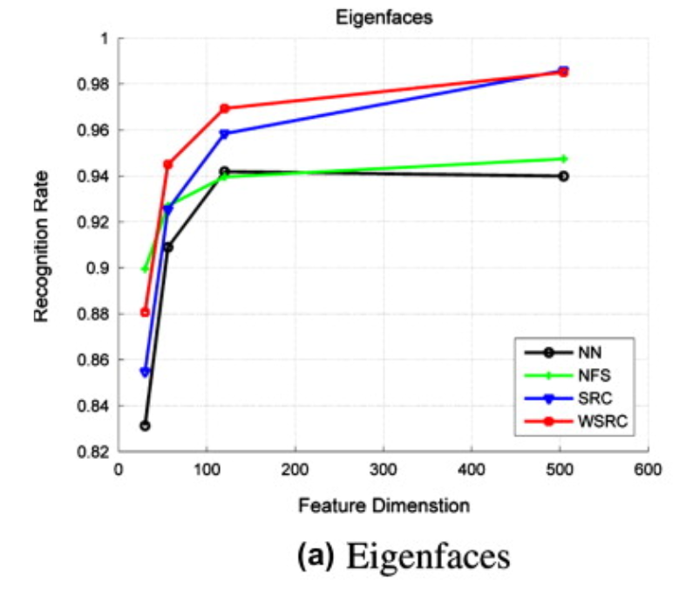
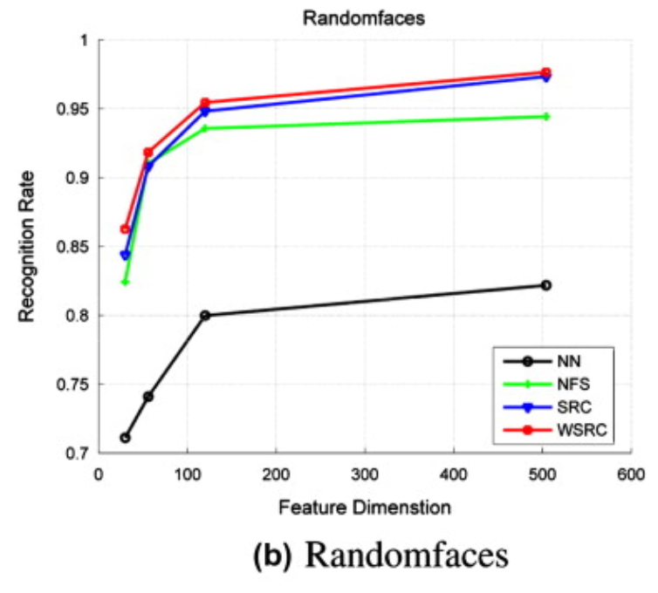
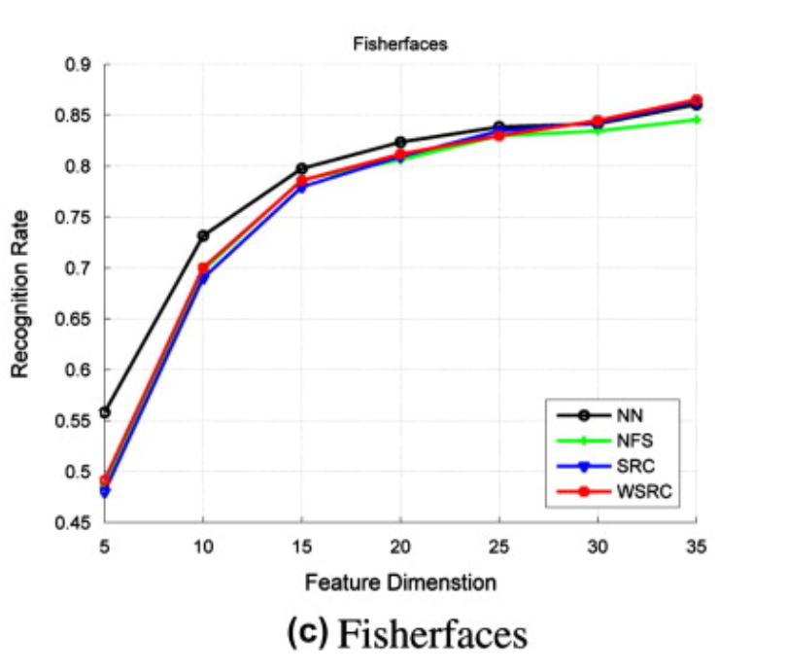

EXPERIMENTAL RESULTS – EXTENDED YALE B DATABASE
Consist of 2414 frontal face images of 38 individuals under different lightening conditions.
Parameters: $ε= {10}^{−4} \& s=1.5$
Notes:
Find a subspace that maps the sample vectors of the same class in a single spot of the feature representation and those of different classes as far apart from each other as possible

Slide 15
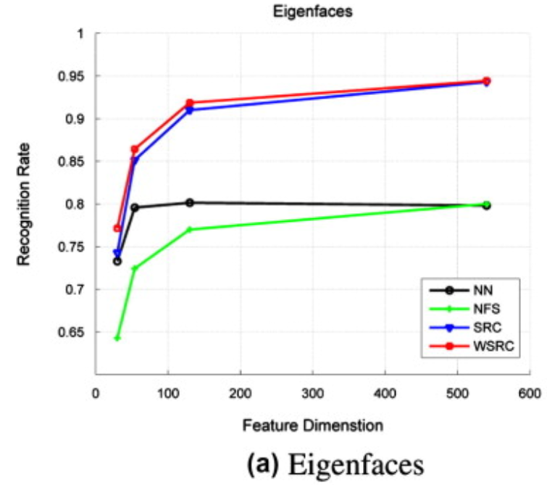
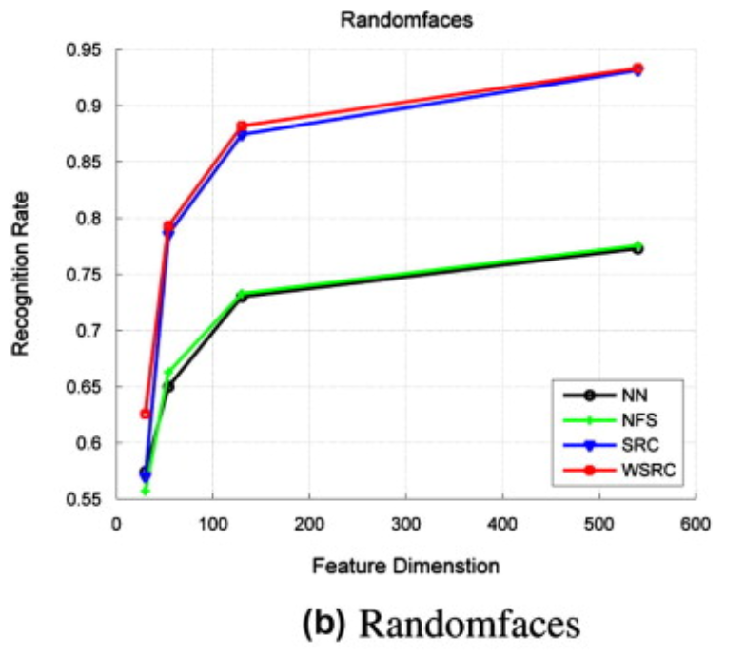
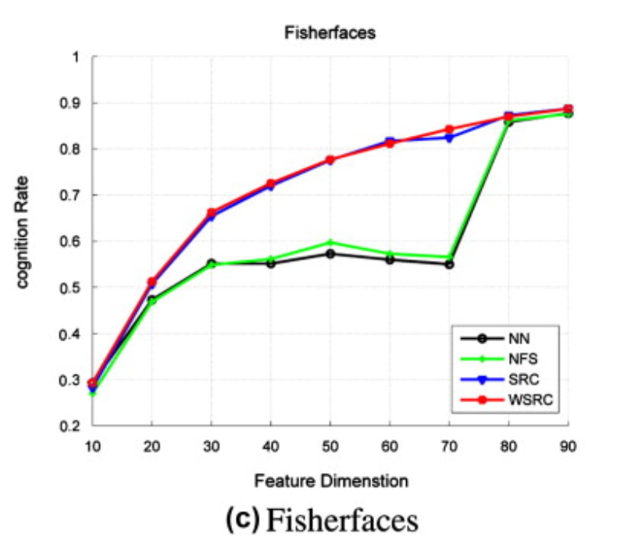

EXPERIMENTAL RESULTS – AR DATABASE
Consist of 4000 frontal face images of 126 individuals.
Subset of AR: 50 males & 50 females
Parameters: $ε= {10}^{−4} \& s=1.5$
Notes:
AR : These images include more facial variations, including illumination change, expressions, and facial disguises
Subset: illumination change, expressions,

Slide 16
THANK YOU

