Slide 1
What makes a movie click?
Factors affecting success and failure of movies
Shikha Chamoli, MSCS , IIT Chicago

Slide 2
Outline
Quantifying the success of a movie
Identifying the underlying factors
Demographic factors
Style factors
Genre
Plot
Factor Model:
Establishing a response variable
Objective : To explain the variance of the response variable
Identifying the shortcomings of the model
Conclusions:
What Strategies to follow
What to avoid

Slide 3

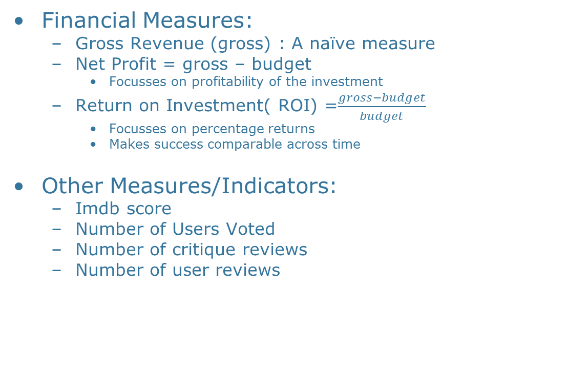
Quantifying Success
Financial Measures:
Gross Revenue (gross) : A naïve measure
Net Profit = gross – budget
Focusses on profitability of the investment
Return on Investment( ROI) =$\frac{gross−budget}{budget}$
Focusses on percentage returns
Makes success comparable across time
Other Measures/Indicators:
Imdb score
Number of Users Voted
Number of critique reviews
Number of user reviews

Slide 4
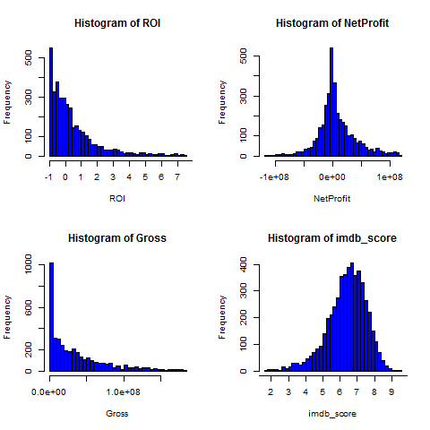
Quantifying Success
ROI & Gross: Looks like right skewed with a thin tail.
Net Profit : Looks normally distributed around 0
Imbd Score: Looks normally distributed around 6.5

Slide 5
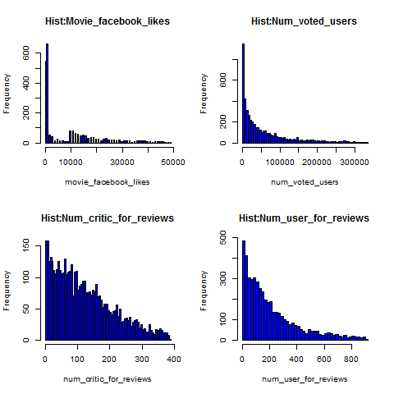
Quantifying Success
Movie FB likes : No Information
NumVotedUsers & numUserReviews:
Has similar distribution to ROI
NumCriticReviews:
Looks somewhat correlated to ROI

Slide 6
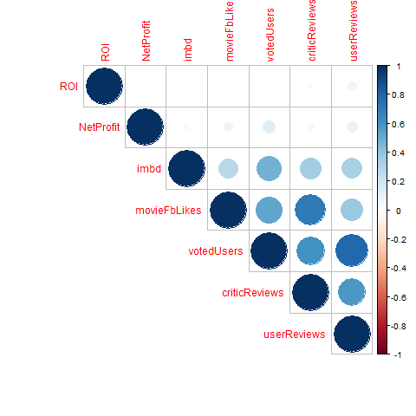
Quantifying Success
Correlation Plot for various variables:
Establishes that ROI and NetProfit are indeed positively correlated with all the other indicators.
Confirms our observations of similar distributions in previous slides.

Slide 7
Identifying Factors: Demographics
Language:
Among 5043 data points, 3707 are of English
Other 37 languages have very small number of movies.
Statistical Conclusions:
Most conclusions will be dominated by English movies
Wouldn’t really apply to other language movies.
Country:
Among 5043 data points, 3074 are made in USA:
Other 116 countries have relatively small number of movies.
Statistical Conclusions:
Most conclusions will be dominated by American movies
Wouldn’t really apply to other language movies.
Content Rating:
GP and M are both (now) PG-13 standard which is of moderate impact
Data says, that these are the movies that do best business
content_rating | Med_ROI | Med_NetProfit
G | 0.3402045 | 13696761
X | 3.3941449 | 11405307
Approved | 4.0833333 | 26635000
GP | 5.0833333 | 36600000
Passed | 6.408971 | 4231215
M | 9.1543131 | 56054450

Slide 8
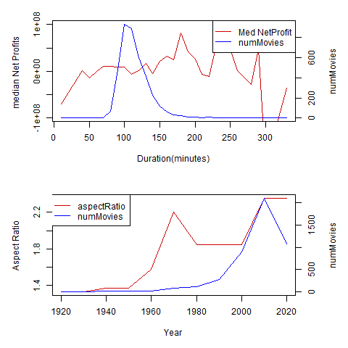
Identifying Factors: Style
Color: Almost all data is for color movies
Duration:
Bulk of the movies are of length 90 to 150 mins
Longer (100-200) are slightly better (Net Profits wise)
Aspect Ratio: Mostly irrelevant,
has gradually changed over years.

Slide 9
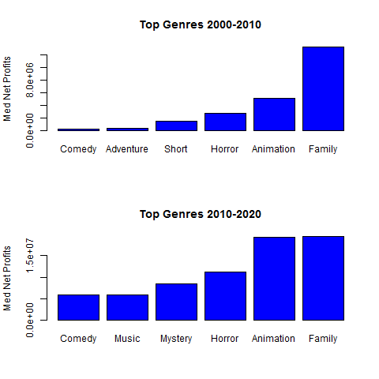
Identifying Factors: Genre
Top Genres By Net Profit
Genre | Med_ROI | Med_NetProfit | numMovies
Adventure | 0.062 | 2853933 | 795
Music | 0.318 | 3946250 | 161
Fantasy | 0.131 | 4976634 | 517
Horror | 0.490 | 6753840 | 397
Animation | 0.200 | 11571351 | 199
Family | 0.314 | 14008741 | 453
Key Observations:
For high budget, Animation and Family are best (for business)
For constrained budget, Horror and Short Movies are best
Animations: Business wise this Genre has picked a lot after 2010, and as of now it is as big as Family
Top Genres By ROI
Genre | Med_ROI | Med_NetProfit | numMovies
Comedy | 0.195 | 2690677 | 1511
Animation | 0.200 | 11571351 | 199
Family | 0.314 | 14008741 | 453
Music | 0.318 | 3946250 | 161
Horror | 0.490 | 6753840 | 397
Short | 4.533 | 909267 | 2

Slide 10
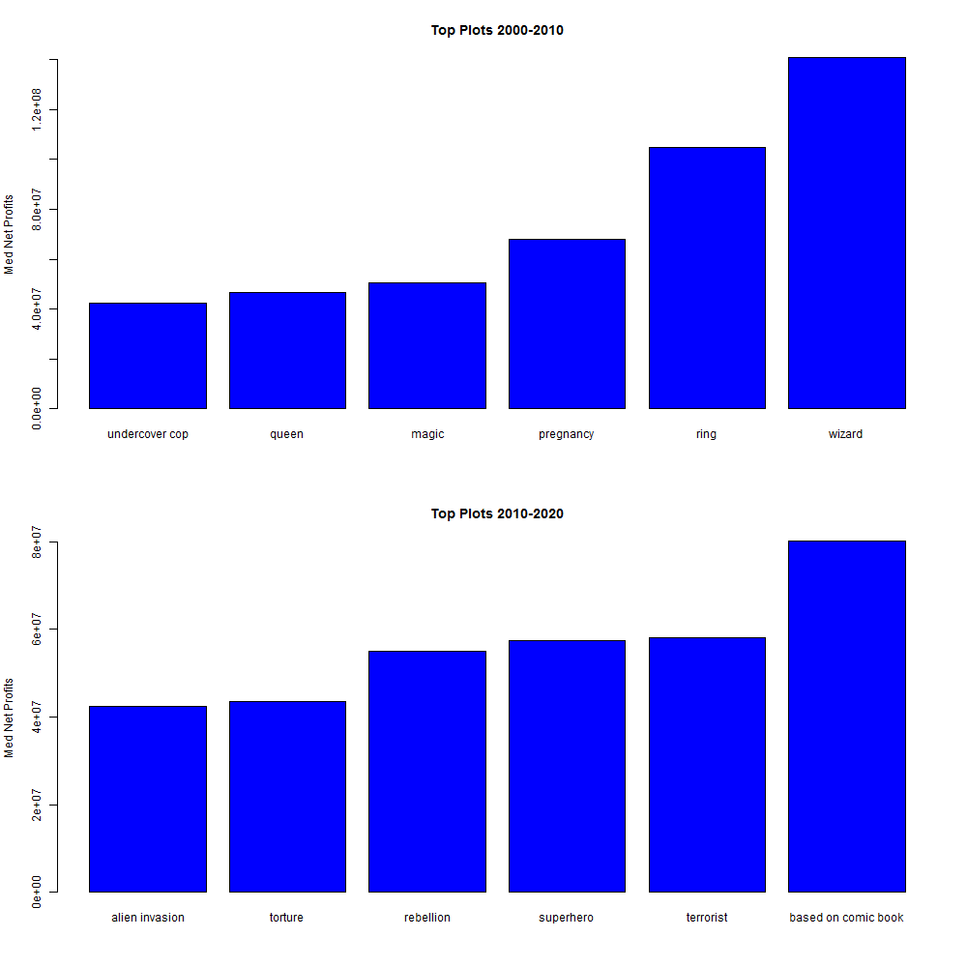
Identifying Factors: Plot
Top Plots by Number of movies
Plot | Med_ROI | Med_NetProfit | numMovies
new york city | 0.09726693 | 308707 | 75
police | 0.114865 | 1239558 | 93
death | 0.02067494 | 682273 | 105
murder | -0.1171151 | -2057591 | 132
friend | 0.3522218 | 1727544 | 137
love | -0.1035104 | -744000 | 155
Key Observations:
2000-10: Most important plots words are ring and wizard
Its probably dominated by LOTR, and Harry Potter (both mega hits)
Post 2010 :
Most popular plot is from comic books and superheros
Terrorist plot has gained importance: Reflects fear in society
Popular among movie makers BUT Bad:
Love, murder , death : People have had enough of these plots

Slide 11
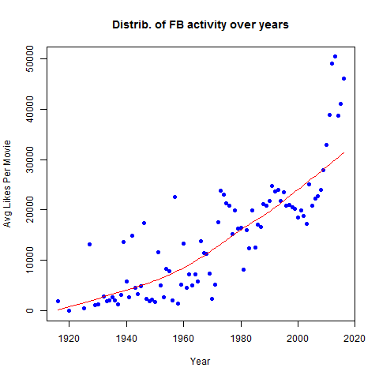
Identifying Factors: Facebook
Key Observations:
Facebook didn’t exist before 2005, but people now can still vote for a 1960 movie
Activity in new movies are far more than those in old movies (non-linearity is clearly visible)
Further analysis in Model

Slide 12
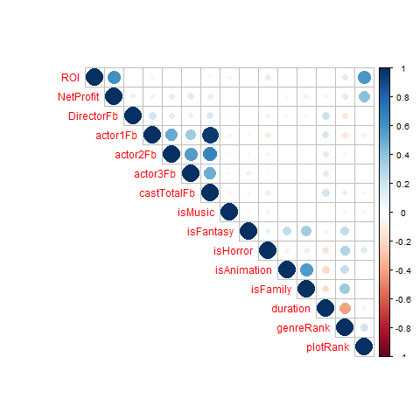
Factor Model:
Genre and Plot both look important but to quantify its importance, I have created 2 factor
GenreRank: WghtAvg of ROI of Movies in a given genre
PlotRank: WghtAvg of ROI of Movies with a given plot
Factor Correlations:
Use these to eleminate
Correlated factors
Lack of inter factor
Correlations is good

Slide 13
Factor Model: Continued
Two Models :
Model 1 : for predicting ROI
Model 2 : for predicting NetProfit
X Variables:
FB likes of director, actor , cast
Indicator variables for popular genres
PlotRank
GenreRank
Model 1 (Post dropping weak factors):
ROI ~ DirectorFb+isMusic+isFantasy+isHorror+plotRank
Model 2 (Post dropping weak factors):
NetProfit ~ DirectorFb +castTotalFb+isHorror+isFamily+genreRank+plotRank
Model 1 |  | R2=0.33 | F-stat 384
Estimate | Std. Error | t value | Pr(>|t|)
1.59E-01 | 3.82E-02 | 4.162 | 3.22E-05
2.05E-04 | 6.28E-05 | 3.268 | 0.00109
3.08E-01 | 1.44E-01 | 2.149 | 0.03169
-1.75E-01 | 8.42E-02 | -2.076 | 0.03796
3.14E-01 | 9.59E-02 | 3.274 | 0.00107
2.82E+00 | 6.63E-02 | 42.467 | < 2e-16
Model 2: |  | R2 = 0.33 | F-stat 171
Estimate | Std. Error | t value | Pr(>|t|)
-6776650.7 | 961551 | -7.048 | 2.14E-12
8521.5 | 1313.5 | 6.487 | 9.83E-11
406.8 | 50.9 | 7.991 | 1.75E-15
-4450913.3 | 2089053.7 | -2.131 | 0.0332
6363528.9 | 2003254.7 | 3.177 | 0.0015
31433483.2 | 7941473.8 | 3.958 | 7.69E-05
39408330.5 | 1379601.8 | 28.565 | < 2e-16

Slide 14
Conclusion: Strategy
US remains the biggest market :
So make a movie for this market
English remains the most dominant language.
No point considering foreign language
High Budget :
For High Budget Project Stick to Genres like Family and Animations
These Genres have low ROI , but they do a lot more volume, and Net Profit is higher
Low Budget :
Stick to genres like Horror and Short films
These have high ROI but need less investment and are smaller scale projects
Once Decided on budget, and demography:
Use both the Regression Models to Optimally choose the plot , director and story line.
Use both the models to gain an insight on how much investment and ROI potential should be expected from any given existing project.

Slide 15
Thank You
Please also read a supplementary report that I am submitting with this presentation

Slide 16
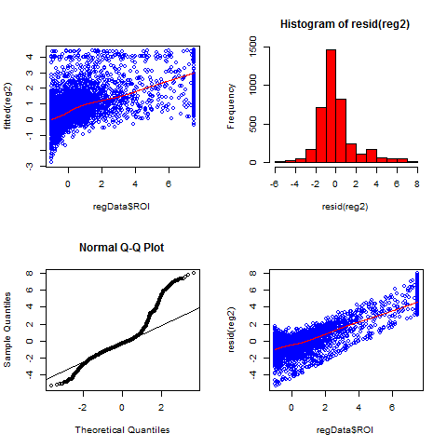
Appendix: Reg1 : Residuals
Plot1 : Y vs Fitted : Shows model has strength
Plot2 : Hist of Resid : resembles normality
Plot3 : QQ plot of resid: Close to normal
Plot4 : Should ideally be horizontal: Data not nice.

Slide 17
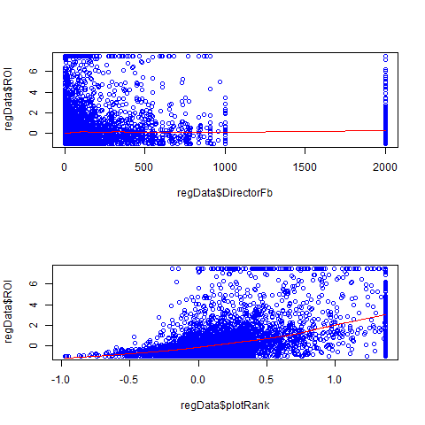
Appendix: Reg1 : XY-plots
Plot1 : ROI vs DirectorFB :
Relation is weak (possibly the reason behind low R-sq)
DirectorFb even if bounded has serious outlier problems
Plot2 :ROI vs PlotRank:
Mild Non linearity, but there is clear relationship.

Slide 18
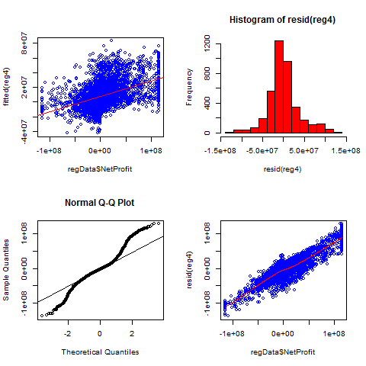
Appendix: Reg2 : Residuals
Plot1 : Y vs Fitted : Shows model has strength
Plot2 : Hist. of Resid : resembles normality
Plot3 : QQ plot of resid: Close to normal
Plot4 : Should ideally be horizontal: Data not nice.

Slide 19
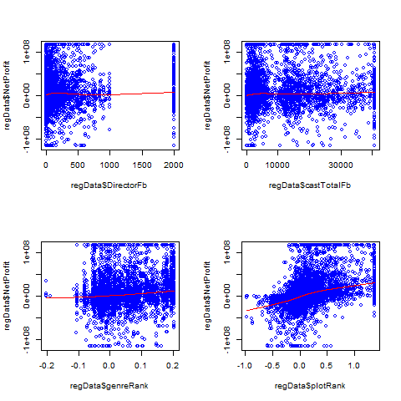
Appendix: Reg2 : XY-plots
Plot1 ,Plot2: NetProfit vs DirectorFB, castTotalFb likes:
Relation is weak (possibly the reason behind low R-sq)
Outliers remain problem
Plot2 :NetProfit vs GenreRank, PlotRank:
GenreRank: Mild relationship. Weak factor.
PlotRank : Some Non linearity, but clear relationship.

Slide 20
Appendix: Reg: Key Remarks
The most important factors (based on t-stat) is the plotRank.
One needs to have a good story line and plot.
ROI Model (by t-stat ):
Horror Genre: Most important Genre for high ROI,
Somewhat important in the NetProfit model too.
Net Profit Model (by t-stat):
Family Genre : Most Important Genre for high NetProfit
Not important to ROI model
The above conclusions are in sync with the genre and plot analysis done earlier(Slide9,10)
Quality of data :
Over all quality of data is poor,
Deploying even more advance Datamining skills may not be of much help.
Data suffers from a lot of outliers
High Fstat of both models (ROI and NetProfit):
Shows that the regression models are valid
Near normal residual QQ plots in both regressions:
Further confirms that model assumptions are satisfied and model is valid.

