Slide 1

MEDICAPS UNIVERSITY
INTERNSHIP DONE FROM TCS
SUBMITTED BY:-
Shikha Sharma (EN16CS301243)
Shikhar Sharma (EN16CS301244)
Shubham Trivedi (EN16CS301258)
Yash Rathi (EN16CS301294)
Yash Upadhyay (EN16CS301295)

Slide 2
Predictive Analytics for Breast Cancer Detection
Team members and their roles:
Shubham Trivedi –Model Selection
Shikhar Sharma - Data Pre-processing
Shikha Sharma – Data Visualization and Flask workouts
Yash Upadhyay –Azure Model Deployment and model selection
Yash Rathi – Model Selection

Slide 3
Introduction
Breast cancer unarguably has been the very prominent disease amongst women as well as the next dangerous after lung cancer.
So there’s an need to develop an automated system based on machine learning techniques to detect breast cancer early.

Slide 4
Project Objective:
Our project objective is to predict through data whether a person is having breast cancer or not that is Malignant or Benign.
Also since such health issues need to be handled accurately we need to be more accurate with our results.
It’s a two class classification problem

Slide 5
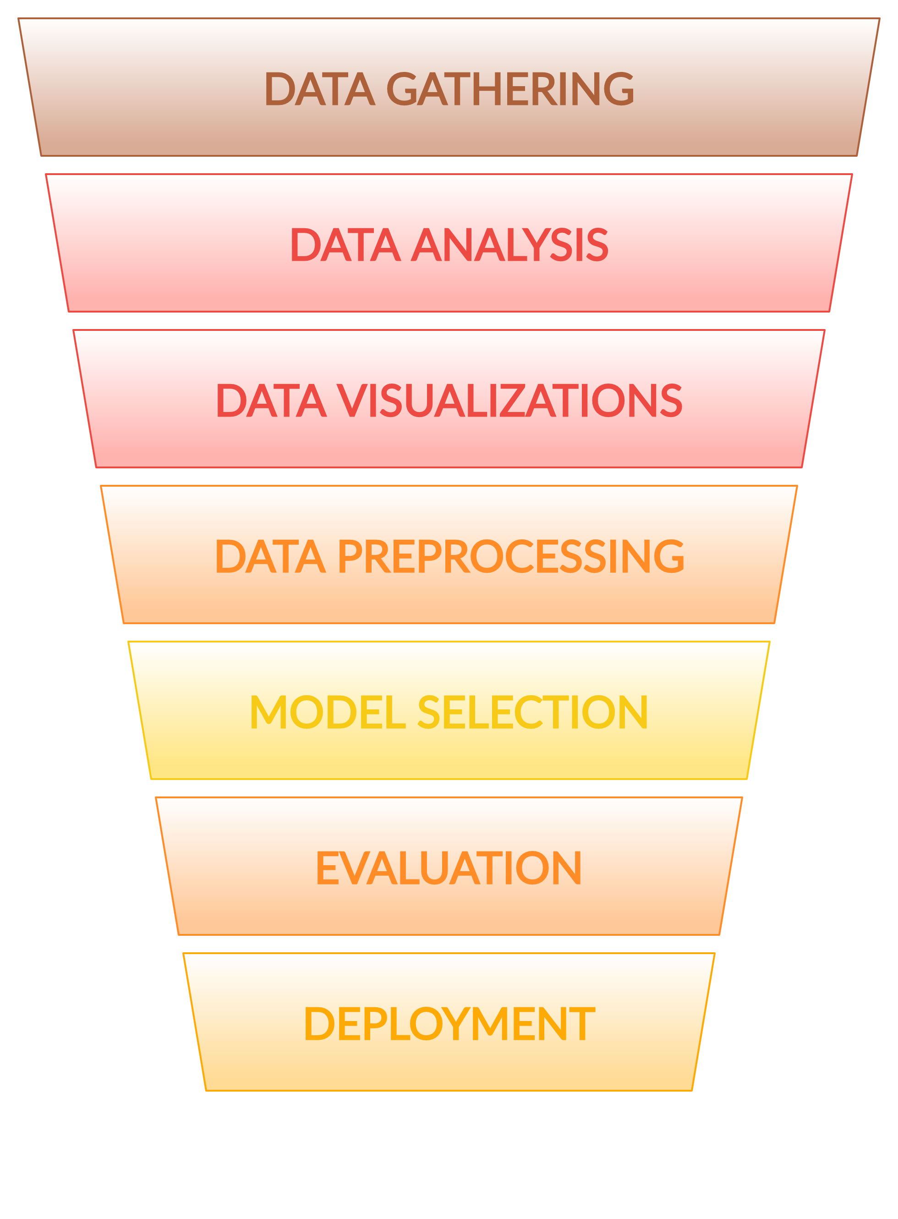
Plan of action:
Data Gathering
Data Pre-processing and Visualizations
Model Selection
Model Evaluation
Web service deployment
Azure Deployment

Slide 6
Initialization and data gathering
For starting our project the first motto was to identify a dataset which can be used for training the model.
For searching dataset we referred to research papers and the data which was suggested was “Wisconsin Breast Cancer Diagnostic Dataset” collected from UCI Learning Repository
Wisconsin Breast Cancer dataset is for diagnostic purposes which includes 32 features or we can say columns and 569 instances. http://archive.ics.uci.edu/ml/datasets/breast+cancer+wisconsin+(diagnostic)

Slide 7
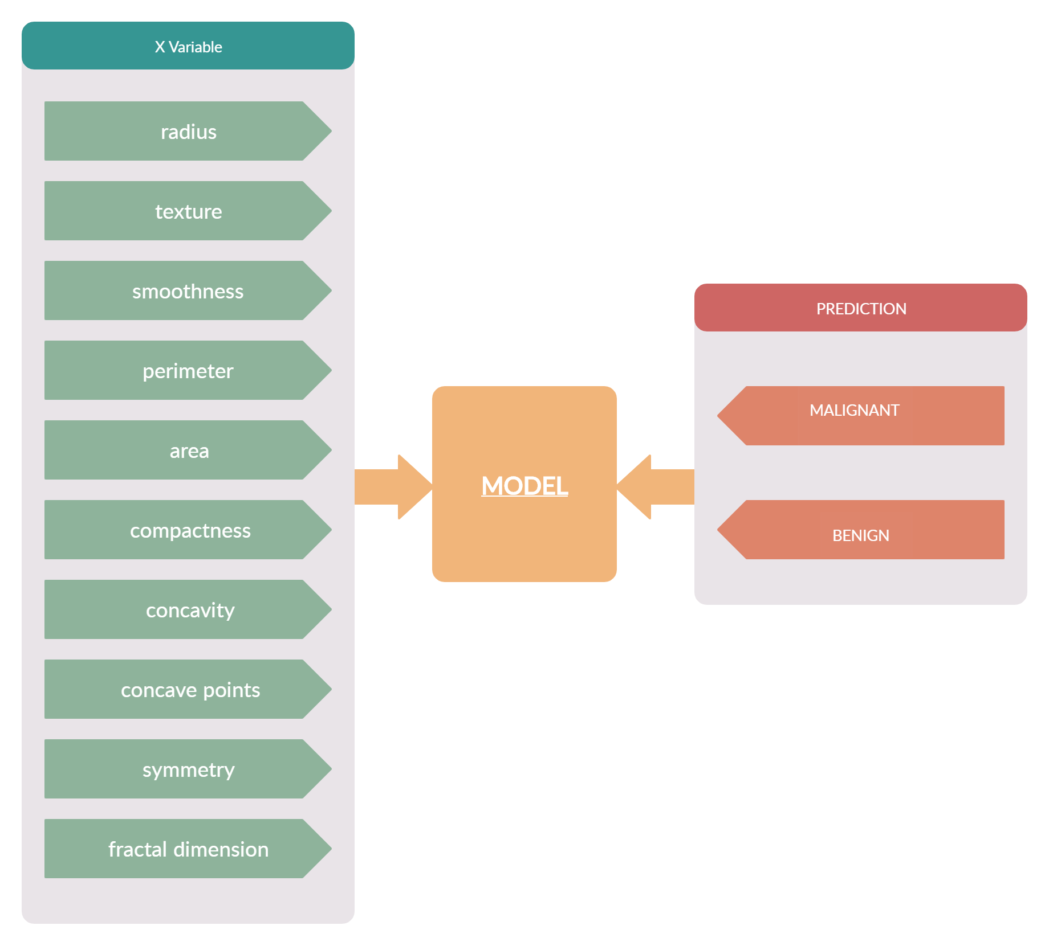
Features of Dataset

Slide 8
Data analysis
The dataset includes 33 columns out of which diagnosis is the target variable and the rest are the features which are used to diagnose cancer
The other features are – radius, area, perimeter, concavity, texture, fractal dimension, compactness, concave points , smoothness, symmetry and the features include their mean , se, and worst figures.

Slide 9
Data Visualization
We have used boxplot to determine the outliers in the data
Heatmap to determine the covariance of features among themselves and also the target variables.
Dist-plot to get an idea of distribution of features hued with respect with target variable
Count-plot corresponding to target variable
Scatter plot to determine correlation between variables.
Bar plot to determine the correlation between variables.
Missing values plot to know the missing values.

Slide 10
Data Preprocessing
Data pre-processing as we know is what consumes 80% of time. The data pre-processing steps taken are-
1) Label Encoding of diagnosis column as it includes M and B for Malignant and Benign.
2) Using covariance matrix or we can say heatmap determine features relationship amongst each other.
3) Removing outliers using interquartile range and Imputing missing values
4) Normalizing the data using Minmax Scaler
5) Dimensionality Reduction using PCA
6) Splitting data into test and train

Slide 11
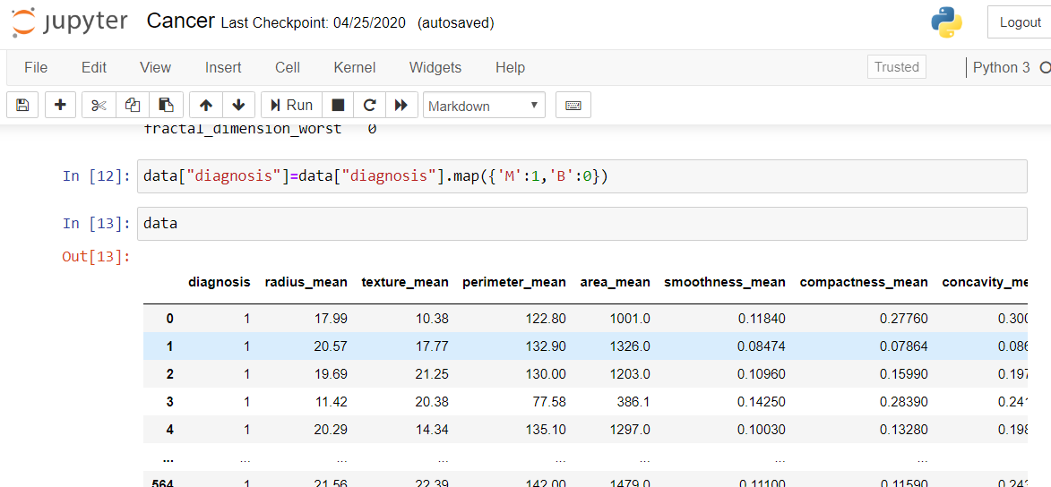
Label Encoding of diagnosis column as it includes M and B for Malignant and Benign
Label Encoding

Slide 12
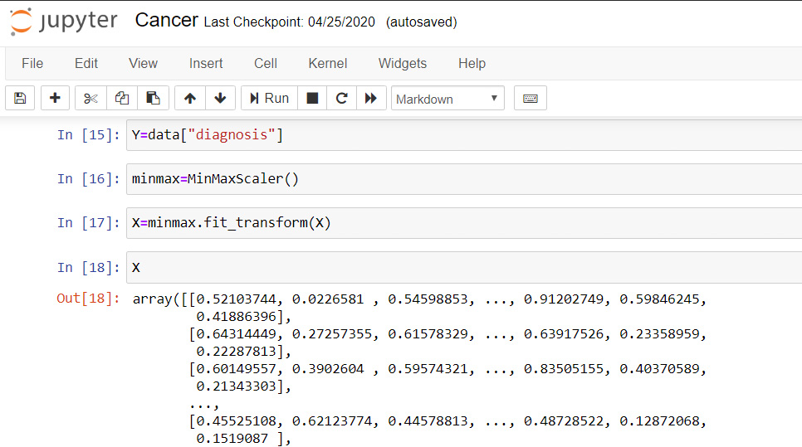
Scaling Data

Slide 13
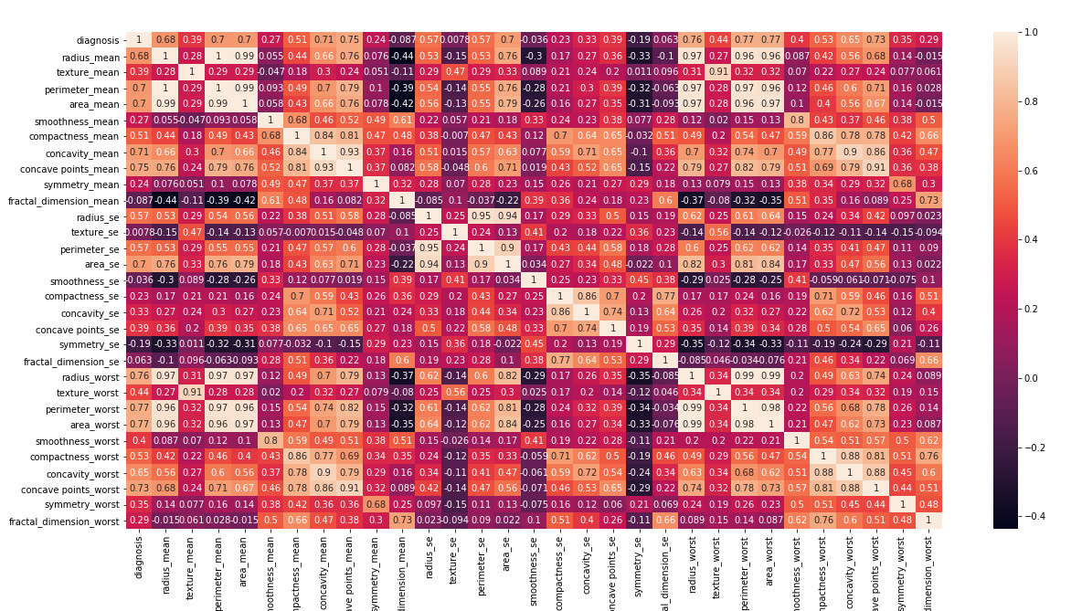
Feature Selection using heatmap

Slide 14
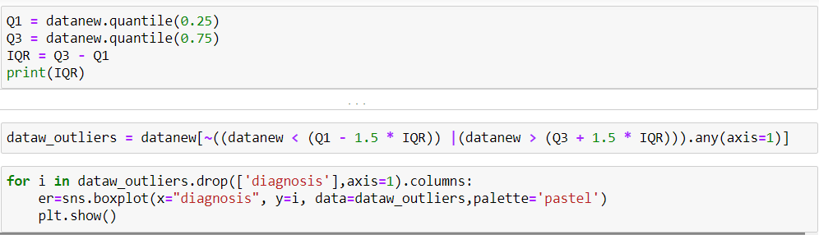
Removing outliers
Using IQR

Slide 15
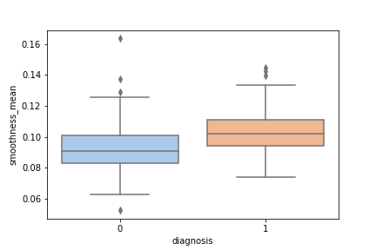
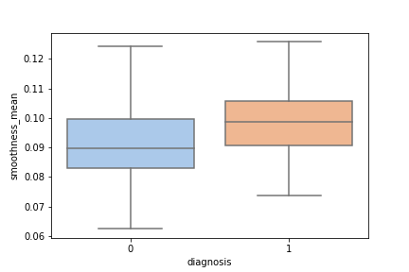

Slide 16
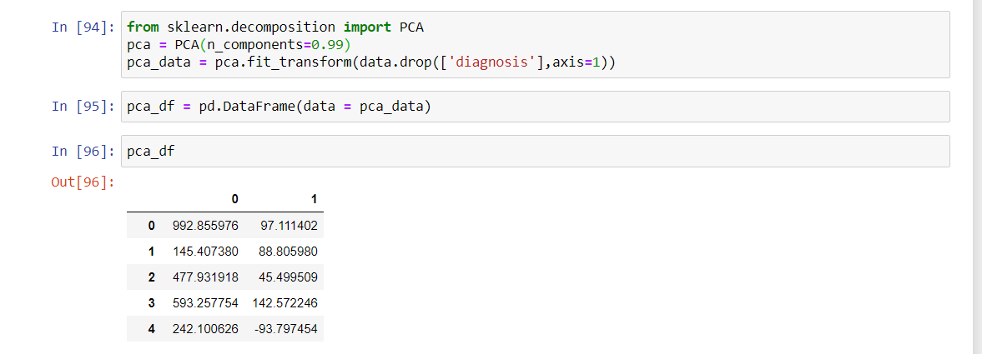
Dimensionality Reduction

Slide 17
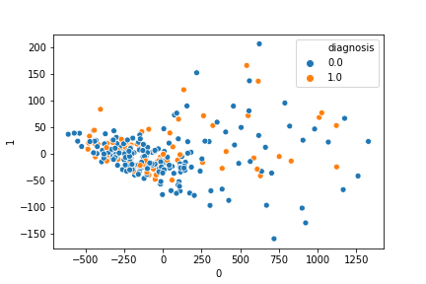
Scatterplot for principal components
Principal Component 2
Principal Component 1

Slide 18
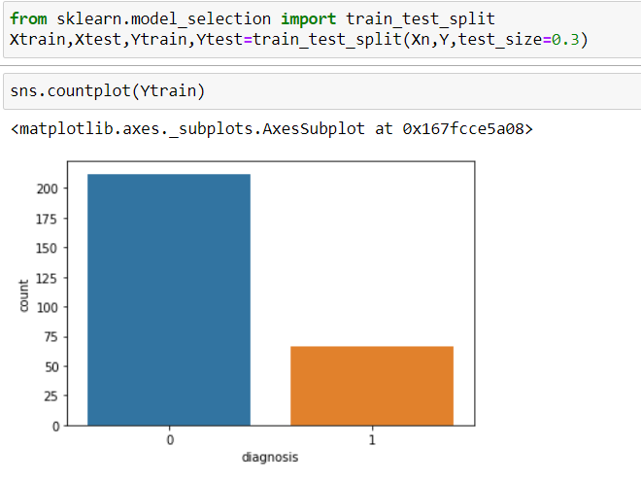
Split Data Into Train Test Sets

Slide 19
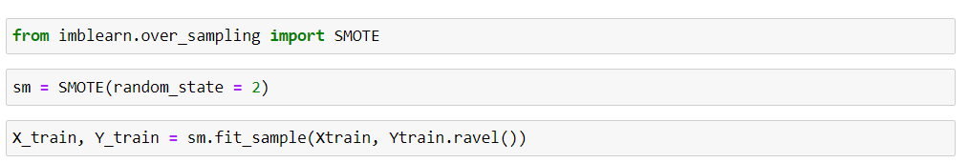
SMOTE
Synthetic Minority over-sampling technique used to handle imbalanced datA

Slide 20
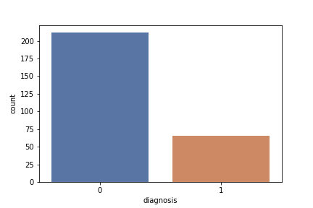
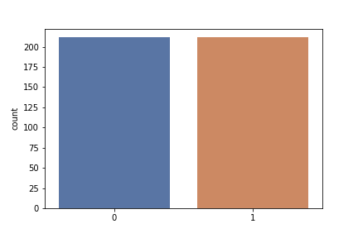

Slide 21
Model Creation
For model creation we had many options available we used these models to determine which worked the best in our case-
Support Vector Machine
Naïve Bayes
Logistic Regression
Ada-boost
Decision Tree
Random Forest

Slide 22
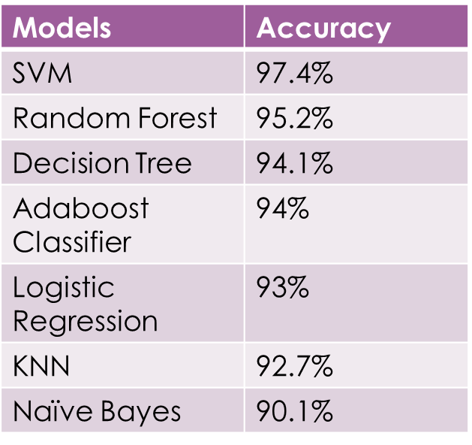
Model Accuracies

Slide 23
Hyperparameter Tuning
Since parameter plays a major role in determining the accuracy of the model so its necessary to provide a value to parameter such that it increases the accuracy of the model.
The best way of hyperparameter tuning is using GridSearch. We used GridSearchCV from sklearn.model_Selection for the purpose of hyperparameter tuning.
In GridSearch we provide some parameters as candidates and the GridSearchCV provides the best estimators out of them.

Slide 24
Pipelining
Pipelining is the last step of our model Pipelining can be build using make_pipeline or passing steps to pipeline constructor.
A machine learning pipeline is used to help automate machine learning workflows. They operate by enabling a sequence of data to be transformed and correlated together in a model that can be tested and evaluated to achieve an outcome, whether positive or negative.
Machine learning (ML) pipelines consist of several steps to train a model. Machine learning pipelines are iterative as every step is repeated to continuously improve the accuracy of the model and achieve a successful algorithm. To build better machine learning models, and get the most value from them, accessible, scalable and durable storage solutions are imperative, paving the way for on-premises object storage.

Slide 25
Web App Creation
For web app creation we have used flask and pickle.
Pickle is used to create our machine learning models dot pkl file which can further be used for prediction.
Flask is used for linking our web app with model.
Flask is used to take the data from user from front end and then provide that data to our model so that it can predict and further operations like what is to be shown to the user can be performed.

Slide 26
Flask File Structure
The necessary elements are-
Static Folder – Exists in the root directory. This contains all your static assets like css file, images , fonts.
Template Folder – Exists in the root directory. It is the default location where all html files must be present.
index.html- This is the first file which includes our form and where users interact
app.py – Exists in the root directory this file acts as the link between user and our model.
app.py takes the data from the user and give it to our pickle model file which then further provides the prediction results.

Slide 27
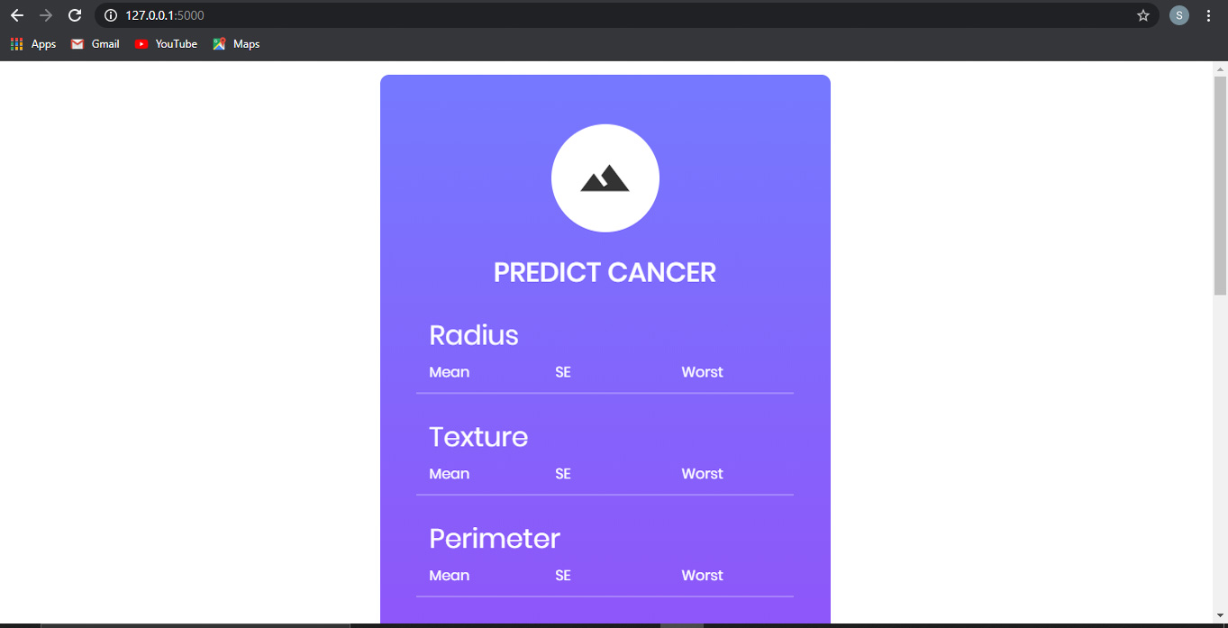
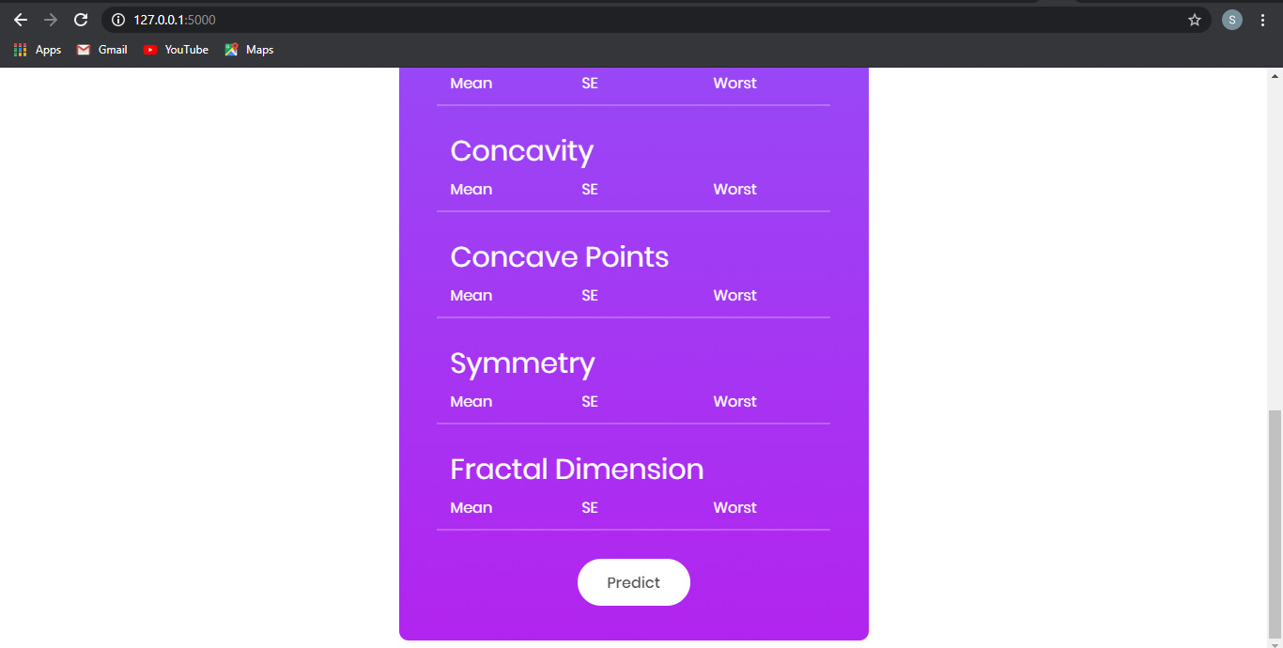
Web App Screenshots

Slide 28
Azure Deployment
Microsoft Azure is one of the most suitable and easy to use platform for data pre-processing , applying model ,evaluation of model and also to generate an API to be further used for prediction or analysis.
Azure provides an drag and drop feature which makes it easier to use.
To use azure for your machine learning perspectives firstly you need to create a resource group and then you need to create a machine learning studio classic workspace then an experiment where we will be performing our workouts.

Slide 29
Steps followed for Azure -
Import the dataset
Clean Missing values
Edit Metadata
Normalize data
Apply Train Test split
Model selection SVM in our case
Train your model
Score Model
Evaluate Model
For better accuracy perform hyperparameter tuning by providing a range of parameters
Evaluate your model using request response and also using batch execution

Slide 30
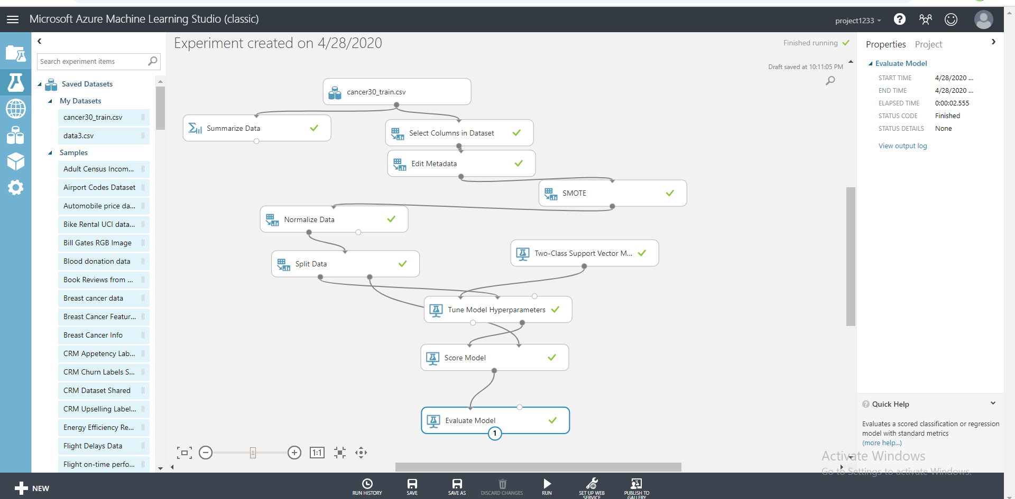

Slide 31
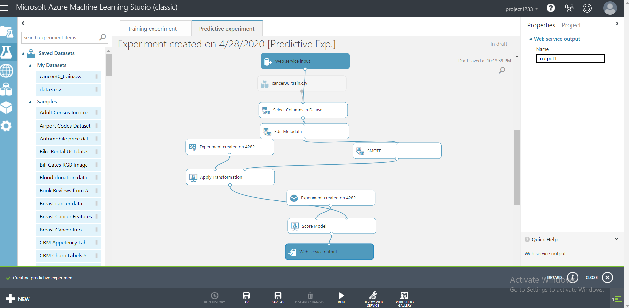

Slide 32
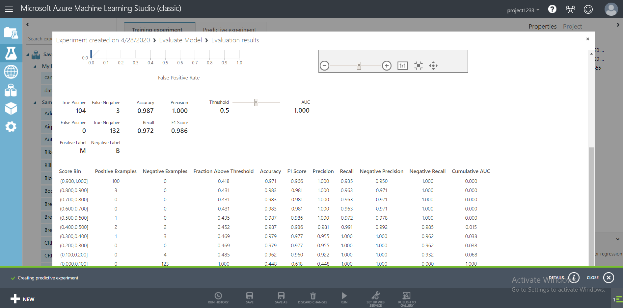

Slide 33
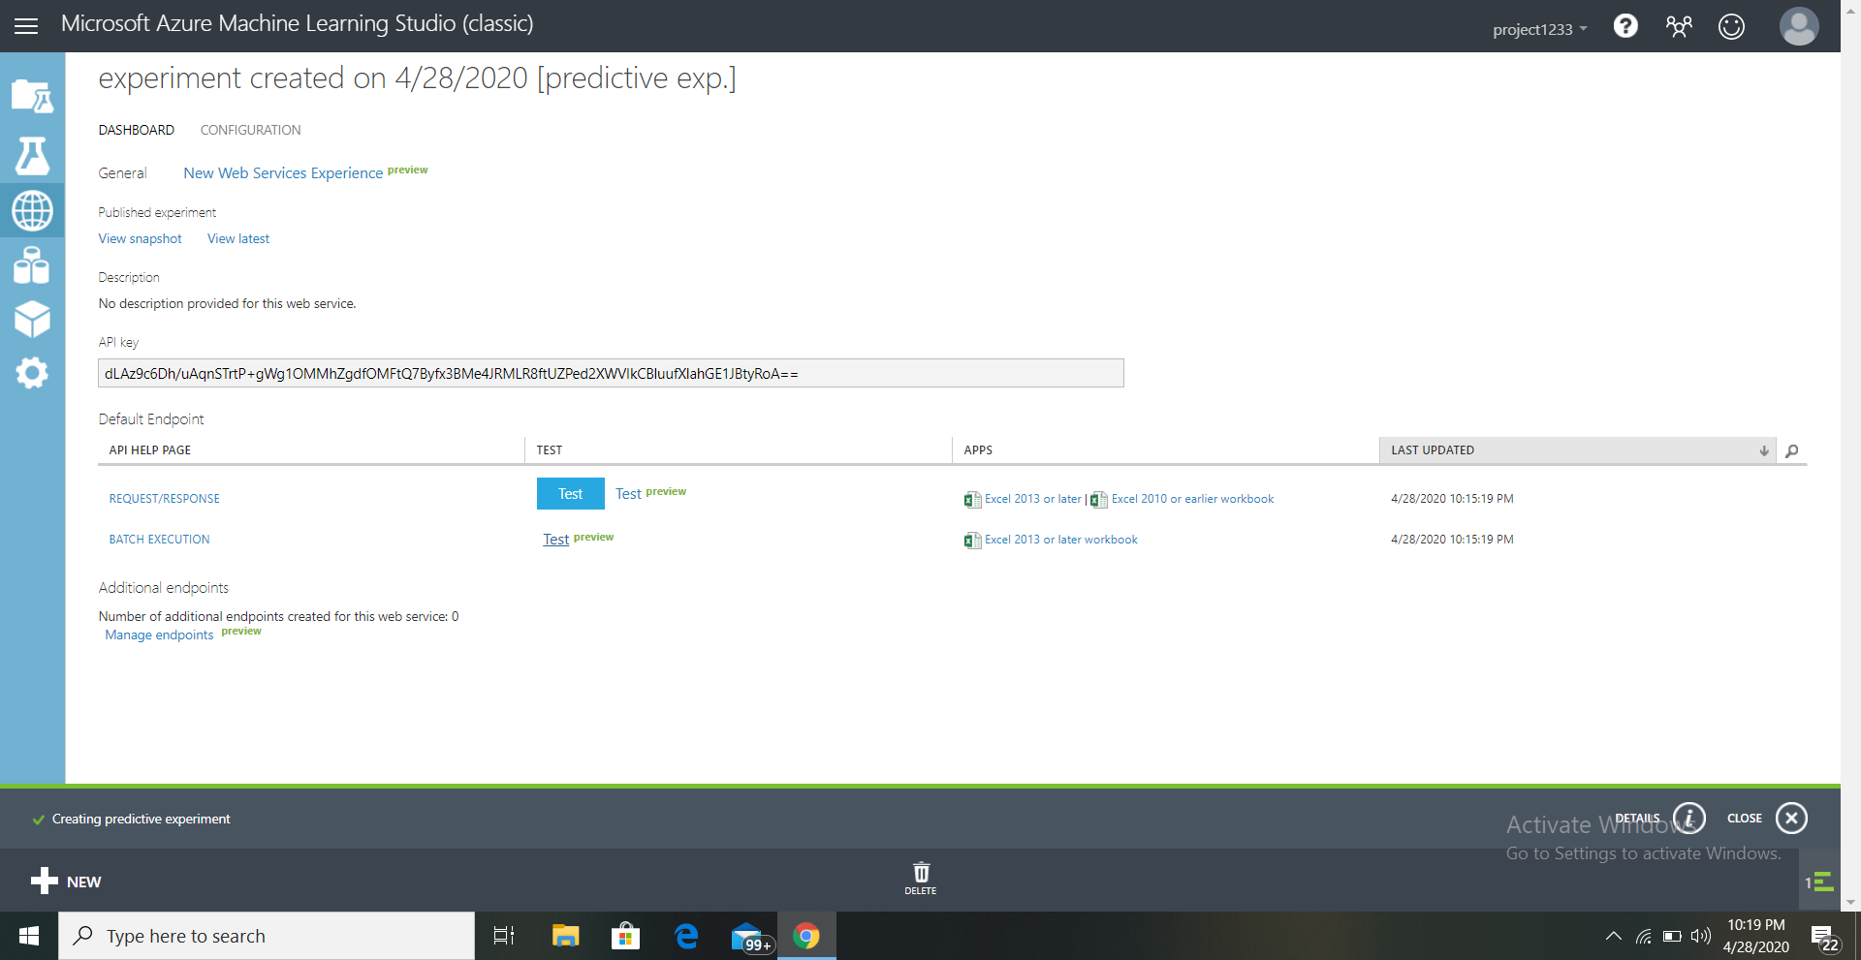

Slide 34
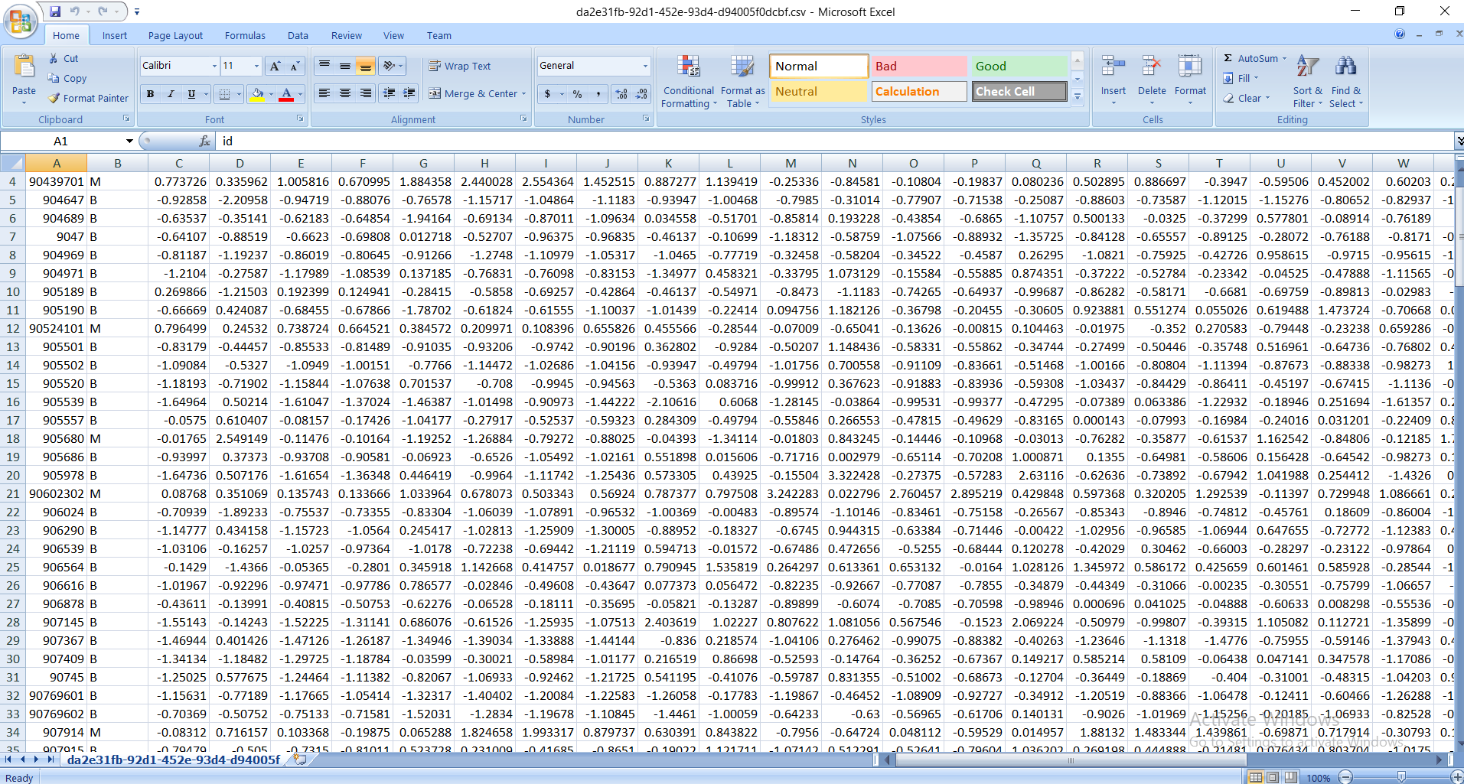

Slide 35
Future Scope
As far as future scope is concerned we are planning to move in to predict histopathologically using an image rather than the data.
So it would be a better approach and it would also help to lead us to learn some deep learning concepts and also we think moving this project to deep learning would provide better accuracy I would say not only say accuracy instead I would say the the case where false predictions in case of true should be much less as it’s a sensitive matter.

