Slide 1
Big Data Xpress
Census - Income
Ajinkya Rode Harshit Shah Ninad Ingale Shikha Soni
Computer Science
Rochester Institute of Technology

Slide 2
Agenda
Introduction
Data Cleaning
Schema Design
Analysis & Hypotheses
Lessons Learned
Future Work

Slide 3
Introduction
Why we chose this data?
Attributes & Instances
Tools used: R, Weka, PSQL

Slide 4
Data Cleaning
11 attributes removed using Excel
100,000 instances removed
Important attributes with “Not in universe” data. ( industry_code, occupation_code, wage_phour, weeks_year )

Slide 5
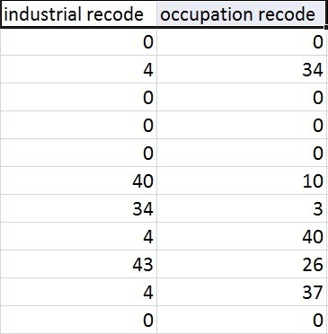
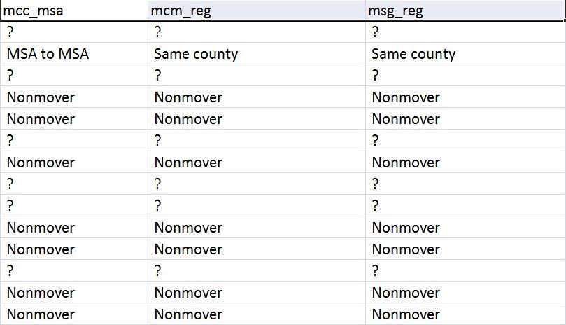
Why removed?

Slide 6
Schema Design
Person (p_id, age, education, marital_status, race, hispanic_origin, sex, labor_union, unemployment_reason, region_prev_residence, state_prev_residence, household_family_stat, live_in_house, citizenship, self_employed, veteran_benets, cob_father, cob_mother, cob_self )
Employment (employee_id, class_worker, wage_phour, industry_code, occupation_code, employment_status, no_persons_worked, weeks_year)
Person_Employed (p_id, employee_id)
Education (education, edu_high_qual)
Monetary (m_id, capital_gain, capital_loss, dividend_stock, tax_status)
Person_Monetary (p_id, m_id)

Slide 7
Weka for Classification
Open source for data mining
J48:
- It is easy to understand by the end user.
- It can handle a variety of input data: Nominal, Numeric and Textual
- Able to process erroneous datasets or missing values
Disadvantage: Runs slow for large data sets

Slide 8
Analysis & Hypotheses

Slide 9
Employment Status
Columns used: - age, education, sex, citizenship, marital status, employment status
Groupings: - To minimize tree and get accurate result
How ‘employment Status’ column value selected:
- Employed if ‘New entrant’ or ‘Re-entrant’
- else ‘Unemployed’ for all values

Slide 10
Groupings
age:
18, 27, 58, 65
education:
School Level, Bachelor’s Degree, Master’s-Doctorate Degree
citizenship:
US Citizen, Not a US Citizen
marital_status:
Married, Unmarried

Slide 11
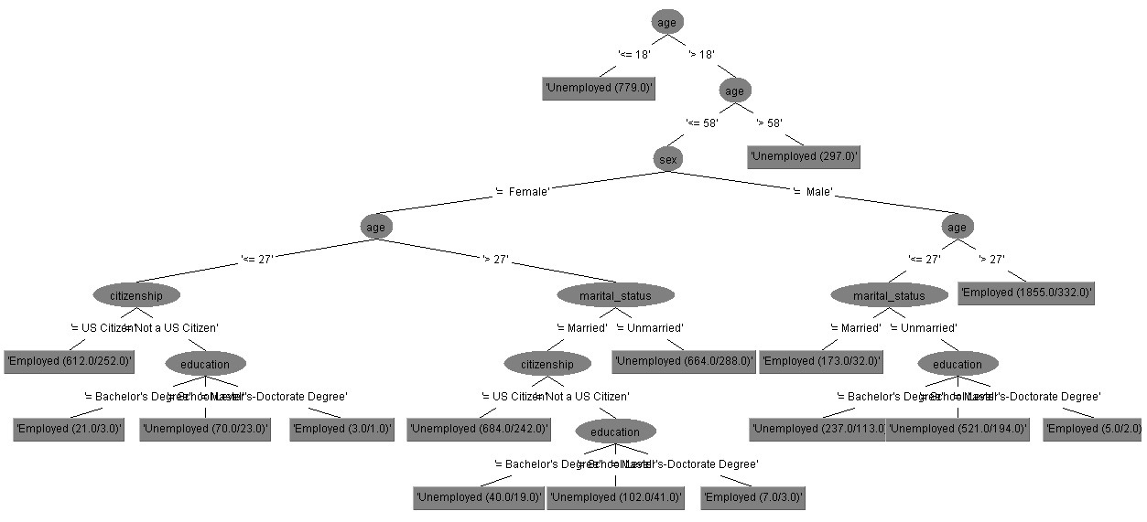

Slide 12
Results
Accuracy: 74.547 %
No of Instances used: 6070
Correctly Classified Instances: 4525
ages below 18 & above 58 -> unemployed
Females: age > 27 & unmarried -> unemployed
non US citizens -> employed if Masters/doctorate degree, while others are unemployed.
Males:
age greater than 27 -> employed
age <= 27 and > 18, -> if married – employed, while unmarried -> Masters/Doctorate degree -employed

Slide 13
Preferred Gender in Industry
The columns used for this classification are age, education, sex and industry_code.
This was done to find out gender preferences of the industries
Why Groupings?

Slide 14
Groupings
age:
18, 27, 58, 65
education:
School Level, Bachelor’s Degree, Master’s-Doctorate Degree
industry_code:
Divided total 23 industries into 5 groups

Slide 15
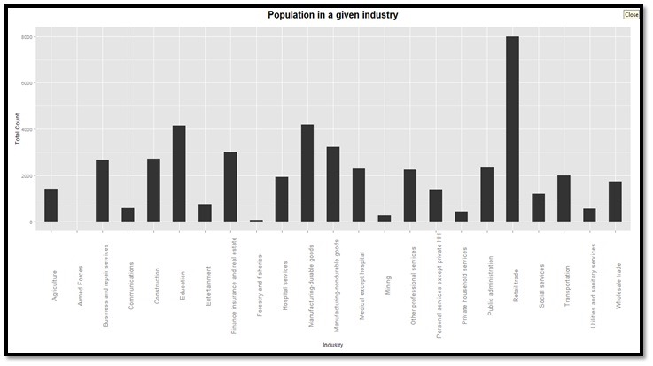

Slide 16
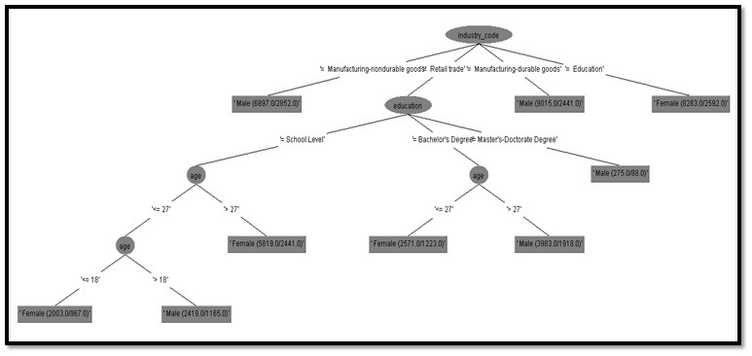
Industries Group1

Slide 17
Results
Accuracy: 61.9847%
No of Instances used: 41265
Correctly Classified Instances: 25578
Manufacturing- non Durable/ Durable goods: Prefers only Males in industry.
Retail trade: Education-> School Level
age-> <18 and <27, Females
age-> >18 and >27, Males
Education->Bachelors
age<27->Females
age>27->Males
Education-> Masters and Doctorate -> Males
Education: This industry only prefers the female population

Slide 18
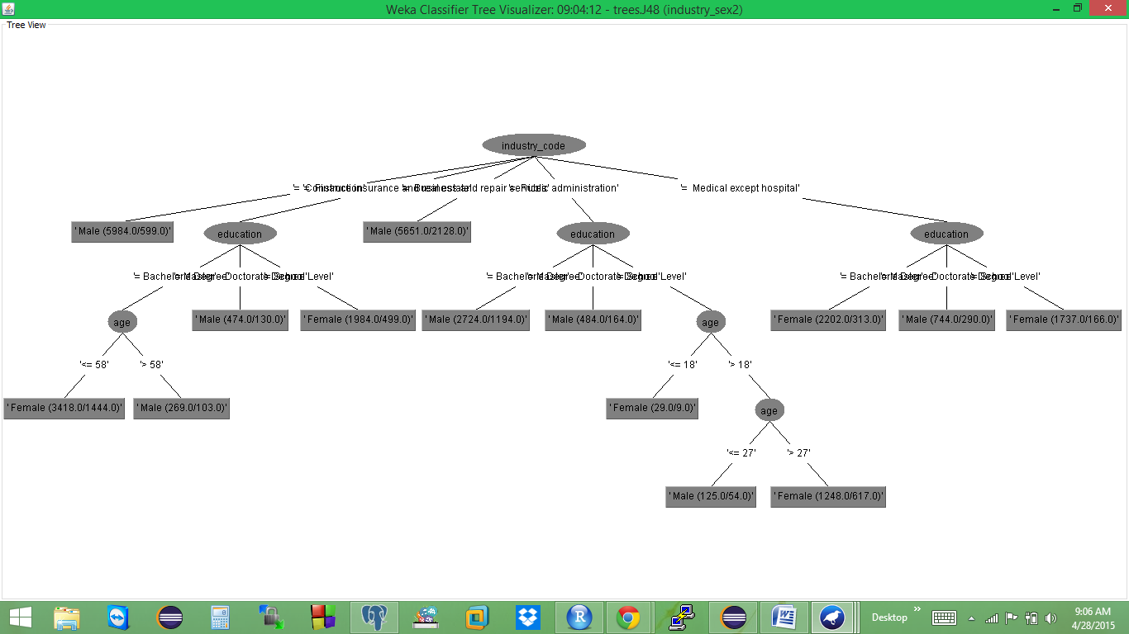
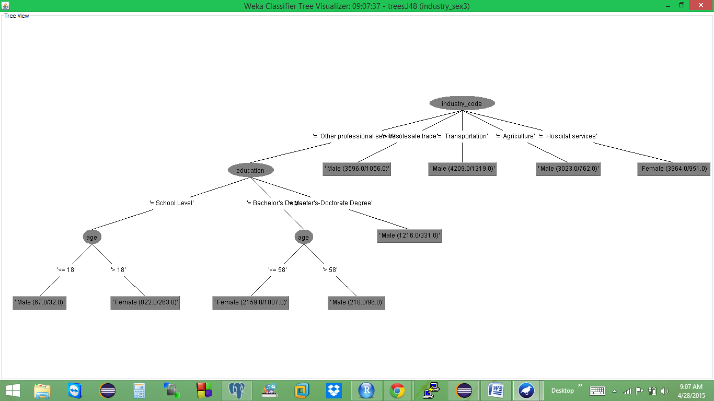
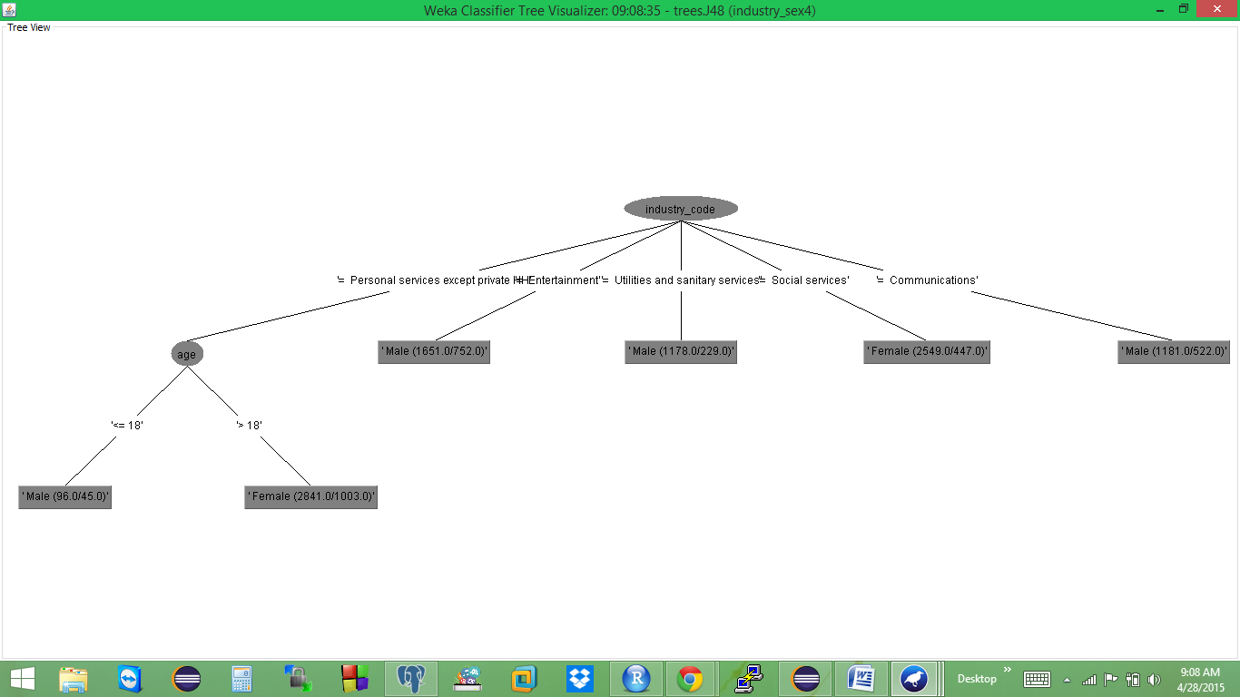
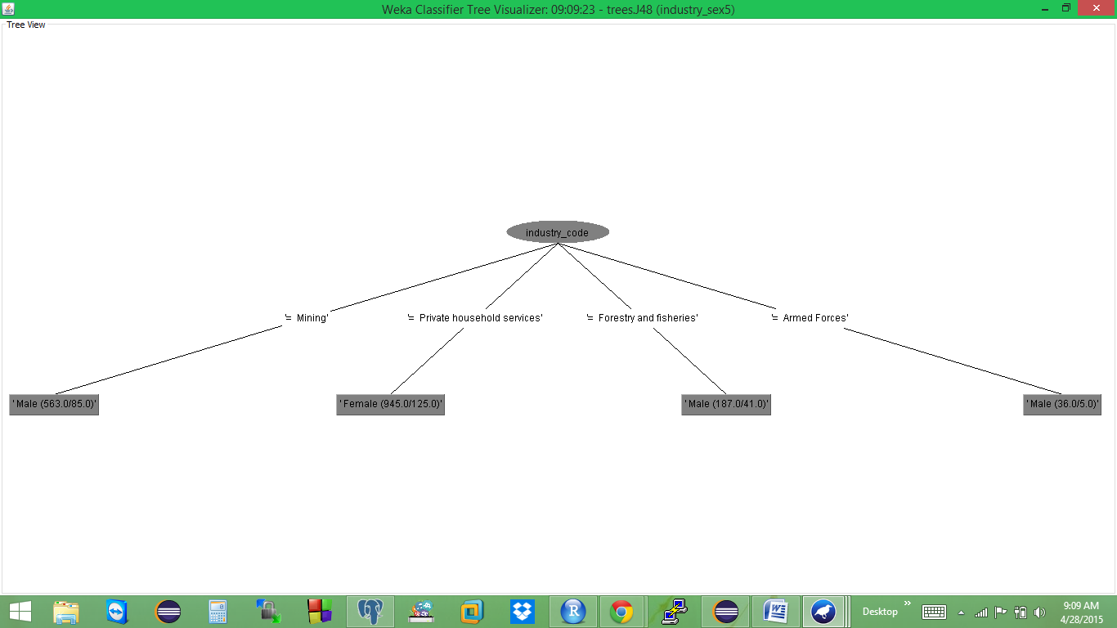

Slide 19

Income Tax Analysis
Income tax is calculated on the basis of :
Wage per hour
Weeks worked in a year
Tax filer status

Slide 20
Description of Columns used :
wage_phour :
wage per hour
weeks_year :
weeks worked in a year
tax_filer_status:
based on age and marital status
Formula used :
Annual income = wage_hour * weeks_year * 40
Tax calculation rules : http://www.unclefed.com/IRS-Forms/1995-1991/1994TaxRateSchedules.pdf

Slide 21
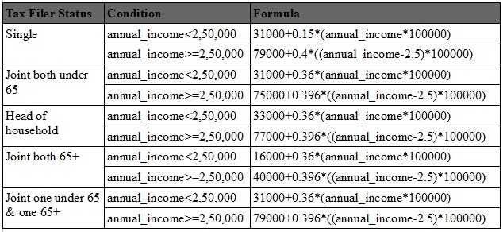
Conditions for calculating Tax based on Annual Income and Tax Filer Status

Slide 22
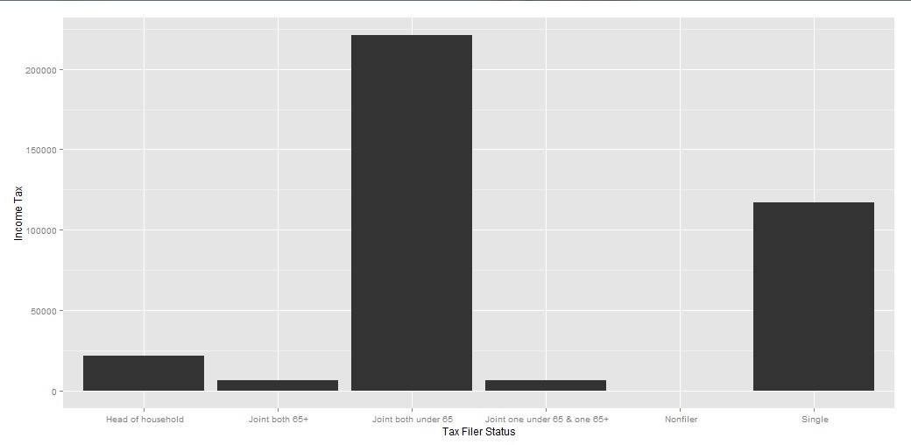

Slide 23
Results
The most tax paying tax group is ‘Joint both under 65'.
The targeted population is for the Tax Filer Status “Joint both Under 65” and “Single”

Slide 24
Region wise Development
Analysis for different industries based on significant population in that industry.
Columns used: -industry_code, occupation_code, state_curr_residence, curr_region
Columns added: - state_curr_residence, curr_region

Slide 25
Groupings / Columns added
state_curr_residence:
48 distinct stated added
curr_region:
divided the states into four regions Grouping: - Region wise four groups: North, South, East, West

Slide 26
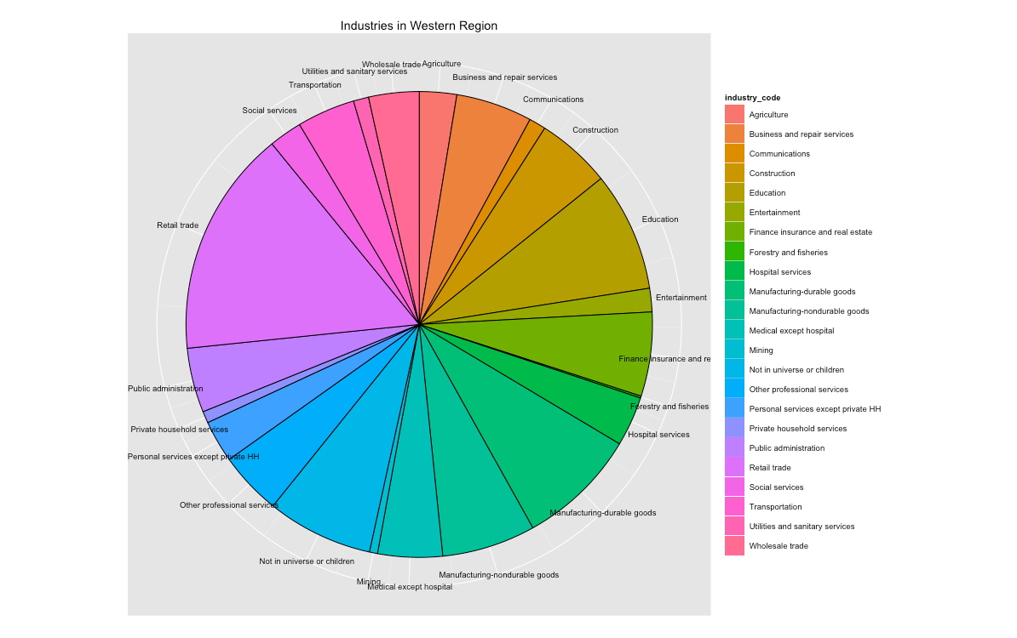
Region wise Industries

Slide 27
Results
Most populated industry : Retail trade
We further drill down in this industry for occupations in all regions.

Slide 28
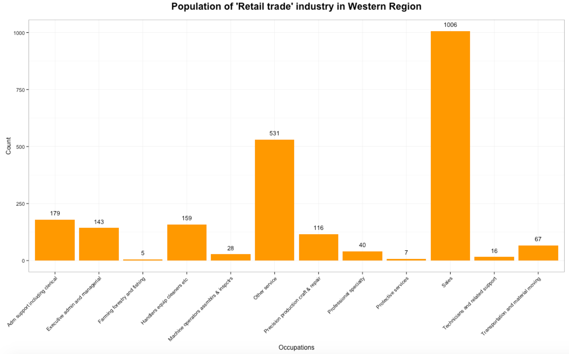
Region wise Occupation : “Retail trade”

Slide 29
Results
The most influential industry in terms of development in the entire country is “Retail trade”.
It was analyzed on the basis of the bar graph that Sales is the occupation major occupation for that industry.

Slide 30
Industry wise Average Income
Average annual income is analyzed on the basis of :
Wages per hour
sex
industry codes
annual_income_in_terms_of_100K

Slide 31
Description of columns added
Columns added: annual_income_in_terms_of_100K
Formula used : annual_income_in_terms_of_100K = wage_hour*weeks_year*40

Slide 32
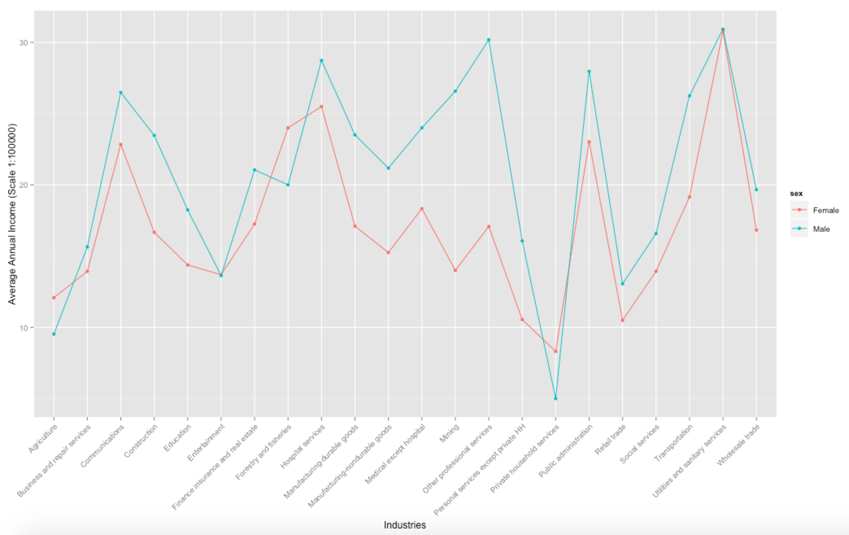

Slide 33
Results
Industries like Agriculture, Forestry, and Private household services have males with higher average annual income.

Slide 34
Age wise education for gender
Columns used:
- age, education, sex
Groupings:
- age: 18, 27, 58, 65 - education: `PreSchool-Kindergarten',`Elementary School (1st-4th grade)', 'Middle School (5th-8th grade)', 'High School(9th-12th grade)', 'College or University (Bachelor's Degree)', 'College or University (Master"s-Doctorate Degree)', 'Vocational-Associates Degree'

Slide 35
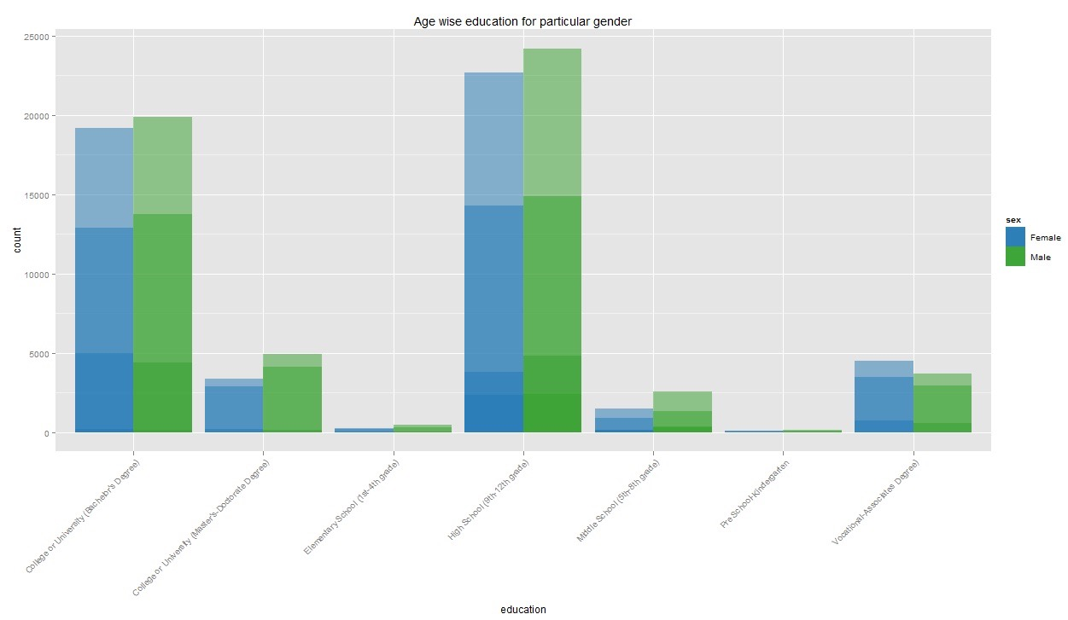

Slide 36
Result : - age <=18 -> limited till high school, middle school and vocational-associate degree - Majority -> studied till either high school or completed their bachelor's
- age <= 58 & > 27 -> majority people and in all education

Slide 37
Lessons Learnt
Grouping instances with similar values gives a better classification.
Irrelevant instances give lesser accurate results, thus proper data cleaning is an important step in data analysis.
Correct dataset selection is the base of any project
For performing SQL operations, use any database management system tools rather than machine learning analysis tools.

Slide 38
Future Work
We can make UI for getting predictions.
Testing on the model can be done.
Regression on tesing can be done.

