Slide 1
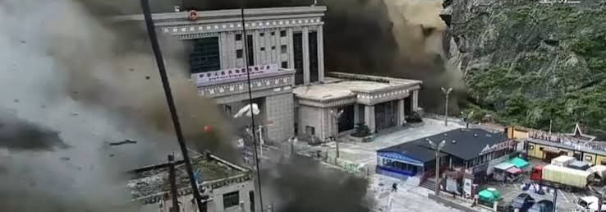

BLOCKCHAIN BREAKTHROUGHS FOR A BETTER WORLD
Flash flood at the Nepal-China border, 26 Aug 2026 (screenshot from a news broadcast)
FloodGuard
Shikhar Pandey
Blockchain early warning and transparent disaster relief for Nepal
West Virginia State University

Slide 2
Nepal 2026 is part of a global problem
1,342
deaths reported by Nepal's disaster authority (NDRRMA), 6 Sept
WORLDWIDE, EVERY YEAR
~250M
$388B
people affected by floods
average yearly flood losses
~4,900
people missing or out of contact at that time
Relief money that goes missing
No reliable global total. Sector estimates of fraud and diversion in humanitarian aid range from 2% to 15%.
Hurricanes Katrina and Rita: up to $1.4 billion in improper payments (US GAO).
Ebola response: over $5 million lost out of $124 million handled by the Red Cross network.
84,270
people affected across 17 municipalities in six districts (IOM)
Sources: NDRRMA via Copernicus EMS; IOM; UNDRR (people affected; GAR 2025 losses); U4 Anti-Corruption Centre (2-15% estimates); US GAO (Katrina and Rita); IFRC Ebola audit as reported by OCCRP. Annual figures are averages.
FloodGuard | Shikhar Pandey | West Virginia State University
2

Slide 3
Two gaps to close: warning and trust
The warning gap
The trust gap
Steep valleys flood fast
After the flood, who can verify?
Sensor, weather and satellite data are scattered
Villagers need alerts in minutes
Alerts must reach ordinary phones
Donors cannot trace how funds are spent
Households can be missed or counted twice
Aid can be delayed or diverted
Speed for warnings. Verification for relief.
FloodGuard | Shikhar Pandey | West Virginia State University
3

Slide 4
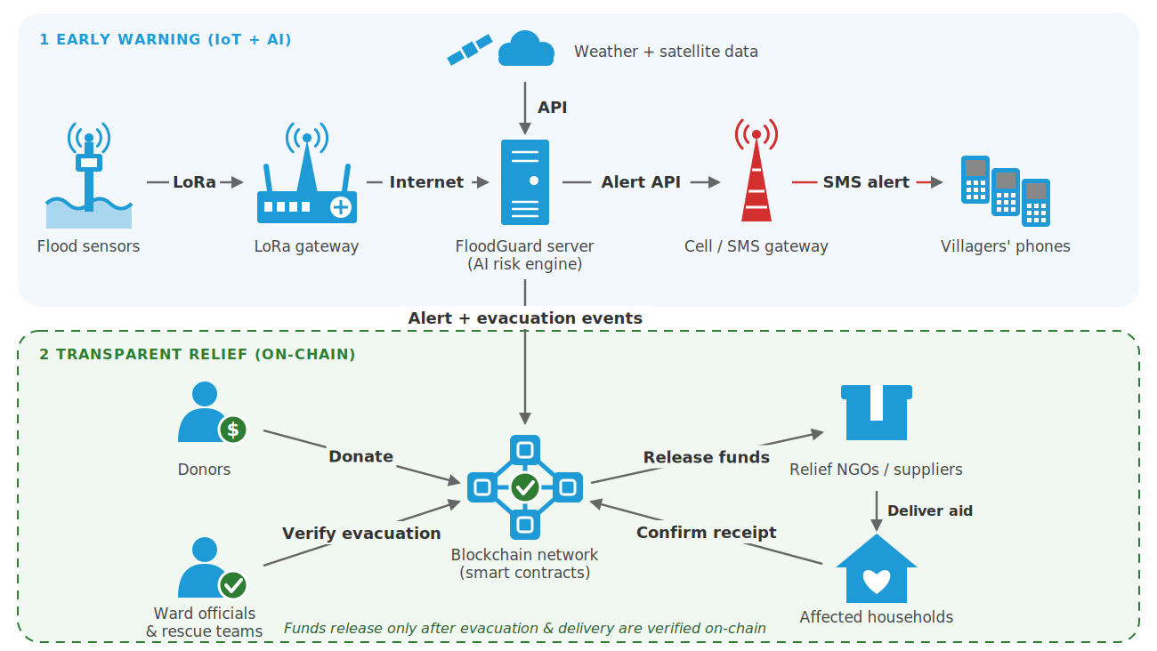
How FloodGuard works
FloodGuard | Shikhar Pandey | West Virginia State University
4

Slide 5
Where blockchain adds trust
ON-CHAIN
OFF-CHAIN
1
Alert hash anchored on-chain: tamper-proof record
Fast warnings
Sensors, risk scoring and SMS alerts run without blockchain, because speed matters most.
2
Households registered once as hashes: no personal data
3
Evacuation confirmed by ward officials
4
Donations held in a smart contract
5
NGO claims aid for verified households only
6
Funds released after receipt is confirmed
FloodGuard | Shikhar Pandey | West Virginia State University
5

Slide 6
Impact and innovation
Villagers
Affected households
Donors and NGOs
Earlier warnings on ordinary phones
Verified once, so aid is faster and fairer
Proof of where money went, less paperwork
What is different
Disaster relief moves from a system that relies on trust to one where donations, evacuations and aid delivery can be independently verified by donors, officials and communities.
Target: 1 million people across the Great Himalayan region, starting in Nepal
FloodGuard | Shikhar Pandey | West Virginia State University
6

Slide 7
Prototype built, pilot next
Built so far
Roadmap
FloodRelief smart contract: donations, verified registry, aid claims, payout on receipt
Python risk engine: scoring, English and Nepali SMS, alert hashing
Open README and architecture
1
Connect web3 and an SMS gateway
2
Pilot in one river basin with ward offices, Red Cross and local NGOs
3
Calibrate on Nepal data; add glacial-lake monitoring
4
Household confirmation by signature or SMS code; independent audit
I lost people close to me in Nepal's floods. FloodGuard is how I want to help the next community.
Shikhar Pandey | West Virginia State University
FloodGuard | Shikhar Pandey | West Virginia State University
7

