Slide 1
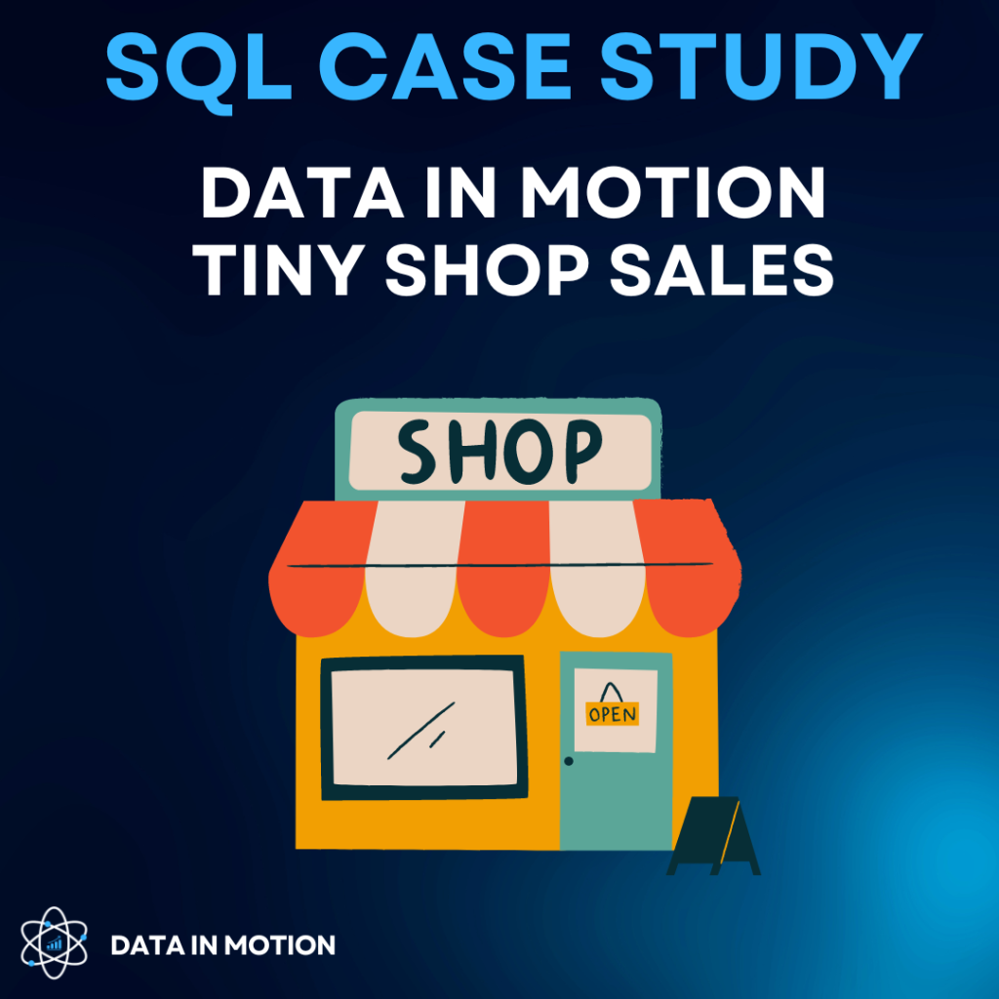
SQL CASE STUDY TINY SHOP SALES
PRESENTED BY - SHIKHAR CHOPRA

Slide 2
OVERVIEW
This case study uses PostgreSQL. To successfully answer all the questions you should have been exposed to the following areas of SQL:
Basic aggregations
CASE WHEN statements
Window Functions
Joins
Date time functions
CTEs

Slide 3
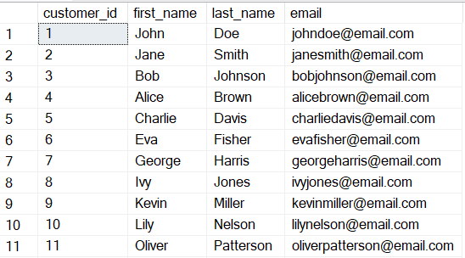
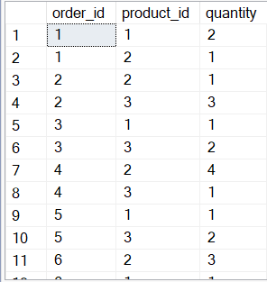


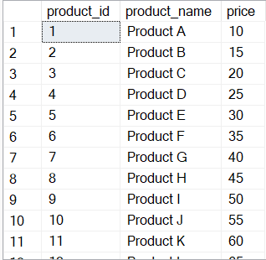
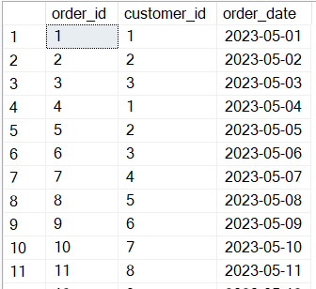
DATA
Customers Table
Order_items Table
Products Table
Orders Table

Slide 4
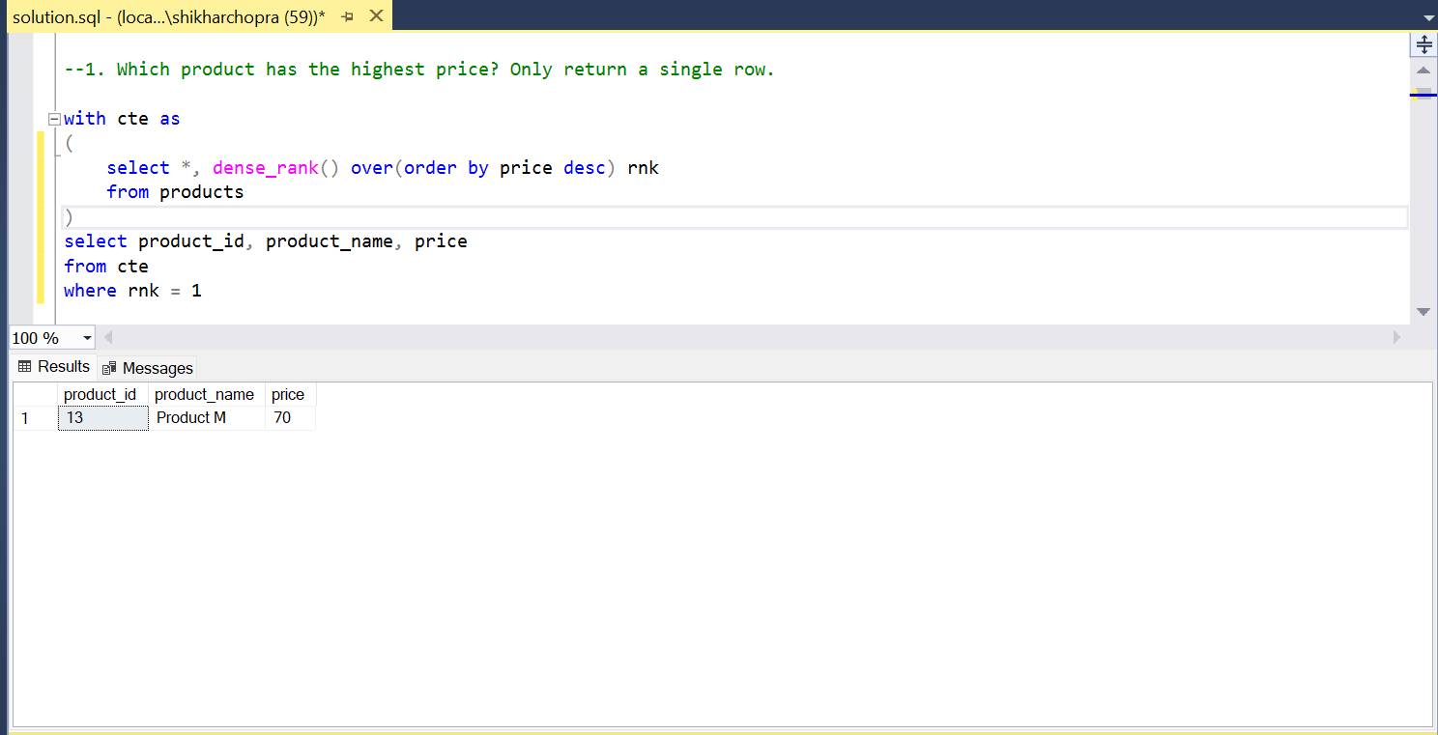
1. Which product has the highest price? Only return a single row.

Slide 5
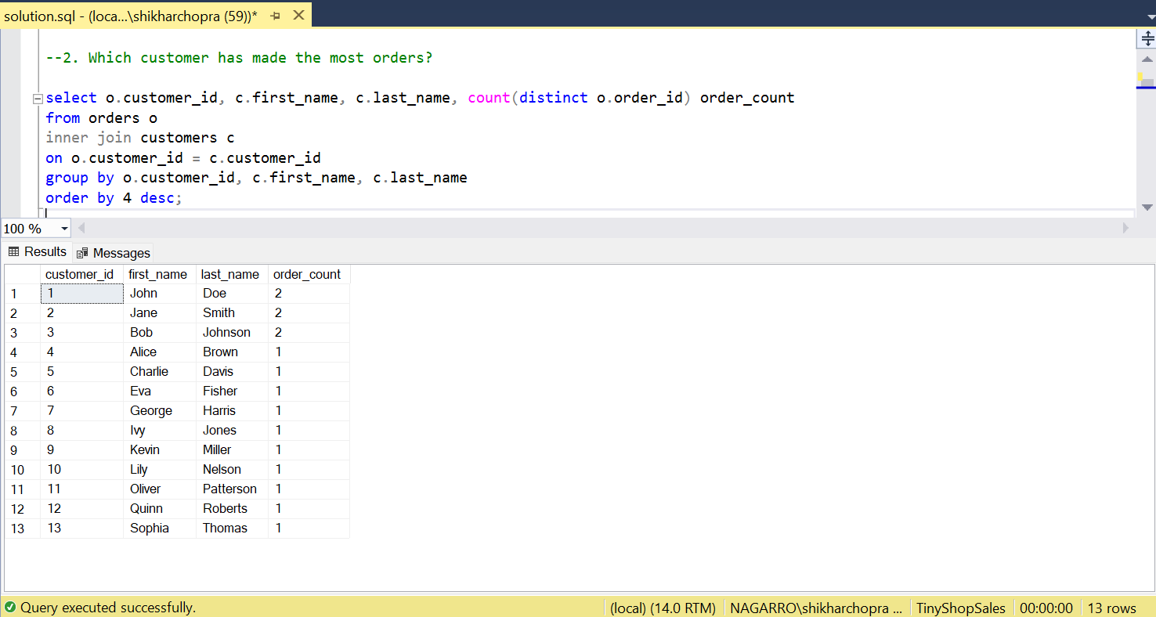
2. Which customer has made the most orders?

Slide 6
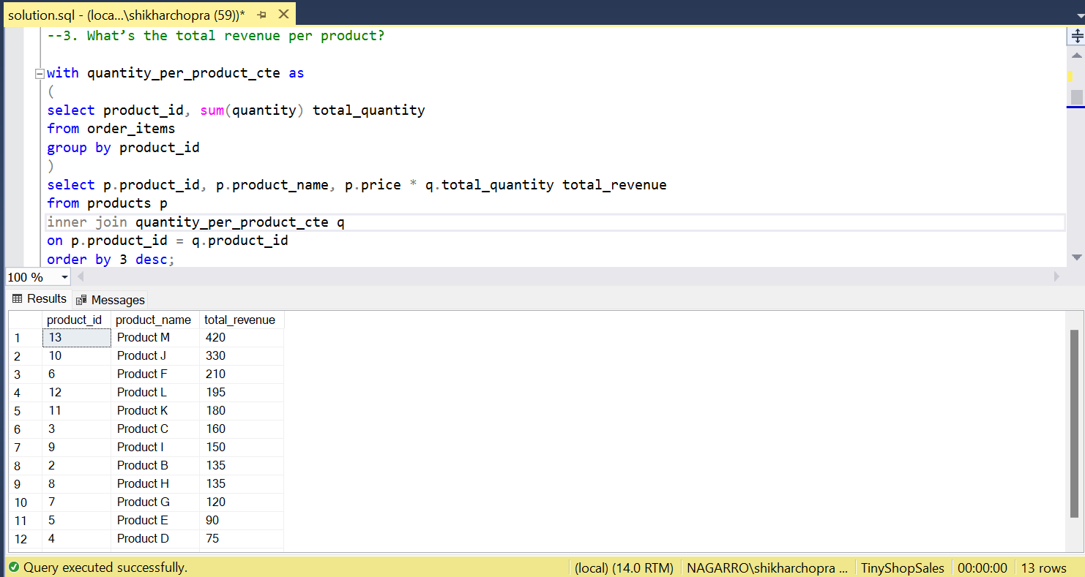
3. What’s the total revenue per product?

Slide 7
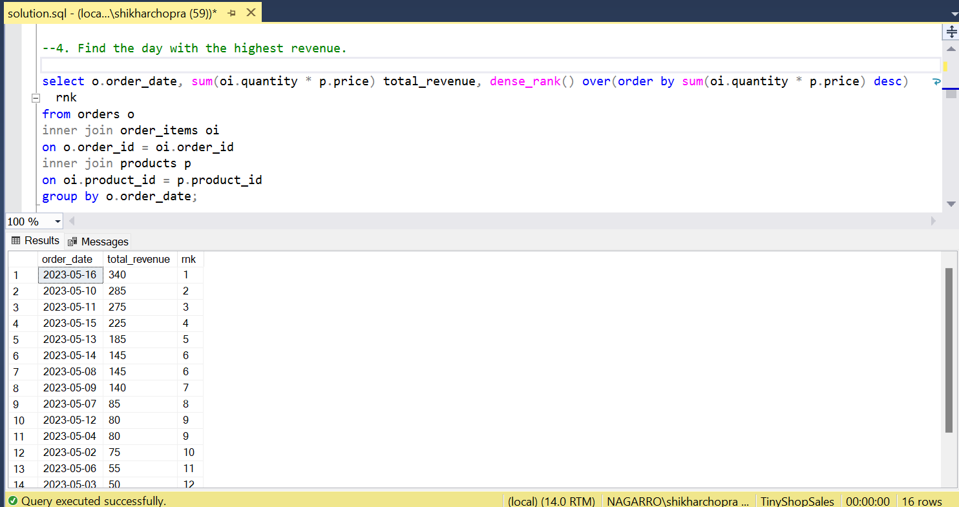
4. Find the day with the highest revenue.

Slide 8
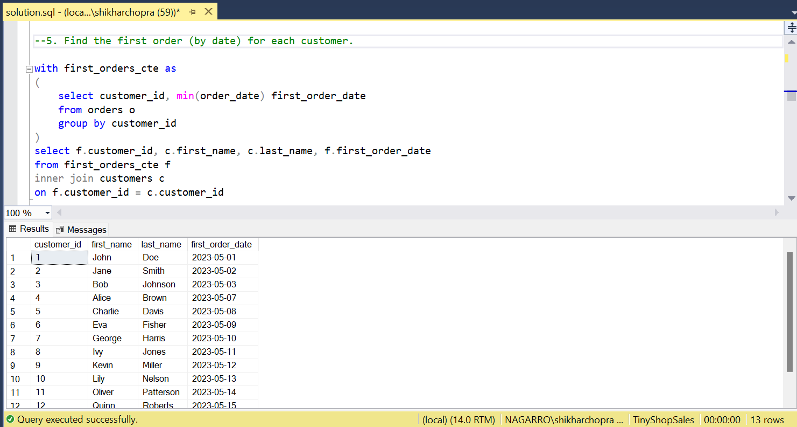
5. Find the first order (by date) for each customer.

Slide 9
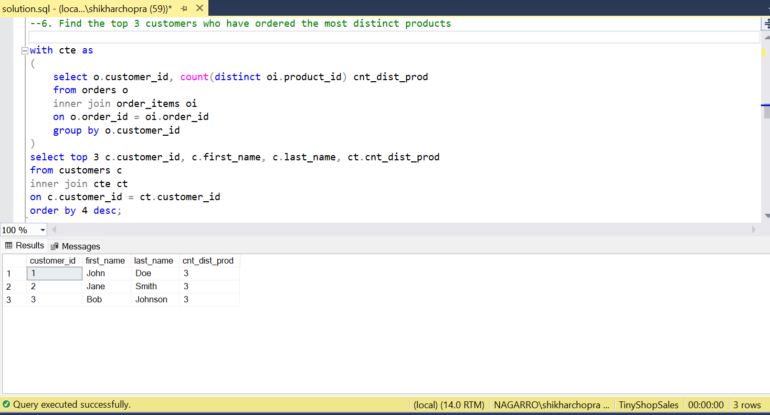
6. Find the top 3 customers who have ordered the most distinct products

Slide 10
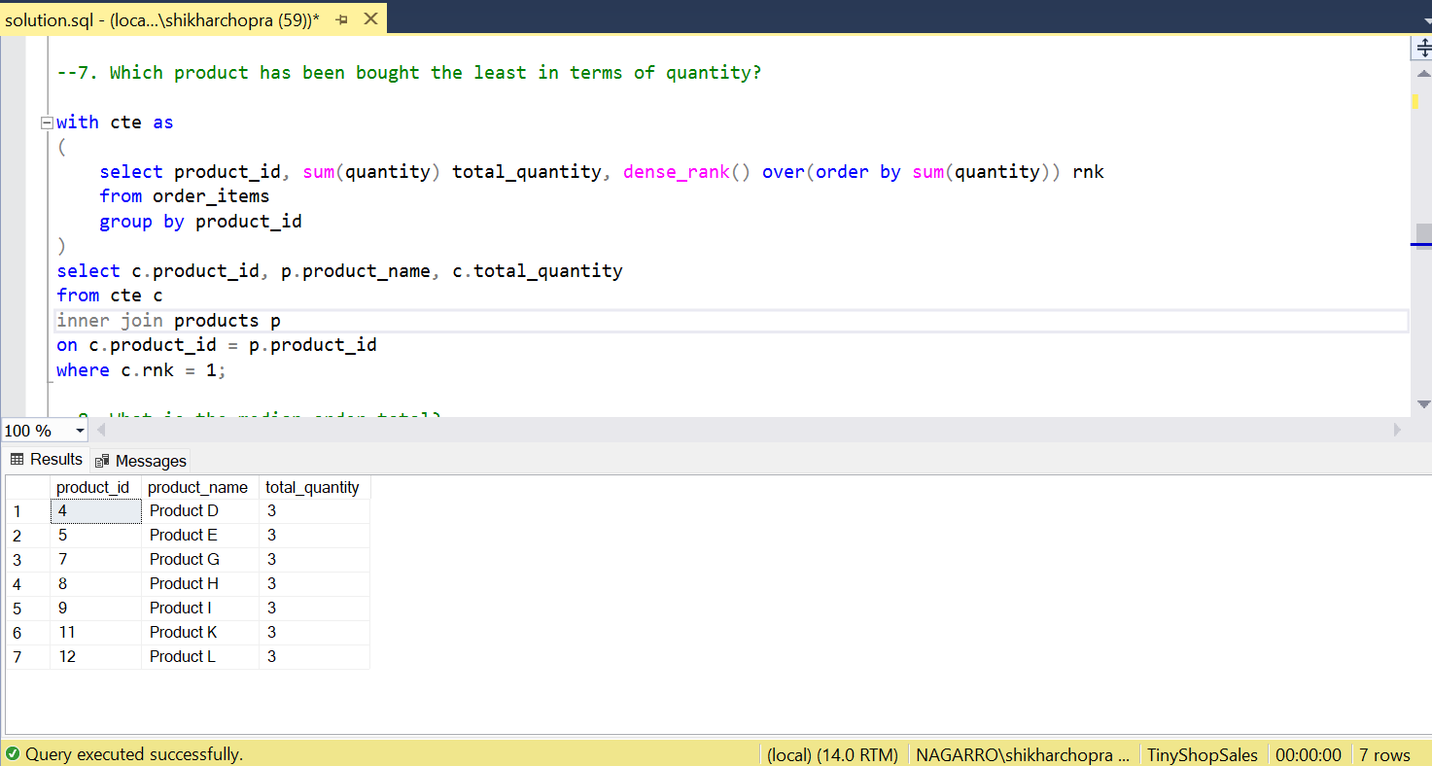
7. Which product has been bought the least in terms of quantity?

Slide 11
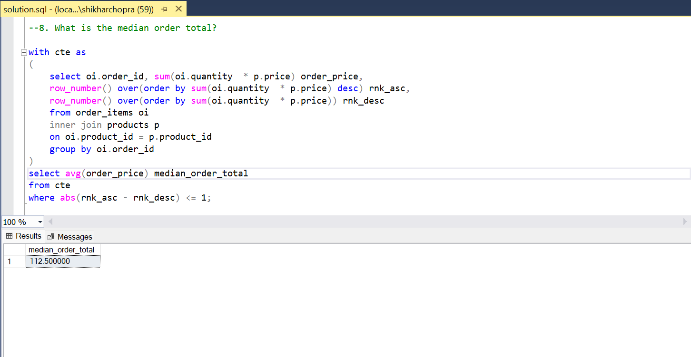
8. What is the median order total?

Slide 12
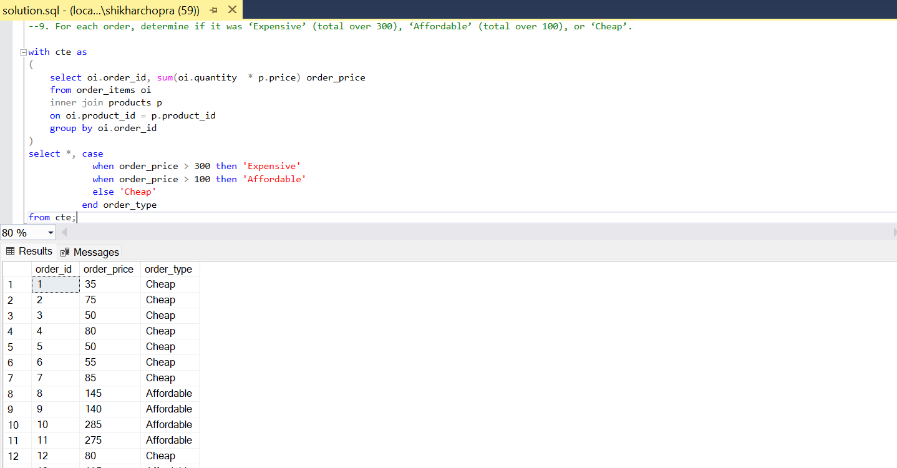
9. For each order, determine if it was ‘Expensive’ (total over 300), ‘Affordable’ (total over 100), or ‘Cheap’.

Slide 13
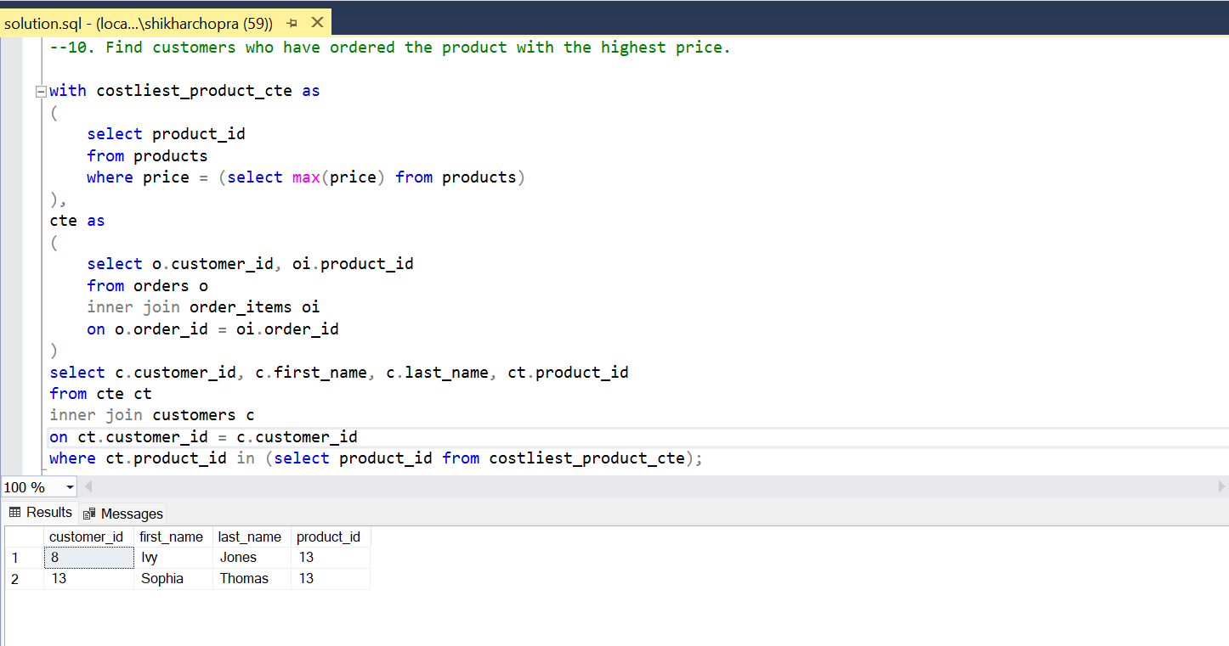
10. Find customers who have ordered the product with the highest price.

Slide 14
INSIGHTS
Product M is the costliest product
Jon Doe, Jane Smith, Bob Johnson have made the most orders (2)
Highest revenue was generated on 16/05/23 ($360)
Jon Doe, Jane Smith, Bob Johnson have ordered the most distinct products (3)
The median order total is $112.50
Note – Assumed currency as USD ($) for the case study

