Slide 1
Data Related Problems
Reading multiple files into a data frame of timeseries data.
Understanding the outliers and bright stars and removing outliers only.
Unwanted variables.
Missing values in the data.
Negative values of flux (uJy).
Unscaled data.

Slide 2
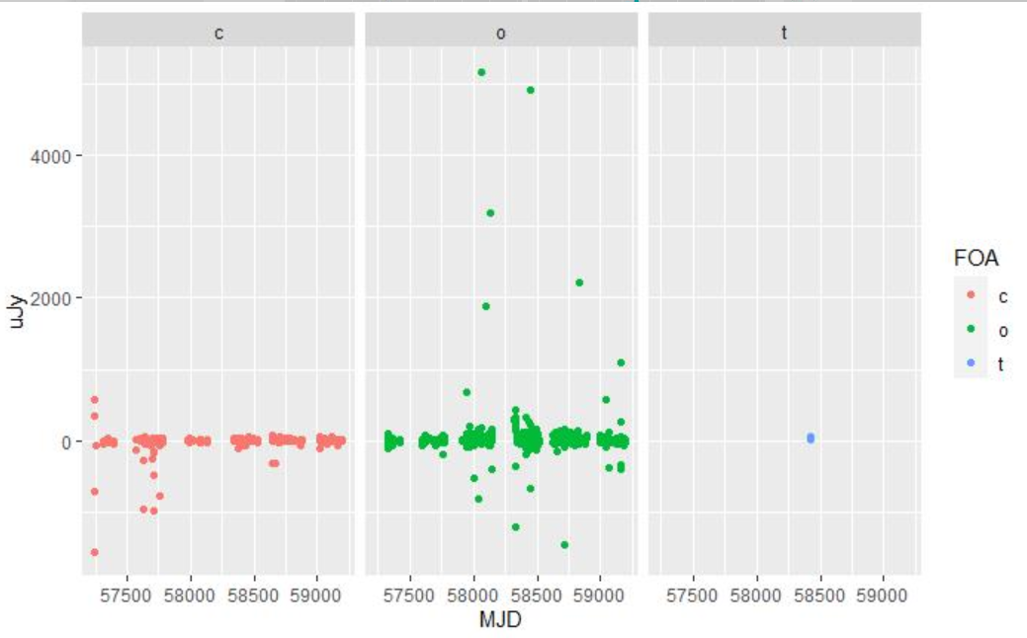
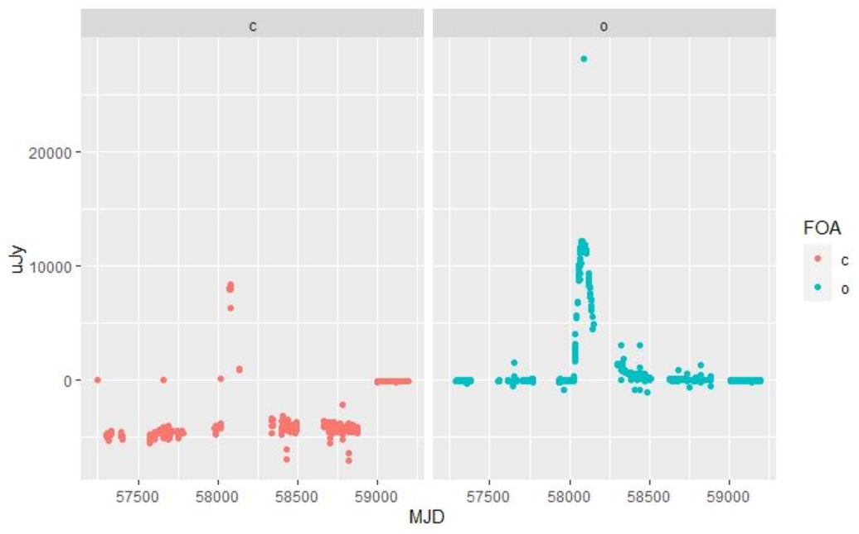
Scatter plot for raw data

Slide 3
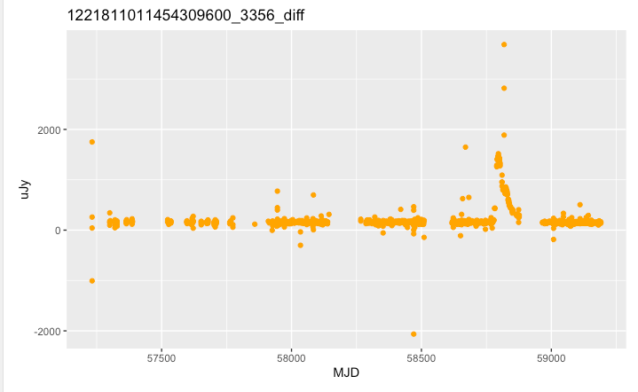
Exploration of Data
Summary statistics the flux information.
Understanding the shapes of the graphs of lightcurves.
Understanding the relationships between our variables.
uJy - exploring range for the flux of the object.
Checking the units of the variables

Slide 4
Data Processing
Removed missing values.
Selecting columns of the data we are interested in.
Looking into outliers – whether they are needed to be removed.
Data being shifted to above zero.
Looking at one filter.
Merging Luminosity with Flux.

Slide 5
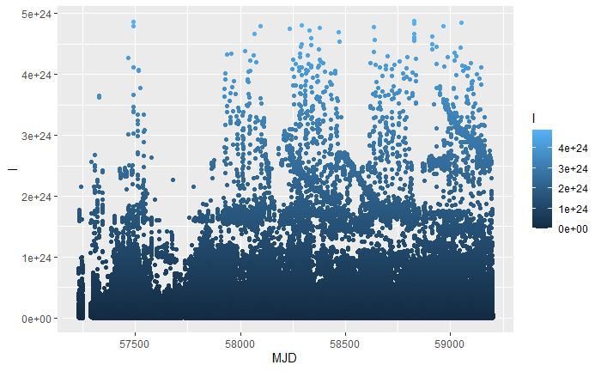
Merging Luminosity with Flux
Adding the Distance with each UUID.
Calculating the Luminosity by formula (4πr^2*f) where f is the flux and r is the distance.
Plotted the graph for luminosity to check the trend of it.
Converting distance in meters and flux to Watts /m^2*Hz

Slide 6
Clustering + Analysis
Kmeans
Data used:
Summary of flux value by Light-curve (mean, median and max) so we can cluster the curves.
Optimal Number of clusters:
Elbow method : 4
Silhouette method : 3 and 7
The gap-statistic method : 1
Nbclust : 3 and 5
Number used : 3 and 5

Slide 7
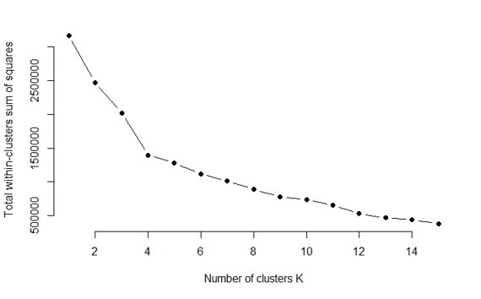
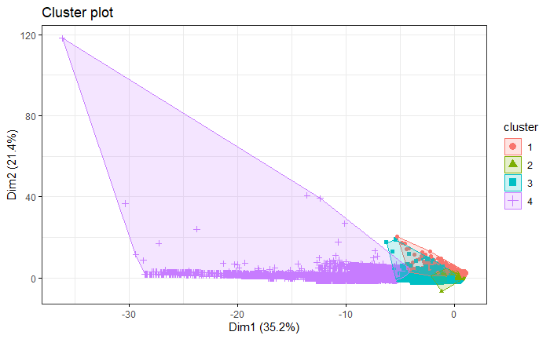
Elbow Method As we can see by the plots, the number of clusters to be considered is 4

Slide 8
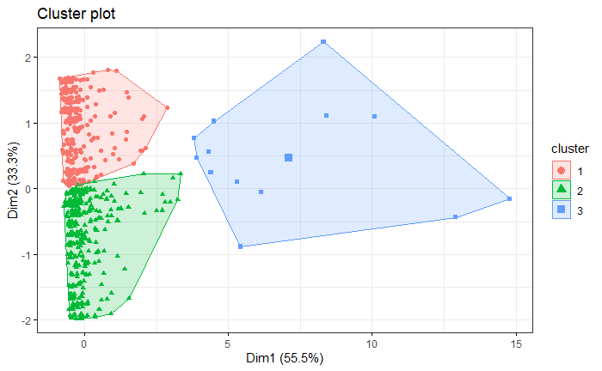
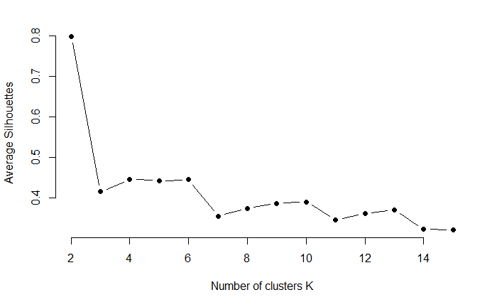
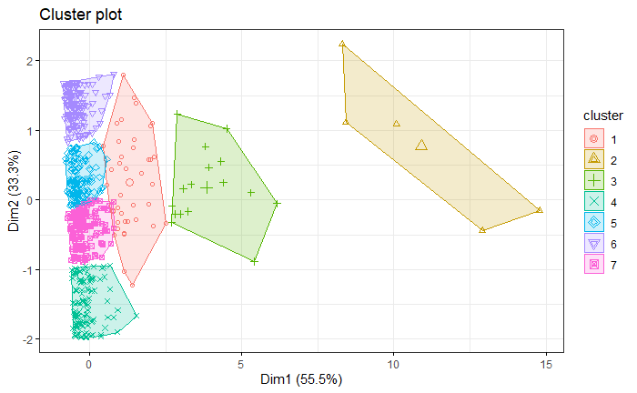
Silhouette Method As we can see by the plots, the method predicted average number of clusters to be 3 or 7

Slide 9
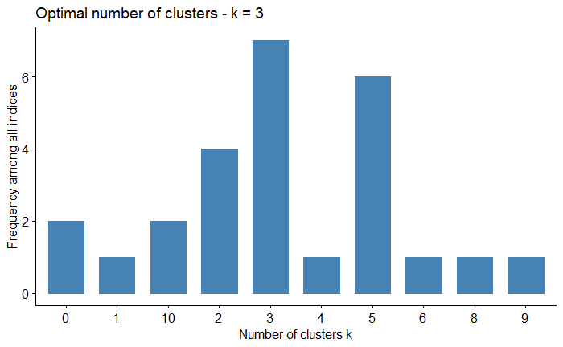
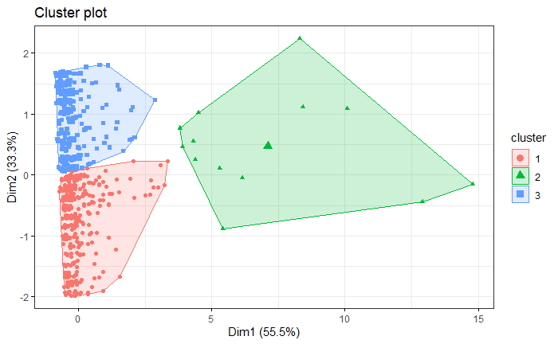
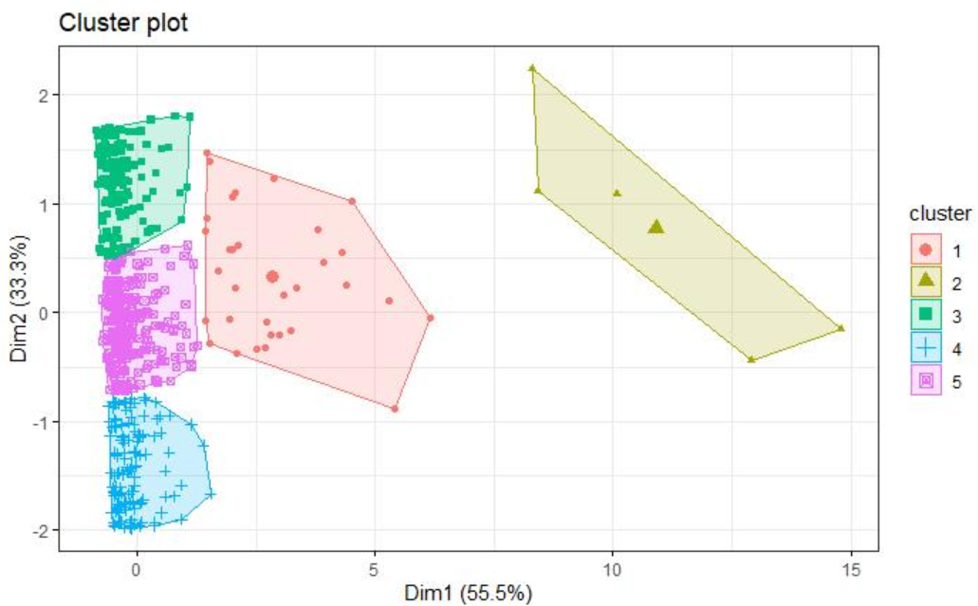
NbClust The optimal number of clusters predicted by NbClust are 3 and 5

Slide 10
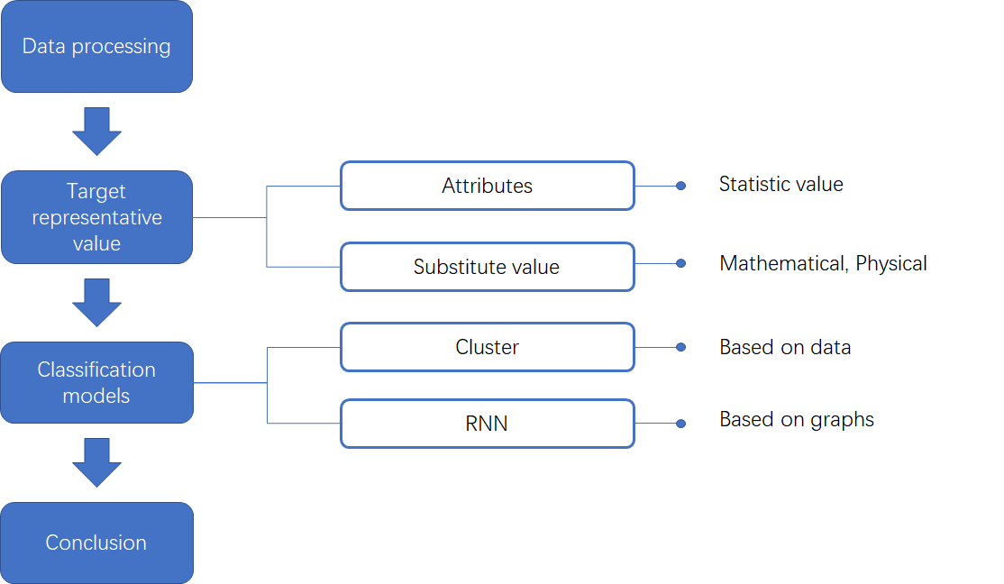
Another Approach

Slide 11
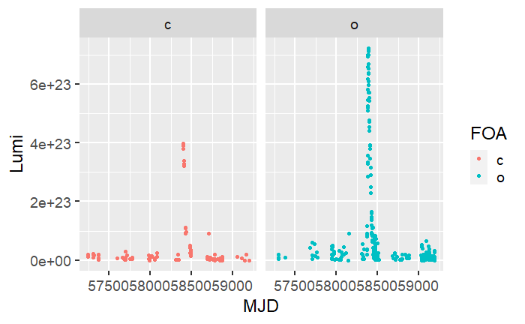
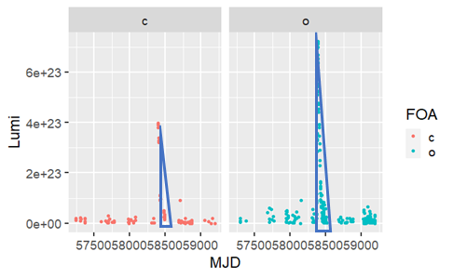
Another Approach
Focus on explosion
Use triangle area to represent objective

Slide 12
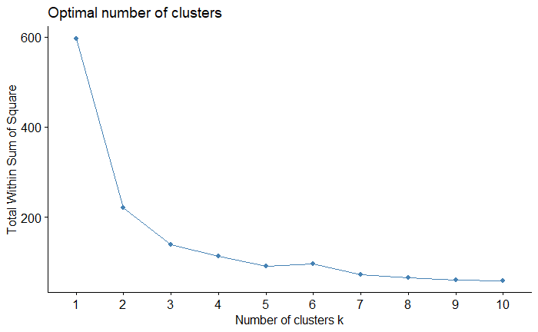
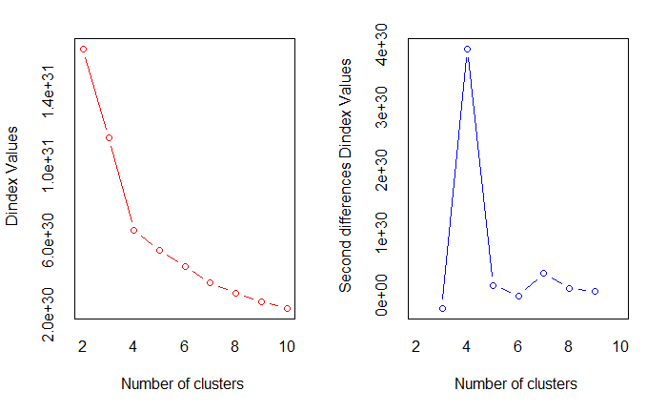
Result from the approach.. the number of clusters to be considered is 2 or 4

Slide 13
Fitting is too simple
Improve the accuracy of identifying the explosion zone
Explore better representative values
Try other models
Problem to be optimized

Slide 14
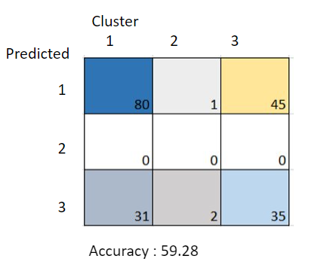
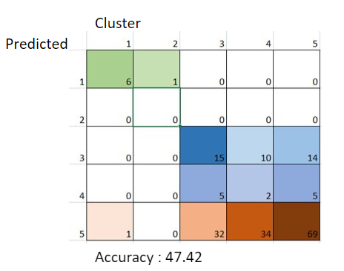
KNN classification based on the clusters from k-means

Slide 15
Future Work
Improve accuracy
Isolating the light curve
Removing noise
Modelling
Other clustering techniques
Hierarchical clustering
Model-based clustering
CNN
More classification models
Random Forests
What makes curves similar or different to each other
Understanding the clusters

Slide 16
Conclusion
The optimal number of clusters for K-means is 3 or 5
KNN results: Most accurately predicted clustering is for 3 of accuracy 59.28
Other approach: Number of clusters optimum was 2 or 4

Slide 17
Thank you!

