Slide 1
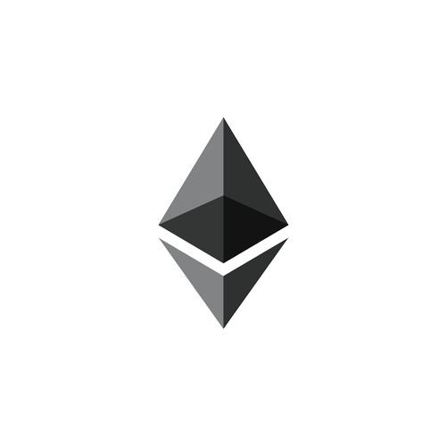
LIFEBLOCKS: A BLOCKCHAIN BASED INSURANCE PLATFORM
Group No.: 14
Sumit Hotchandani
Shikhar Bhatt
Kailash Raj Gaur
Project Guide:
Sumedha Sirsikar

Slide 2
Contents
Problem Statement
Limitations of Existing System
Introduction
Objectives
Literature Survey
Scope
Methodology : AURA, PBFT
System Architecture
UML Diagrams
Tools/Technologies
Hardware Requirements
Outcomes
References

Slide 3
Problem Statement
To create a Blockchain based platform which maintains medical history of users, allows them to purchase insurance policies, generating smart contracts to implement the terms of the policy contract and automates claim settlement.

Slide 4



Limitations
Punekar has to fill out lengthy forms
No interoperability between medical departments and hospitals
Goes to KEM Hospital
KEM
Hospital
Have to incur additional administrative costs for manual claim verification
No control over personal medical records
Loses paper based medical records
Goes to Sassoon Hospital
Punekar might not have/forget to his previous medical records
Has to deal with intermediaries for policy servicing and claim settlement
Punekar/
User
Punekar has to fill out lengthy forms again
Sassoon
Hospital
Without medical history doctor might not understand the actual problem
Policy Servicing
Middlemen involved for policy marketing and servicing
Insurance
Companies
Need to manually verify records for claim settlement

Slide 5


Introduction: Blockchain
Hospital 1
T_{x}
T_{x}
T_{x}
T_{x}
T_{x}
T_{x}
Insurance Company
User 1
T_{x}
T_{x}
T_{x}
T_{x}
T_{x}
T_{x}
T_{x}
T_{x}
T_{x}
T_{x}
T_{x}
T_{x}
User 2
T_{x}
T_{x}
T_{x}
T_{x}
T_{x}
T_{x}
User 3
T_{x}
T_{x}
T_{x}
T_{x}
T_{x}
T_{x}
Hospital 2
T_{x}
T_{x}
T_{x}
T_{x}
T_{x}
T_{x}

Slide 6
Introduction
Punekar has to only provide AADHAAR card
Goes to KEM Hospital
Structural interoperability between medical departments and hospitals
KEM
Hospital
Reduced administrative overhead for claim verification
Owns medical records encrypted using his public key
Punekar doesn’t have to bring his previous reports
Can easily keep track of his medical history
Goes to Sassoon Hospital
Punekar
Punekar has to only provide AADHAR card again
No longer has to deal with intermediaries for policy servicing and claim settlement
Sassoon
Hospital
Doctor can easily track medical history of the patient and view by requesting access
No middlemen involved in policy marketing and servicing
Policy Servicing
Insurance
Companies
Automated claim settlement and smart contracts

Slide 7
Objectives
To create an efficient and streamlined healthcare system.
Secured storage and sharing of medical records.
Storing health records according to certain standards would ensure at the very least structural interoperability between hospitals.
Electronic Health Records make it easy for hospitals and patients to track medical history.
Reduce middlemen involved in the insurance policy life cycle.
Reduce manpower and interactions required in claim verification.
Smart contracts can facilitate automated and quick claim settlement.
Make basic healthcare accessible to people from all walks of life.

Slide 8
Literature Survey
Sr. No. | Reference Name | Seed Idea / Work Description | Advantages
1 | Satoshi Nakamoto (2008). "Bitcoin: A Peer-to-Peer Electronic Cash System." | First Successful Implementation of Blockchain. | Simplified Payment Verification. Consensus based validation.
2 | Darra L. Hoffman. "Legally Speaking: Smart Contracts, Archival Bonds, and Linked Data in the Blockchain" | Use of Legal Language in Contract Drafting. | Writing legally enforceable smart contract.
3 | Stefano De Angelis, Leonardo Aniello, Roberto Badoni, Federico Lombardi, Andrea Margheri, and Vladimiro Sassone. "PBFT vs Proof-of-Authority: Applying the CAP Theorem to Permissioned Blockchain" | Introduces the concept of Proof of Authority and demonstrates why it is more efficient than PBFT. | Equal block creation opportunity for all nodes. Faster Block creation.

Slide 9
Literature Survey
Sr. No. | Reference Name | Seed Idea / Work Description | Advantages
4 | Juan Benet (2014). "IPFS – Content Addressed, Versioned, P2P File System" | Introduces the idea of a peer-to-peer, version-controlled approach to a filesystem | Fault-tolerant storage Content Addressed storage for low latency access. Alleviates need of storing data on the blockchain Decreases redundancy
5 | Valentina Gatteschi, Fabrizio Lamberti, Claudio Demartini, Chiara Pranteda and Víctor Santamaría "Blockchain and Smart Contracts for Insurance: Is the Technology Mature Enough?" | Explanation of basic use-cases in the system. | Describe the basic framework of the system. SWOT analysis

Slide 10
Scope
What is covered
Blockchain helps us with decentralized storage of medical records and policy details of every citizen.
It eliminates the need of an intermediate trusted authority to facilitate digital relationships.
Blockchain may be useful in reducing fraud related to the integrity of a policy or claim.
By maintaining the integrity of the asset through various owners, Blockchain will minimize counterfeiting, double booking, document or contract alterations.
What isn’t covered
Although blockchain helps in deterring fraud, it is not helpful in preventing first party frauds.
Running analytics on aggregates of data can help the government for preventing disease outbreaks, pharmacists to predict which medicines to stock up on and insurance companies for targeted marketing.

Slide 11
Methodology: Aura
Aura(Authority Round):Blockchain consensus algorithm
Aura - Overview
Authority nodes create blocks.
Create blocks in rounds.
Every authority node gets a time slot to create a block and is referred as primary node.
Authority Node
T_{x}
T_{x}
T_{x}
T_{x}
T_{x}
T_{x}
T_{x}
T_{x}
T_{x}
T_{x}
T_{x}
T_{x}
T_{x}
T_{x}
T_{x}
T_{x}
T_{x}
T_{x}
Blockchain Network

Slide 12
Methodology: Aura
Primary node selection is decided by ‘step’.
Calculation –
Step s = timestamp/step-duration
At each step primary node is selected by:
select = s mod n
where n = total authority nodes
Authority Node
T_{x}
T_{x}
T_{x}
T_{x}
T_{x}
T_{x}
T_{x}
T_{x}
T_{x}
T_{x}
T_{x}
T_{x}
T_{x}
T_{x}
T_{x}
T_{x}
T_{x}
T_{x}
Blockchain Network

Slide 13

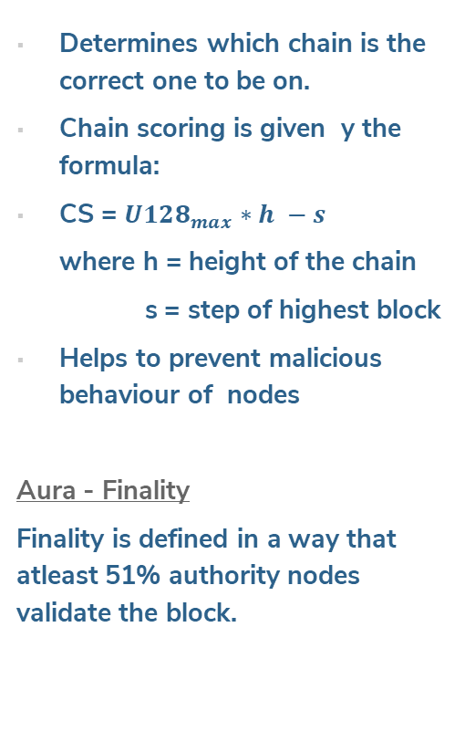
Methodology: Aura
Chain Scoring
Determines which chain is the correct one to be on.
Chain scoring is given y the formula:
CS = $U128_{max}∗h −s$
where h = height of the chain
s = step of highest block
Helps to prevent malicious behaviour of nodes
Aura - Finality
Finality is defined in a way that atleast 51% authority nodes validate the block.
Authority Node
T_{x}
T_{x}
T_{x}
T_{x}
T_{x}
T_{x}
T_{x}
T_{x}
T_{x}
T_{x}
T_{x}
T_{x}
T_{x}
T_{x}
T_{x}
T_{x}
T_{x}
T_{x}
T_{x}
T_{x}
Blockchain Network

Slide 14


Methodology: pBFT
pBFT (Practical Byzantine Fault Tolerance)
4 Phases of pBFT algorithm:
Client sends request to leader
node to invoke operation.
Leader multicasts the
request to backup nodes.
Nodes execute request
and reply to the client.
Client awaits f+1 (where f is maximum number of faulty nodes) replies from different nodes with the same result.
Authority Node
T_{x}
T_{x}
T_{x}
T_{x}
T_{x}
T_{x}
T_{x}
T_{x}
T_{x}
T_{x}
T_{x}
T_{x}
T_{x}
T_{x}
T_{x}
T_{x}
T_{x}
T_{x}
Blockchain Network

Slide 15
Methodology: pBFT
pBFT (Practical Byzantine Fault Tolerance)
Conditions:
Needs 66% consensus or 2/3rd
majority.
Faulty nodes should not be
more than 1/3rd of the total
nodes in the network.
Authority Node
T_{x}
T_{x}
T_{x}
T_{x}
T_{x}
T_{x}
T_{x}
T_{x}
T_{x}
T_{x}
T_{x}
T_{x}
T_{x}
T_{x}
T_{x}
T_{x}
T_{x}
T_{x}
Blockchain Network

Slide 16
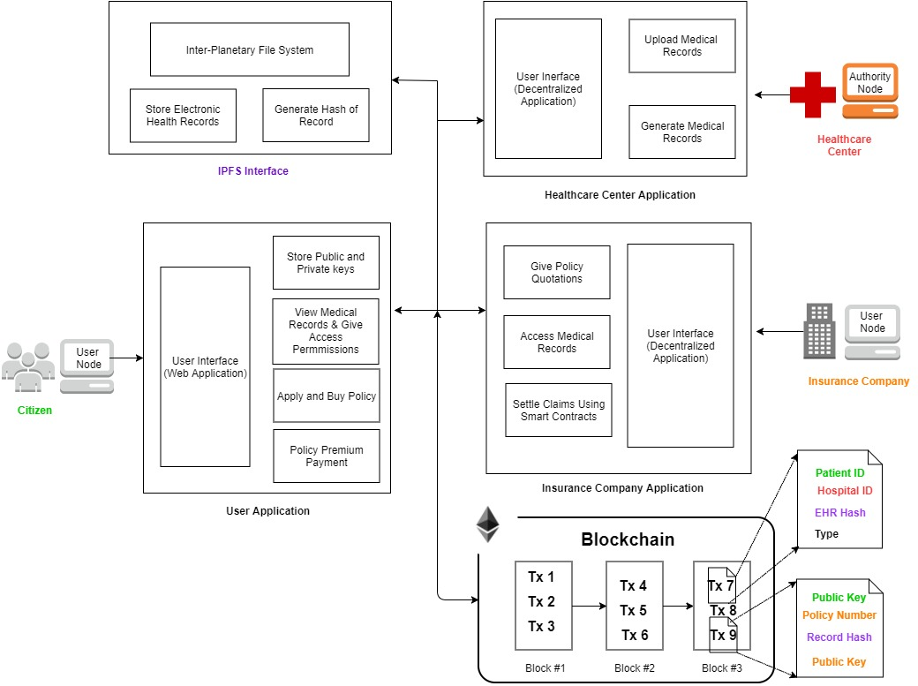
System Architecture

Slide 17
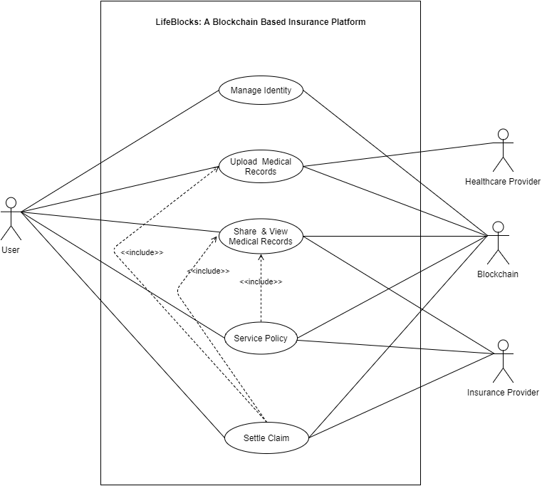
Use-Case Diagram

Slide 18
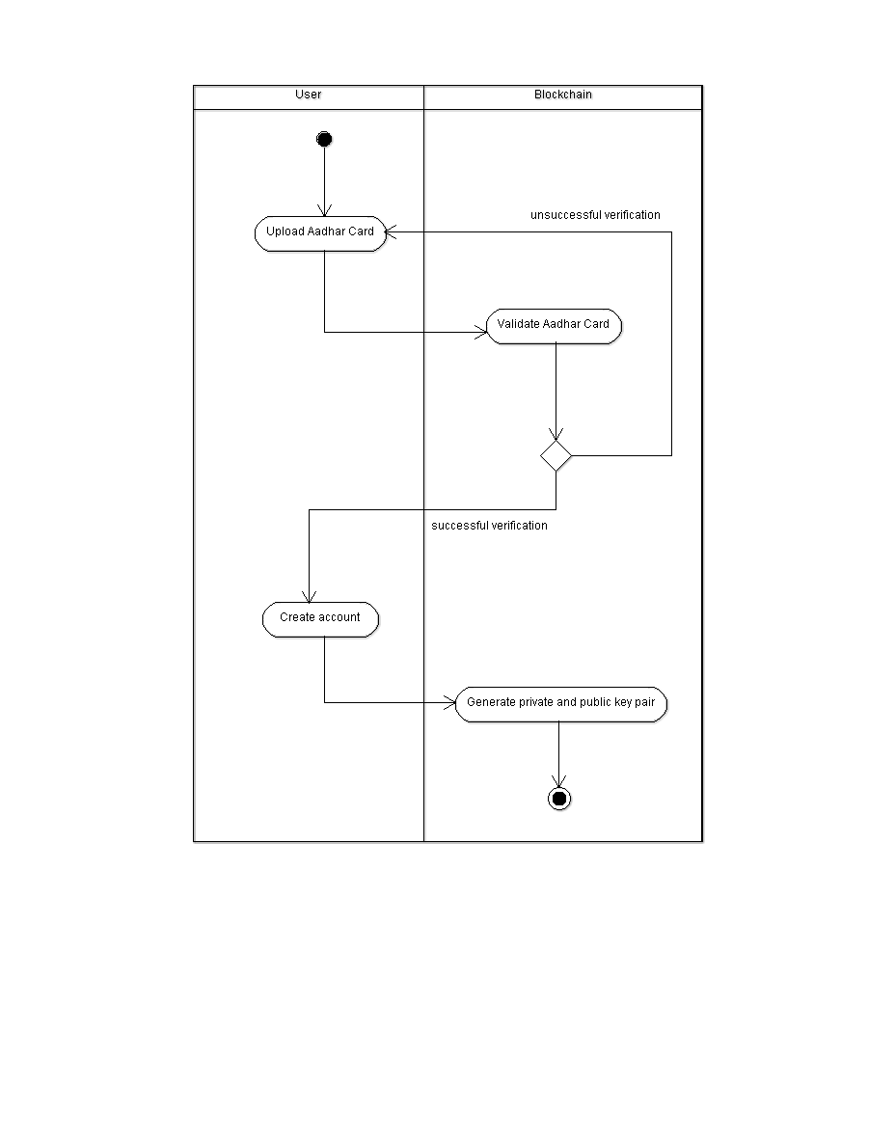
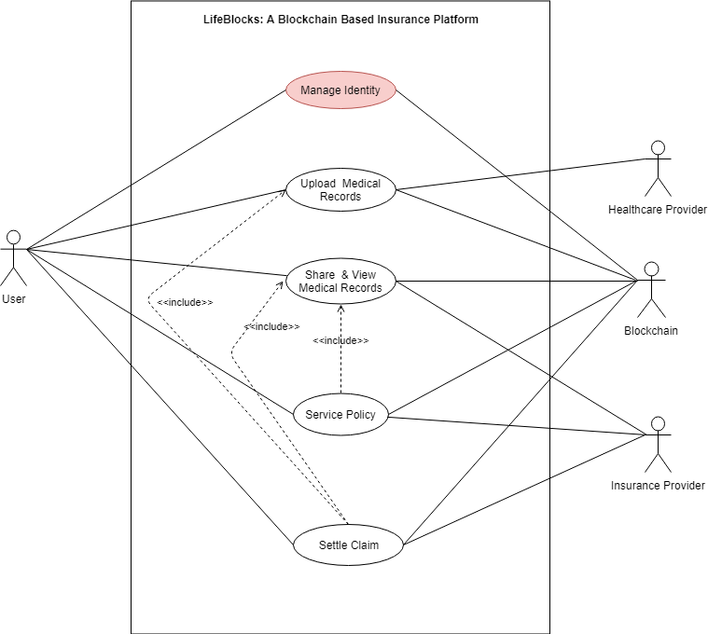
Activity Diagram Identity Management

Slide 19
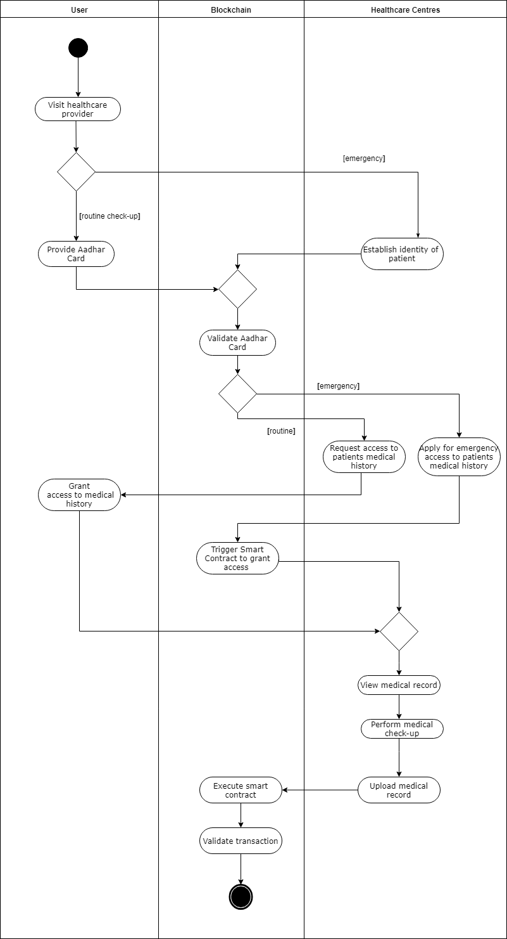
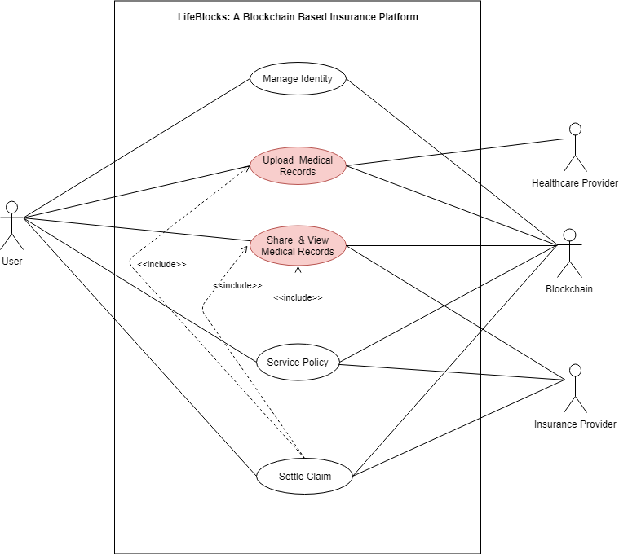
Activity Diagram EHR Storage and Access Permission

Slide 20
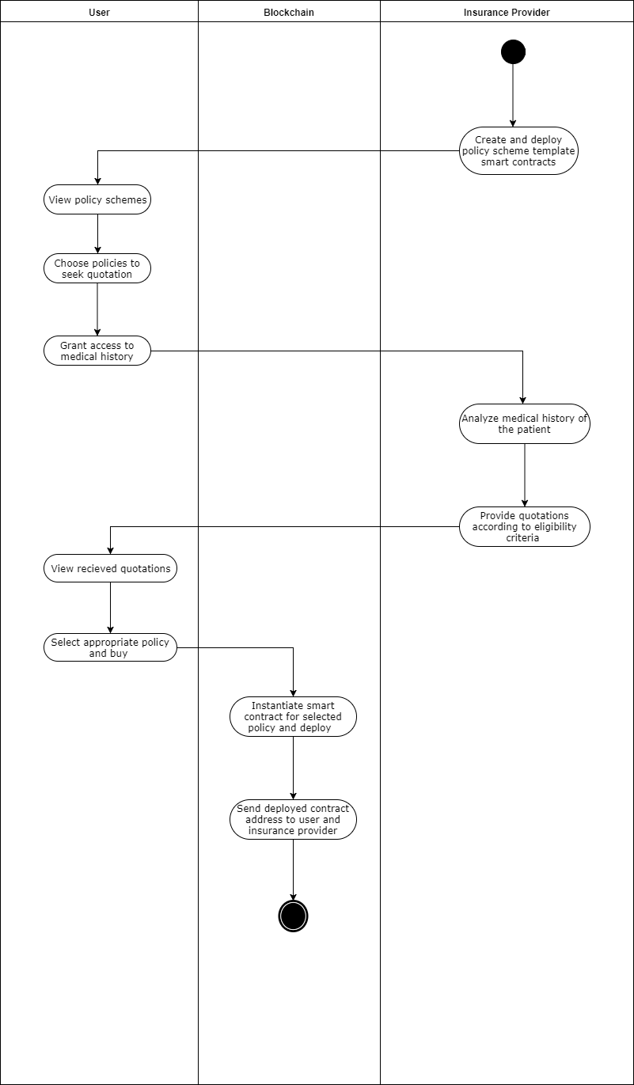
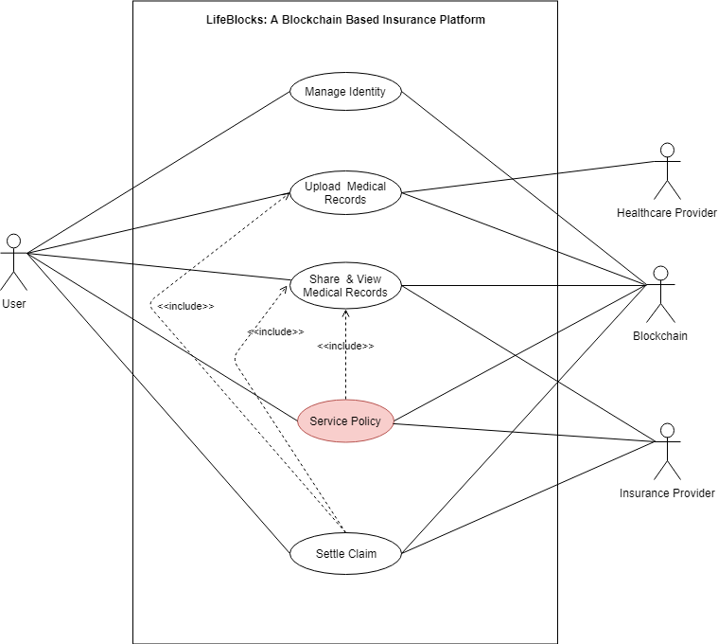
Activity Diagram Policy Servicing

Slide 21
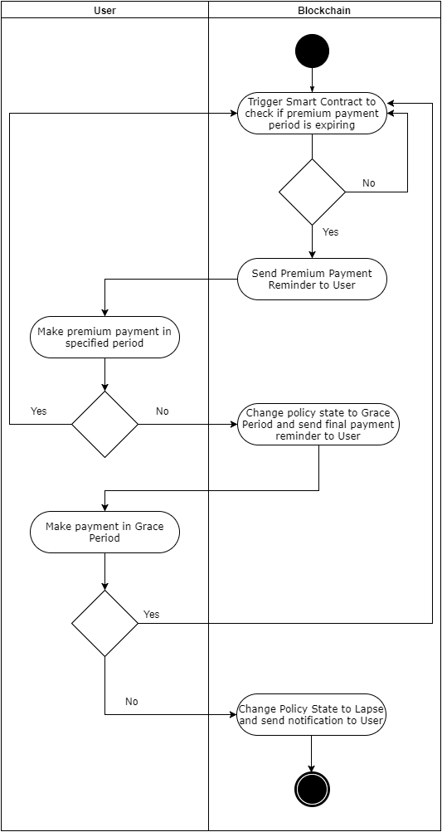
Activity Diagram Policy Servicing

Slide 22
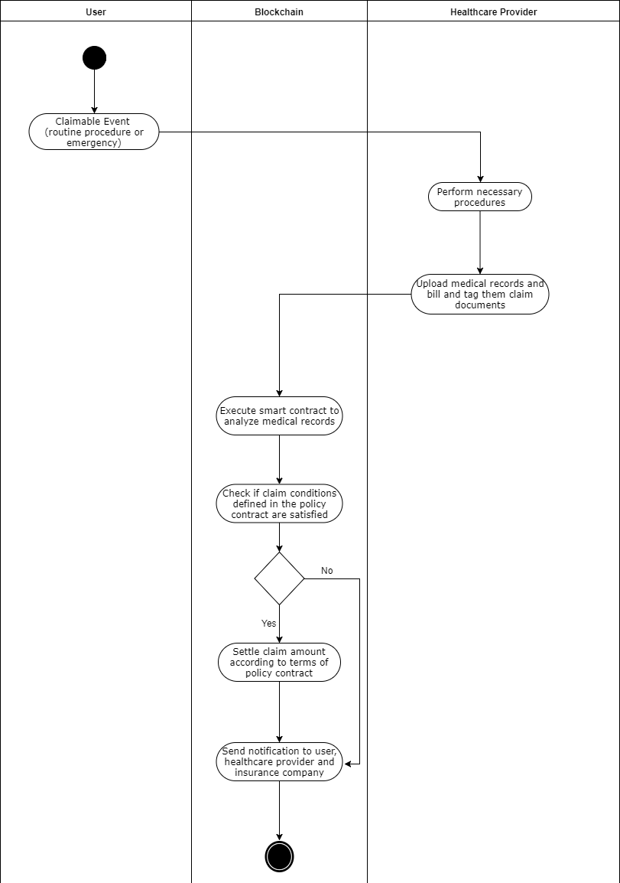
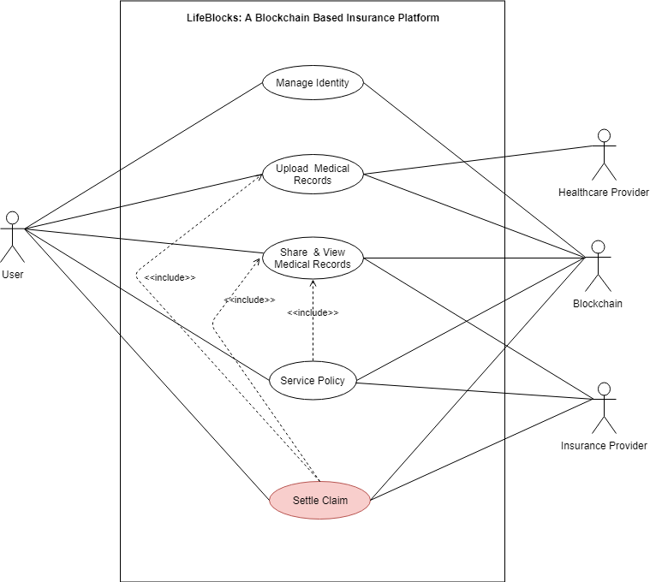
Activity Diagram Claim Settlement

Slide 23
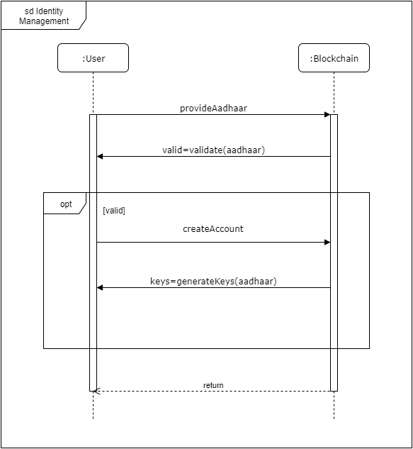
Sequence Diagram Identity Management

Slide 24
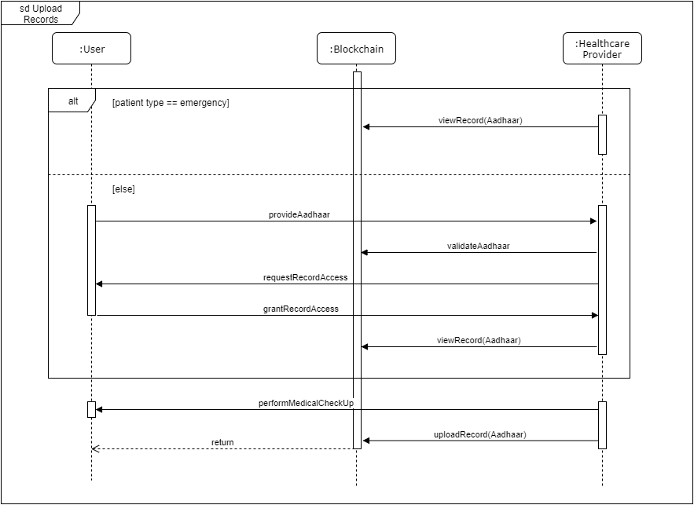
Sequence Diagram EHR Storage

Slide 25
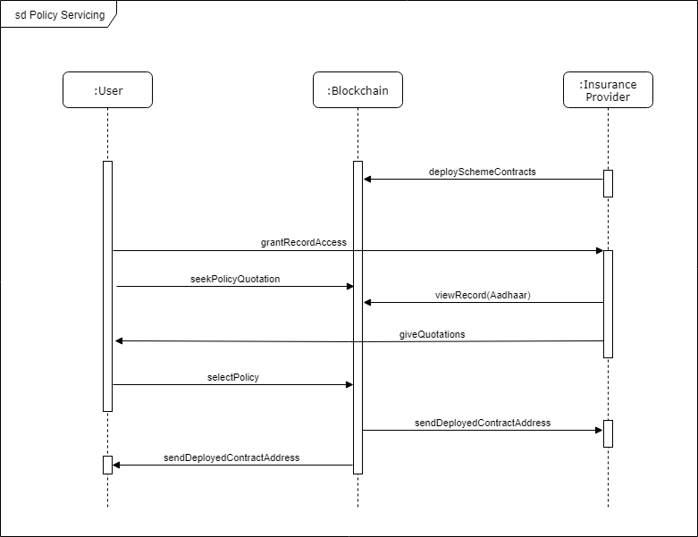
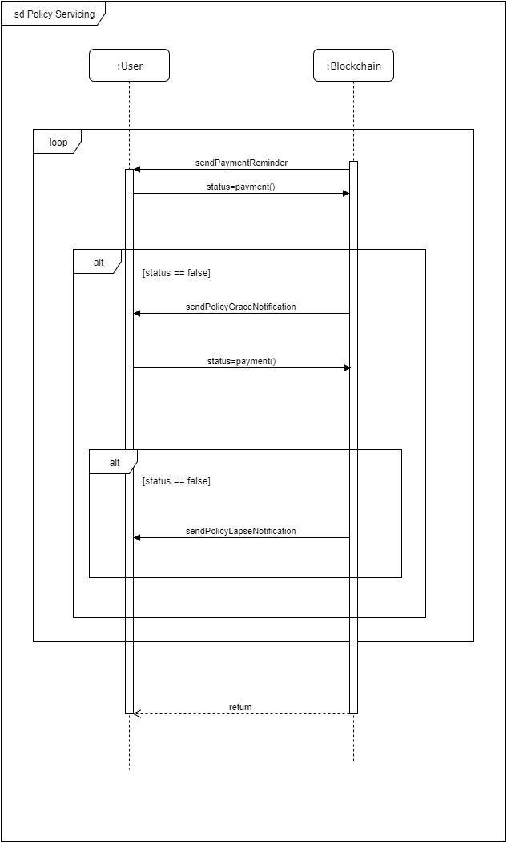
Sequence Diagram Policy Servicing

Slide 26
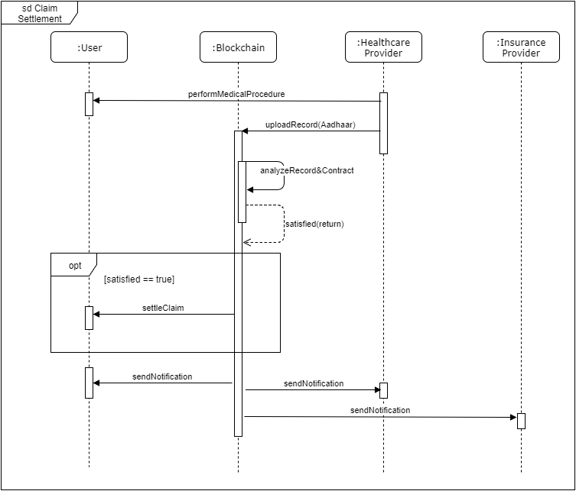
Sequence Diagram Claim Settlement

Slide 27
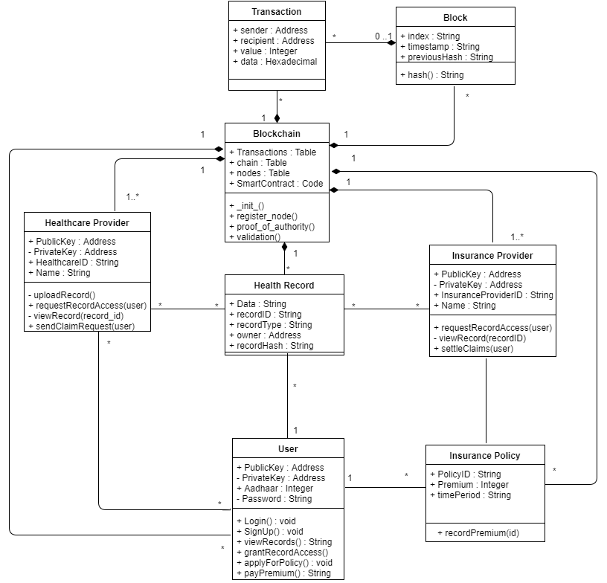
Class Diagram

Slide 28
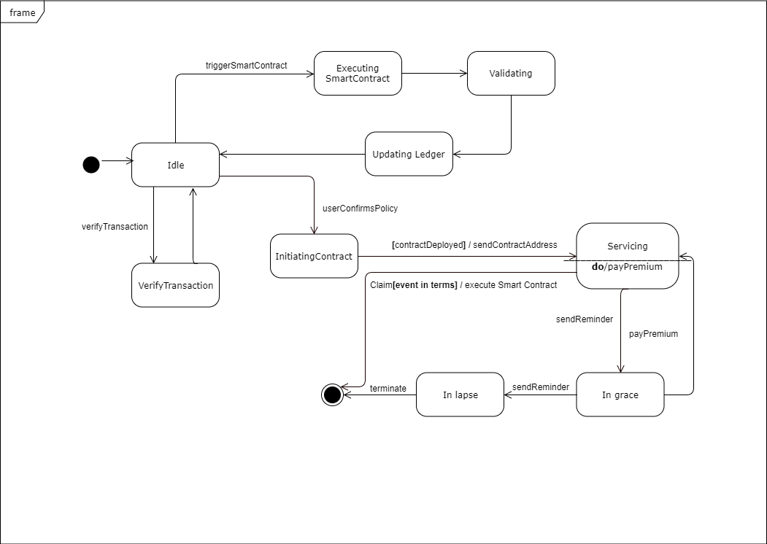
State Diagram

Slide 29
Software Technology/Tools
Sr. No | Technology/Tool | Description
1 | Blockchain | Distributed across a number of computers Time-stamped and Programmable Uses cryptography and digital signatures to prove identity
2 | Parity Ethereum | an open-source project built programmable - allows users to create their own operations of any complexity they wish
3 | IPFS InterPlanetary File System | Decentralization, fault tolerance and scalability. Distributed hash tables (DHT),stores information as key/value pairs.
4 | Smart Contract | Self-verifying Self-executing Tamper resistant

Slide 30

Outcomes
Hospitals/Mobile Clinics
Track medical history of patient
Achieve structural interoperability
Ease of record access
Real-time record uploading
Improve delivery of services
Government
Better management of health records
Economization(cost-reduction)
Basis for developing long-term strategy
Citizens
Health records stored securely
Easy to access records
Record portability
Easy to track medical history
Records shared with others to their discretion
Insurance Companies
Reduces middlemen required for policy
marketing and servicing
Less overhead for claim verification.
Quick claim settlement

Slide 31
THANK YOU

