Slide 1
Z
N=1 EXPLORATORY WALKTHROUGH · ZIPCAR.COM
Two things I couldn't make sense of
as a first-time visitor
P0
Category clarity
Validate first
I read Zipcar as a used-car marketplace for several seconds before the booking form loaded.
P1
Search feedback
Validate next
Changing the date/time gave no signal that my edit had been registered.
Neither is a validated finding. Both looked inexpensive to test with real users — that's what the rest of this is for.
Shikhar Shukla · Independent UX / behavioral researcher studying how interface conditions shape user interpretation and behavior.

Slide 2
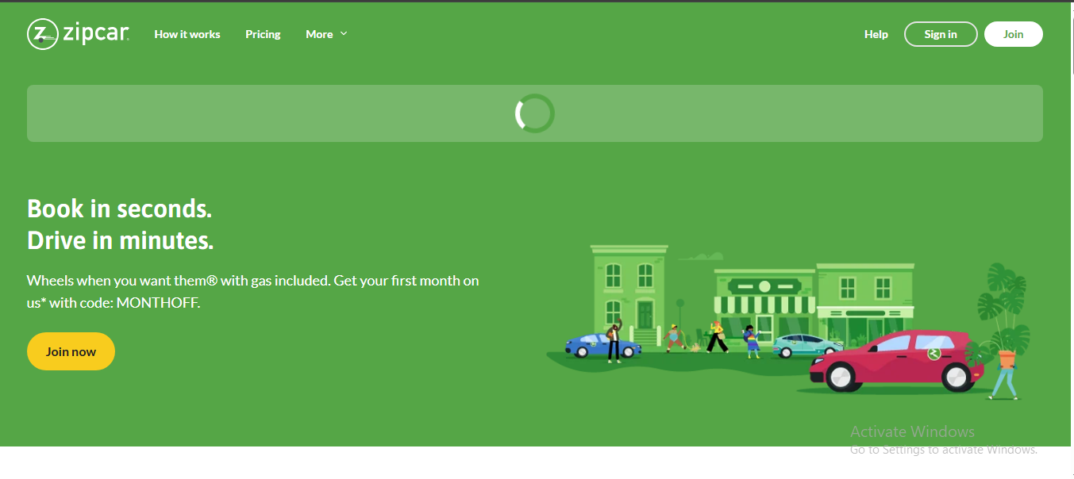
FINDING 01 · P0 — VALIDATE FIRST
The service category isn't clear
for several seconds
OBSERVATION
In the first seconds on the homepage I read Zipcar as a used-car marketplace. The hero
rendered instantly; the booking form (pick-up/return fields) loaded 2–3 seconds later. My
read shifted again mid-load: “taxi site” at “pick up,” then “car rental” once “return” appeared.
1
2
INTERPRETATION
The first viewport alone didn't establish the car-sharing model for me — that only
resolved once the delayed booking form finished loading and I read its fields.
HYPOTHESIS — untested
Stating the model explicitly and immediately (e.g. a static line: “Book a car by the hour
or day”) may shorten this comprehension delay for other first-time visitors.
1 Loading placeholder — the one element that resolves category ambiguity 2 What's visible reads as generic, not category-specific
01

Slide 3
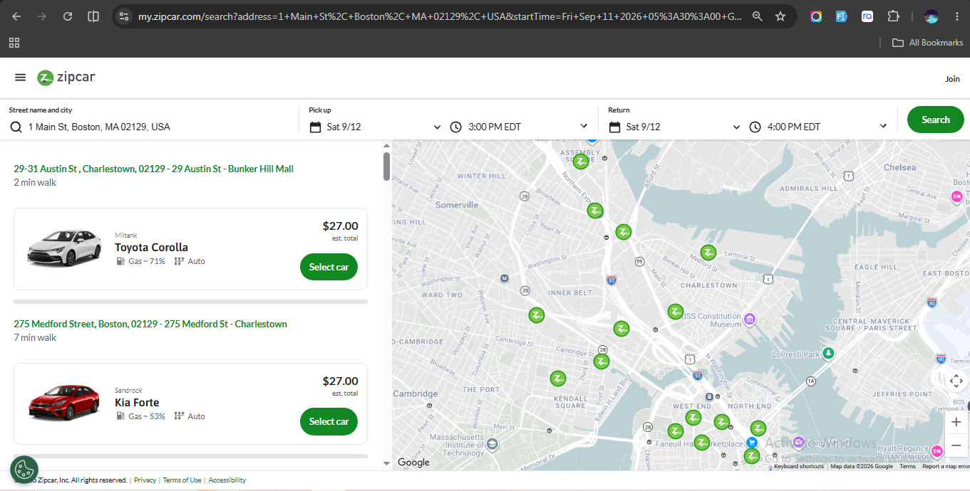
FINDING 02 · P1 — VALIDATE NEXT
Editing the form gives no signal
that anything happened
OBSERVATION
After changing the return time three times, results didn't update. Each time I paused
2–3 seconds expecting an automatic refresh, then had to locate and click “Search” on the
far right before seeing updated results.
2
1
INTERPRETATION
With no visible state change after editing a field, I assumed the system hadn't
registered my change — not that a manual step was simply required.
HYPOTHESIS — untested
A signal tied to the moment of change (not only the Search button's location) may
resolve this faster than either full auto-refresh or the current silent state.
1 Search button — the only place a click is actually required 2 Date / time fields — changed here with no visible response
02

Slide 4
WHAT I'D TEST
Z
Two cheap tests, before anyone builds anything
Test 1 — Category comprehension (5 users)
Test 2 — Search-state comprehension (5 users)
RESEARCH QUESTION
RESEARCH QUESTION
Can first-time visitors correctly identify Zipcar's service within 5 seconds?
Do people know whether on-screen results reflect their latest change?
TASK
TASK
Show the homepage for 5 seconds, hide it, ask “What do you think this company does?”
After changing return time, ask “Are these results up to date with what you just changed?”
SUCCESS
SUCCESS
4–5 of 5 identify car-sharing / hourly-or-daily rental, unprompted.
Correctly states current/not current, and can point to what told them so.
Why these two: they're the cheapest way to find out whether category confusion and search-state uncertainty
are real problems worth fixing — before anyone commits engineering time to a solution.
N=1 exploratory observation. Nothing here is validated yet.
Full report: https://docs.google.com/presentation/d/1rPqm54lZRCnCmpSDettAXGx5mGV_9Chi/edit?usp=drive_link&ouid=101182436828510892379&rtpof=true&sd=true
03

