Slide 1
Z
N=1 EXPLORATORY WALKTHROUGH · FTUE AUDIT
Zipcar First-Time Experience Audit:
Two Testable Friction Points Before Booking
An outside, self-run look at zipcar.com's first-time booking experience — with two
friction points that look cheap to validate with real users.
Prepared by
Shikhar Shukla
Method: FTUE walkthrough & heuristic evaluation · Evidence: N=1 self-observation
Independent UX / behavioral researcher studying how interface conditions shape user interpretation and behavior.

Slide 2
EXECUTIVE SUMMARY
I found two high-priority first-time-experience risks on Zipcar's homepage.
In a self-run exploratory walkthrough, I initially misread the service category, and couldn't tell whether an
edited search had been applied. Neither is a validated finding — both looked inexpensive to test with real users.
P0
Category clarity
Validate first
Clarify “car sharing” before the booking widget loads.
P1
Search feedback
Validate next
Show whether changed dates/times are pending or applied.
RECOMMENDED NEXT STEP
Run a 5-user comprehension + task test on both, compared against homepage → search conversion analytics.
Scope: N=1, self-run walkthrough and heuristic pass across two homepage visits. This surfaces testable
hypotheses — not statistically validated findings. Full detail in the appendix.
01

Slide 3
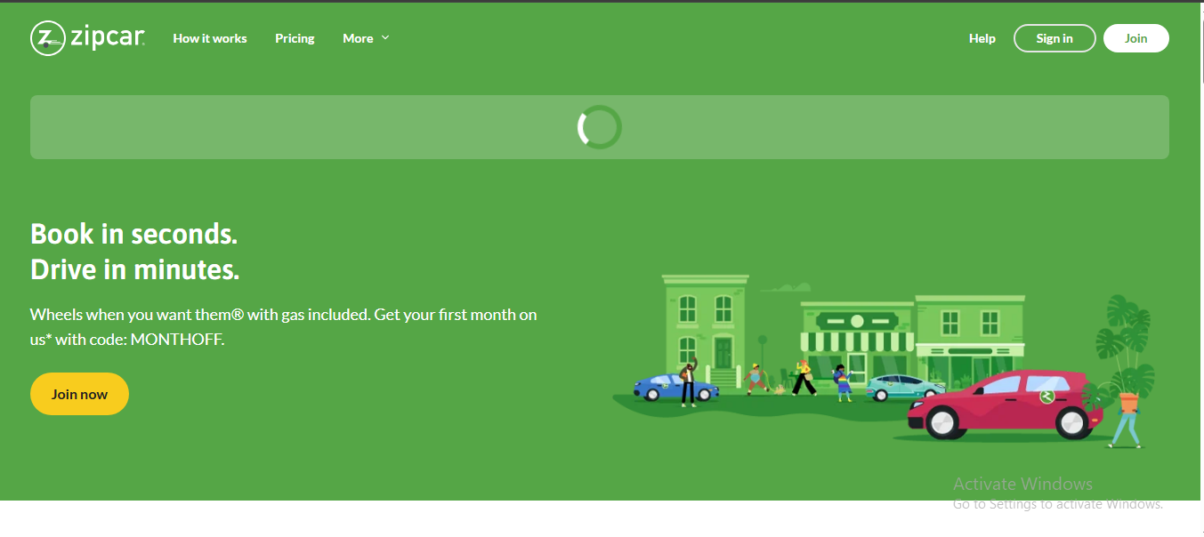
FINDING 01 · P0 — VALIDATE FIRST
The service category isn't clear
for several seconds
OBSERVATION
In the first seconds on the homepage I read Zipcar as a used-car marketplace. The hero
rendered instantly; the booking form (pick-up/return fields) loaded 2–3 seconds later. My
read shifted again mid-load: “taxi site” at “pick up,” then “car rental” once “return” appeared.
1
2
INTERPRETATION
The first viewport alone didn't establish the car-sharing model for me — that only
resolved once the delayed booking form finished loading and I read its fields.
HYPOTHESIS — untested
Stating the model explicitly and immediately (e.g. a static line: “Book a car by the hour
or day”) may shorten this comprehension delay for other first-time visitors.
1 Loading placeholder — the one element that resolves category ambiguity 2 What's already visible reads as generic, not category-specific
02

Slide 4
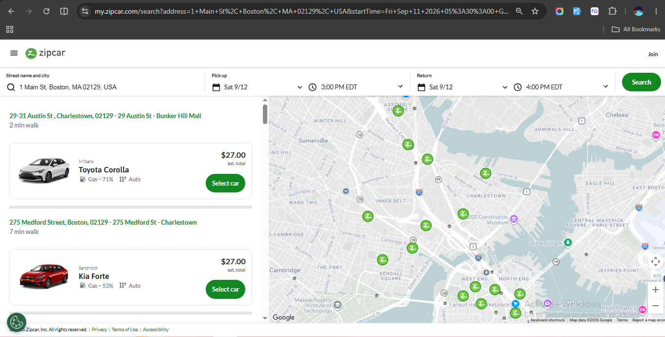
FINDING 02 · P1 — VALIDATE NEXT
Editing the form gives no signal
that anything happened
OBSERVATION
After changing the return time three times, results didn't update. Each time I paused
2–3 seconds expecting an automatic refresh, then had to locate and click “Search” on the
far right before seeing updated results.
2
1
INTERPRETATION
With no visible state change after editing a field, I assumed the system hadn't
registered my change — not that a manual step was simply required.
HYPOTHESIS — untested
A signal tied to the moment of change (not only the Search button's location) may
resolve this faster than either full auto-refresh or the current silent state.
1 Search button — the only place a click is actually required 2 Date / time fields — changed here with no visible response
My own reasoning: a manual click isn't inherently wrong — refreshing on every edit could
get irritating. The right call likely depends on how often people edit the form after
landing, which I don't have data on. See the Validation Plan for the options this suggests.
03

Slide 5
OTHER OBSERVATIONS
Three more findings — lower confidence or smaller likely effect
Finding | Observation | Hypothesis — untested | Priority
CTA hierarchy | “Join now” sits at nearly the same value as the hero background; I only noticed the white-background Search button unprompted. | A CTA using a color the background doesn't already own (Zipcar's own gold) may be noticed more reliably. | P1 — Validate next
Map behavior | Panning the map toward a different address made previously visible pins disappear until I re-searched. | Fetching pins for the visible map area as it's panned — not only the last search — may reduce false “no cars here” impressions. | P2 — Explore later
Gas label | “Gas ~40%” appears with no plain-language explanation of what it means or who pays. | Regular car-share users likely already read this like a phone battery level — the real gap is Zipcar's fuel policy (free, via an included card), unfamiliar to people new to car-sharing. | P2 — Explore later
Compressed here because my confidence is lower (map) or the likely effect is smaller (CTA, gas label) than the two
headline findings — not because they aren't real. Priority reflects validation urgency, not engineering priority.
04

Slide 6
BUSINESS IMPACT & WHAT TO MEASURE
I can't prove these effects from one walkthrough — here's what I'd measure to find out
UX finding | Business question | Metric to watch
Category clarity delay | Does first-visit comprehension affect homepage → search conversion? | Homepage → search conversion; 5-second comprehension test success rate
No search-change feedback | Do visitors retry, abandon, or submit stale searches? | Search abandonment; date/time edits per session; search retries
CTA hierarchy is weak | Does it reduce sign-up or booking engagement? | Sign-up click-through rate from homepage
Map pins disappear on pan | Might visitors incorrectly conclude no cars are available? | Map-pan → re-search rate; “no cars” impressions
Gas label unclear | Does this create hesitation or support questions? | Fuel-related support contact rate; drop-off at car-detail step
05

Slide 7
RECOMMENDED VALIDATION PLAN
Options to test, not a verdict
Category Clarity
P0
Search Feedback
P1
APPROACHES TO TEST
APPROACHES TO TEST
A. Static sub-headline (“Book a car by the hour or day”)
B. Skeleton screen instead of a blank pill
C. Category-specific hero imagery
A. Visual “ready to update” state
B. Debounced auto-refresh
C. Keep explicit Search, but glow/flag it the moment an input changes
TEST
TEST
Research question: Can first-time visitors correctly identify Zipcar's service within 5 seconds?
Task: Show homepage 5s, hide it, ask “What do you think this company does?”
Success: Identifies car-sharing / hourly-or-daily rental unprompted, 4-5 of 5 users.
Research question: Do people know whether on-screen results reflect their latest change?
Task: After changing return time, ask “Are these results up to date with what you just changed?”
Success: Correctly states current/not current, and can point to what told them so.
06

Slide 8
WHAT I'D DO NEXT
Z
If I joined the team tomorrow
P0
Validate product-category comprehension
High impact · easy to test
P1
Validate search-state expectations
High impact · easy to test
P2
Investigate map exploration with real users
Lower confidence · higher effort
P2
Test gas-label comprehension
Lower impact
THE TAKEAWAY
Zipcar doesn't necessarily need more information on the first screen. It needs the existing
information to become understandable sooner.
Shikhar Shukla · Questions, or want the full walkthrough recording? Happy to share — no strings attached.
07

Slide 9
APPENDIX A · METHOD & JOURNEY
How the walkthrough was run, and where it went
One participant — me — across two homepage runs (a first-time run and a repeat run), plus a self-run
heuristic pass. Think-aloud narration and screen-by-screen recording throughout. No other participants
were recruited.
1
2
3
4
5
6
7
8
Landing
Page
>
Interpret
Product
>
Booking
Form
>
Search
Results
>
Car
Selection
>
Map
Exploration
>
Modify
Search
>
Potential
Friction
Every finding in this deck sits on one of these eight steps — most of them before step 4.
Reading rule: wherever this deck says “may” or “hypothesis”, that's a conjecture from one person's walkthrough —
not a measured result. Nothing here should drive a roadmap decision without testing with real, multiple users.
08

Slide 10
APPENDIX B · HEURISTIC EVALUATION
A Nielsen-style pass over what I actually saw
Heuristic | Observation (from this walkthrough) | Severity
Visibility of system status | Booking widget shows a loading spinner while the rest of the hero has already rendered. | Medium
Visibility of system status | After changing pick-up/return date or time, nothing indicates whether the new query applied. | Medium
Match between system & real world | “Gas ~40%” appears with no plain-language explanation of what it means. | Low–Med
Consistency & standards | Primary (“Join now”) and secondary CTAs render in close to the same green as the background. | Medium
User control & freedom | Panning the map hides previously visible car pins without explaining why. | Med–High
HONEST SCOPE
WHAT ALREADY WORKS
One informal reference point: my first impression matched Spinny (a used-car marketplace) — not a structured competitive comparison. No other competitors were reviewed.
The half-cut mobile visual in “How Zipcar Works” broke my banner-blindness and got me reading all four steps — worth keeping and extending, not just fixing what's broken.
09

Slide 11
APPENDIX C · EXTERNAL CORROBORATION
Checking my own reaction against public reviews
I ran a small number of my own searches (Trustpilot, general web search) rather than relying on unverified
secondhand claims. This is signal extraction from a handful of reviews, not a prevalence estimate.
My observation | External signal | Verdict
Category clarity (P0) | No direct match found for “misread as used-car marketplace” — that stays unique to this walkthrough. A UK Zipcar marketing case study documents a broader category-awareness problem, but that's a different market and entity from the zipcar.com site audited here. | Not independently corroborated for this product — pattern exists elsewhere, not proof
Search feedback (P1) | A verified Trustpilot review of zipcar.com describes the app and filters as “confusing” and inconsistent — adjacent to, but not a precise match for, the specific no-feedback-after-editing behavior I observed. | Adjacent signal, not a direct match — still needs testing
Gas label (P2) | Verified Trustpilot reviews (US and UK) describe real frustration with fuel cards — mostly missing or non-functional physical cards and billing disputes, not the on-screen “Gas ~40%” label itself. | Related pain point confirmed; my specific label-clarity finding is not directly confirmed
CTA hierarchy, Map behavior | No verifiable public complaints found for either in the sources I checked. | No external signal found
Public review signal is dominated by post-booking problems (billing, vehicle condition); this audit focuses on
pre-booking behavior. External evidence increases the case for testing — it does not validate the mechanism.
10

