Slide 1

UX RESEARCH CASE STUDY
Buying a Cycle on
Decathlon.in
A Heuristic Evaluation of the Online Purchase Journey
EVALUATOR
DATE
PRODUCT
TASK
Shikhar Shukla
September 2026
Decathlon.in (India)
Purchase a cycle,
start to finish
Framework: Jakob Nielsen's 10 Usability Heuristics — Nielsen Norman Group

Slide 2
METHODOLOGY
The Walkthrough
Task — buy a cycle for exercise, start to finish: home page to payment confirmation, the way an ordinary shopper would.
SEVEN GUIDING QUESTIONS
1. Compare products without opening many tabs?
2. Are delivery charges shown early enough?
3. Are taxes and fees transparent?
4. Can quantity be changed or an item removed easily?
5. Are return and warranty conditions understandable?
6. Is “Buy now” / “Add to cart” visually clear?
7. Does checkout show progress?
Method — walked step by step against seven questions on discoverability, pricing, cart control, policy clarity, and checkout feedback; each friction point mapped to the Nielsen heuristic it violates.
Scope — six heuristics were the original focus. A seventh, Consistency and Standards, surfaced on its own and earned a place too.
THE FUNNEL
Home
Search
Product
Page
Cart
Delivery
Payment
● Friction found during the walkthrough

Slide 3

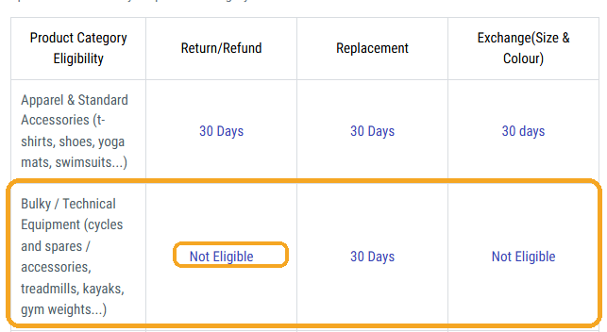
HIGHEST-IMPACT FINDING
This cycle can't actually be returned.
Buried in the return policy's eligibility table — reachable only via a footer link on the product page, several scrolls down — is the line that mattered most before checkout: Bulky/Technical Equipment, the category covering cycles, is Not Eligible for Return or Refund. Only a Replacement within 30 days is available; even a size or colour exchange is off the table.
Nothing on the product page, cart, or checkout discloses this. A shopper who assumes the standard 30-day return shown elsewhere on the same page learns otherwise only by going looking for it — usually after paying.
Return-eligibility table — Bulky/Technical Equipment row
BUSINESS IMPACT This is the kind of gap that turns into a return dispute, a support ticket, or a public complaint — discovered after the sale, not before it.
HEURISTICS IMPLICATED Recognition Rather Than Recall · Match Between System and the Real World

Slide 4

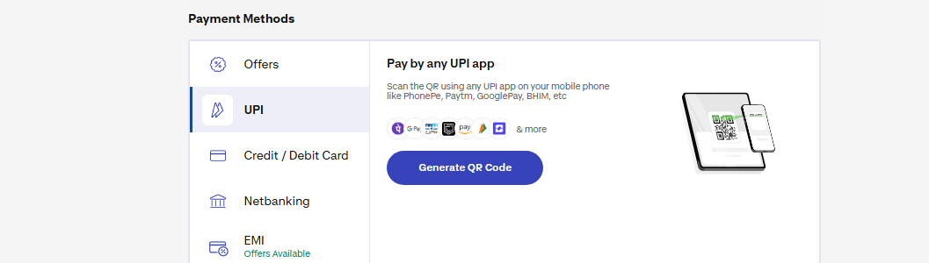
HEURISTIC 1
Visibility of System Status
Keep people informed about what's happening — with clear, fast feedback after every action.
LOCATION
Checkout → Payment step
MEDIUM PRIORITY
Clicking “Proceed to pay” triggers a 15–20 second wait with no spinner, progress bar, or message — long enough that the tester reconsidered the ₹6,999 purchase mid-wait.
Checkout progress bar — low contrast
Payment page — after the 15–20s wait
LOCATION
Checkout → Delivery step
LOW PRIORITY
A step progress bar does exist, but its fill colour barely contrasts with the white background — the one control built to show checkout progress is easy to miss entirely.
RECOMMENDATION Add a loading indicator (spinner + reassuring microcopy) for the payment redirect, and restyle the progress bar with real contrast against its background.
DECATHLON.IN — HEURISTIC EVALUATION
01

Slide 5

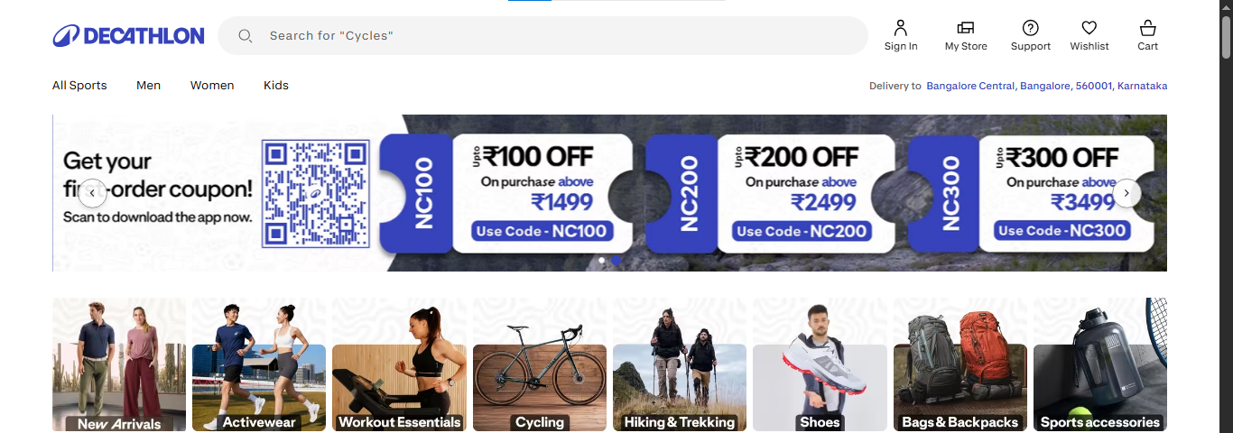

HEURISTIC 2
Match Between System and the Real World
Speak the user's language. Match real-world conventions instead of internal logic or jargon.
LOCATION
Home & category pages
MEDIUM PRIORITY
Homepage — offers before products
The homepage opens with a full-width discount banner before any products, and category pages repeat the pattern. Real-world shopping runs the other way: item first, then price, then whatever discount applies.
Order summary — “Convenience fee”
LOCATION
Cart → Delivery step
MEDIUM PRIORITY
The delivery charge is labelled “Convenience fee,” not “Delivery fee” — and it isn't shown until the delivery step, three clicks into checkout.
RECOMMENDATION Lead category templates with products, not promos. Rename “Convenience fee” to a plain “Delivery fee” and surface it as early as the cart page.
DECATHLON.IN — HEURISTIC EVALUATION
02

Slide 6

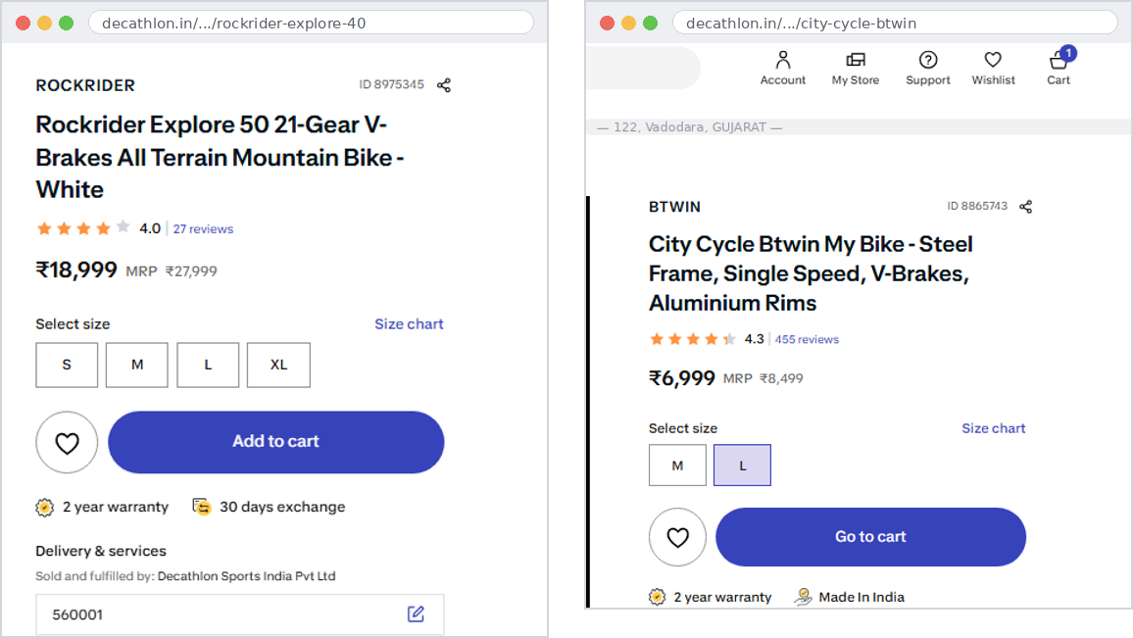
HEURISTIC 3
Consistency and Standards
Similar things should look, behave, and mean the same — and match the patterns users already know.
Not on the original checklist — this one surfaced on its own during testing.
LOCATION
Product listing & detail pages
MEDIUM PRIORITY
Two tabs, two prices — no built-in way to compare
There's no way to compare two products side by side. Comparing the BTWIN against the Rockrider meant a second browser tab — the workaround Jakob's Law predicts.
LOCATION
Product detail page
HIGH PRIORITY
“Add to cart” permanently swaps to “Go to cart.” There's no way to add a second unit of the same item without refreshing the page — which then reverts the button and loses that state again.
BUSINESS IMPACT Every blocked re-add is a shopper who either gives up on the second unit or opens a second tab — both cost the sale its momentum.
RECOMMENDATION Add a lightweight compare tray (2–3 items). Replace the one-way button swap with a persistent quantity stepper, the way the cart page itself already works.
DECATHLON.IN — HEURISTIC EVALUATION
03

Slide 7

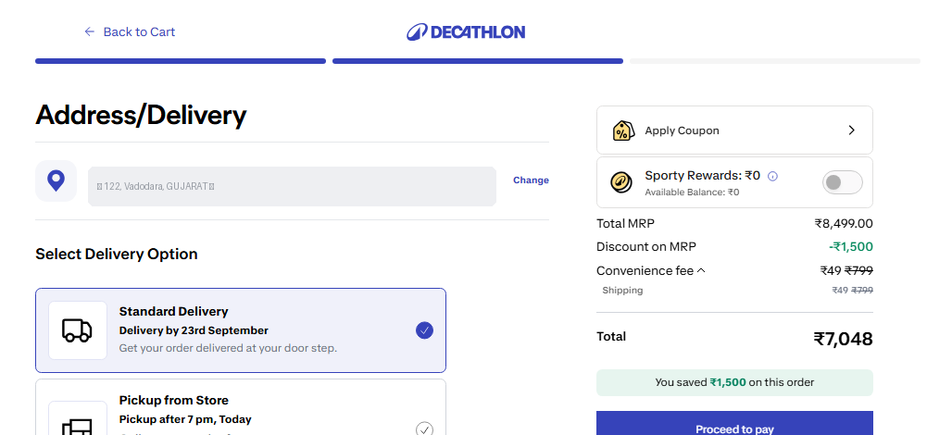
HEURISTIC 4
User Control and Freedom
Let people move freely, undo mistakes, and exit an unwanted path without extra friction.
Delivery step — tied to a saved account address
LOCATION
Cart → Delivery step
MEDIUM PRIORITY
Checking delivery availability and cost requires being logged in with a saved address — there's no lightweight, pincode-only way to preview it earlier, unlike every other browsing step on the site. And there's no “Buy Now” either: every purchase, however certain the shopper is, is routed through Add to Cart → Cart → Delivery → Payment, with no shortcut.
RECOMMENDATION Let shoppers check delivery availability and fees with just a pincode before requiring login. Consider a “Buy Now” fast path for single-item purchases.
DECATHLON.IN — HEURISTIC EVALUATION
04

Slide 8

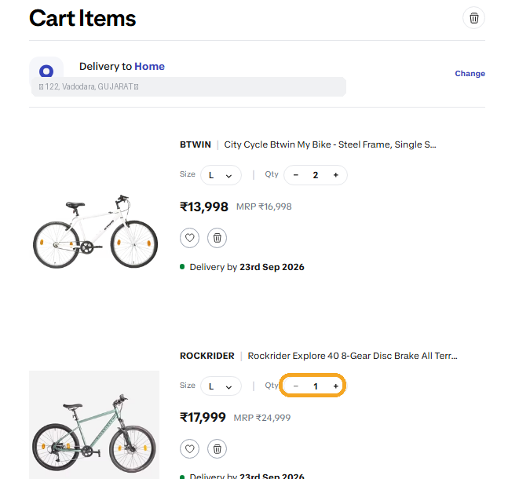
HEURISTIC 5
Error Prevention & Recovery
Prevent problems before they happen — and if one still slips through, say so plainly rather than failing silently.
One finding, two heuristics: Error Prevention, and Help Users Recognize, Diagnose & Recover from Errors.
LOCATION
Cart page — quantity control
HIGH PRIORITY
The same “−” control behaves two ways: with two units it decrements normally; at exactly one unit, it does nothing — no message, no disabled state, no explanation. The only way to remove that item is a separate trash icon, found only after several dead clicks.
BUSINESS IMPACT A control that looks live but does nothing is exactly where shoppers abandon carts or file “broken site” complaints.
RECOMMENDATION Make the control's state visible — grey it out or swap it for the trash icon once quantity reaches one. And when an action can't complete, say so: even a one-line tooltip turns a dead click into a resolved one.
DECATHLON.IN — HEURISTIC EVALUATION
05

Slide 9

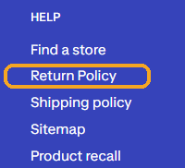
HEURISTIC 6
Recognition Rather Than Recall
Keep what people need visible in the moment — don't make them recall it from an earlier screen.
LOCATION
Product page vs. Cart page
MEDIUM PRIORITY
Footer — the only way to reach the return policy
Return and warranty terms aren't shown on the product page or the cart page — the two places a shopper is actually deciding. The only path is a footer link, and the footer itself doesn't exist on the cart page at all.
LOCATION
Return Policy page
LOW PRIORITY
The section that actually answers “can I return this?” sits below several paragraphs repeating the same boilerplate sentence without adding new information.
RECOMMENDATION Surface a short return/warranty summary directly on the product page. Keep the footer consistent across cart and product pages, and move the eligibility table above the repeated intro text.
DECATHLON.IN — HEURISTIC EVALUATION
06

Slide 10
SUMMARY
Findings at a Glance
9 issues across 6 heuristics — logged the way the workbook asks: principle, location, and priority.
HEURISTIC | ISSUE | LOCATION | PRIORITY
Visibility of System Status | Payment redirect has no loading feedback (15–20s); checkout progress bar too faint to notice | Checkout → Payment/Delivery | Medium
Match Between System & Real World | Discount banner precedes products on Home/category pages | Home & category pages | Medium
Match Between System & Real World | Delivery fee mislabeled “Convenience fee,” shown late | Cart → Delivery | Medium
Consistency and Standards | No product-comparison feature | Product listing/detail | Medium
Consistency and Standards | “Add to cart” locks to “Go to cart,” blocking re-add | Product detail page | High
User Control and Freedom | Login/address required just to check delivery fee; no “Buy Now” shortcut | Cart → Delivery | Medium
Error Prevention & Recovery | Qty “−” control silently fails at Qty = 1, with no fallback message | Cart page | High
Recognition Rather Than Recall | Return/warranty info absent from product & cart pages | Product & Cart pages | Medium
Recognition Rather Than Recall | Cycles ineligible for return/refund, undisclosed pre-purchase | Return Policy page | High
DECATHLON.IN — HEURISTIC EVALUATION
10

Slide 11
CLOSING
What Would Move the Needle
Ship in 2 Weeks
Needs a Product Decision
No roadmap needed — copy, style, and small front-end fixes
Roadmap items — cross-team scope or structural change
Rename “Convenience fee” to “Delivery fee”
Product comparison across listings
Restyle the checkout progress bar for real contrast
Persistent “add to cart” as a quantity stepper, not a one-way button
Pincode-only delivery check before requiring login
Add a one-line return/refund disclosure on cycle & bulky-item pages
Fix the qty “−” control's silent failure at Qty = 1
Add a loading spinner for the payment redirect
Reordered templates: products before promos
Six of Decathlon.in's ten usability heuristics surfaced friction somewhere in a single purchase — most of it fixable without a redesign, just a more honest default: show the cost, the policy, and the state of the system before the shopper has to go looking for them.

