Slide 1
NIELSEN NORMAN GROUP TEMPLATE · APPLIED EVALUATION · BRIEF
Heuristic Evaluation — Brief
Wise.com — international transfer and signup, evaluated for a first-time, India-based visitor
EVALUATOR
DATE
PRODUCT
TASK
Shikhar Shukla
16 Sep 2026
Wise.com (Personal)
Fees, rate, delivery, eligibility, signup
TOP PRODUCT RISK
Pricing is discoverable, but an India-based visitor cannot determine whether a personal account is available to them. Selecting “Personal” and “India” during signup returned the form to its previous screen with no message — creating avoidable uncertainty at the highest-intent moment in the funnel.
F1 · High
Silent signup loop
F2 · High
Eligibility not surfaced
F3/F4 · Med
No rate/time-zone context
Independent, single-evaluator review applying Jakob Nielsen's 10 usability heuristics — not commissioned by or affiliated with Wise. This brief summarizes a full 16-slide evaluation; see the companion deck for all 10 heuristics and full before/after mockups.

Slide 2
WHAT I FOUND
Priority findings
ID | Finding | Product risk | Verified? | Sev.
F1 | Personal + India signup loops silently | Reads as a broken product, not a policy | Behavior: yes · reason: no | High
F2 | India eligibility not surfaced pre-signup | Visitor must search externally to find out | Behavior: yes | High
F3/F4 | No reference rate; arrival has no time zone | Visitor leaves the page to verify both | Behavior: yes | Medium
What's confirmed vs. what needs verification
Confirmed: the signup form silently fails for Personal + India — screenshotted, not inferred. Not yet confirmed: the specific reason (Wise doesn't serve personal accounts to India) is sourced from an external search, not Wise — confirm before naming it in any live message.
THE JOURNEY AT A GLANCE
1–2. Homepage → pricing
Succeeded
3–4. Calculator & fees
Partial
5. Eligibility search
Failed
6. Account creation
Failed
WISE.COM — HEURISTIC EVALUATION, BRIEF
2 / 6

Slide 3
WHAT TO CHANGE
Three recommendations
1
Replace the silent signup reset with an explicit restriction message
State the reason in place, with a route to any available alternative, the moment the blocked combination is detected.
⚠ Confirm the specific reason with Wise before naming India in live copy.
2
Surface country eligibility before signup begins
Show a short, country-aware eligibility line on the pricing and send-money pages once the country is known.
3
Give the calculator enough context to be interpreted
Add a mid-market reference rate beside the quoted rate, and an explicit time zone on the arrival estimate.
WISE.COM — HEURISTIC EVALUATION, BRIEF
3 / 6

Slide 4
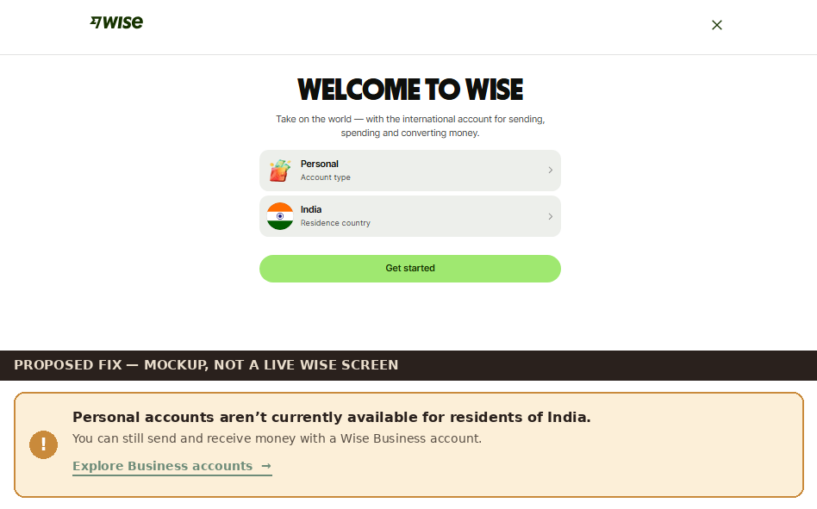
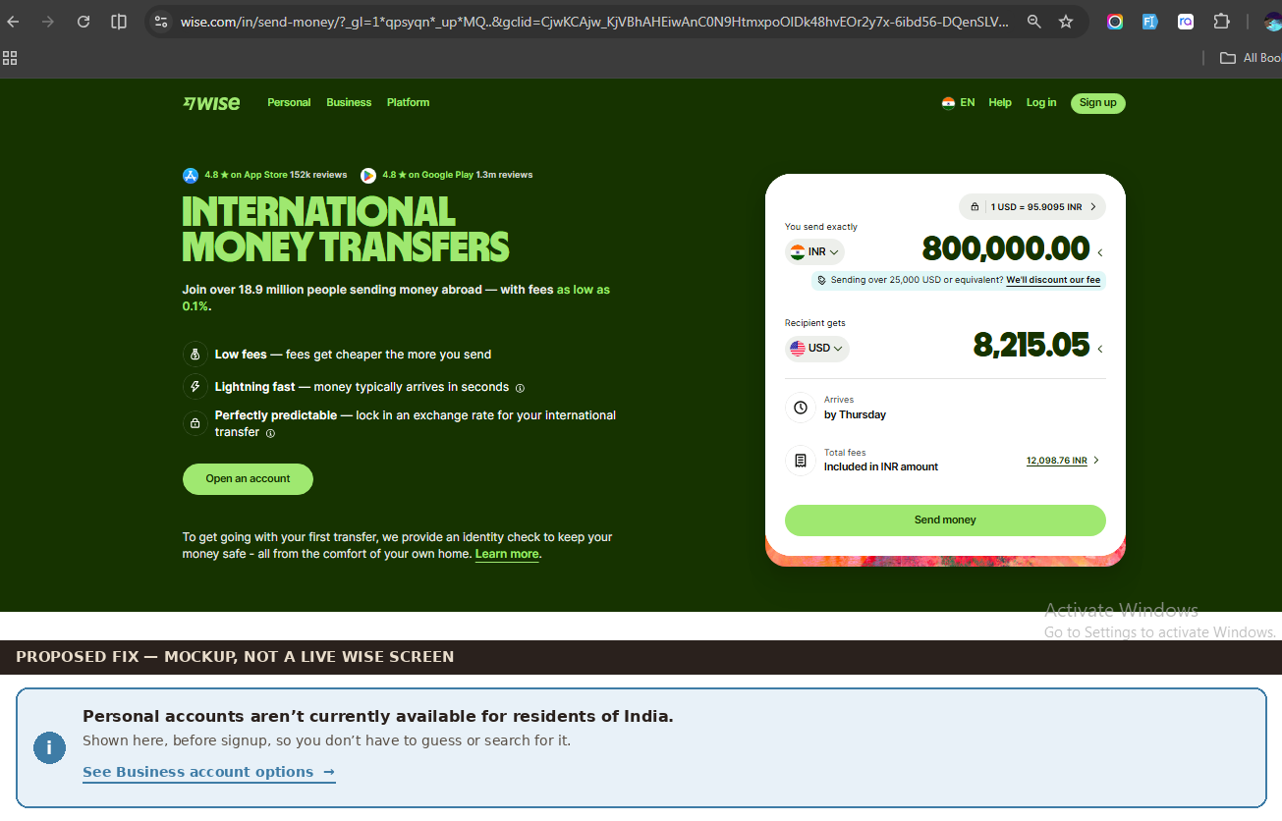
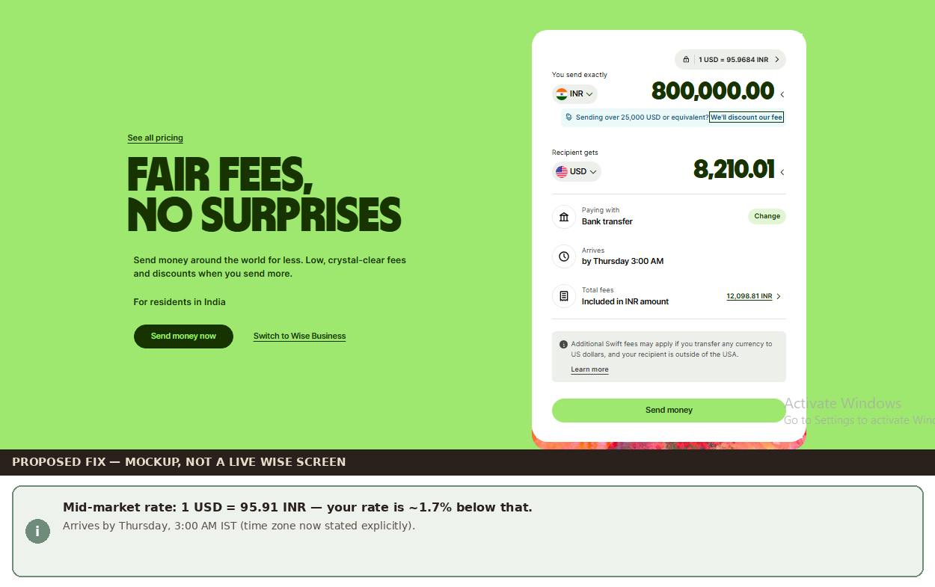
SHOW, NOT JUST TELL
Proposed fixes, at a glance
Mockups only — not live Wise screens. Full before/after pairs are in the companion deck (slides 13–15).
REC 1
REC 2
REC 3
An inline message replaces the silent signup reset.
Eligibility is stated on the send-money page, before signup.
A mid-market rate and explicit time zone are added to the calculator.
⚠ Before shipping: all wording above is illustrative and needs product/compliance confirmation — especially the reason named in Rec 1 and Rec 2.
WISE.COM — HEURISTIC EVALUATION, BRIEF
4 / 6

Slide 5
HOW THIS WAS DONE
Method and limitations
01
Same evidence base
One first-time-visitor walkthrough, 16 screenshots, six decision points — spanning homepage, pricing, eligibility search, and signup.
02
Ten heuristics applied
Jakob Nielsen's 10 usability heuristics, each with one issue, one piece of evidence, one recommendation. Full detail in the companion deck.
03
Single evaluator
Expert walkthrough, not participant research — findings are hypotheses to validate, not measured usability rates.
04
Next step proposed
Moderated sessions with 5–8 first-time, India-based visitors; measure task completion, external tab-switches, and signup completion.
WISE.COM — HEURISTIC EVALUATION, BRIEF
5 / 6

Slide 6
SUMMARY
Three issues to act on first
H9
No error message when signup fails
Personal + India returns silently — the single highest-impact fix.
H6
Eligibility isn't recognizable in context
The visitor must recall and search for information the product already has.
H1
No system status during the signup loop
Zero feedback after a blocked selection reads as a broken product, not a policy.
Full detail: all 10 heuristics, full before/after mockups, and the complete walkthrough log are in the companion 16-slide deck.
Template: Nielsen Norman Group's Heuristic Evaluation Workbook (nngroup.com/articles/ten-usability-heuristics). Independent review, not commissioned by Wise.
6 / 6

