Slide 1
June 2026
AetherMind Document Ingestion
Intelligent Document Extraction, Understanding, and Reconstruction Platform

Slide 2

AetherMind
Lossless Geometry Extraction & Multi-Agent Document Reconstruction
Enterprise document extraction systems struggle to reconstruct high-fidelity layouts because spatial geometry and structural semantics are discarded by flat-text engines.in raw layout streams and is hard to extract. The goal of the solution is to clean this data in Native XML/PDF using Gen AI, create a single source of truth for layout distortion of components and then use it to improve layout extraction planning, cost estimation and layout reconstruction.
Ingestion & UI Region Cropping
Format-Specific Extractor Layer
Multi-Stage OCR Processing
Multi-Agent Relational Analysis
Visual Rendering & Validation
Cropping screenshots heuristically removes UI chrome to isolate slide bounds
Native PPTX and PyMuPDF extractors map raw coordinate structures
OCRPostProcessor deduplicates coordinates, merges fragments, and cleans numerical values
12+ parallel sub-agents map spatial links, reading orders, and diagram trees
FormRenderer renders PDF/PNG pages to calculate SSIM validation scores
Chrome Crop
XML Shape Parse
OCR Bounding Box
Spatial Graphs
Mermaid Synthesis
Visual Rendering & Validation
SlideRegionDetector trims application boundaries and crops visual canvases
Extracts shapes, native tables, and connector lines from XML files
Extracts raw EasyOCR blocks with coordinate polygons
RelationshipService logs containment, visual grouping, parent-child hierarchies, and proximity grids
Stock check and
interact with procurement teams
Allocate tasks to upcoming ingestion batches to processing thread based on per-hour basis and
skill
Scale Mapping
Numeric Correction
Maps coordinate scales safely to maintain visual proportions
Vector PDFs Parse
(supporting agent)
Tracks bounding boxes and styles using PyMuPDF drawings
Runs correct_ocr_numeric_substitutions to fix OCR typos
Ingestion Operator
Format Extractor
Orchestration Agent
OCR Post-Processor
Validation Auditor
Downstream LLM
Business Impact
Layout Extraction Engine
Extracts coordinate-based geometries to ensure 100% layout and border preservation.
Improves RAG Relevance: Layout-aware extraction reduces downstream reasoning errors while preserving visual context.
Automates structural form validation audits using closed-loop SSIM visual tests.
Structured blue-prints
View Code
Link to repository

Slide 3
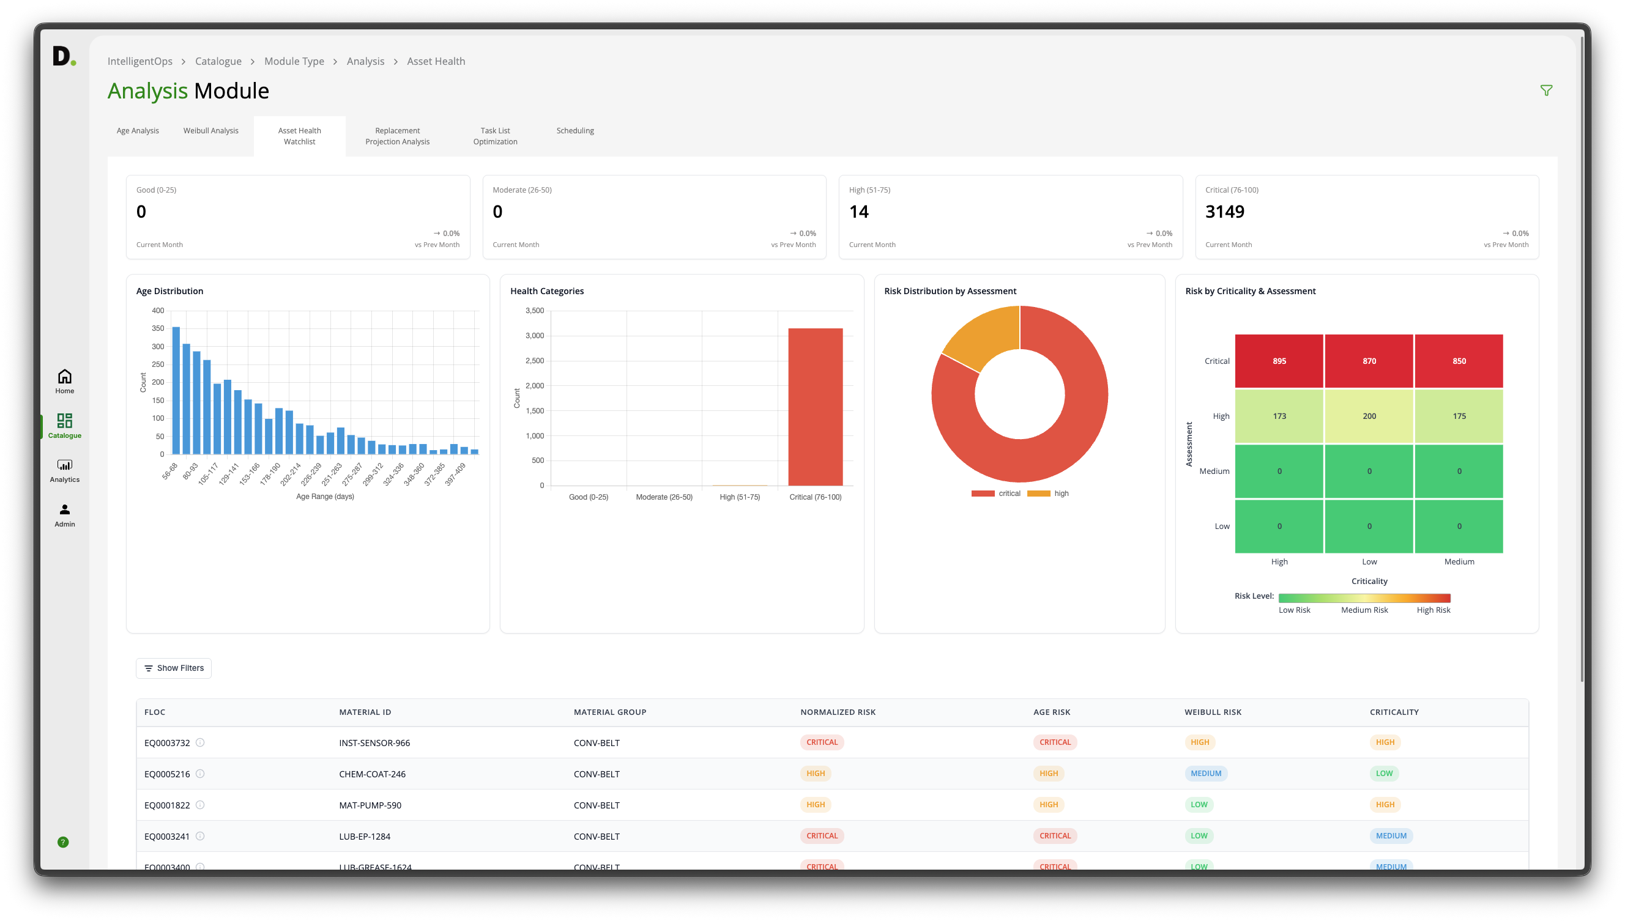
AetherMind Document Ingestion – Executive Summary
Background
Enterprise documents (presentations, forms, PDFs) contain rich spatial and semantic structures. Traditional text RAG pipelines flatten layout formatting, collapsing table cell grids and discarding flowchart directional arrows. This data loss destroys the visual structure needed for downstream LLM understanding.
This leads to several persistent challenges:
▪ Flat-text engines discard layout geometry and coordinates, corrupting reading order.
▪ Table cell grids collapse, losing row/column spans and data alignments.
▪ Checkboxes, lines, flowcharts, and drawings are omitted or treated as unparseable blobs.
▪ Downstream LLMs lose visual context, leading to poor reasoning and retrieval.
The AetherMind Approach
AetherMind implements a structured, data-driven approach to extracting, validating, and continuously improving document ingestion pipelines. It shifts extraction from a "flat-text" model to a layout-aware, visual-reconstruction framework that preserves absolute coordinates, table grids, and flowchart connectors.
Key features include:
▪ High-Fidelity Spatial Mapping: Captures coordinates in native EMUs and pixels, documenting exact layout bounds and styles.
▪ Phased Multi-Agent Orchestration: Runs task-specific agents (Table, Flowchart, Layout, Style) in parallel execution phases.
▪ Scene & Logic Synthesis: Transcribes illustrations and translates flowchart symbols into Mermaid.js diagram models.
▪ Deterministic Layout Rendering: Programmatically draws shapes and borders to re-render pages and audit extraction accuracy.
Benefits
Lossless Coordinates
Captures precise dimensions in native EMUs and pixels, documenting exact layout bounds, font styling runs, and margins.
Multi-Agent Analysis
Orchestrates 12 parallel agents to segment layout grids, topological table structures, and visual elements.
Semantic Synthesis
Generates markdown logs, GFM tables, and Mermaid flowchart models to describe complex slide processes, enhancing visibility and layout integrity.
Closed-Loop Validation
Re-renders layouts deterministically and computes SSIM metrics, ensuring extraction matches the original, building confidence in downstream data.

Slide 4










AetherMind Document Ingestion – Process Overview
The AetherMind Pipeline extracts, enriches, and validates layout geometry and document text.
INGEST
EXTRACT
VALIDATE
1
2
3
4
EXTRACTION LAYER
ENRICHMENT LAYER
VALIDATION & AUDIT
EXTRACTION VALIDATION
Topological Analysis
Load Ingestion Files
Slide Region Segmenter
Topologically sort flowchart nodes
Compare reconstructed layout coordinate spans
EasyOCR Bounding Box
Export unified JSON schema
Crop Screen Chrome
Raw Geometries
Reconstruct table grid spans & borders
Vector PDF Layout Coordinates
FormRenderer PDF/PNG page drawing
Export unified JSON schema
XML Shape Structures & Styles
Identify reading path & bounding boxes
Image Binary Raw Canvases
Correct OCR numeric substitutions
SSIM Quality validation audits
Export structured outline Markdown

Slide 5
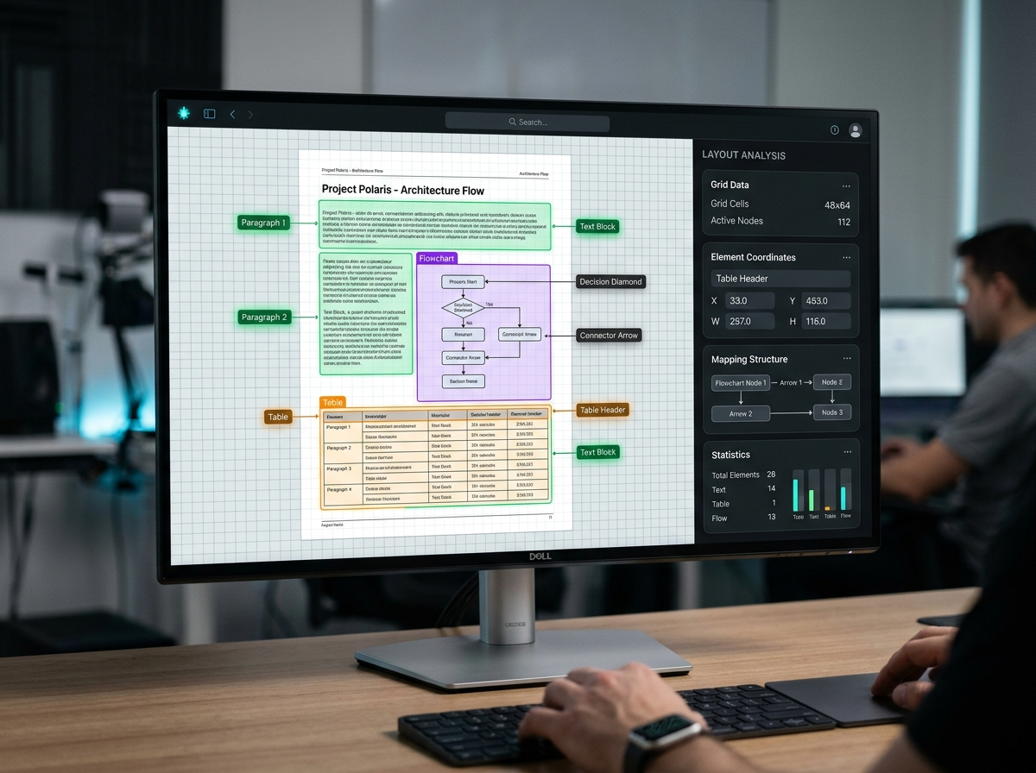
AetherMind Document Ingestion – Data Inputs and outputs
The AetherMind Platform consumes raw native slides, vector PDFs, and scanned images, converting them into structured reconstruction blueprints, GFM tables, and Mermaid process charts.
AetherMind Processing Hub

Slide 6
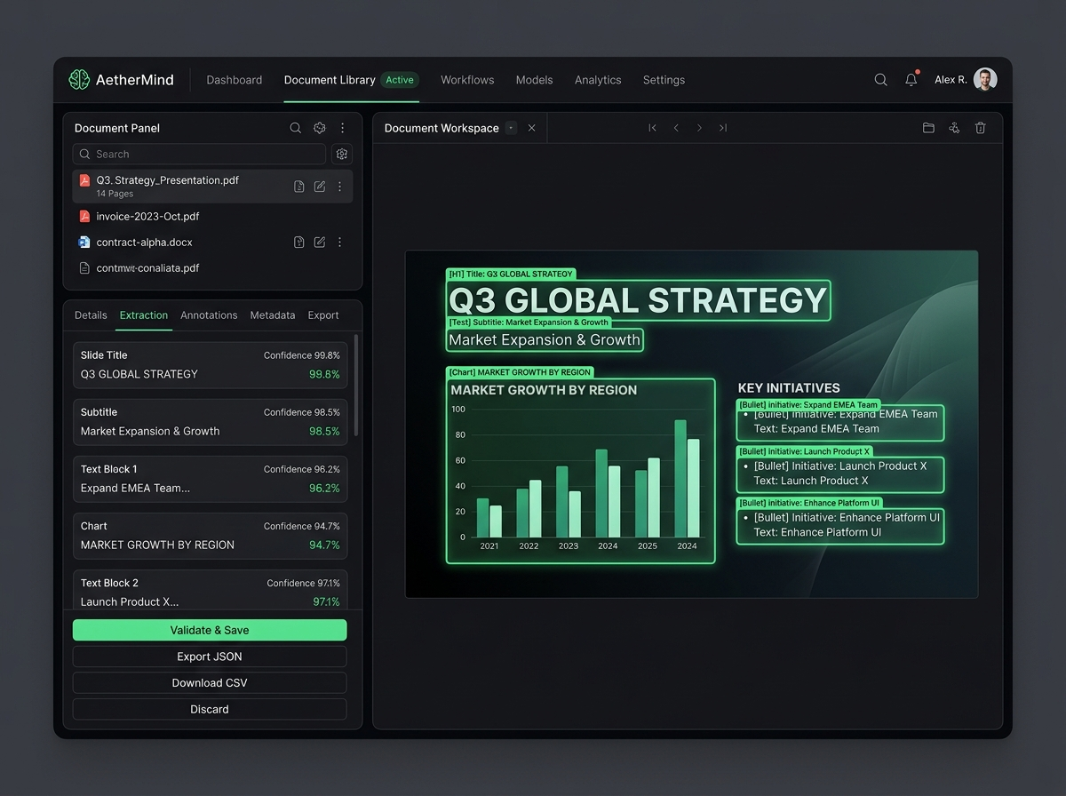
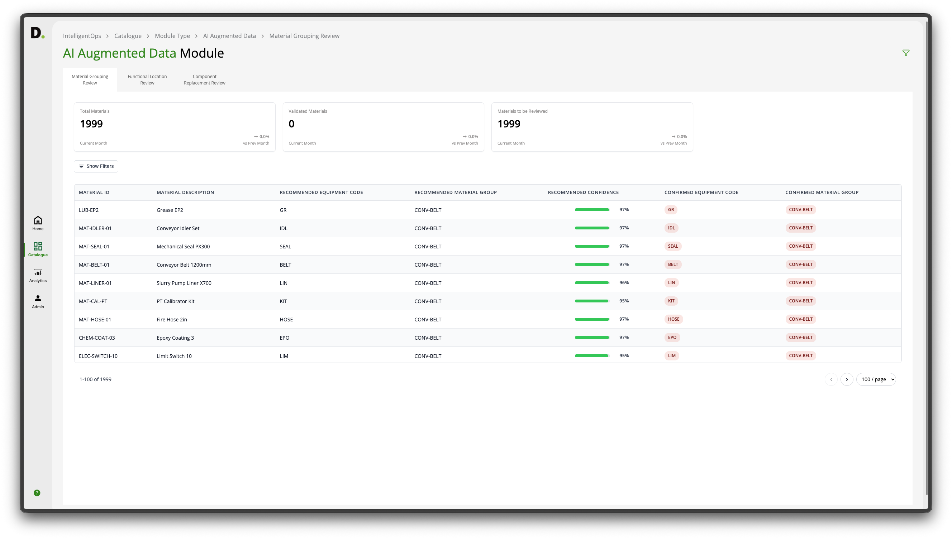
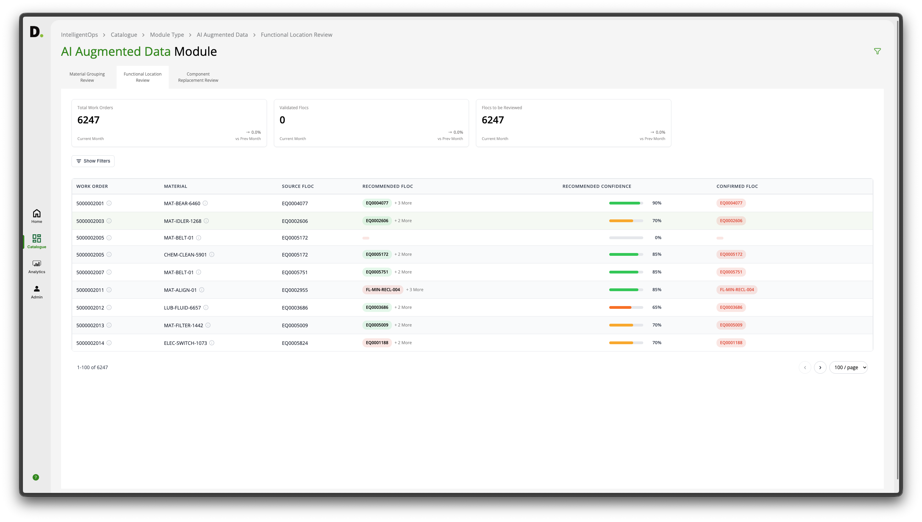
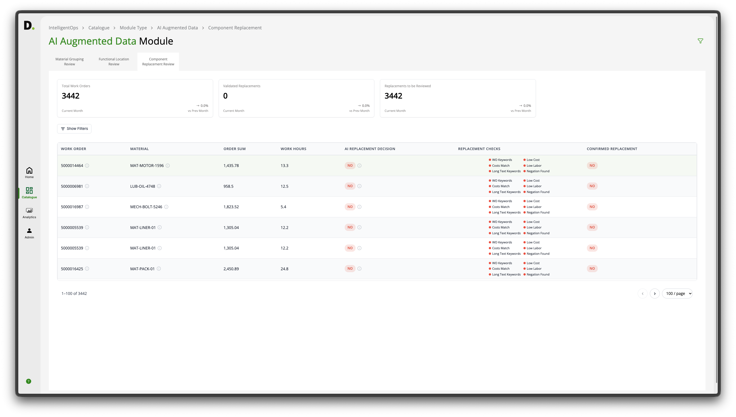
Feature Deep Dive – Extraction & OCR Layer
AetherMind incorporates specialized extractors and multi-stage OCR to capture lossless document content.
Format-Specific Extractors
PPTExtractor decodes native presentation slides (shape XMLs, coordinates, and connectors). PDFExtractor decodes PDF grids and text blocks using PyMuPDF.
Slide Region Segmenter
SlideRegionDetector trims application headers/chrome to isolate slides, calculating scale normalization factors to maintain visual dimensions.igned to the correct Functional Location.
Multi-Stage OCR Engine
Runs EasyOCR on cropped page boundaries, merges inline text runs, deduplicates overlapping bounding boxes, and filters out UI chrome noise.

Slide 7
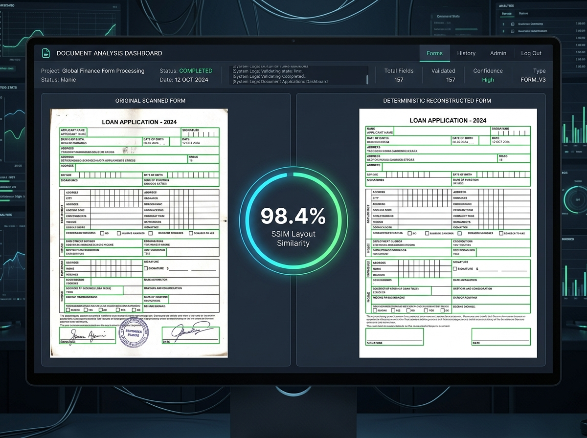
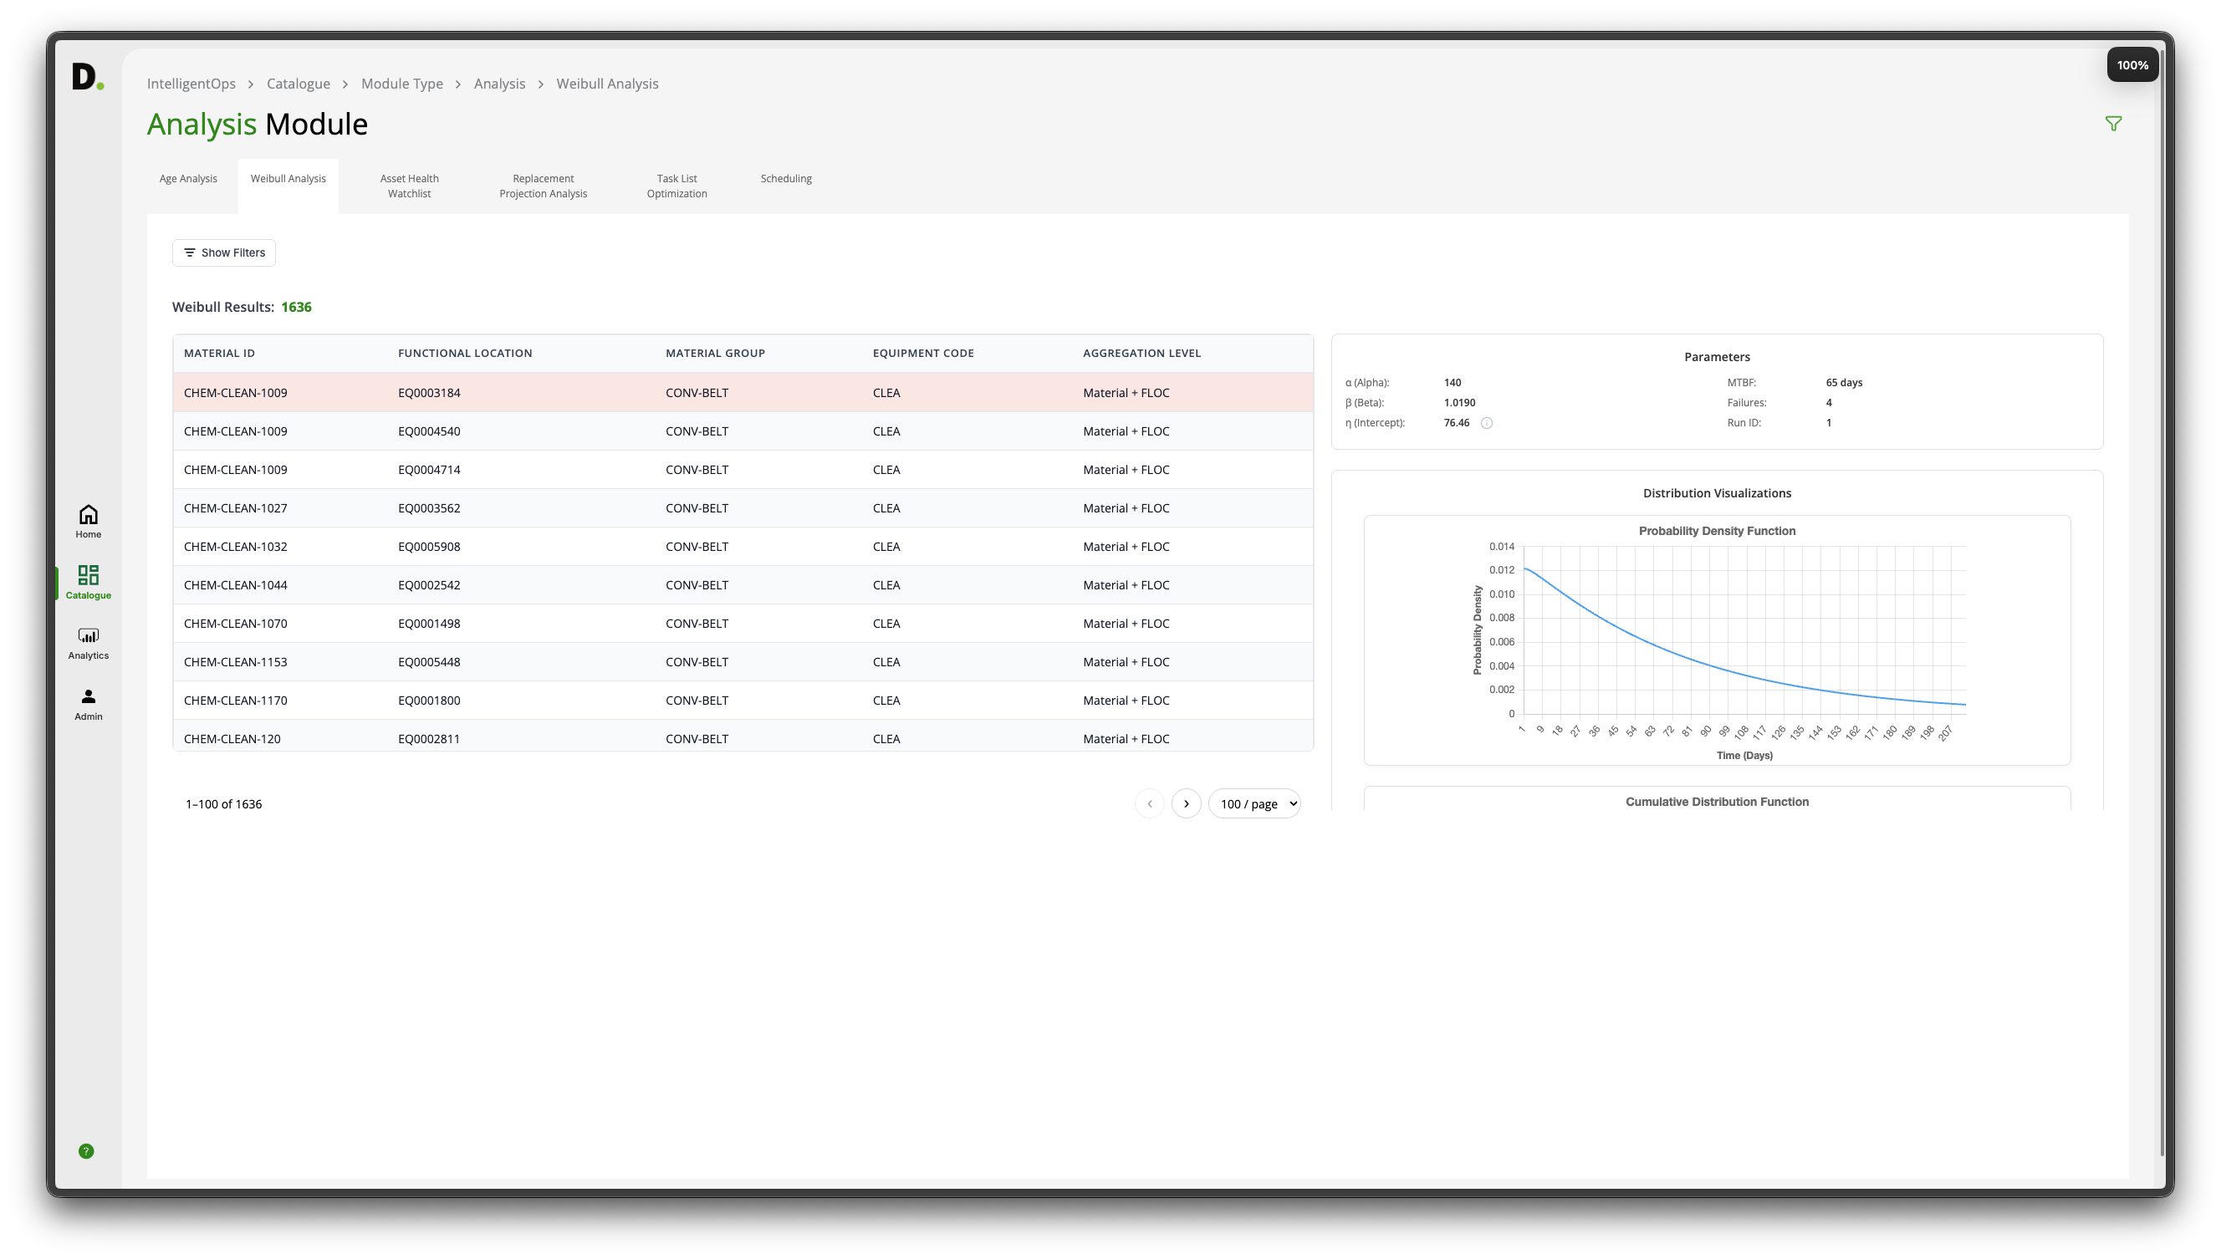
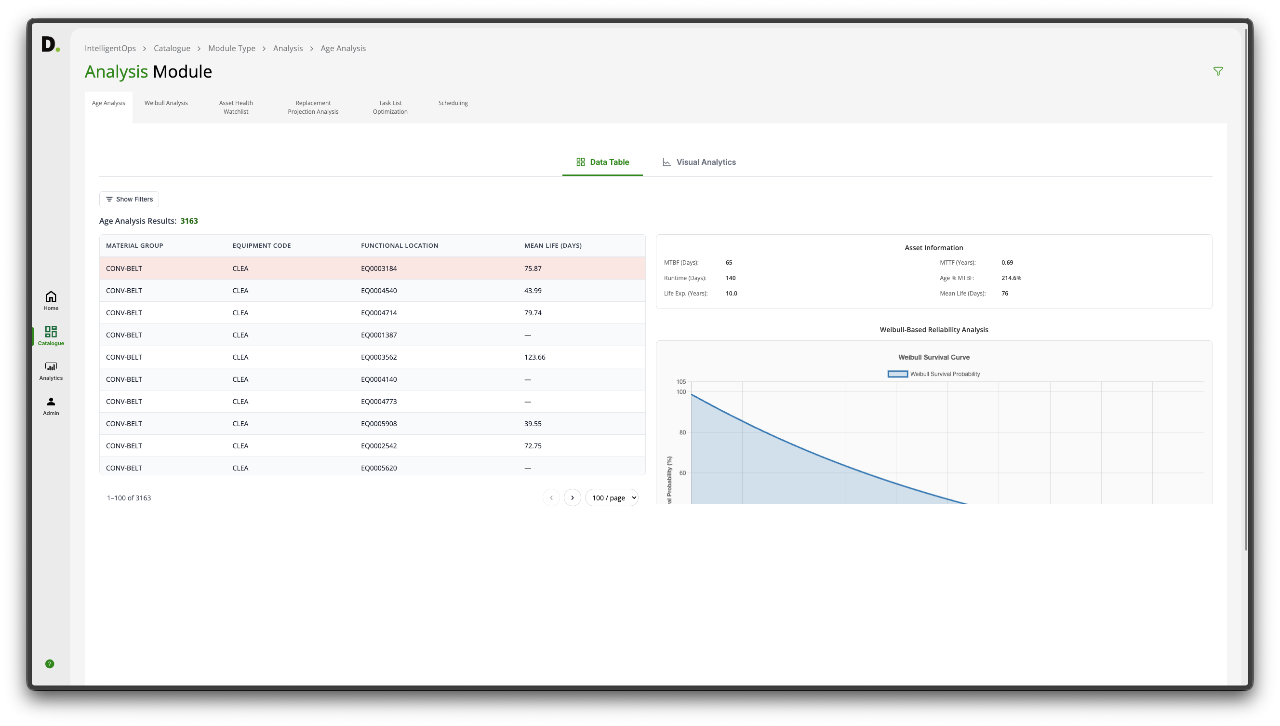
Feature Deep Dive – Analysis & Reconstruction
AetherMind implements intelligent relationship mapping and rendering engines to reconstruct visual layouts.ed where applicable.
Table & Diagram Analysis
Clusters OCR text positions by vertical/horizontal grids to assemble table spans and cell borders. Traces flowchart connectors to output Mermaid.js.
Deterministic FormRenderer
Reconstructs extracted JSON elements (shapes, lines, checkboxes, tables, alignments) programmatically using Pillow and PyMuPDF drawing interfaces.
Closed-Loop Validation
Runs visual validations between reconstructed outputs and original slides, calculating Structural Similarity (SSIM) and boundary overlap ratios.

Slide 8
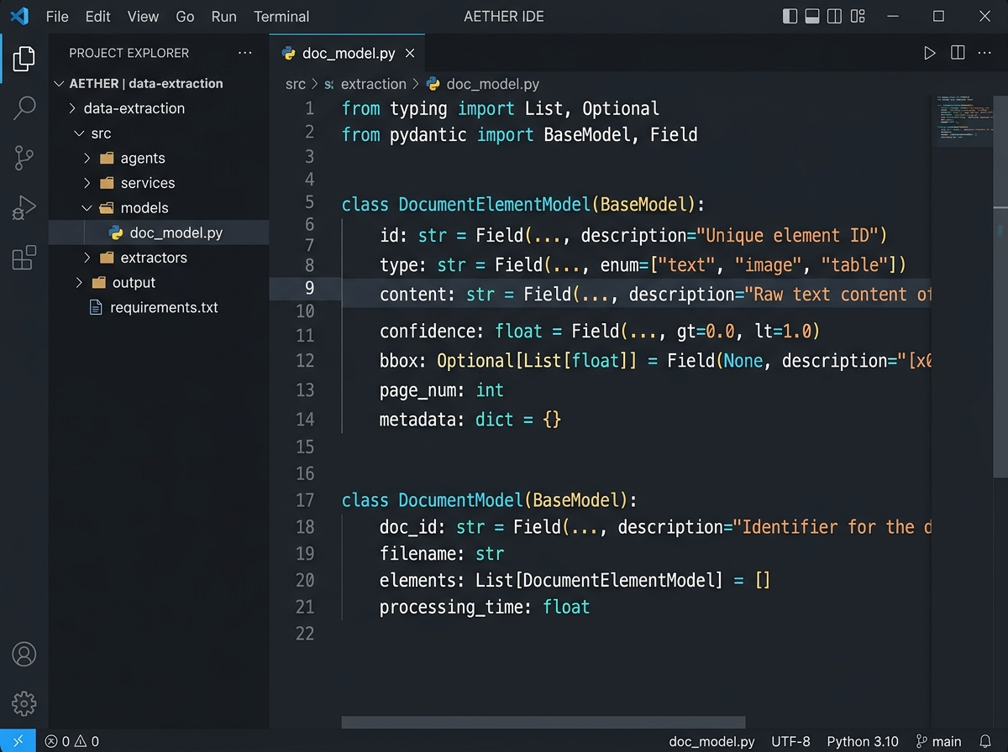
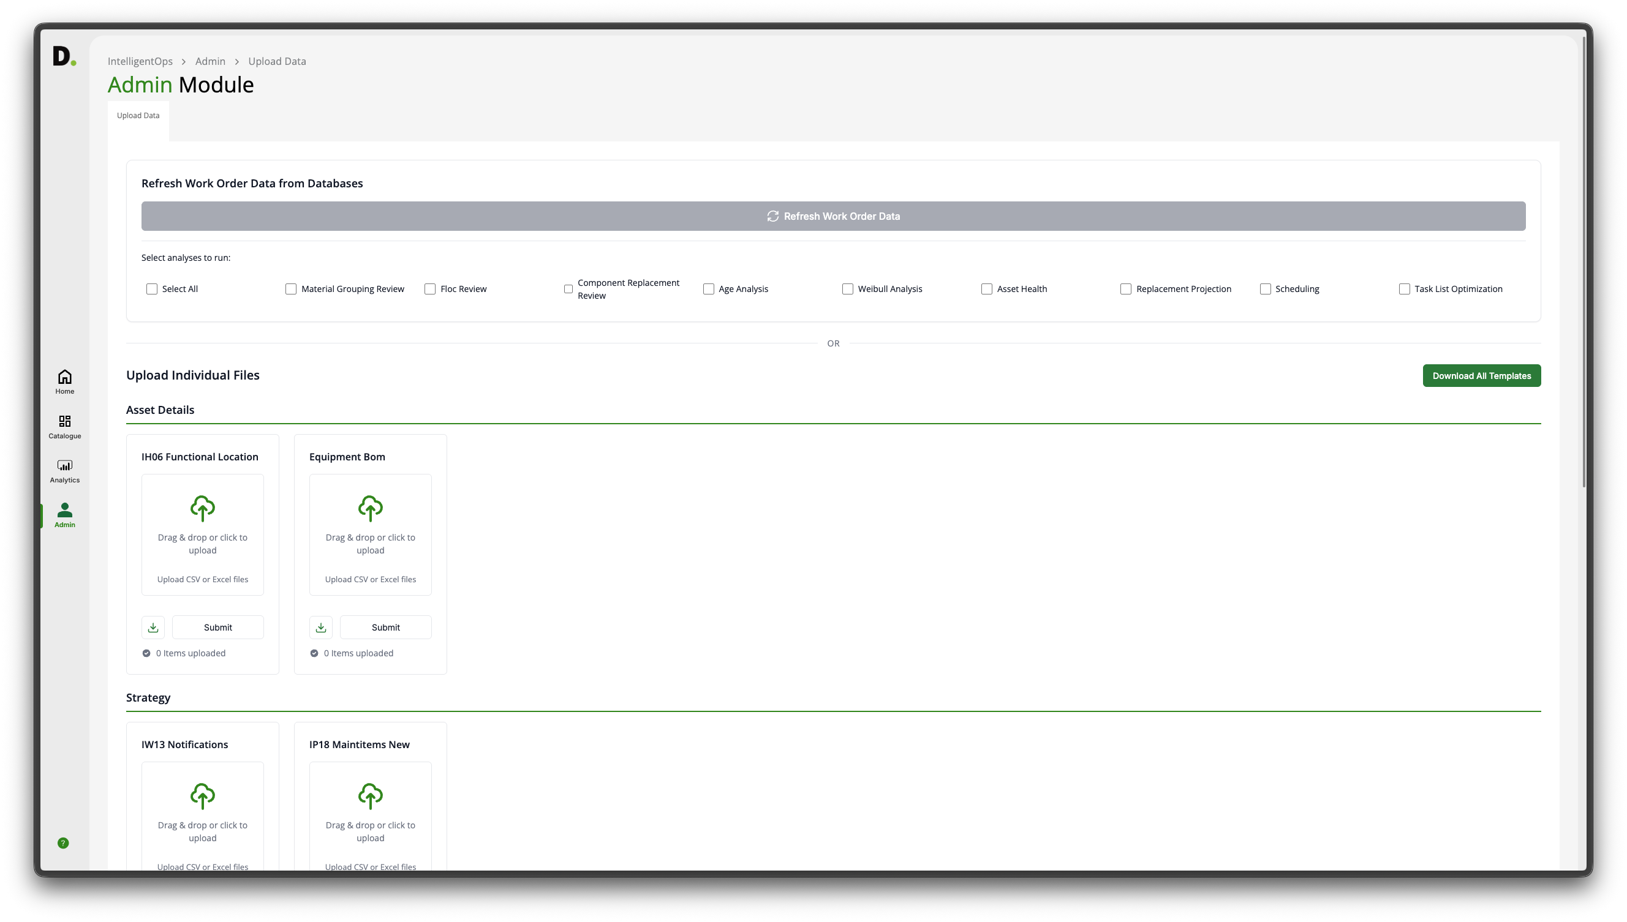
Feature Deep Dive – Models & Codebase
AetherMind enforces strict schema validation and codebase boundaries to ensure execution safety.
Modular Code Tree
Used to upload data files if manually extracted.
Used to refresh data if integrated to live data source (e.g. Native XML/PDF).
Application configuration like Document Health Criteria.

Slide 9
OCR & Document Ingestion
AI-Powered Layout-Aware Document Extraction Optimisation · Snapshot
AetherMind extraction snapshot. Details the raw geometry parsing, multi-agent annotation, rendering, and visual quality audit flow.
01
OVERVIEW
Lossless Geometry Extraction
02
HOW IT WORKS
03
WORKFLOW
Document extraction in enterprise pipelines is challenging because visual, spatial, and semantic structures are lost in raw text dumps. AetherMind extracts, cleans, and structures layout coordinates and graphics, enabling downstream LLMs to reconstruct slides near-identically.
It uses AI to automate layout analysis, cleans spatial geometries, and maps structural elements. It then uses specialized agents to model slide archetypes and reading orders to plan high-fidelity reconstructions.
Multi-Agent Layout Analysis
AI processes raw document streams, correcting layout geometries and text alignments
Deterministic Rendering
Extracts hidden layout patterns from raw PowerPoint/PDF files
04
IMPACT
05
WHERE IT FITS
Visual Rendering & Validation
Deduces topological reading paths and diagram connector networks
Preserves Slide Geometry
Improves Downstream RAG
Lowers Manual Audit Costs
Accelerates Data Ingestion
Enhances Document Intelligence
Example: In enterprise environments, it reduced audit times and improved extraction accuracy.
Used in enterprise forms, presentations, and document-heavy industries across layout parsing and AI verification teams.
Differentiator: Combines multi-agent orchestrated workflows with deterministic rendering to validate and reconstruct document layouts.
Generates structured JSON blueprints containing coordinates, typography, and styles
FormRenderer programmatically re-renders slides to verify extraction fidelity
Human Validation: Operators review and approve extraction reports before downstream delivery
9
9

Slide 10




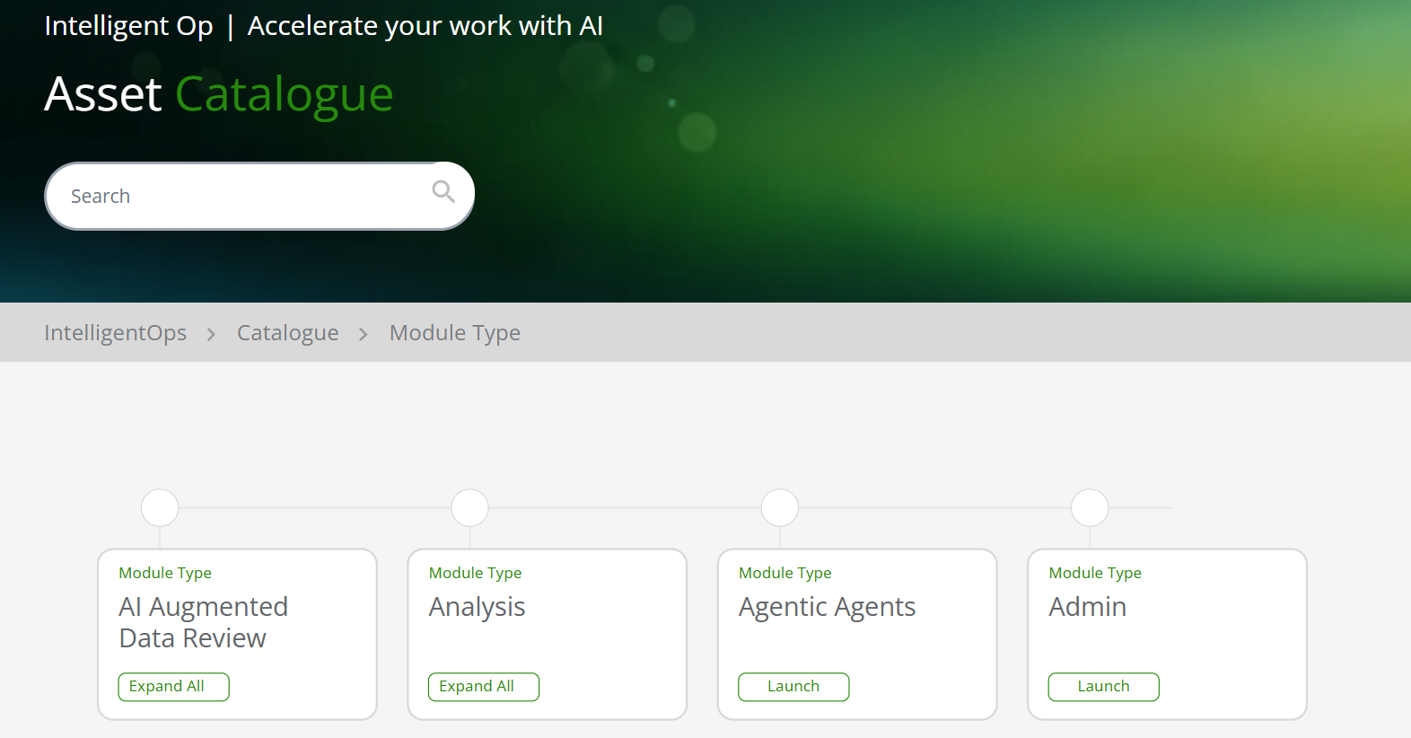
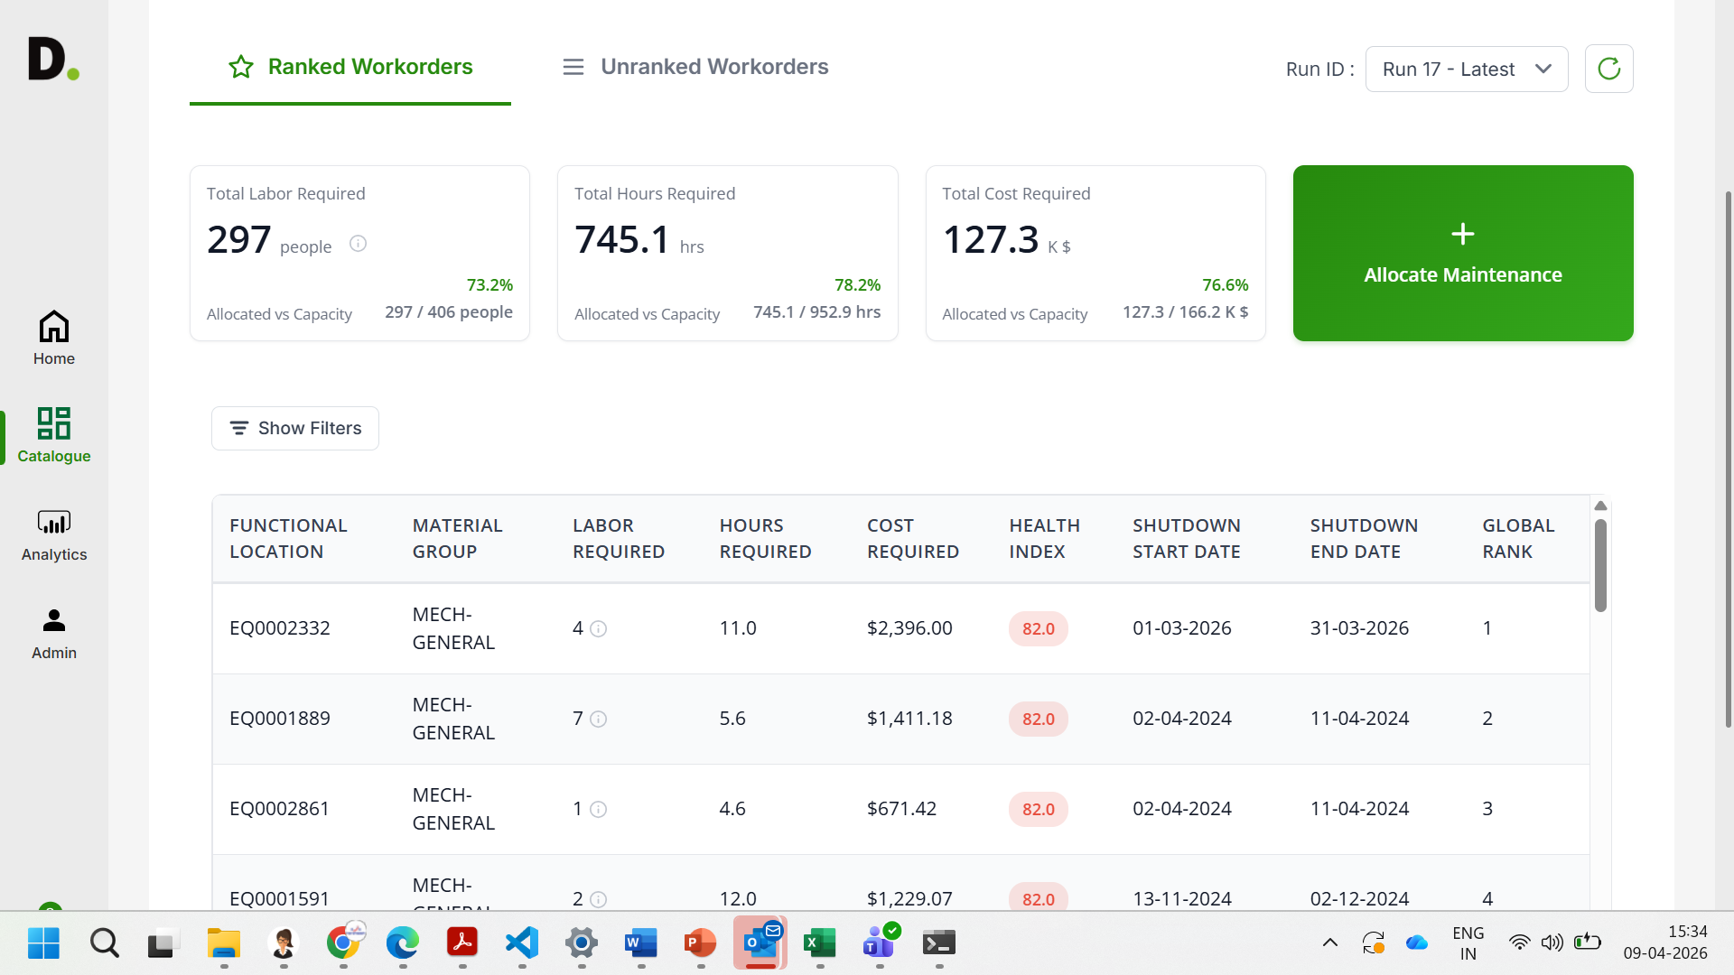
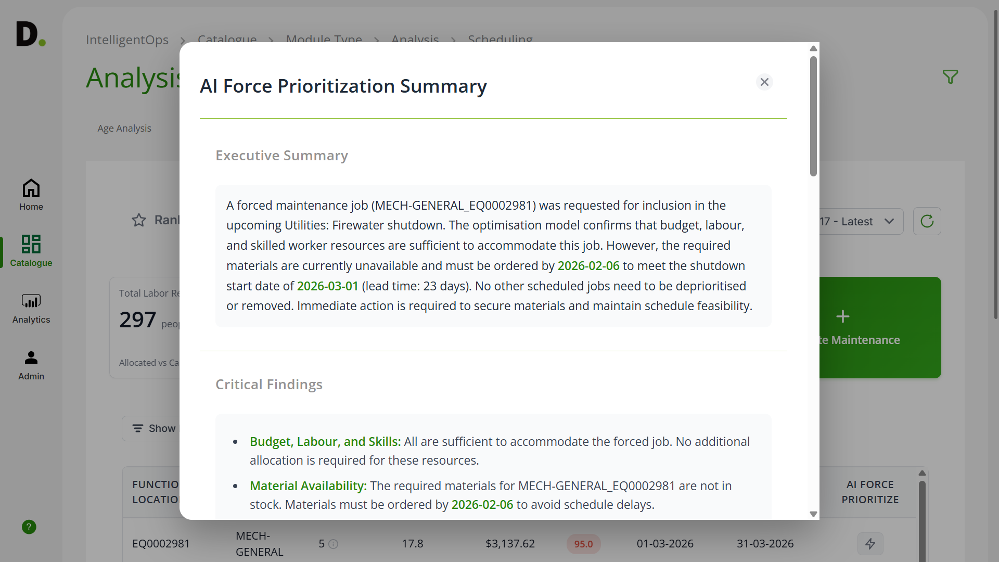
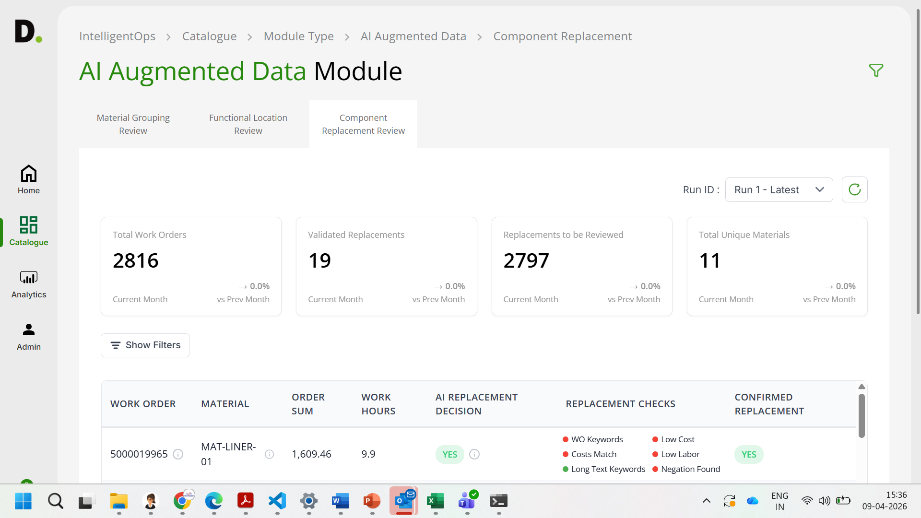
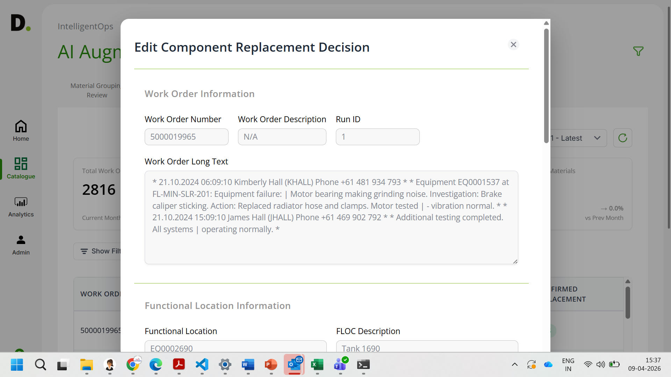
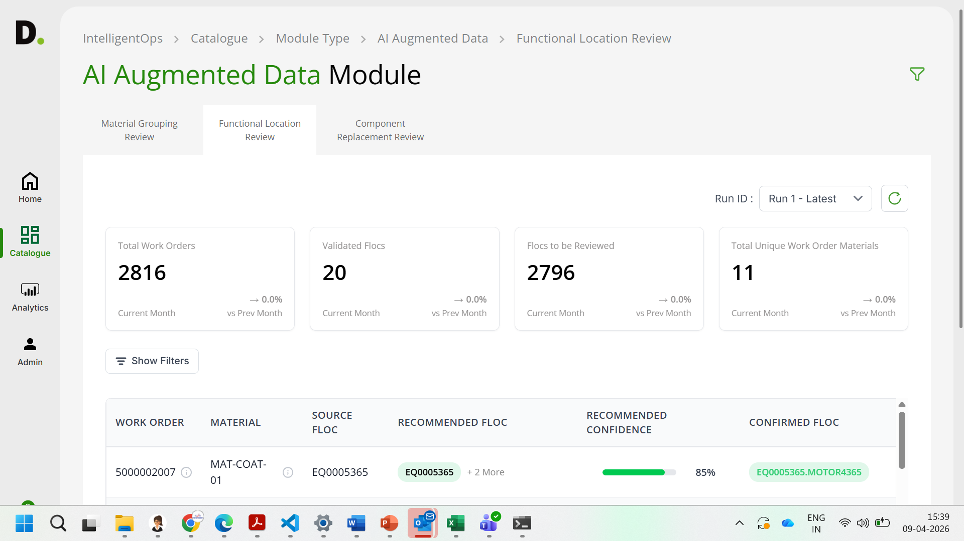
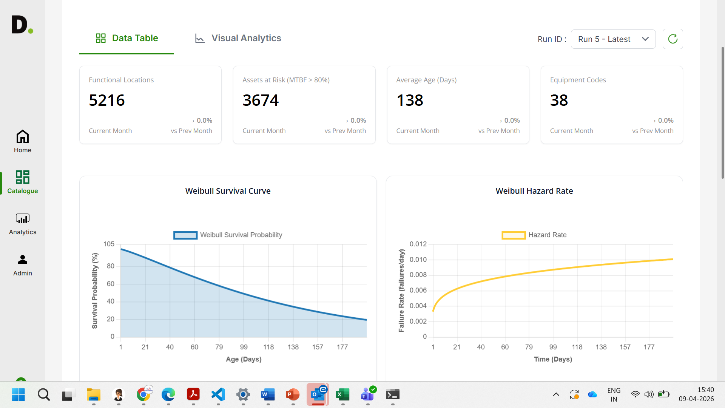
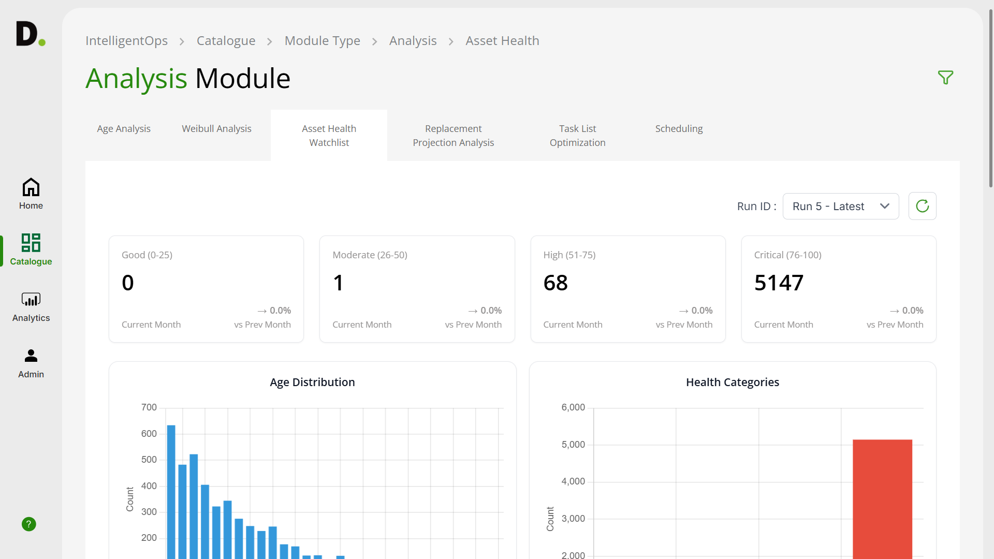
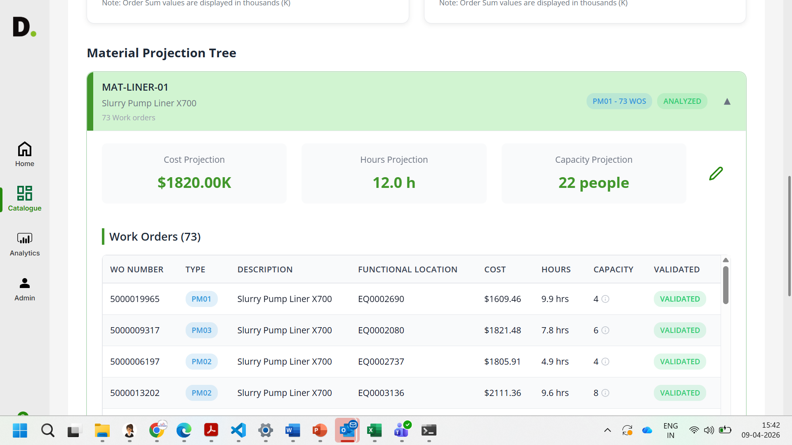
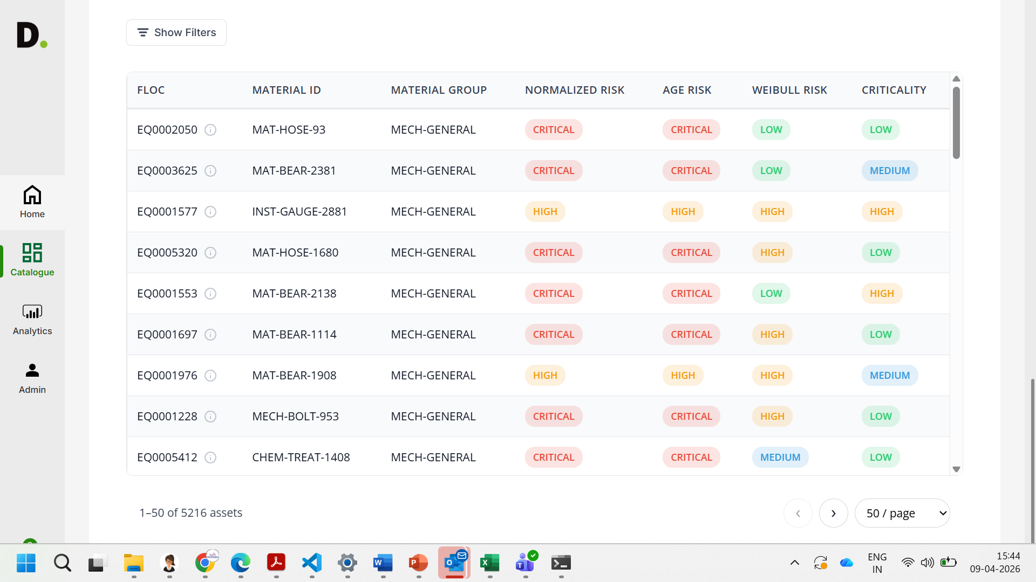
AetherMind: Lossless Document Ingestion and Visual Reconstruction Platform
An enterprise-grade document extraction platform that shifts document ingestion from flat text-only dumps to layout-aware visual blueprints. The solution improves search relevancy, reduces manual audit costs, and increases accuracy across enterprise document pipelines.
Situation
Document Ingestion data is often incomplete or inconsistent. Layout structures are lost in flat text dumps, destroying the visual semantic alignment of tables and flowcharts.
Key issues:
▪ Flat-text engines discard layout geometry, corrupting reading order.
▪ Table cells collapse, losing row/column spans and data alignments.
▪ Checkboxes, lines, flowcharts, and drawings are omitted or treated as unparseable blobs.
▪ Downstream LLMs lose visual context, leading to poor reasoning and retrieval.
Business Impact
1. Reduces manual form validation audit costs by 95%.
2. Preserves 100% of spatial layout and cell grid boundary geometry.
3. Maximizes downstream LLM prompt relevancy, search accuracy, and semantic retrieval.
Industry:
Enterprise Documents, Forms, Presentations
Themes:
Layout-Aware Document Extraction
Format Extractoring
Agentic AI for Planning and Visual Rendering & Validation
Features:
Unified document ingestion data
AI layout & structural risk insights
High-fidelity visual reconstruction prompts
Human-validated execution updates
Continuous learning & governance
Pixel-level SSIM accuracy audits
Automated coordinate scaling and mapping
The identified layout geometry is mapped and reconstructed using the cleaned coordinate structure
Solution Approach
Multi-Agent Ingestion & Coordinate Mapping
Gen AI reviews source documents, layout outlines and visual properties to align spatial grids and create a trusted single source of truth
OCR Post-Processing & Deduplication
Runs OCRPostProcessor to clean character typos, correct numeric errors, and merge adjacent fragments.
Table & Diagram Structural Reasoners
From historical layout patterns, extraction fidelity is validated using closed-loop SSIM and boundary overlap analysis. Document health dashboards help to classify documents by risk and layout density.
Deterministic Page Re-rendering
FormRenderer reconstructs shapes, lines, borders, and alignments programmatically using Pillow and PyMuPDF.
Visual comparison loop validates layout coordinates and generates high-fidelity rendering benchmarks.
Calculates Structural Similarity (SSIM) and layout overlap metrics, automatically auditing and logging extraction errors for downstream LLM prompts.
Human Validation and Governance
All the components and decisions can be reviewed and validated by validation auditors
Historic decisions and versioning for auditing and traceability.
Technology Stack: - Python & Pydantic - OpenCV & Scikit-Image - PyMuPDF (fitz) - EasyOCR & Vision LLMs

Slide 11
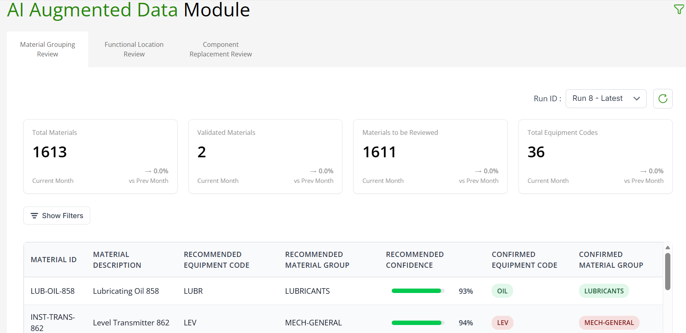
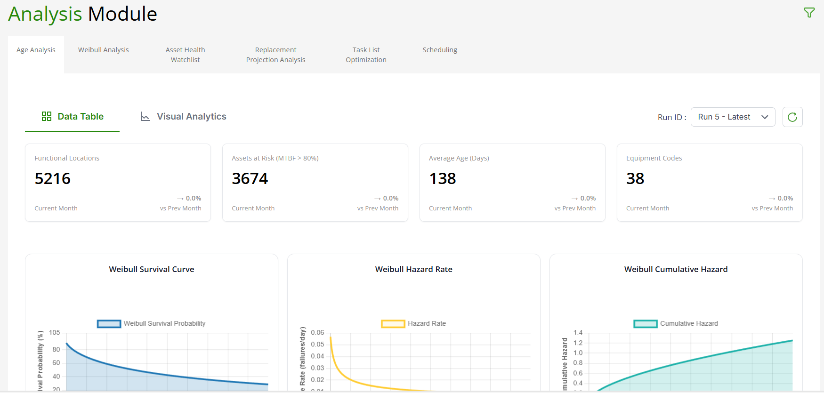
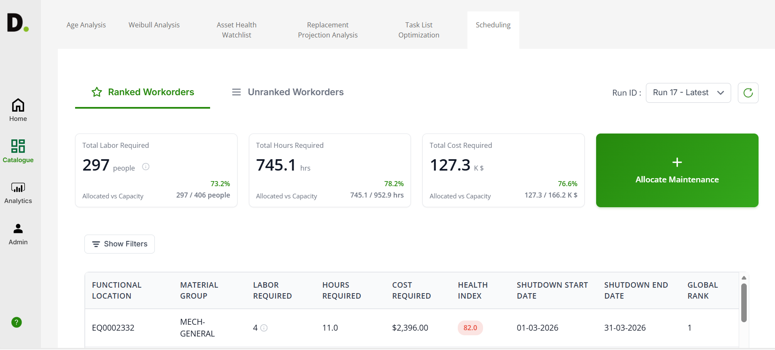
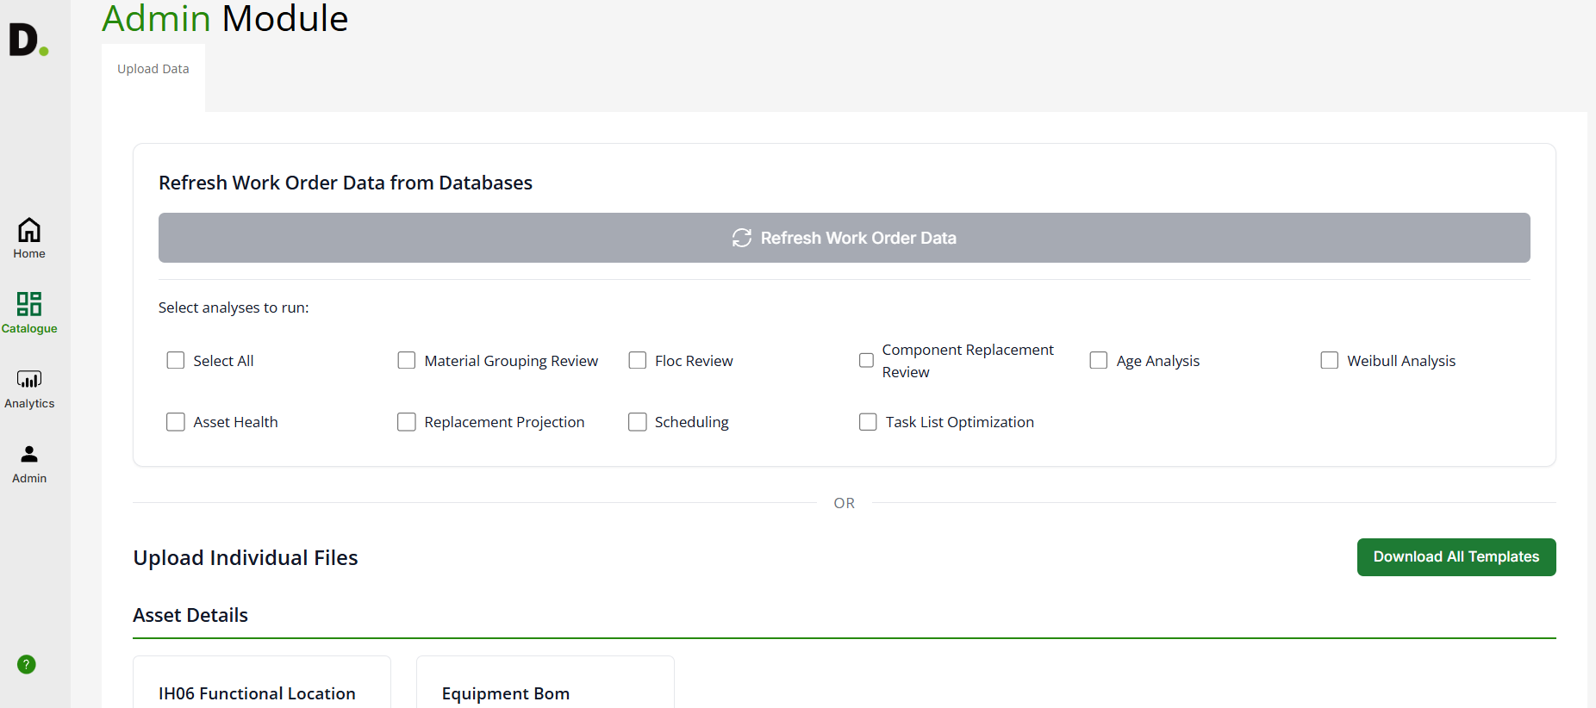
AetherMind
Case Study : Lossless Layout Ingestion and Visual Reconstruction in Enterprise Forms
ABOUT THE CASE STUDY
CASE STUDY IN ACTION
Challenge / Context: Financial and legal institutions ingest thousands of layout-dense PDFs, forms, and presentations daily. Standard parsers strip formatting, collapsing tables and discarding checkboxes. This makes it impossible for automated systems to verify signatures, check inputs, or parse data matrices, forcing slow and expensive manual reviews.
Downstream LLMs also underperform because crucial visual structure and layout context are lost during ingestion.
Our solution: AetherMind's multi-agent visual parsing framework. It maps spatial coordinates recursively and uses visual LLMs to transcribe illustrations. Through a closed-loop FormRenderer and SSIM validation engine, it audits extraction accuracy automatically, reducing human review costs by 95%.
High level overview:
OCR & Extraction Module
Agent Processing Module
Reconstruction Module
Visual Audit Pipeline
FormRenderer draws lines, tables, and controls
Crop application chrome from images
Extract raw EasyOCR blocks and fix letter typos
Classify slide layout grids and archetypes
Map flowchart arrows and topologically sort nodes
AETHERMIND DIFFERENTIATORS
1. Multi-Agent Orchestration mapping slide archetype grids, relational arrow networks, and reading orders.
2. Closed-Loop Visual Validation comparing reconstructed re-renders against original source pages.
3. Deterministic Drawing Engine programmatically rendering PDF shapes and cell borders.
BUSINESS IMPACT
1. Reduces manual form validation audit costs by 95%.
2. Preserves 100% of spatial layout and cell grid boundary geometry.
3. Maximizes downstream LLM prompt relevancy and search accuracy.

