Slide 1
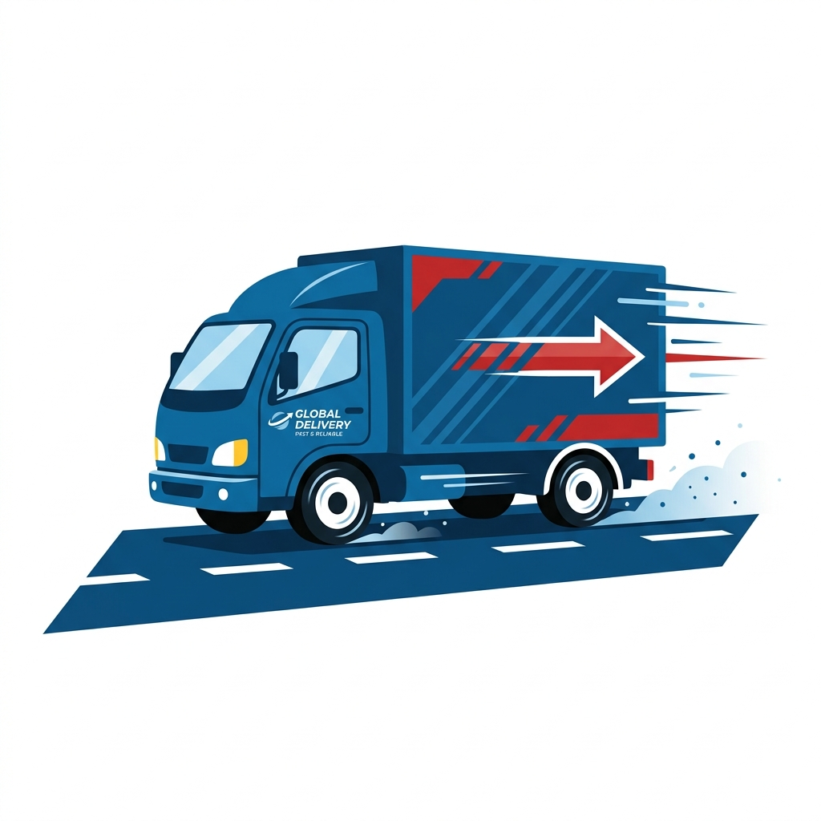
Delhivery Graph Intelligence
Predicting Delays & Identifying Structural Bottlenecks
Prepared by Shikhar Verma

Slide 2
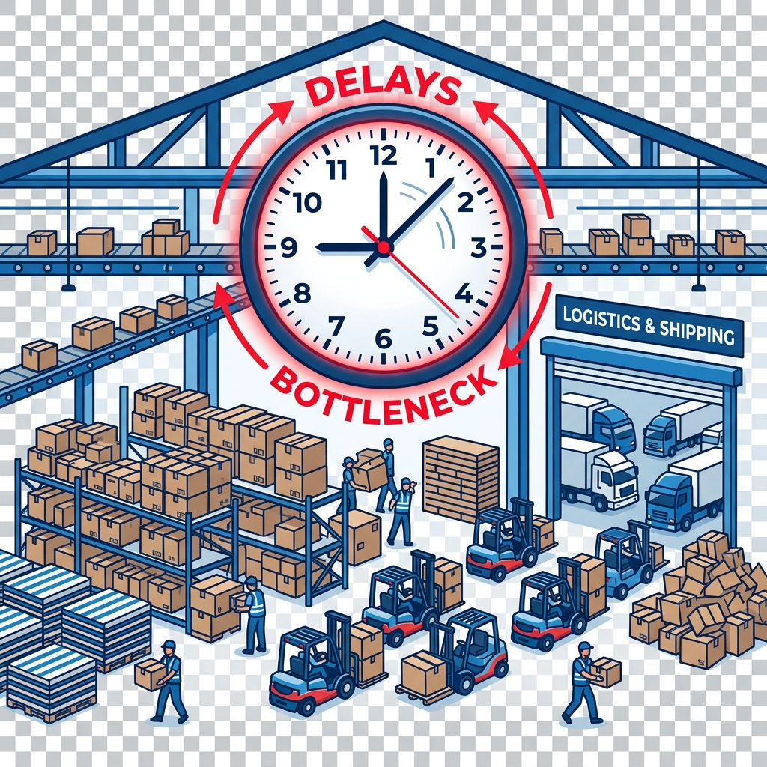
The Strategic Challenge
• Delhivery uses OSRM (shortest path) to estimate delivery times.
• Real-world logistics is messy: dwell times, congestion, and operational constraints cause massive deviations.
The Result:
A 95%+ SLA Breach Rate on chronic routes, breaking downstream capacity planning.

Slide 3
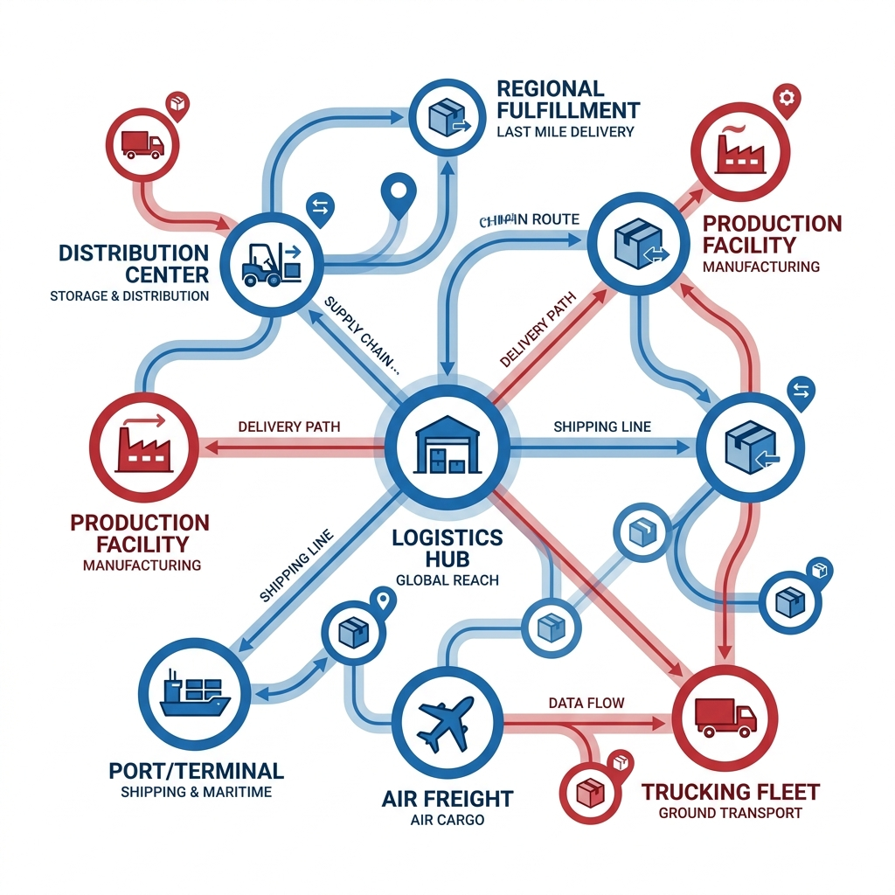
Our Graph-Based Solution
We modeled the logistics network not as isolated trips, but as a living Directed Graph to find structural flaws.
Network Scale:
• 1,657 Connected Facilities (Nodes)
• 2,783 Logistics Corridors (Edges)
• 2,617 Chronic Delay Corridors Identified

Slide 4
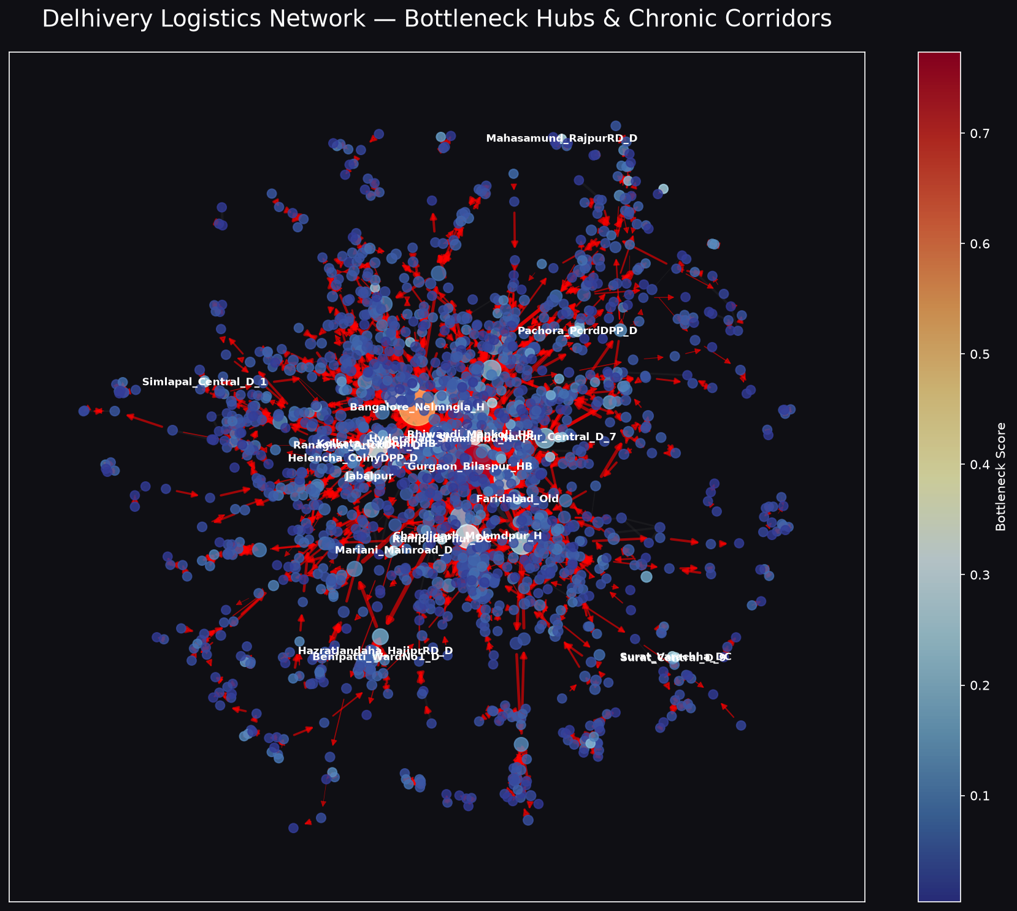
Mapping the Bottlenecks

Slide 5
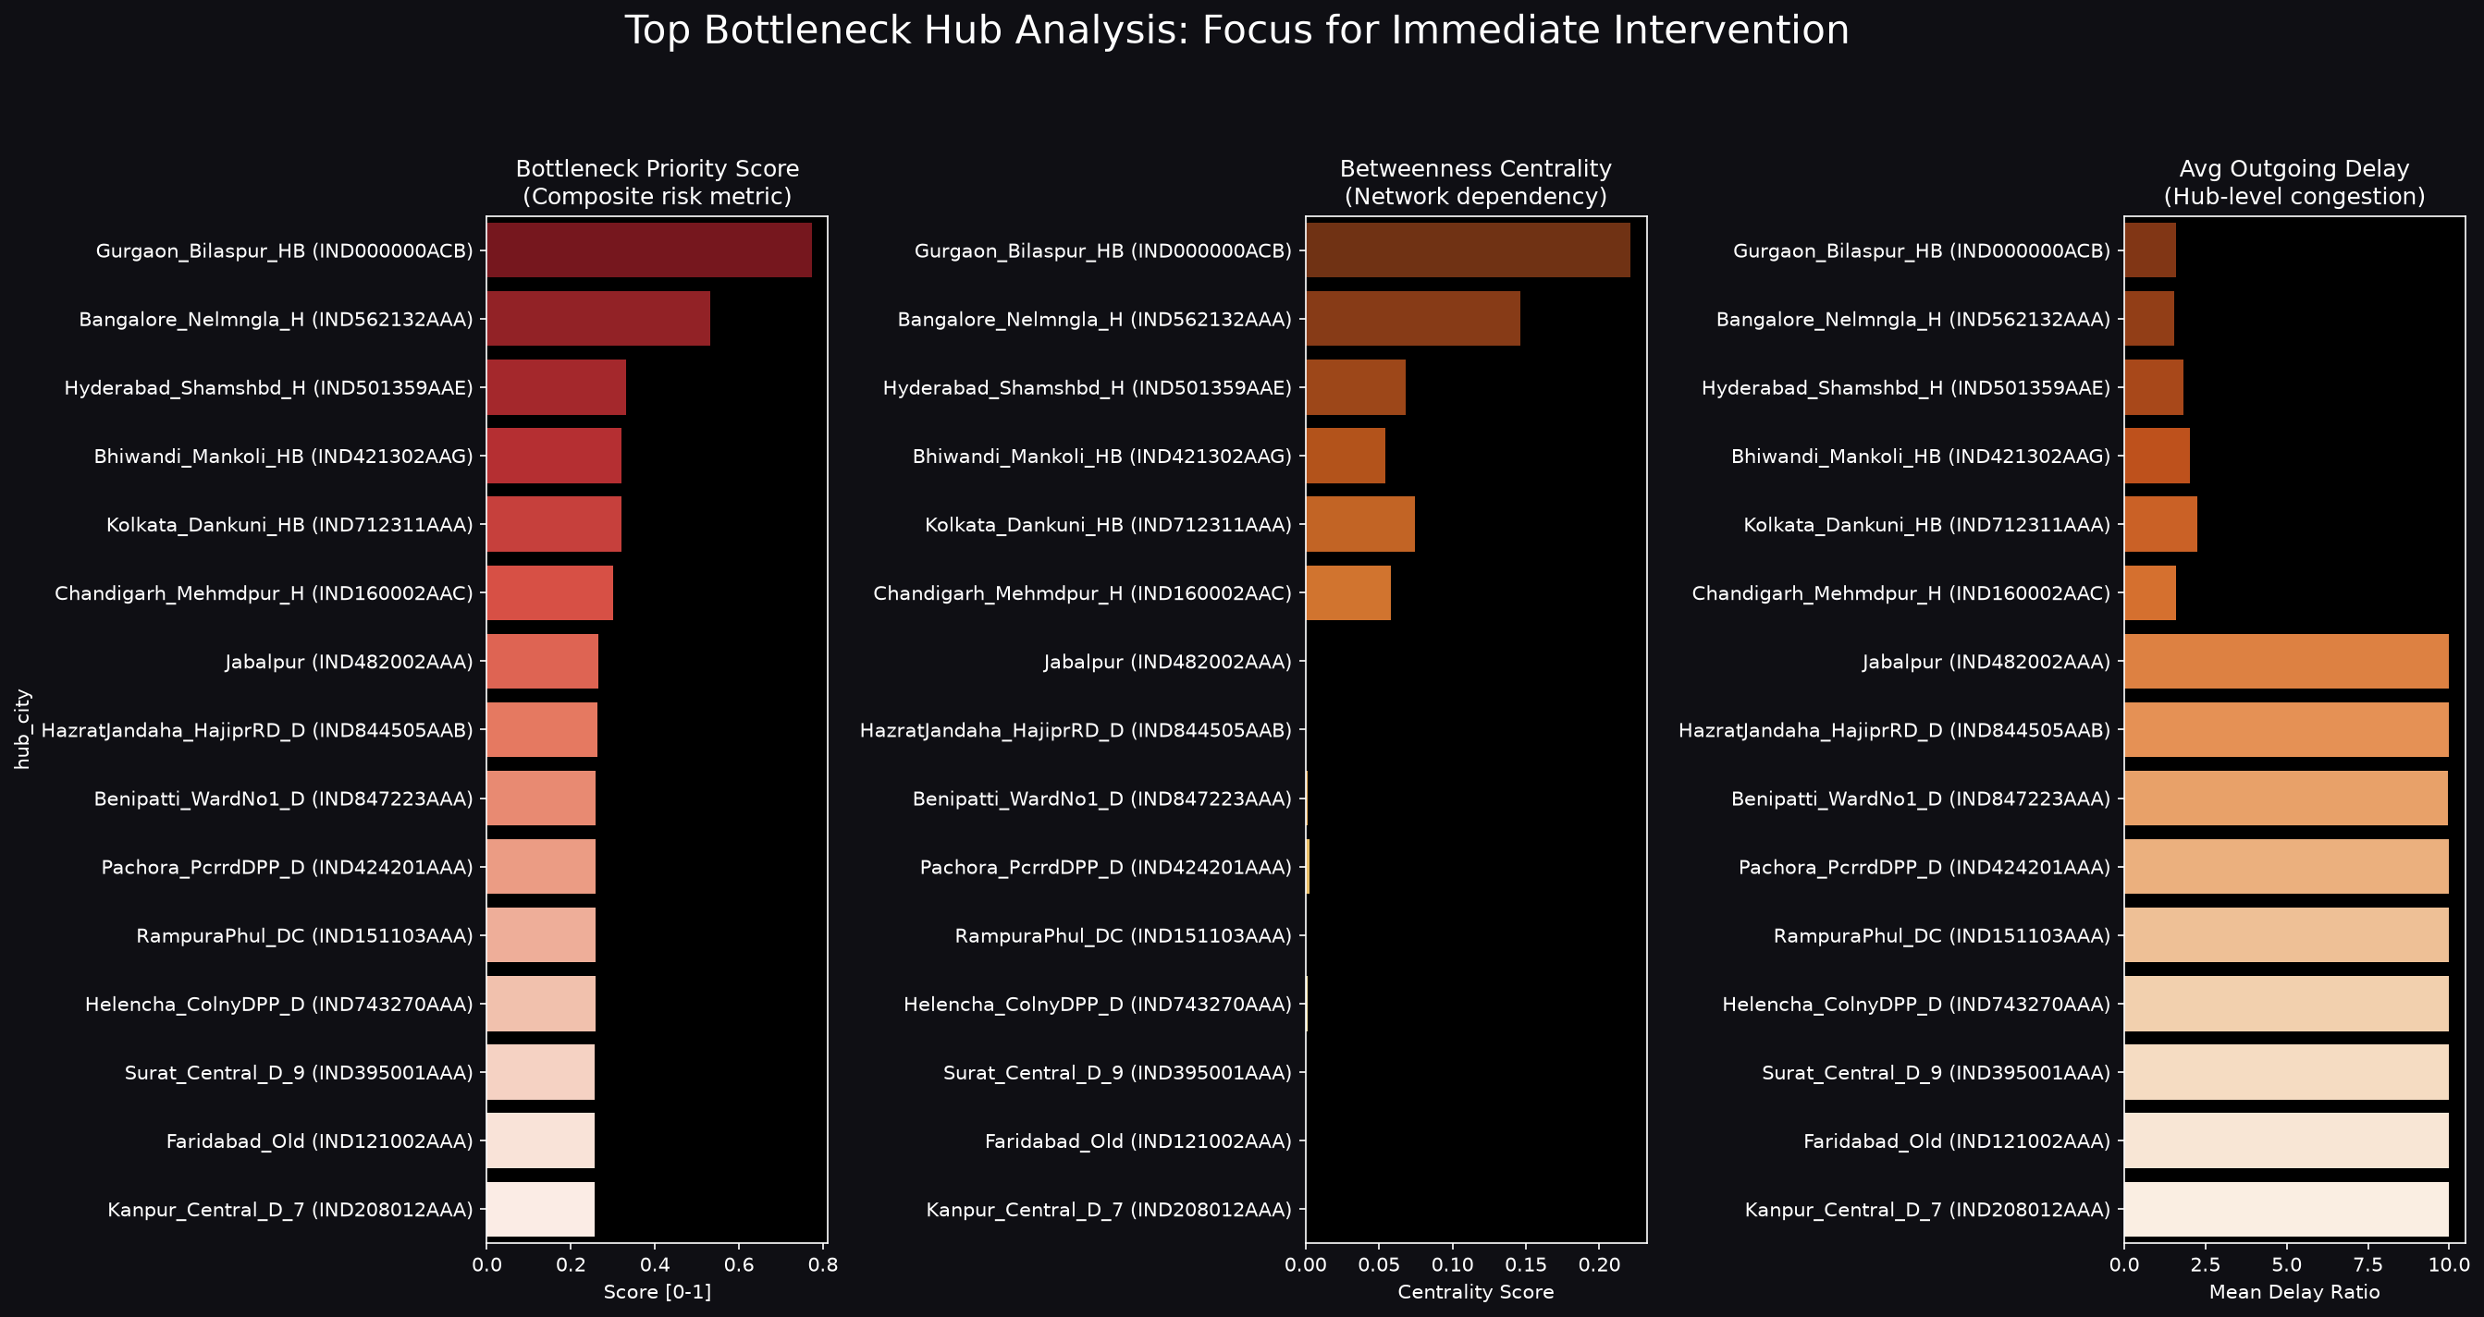
The Top 5 Critical Hubs

Slide 6
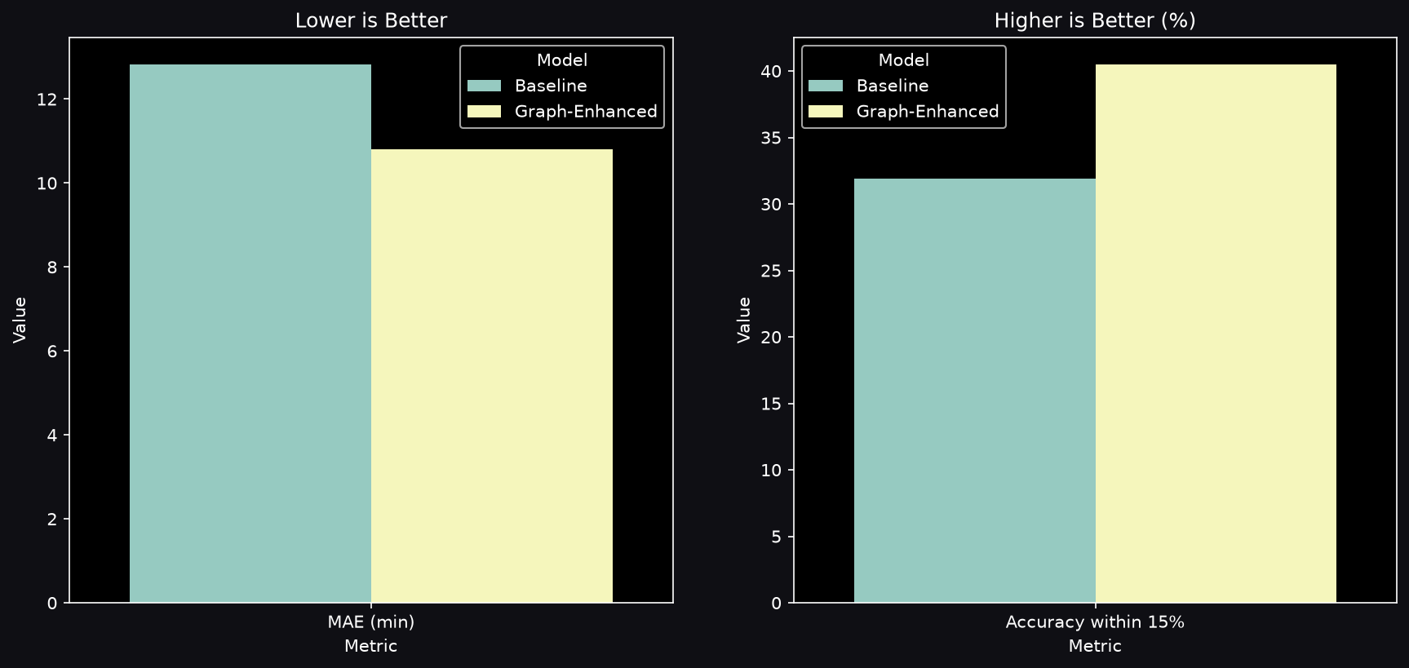
Smarter ETAs via Node2Vec
Result: +8.57% improvement in 15%-Accuracy over OSRM Baseline

Slide 7
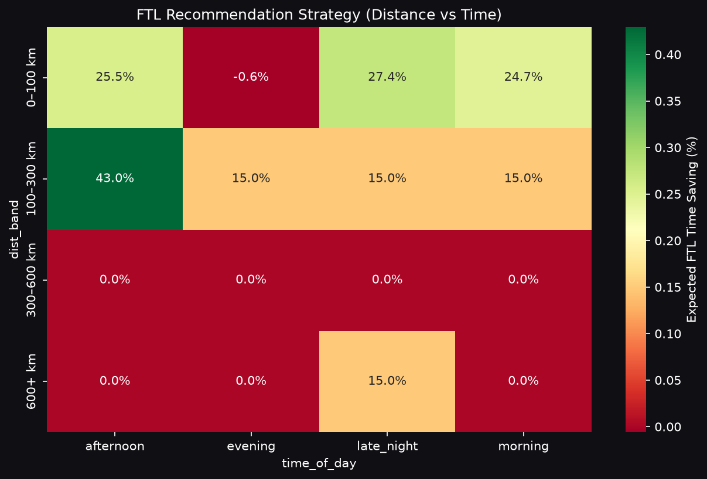
FTL vs Carting Framework

Slide 8
Strategic Recommendations
• Infrastructure Interventions: Upgrade capacity at Gurgaon Bilaspur HB and Bangalore Nelmngla. These are single points of failure causing massive ripple effects.
• Financial Impact: Upgrading the top 3 bottleneck hubs to the network median delay recovers an estimated ₹1.05 Crore in revenue at risk.
• Product Deployment: Integrate the Graph-Enhanced XGBoost model into the customer-facing tracking app to drastically improve consumer transparency.

Slide 9
Thank You
Explore the Live Dashboard:
delhivery-graph-intelligence-system.streamlit.app

