Slide 1


智能片上集成系统设计
Introduction of Intelligent Computing Chip and System
Lecture 1 Introduction
Instructor: Shiwei Liu, Assistant Professor

Slide 2
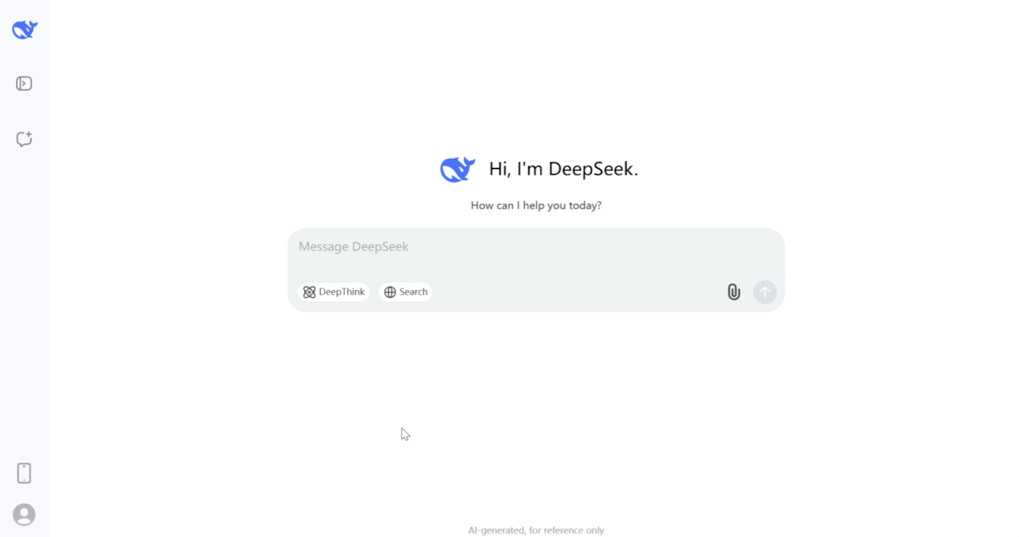
The Artificial Intelligence Era
In the past decades, artificial intelligence (AI) algorithms has grown exponentially in size and operations, evolved from CNN to transformer.
AI has enabling new innovations in many fields , e.g. nature language processing (ChatGPT/Deepseek) and multi-modal generation.
Year | AI Models | Parameter Size (GB) | Computing TFLOPs-day
2012 | AlexNet | 10⁻² | 10⁻³
2015 | ResNet | 10⁻¹ | 10⁻¹
2017 | Transformer | 1 | 10¹
2020 | GPT-2 | 10¹ | 10⁶
2024 | Llama-405B | 10³ | 10⁸
Notes:
- 人工智能算法的的发展
- ChatGPT DeepSeek

Slide 3
Intelligent Computing Chip
High performance computing chips are evolving to include specialized processing units designed to handle the massive computation required by AI models, such as GPUs, NPUs, and custom AI accelerating cores.
Our course objective is to learn the hardware and software of these new cores.
CPU
Core x4
GPU/NPU/Accl.
L3
Cache SRAM
100GB
SSD
flash
8Gb
DRAM
L2 Cache
SRAM
L2 Cache SRAM
DDR PHY
NAND IO
NoC Interconnect
Memory Controller Fabric
PCIe links
DMA
Peripheral links

Slide 4
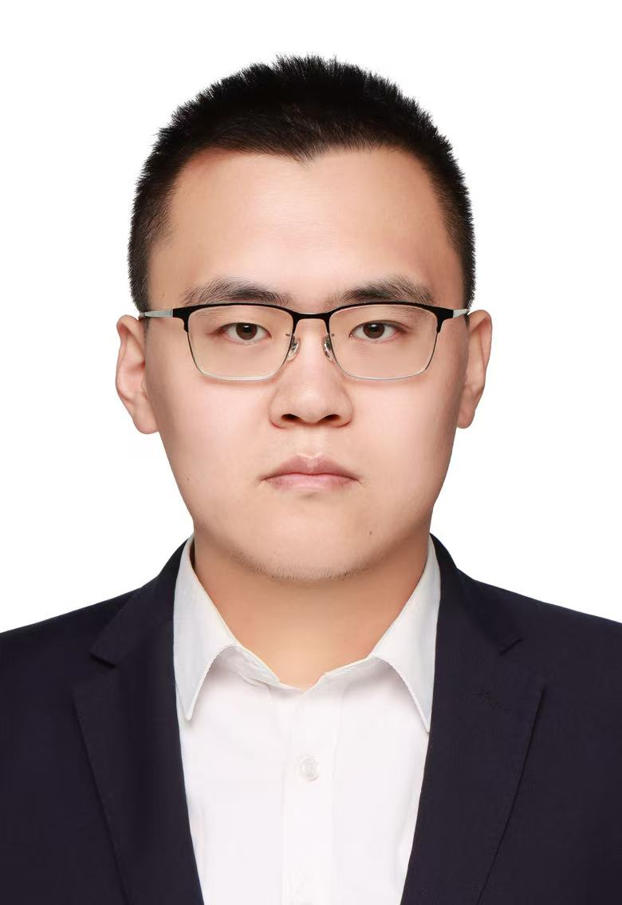
Course Information
Education
  2014 – 2018, B.S., Fudan University
  2018 – 2021, M.S., Fudan University
  2021 – 2024, Ph.D., Fudan University
Work Experience
  2023.09 – 2024.5, Google Research, PhD Researcher
  2024.06 – 2026.05, Hardware Architect, ByteDance
  2026.05 – Present, Assistant, Tonji University
Research Interest
  Compute-in-Memory Chip Design and 2.5D/3D Chiplet Chip Design for LLM Acceleration.
Homepage
https://shiweiliu-ai.github.io/
Email
shiweiliu@tongji.edu.cn

Slide 5

Course Information
Instructor: Shiwei Liu
Email: shiweiliu@tongji.edu.cn
Location: 722 Zhixing Buiding
@ Jiading Campus
Time: Monday Afternonn (14:00-16:00)
Website: https://shiweiliu-ai.github.io/ (Temporary)
TA: Rui Zheng (郑睿), zrlfx@tongji.edu.cn

Slide 6
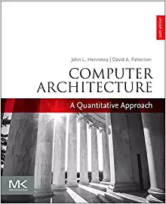
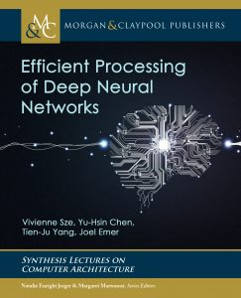
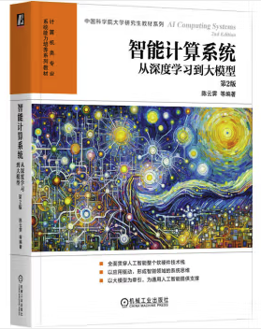
Textbook / Reference Books
Our course mainly focuses on the slides.
Three main reference books for our courses
  Computer Arch - Bible
  智能计算系统 - 计算所
  Efficient Processing of Deep Neural Networks
These three books are very expensive, but most of tutorial video material can be obtained from the Internet.

Slide 7
Contents, Exam and Score
The course is slitted into 3 Modules:
AI basics (3 lectures): introduction and AI algorithm and frameworks
Hardware Part (8 lecture): mainly computing architecture for AI chips
Software & System Part (3 lecture): how to deploy an AI model onto your chip(s)
Score: 10% Attendance + 20% Homework
+ 20% Final Presentation and Experimental Report
+ 50% Final Projects
Final Project: Build a NPU Accelerator with simple compiler according to the course contents:
  Project Score = 0.2*Model Accuracy + 0.4*Latency + 0.4*Energy Efficiency

Slide 8
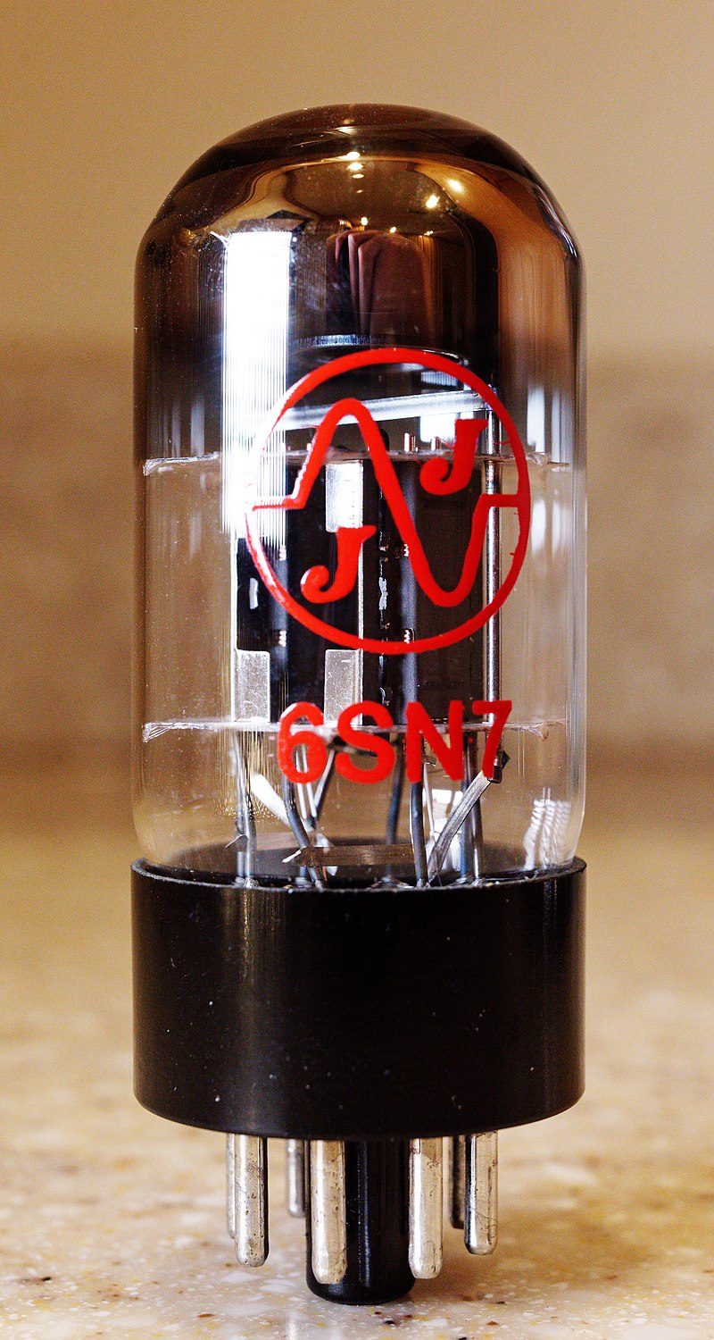
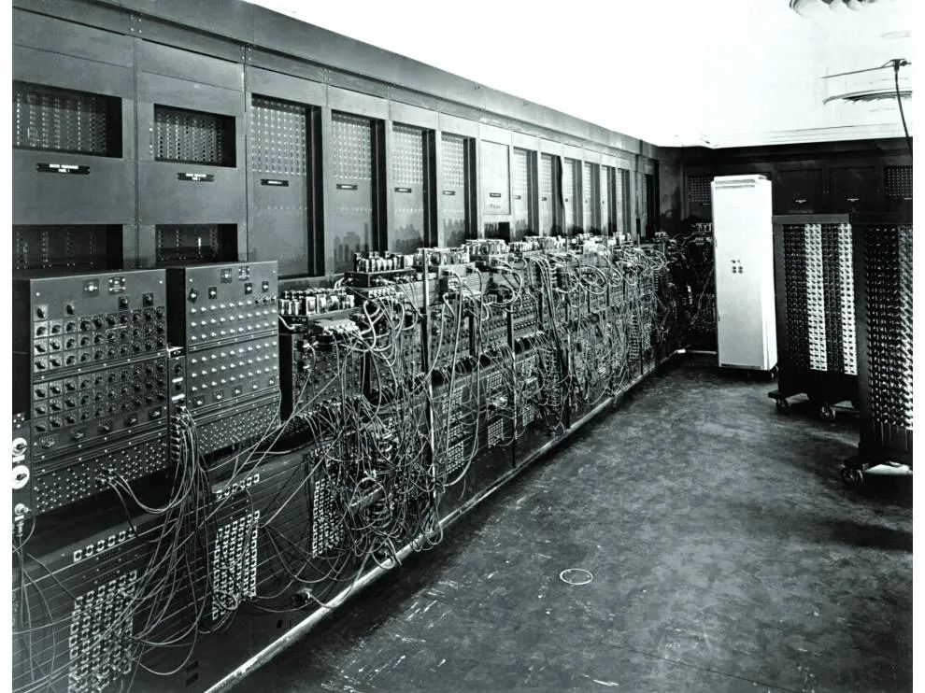
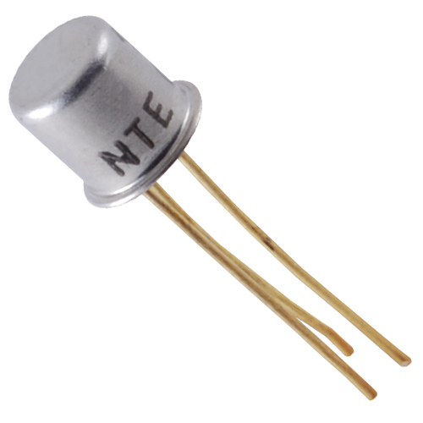
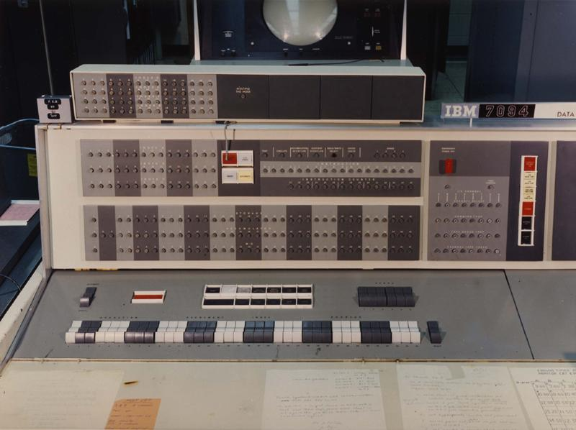
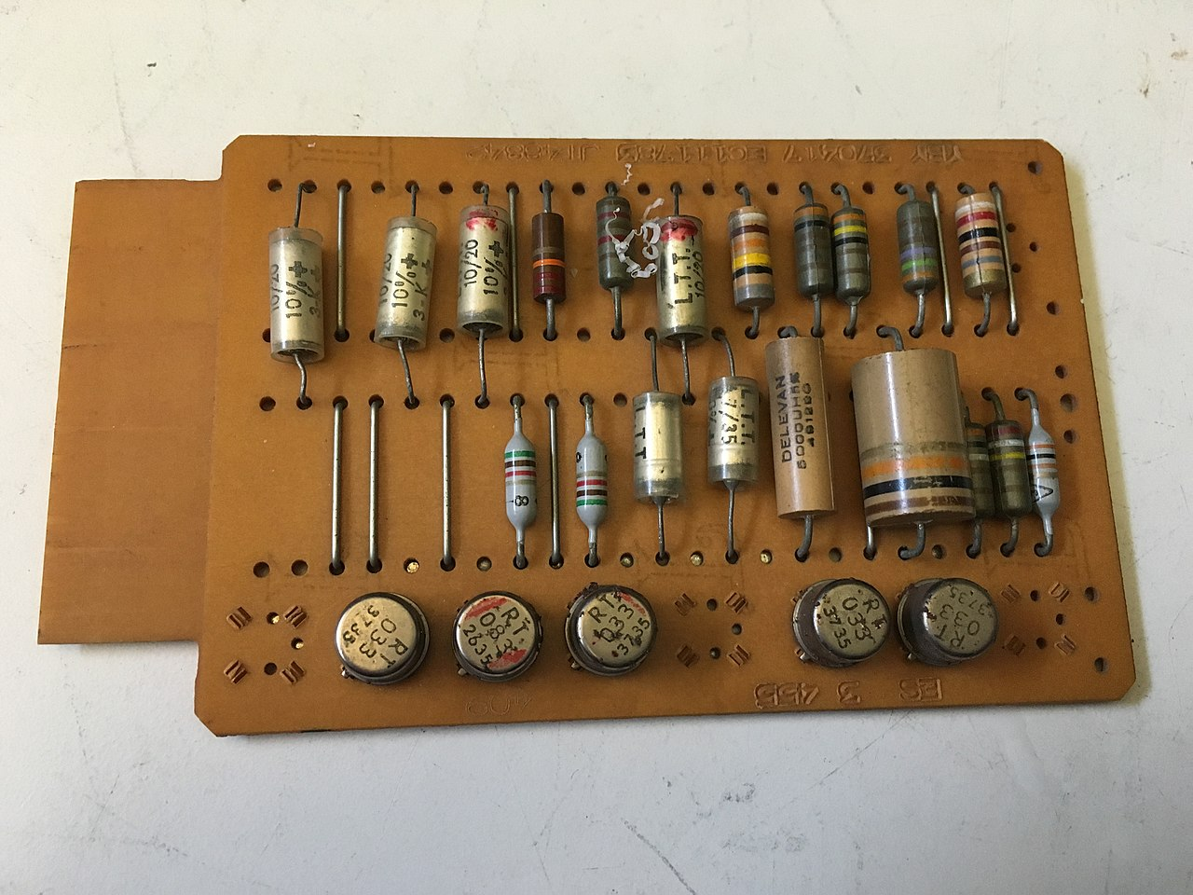
Electronic Computer: Before Integrated Circuits
In the 1940s, to compute the correct angles hitting targets accurately, the first electronic computer based on vacuum tubes was developed in the United States.
In the 1950s and 1960s, the use of computers expanded from military applications to commercial use, with vacuum tubes gradually replaced by transistors.
1 Vacuum tubes
50cm³
First Electronic
Computer ENIAC
17468 VT 385FLOPS
Ge. Transistor
73cm²
5 Transistors
First Commercial
Transistor Computer
50000+ Trans. 100KFLOPS

Slide 9
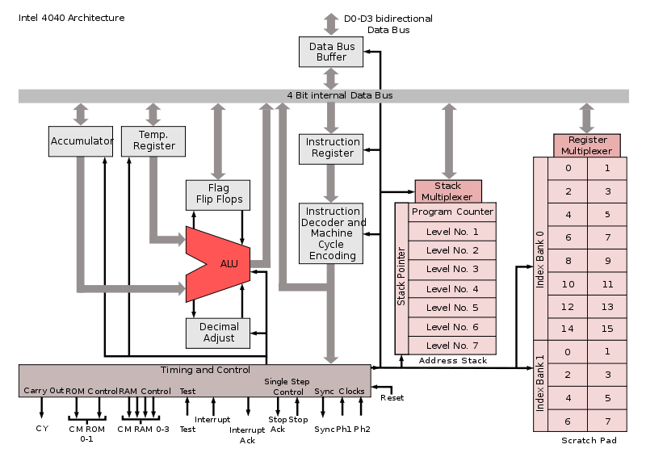
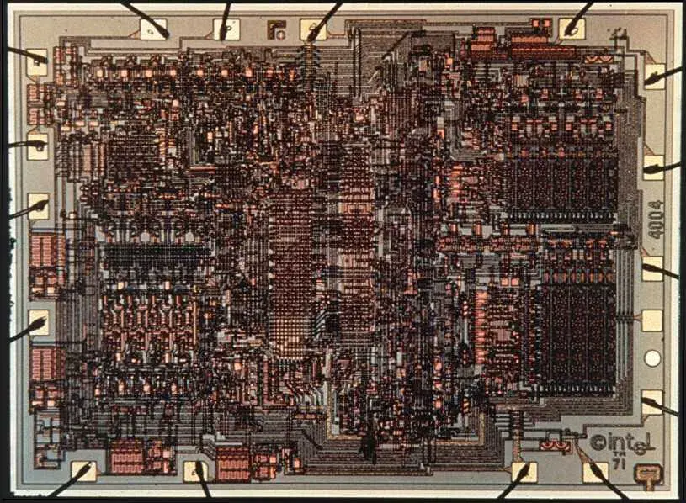
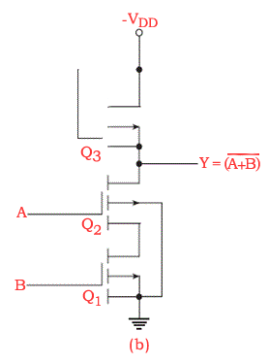
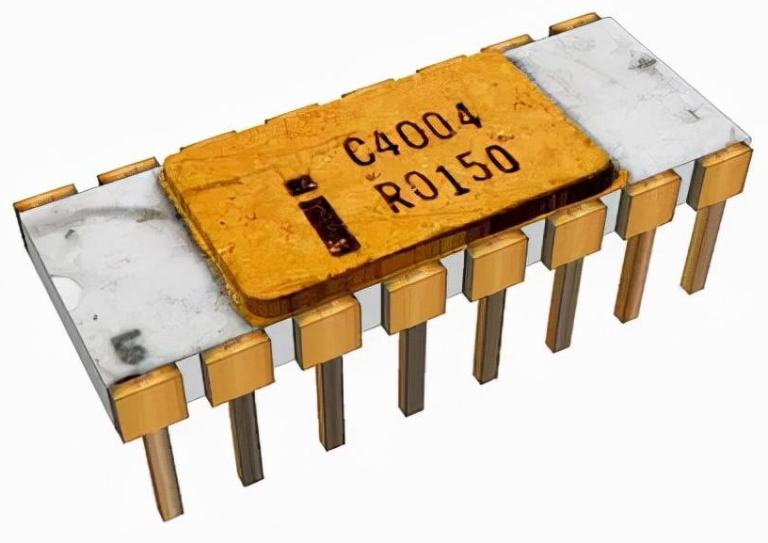
Electronic Computer: First CPU IC Intel 4004
In the 1970s, Busicom, a Japanese company, commissioned Intel to design the 4004 chip, a 4-bit CPU, for a general-purpose desktop printing calculator.
The Intel 4004, fabricated using a 10μm process, integrated 2,300 transistors within 12mm², achieving 60KOPS performance .
First Commercial Computing
Chips (CPU): Intel 4004
Enhance PMOS Load
Logic Gates
Intel 4004 Arch:
Reg File/ALU/Bus/…

Slide 10
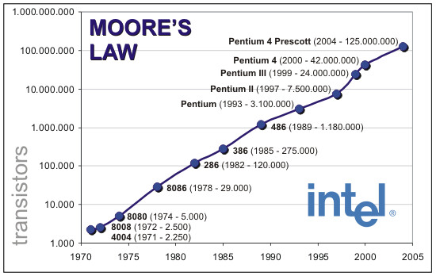
Electronic Computer: First CPU Chip -- Intel 4004
Moore's Law: The number of transistors on integrated circuits doubles approximately every two years with finer and finer lithography technology.
Light sources progressed from mercury lamps (G/I line) to KrF, ArF DUV, enabling shrinkage from micrometers to 100nm, now moving toward EUV.

Slide 11
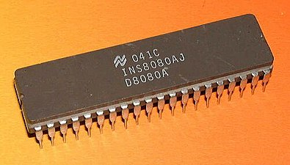
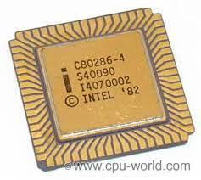
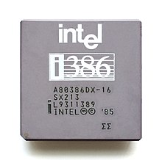
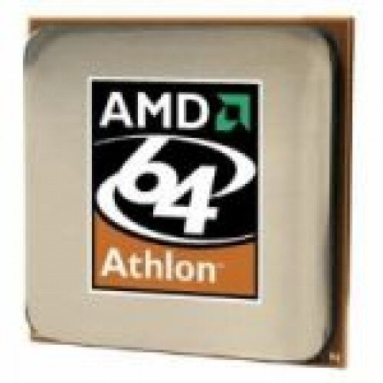
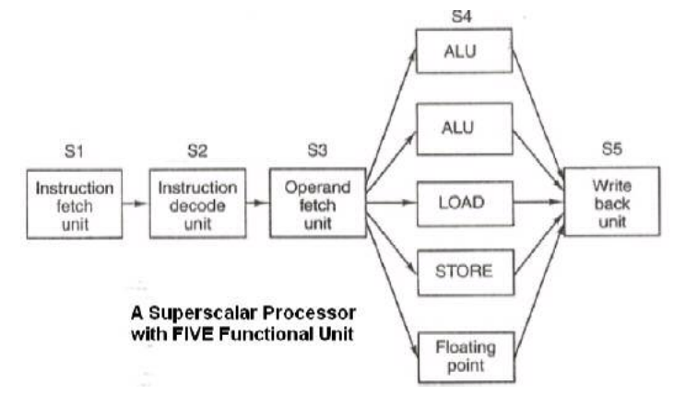
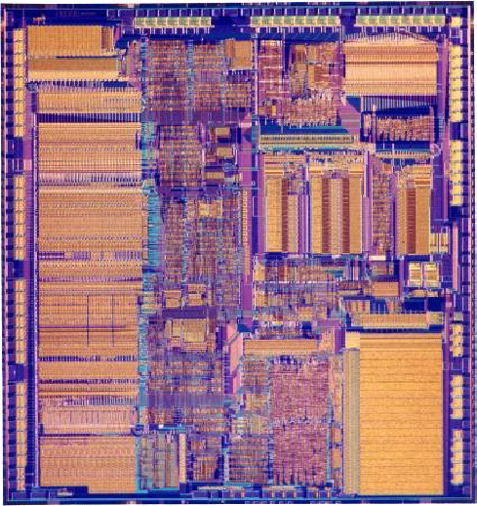
Dennard Scaling and Its Impact on Computing
Dennard Scaling: As technology shrinks from 10 to 0.13μm, power density remains constant, enabling increased CPU complexity, from 4-bit to 64-bit, with pipeline, cache, superscalar, multiple/out-of-order issue etc.
Parameter | Scaling Factor
Gate Length | 1/k
Oxide Cap. | 1/k
Power Supply | 1/k
Saturation Current | 1/k
Power | 1/k²
Intrinsic Delay | 1/k
Transistor Density | k²
Power Density | 1
Intel 8080
8-bi 6μm
Intel 80286
16-bit 1.5μm
80386
32-bit1μm
AMD Athlon 64-bit 0.13 μm
Superscalar
Pipeline
Intel 80386
First on-chip Cache（16kB）
Happy Constant Field Scaling
(Dennard Scaling)

Slide 12


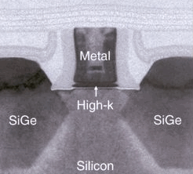


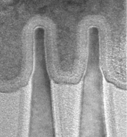
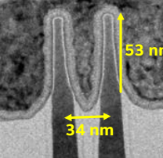
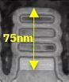
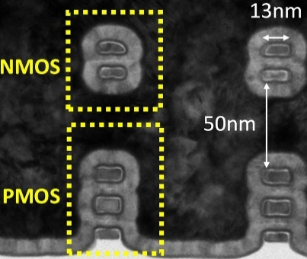
Continuous Scaling Down of Advanced Transistors
Transistor scaling from FinFET to GAA enables higher device density and better electrostatic control, boosting the gates count thus compute logic.
CFET further shrinks after GAA by stacking n/pFET vertically.
Moore’s Law
Post-Moore’s Law
2003
2005
2007
2009
2011
2014
2020
Reaching physical limits
90nm
65nm
45nm
32nm
22nm
14nm~3nm
2nm~1nm……
Strained Si
High-k Gate
FinFET
GAAFET/CFET
Planar Processes
Three-dimensional Processes
Source: IRDS ESI

Slide 13
End of Dennard Scaling and Its Impact
After 100nm process, Dennard Scaling approaches end. Actual device focus on constant voltage scaling, where power density increases with shrinking sizes.
Due to thermal limitations, CPU clock frequency couldn't increase after 2004. Singe-core CPU’s computational growth entered a saturation phase.
CPU Performance
Transistor Count
Nvidia H100 Power Density：0.9W/mm²
Fukushima Nuclear Power Plant’s Reactor PD：0.6W/mm²

Slide 14
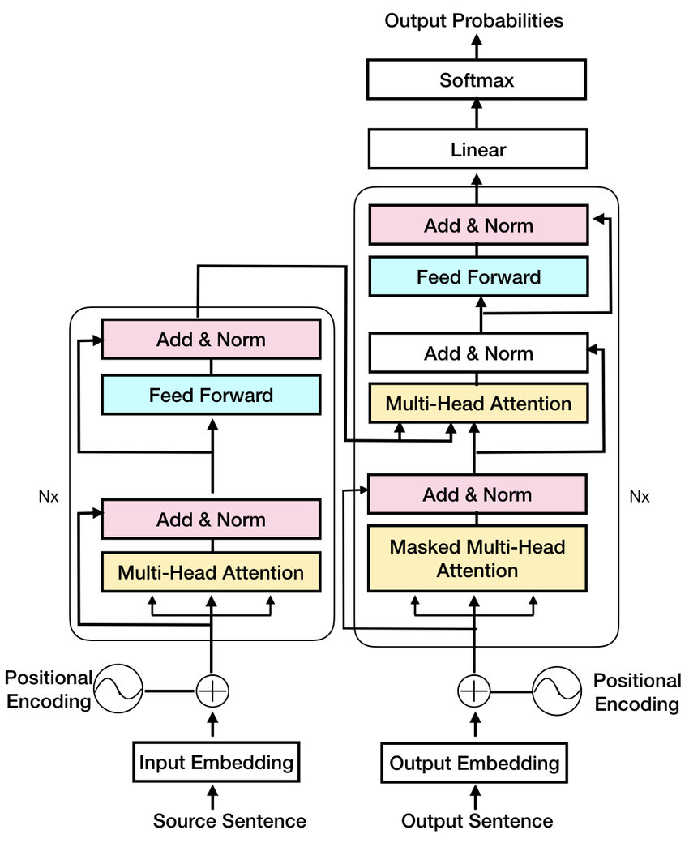
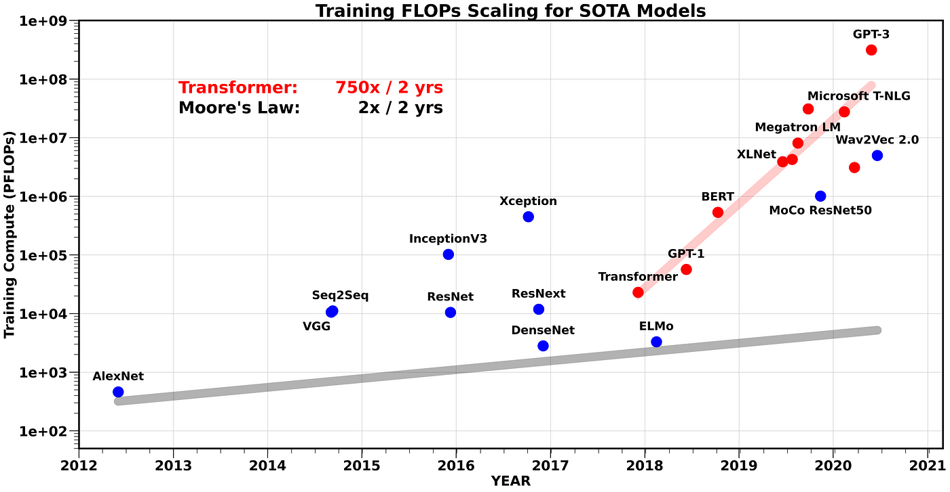
Incredible Scaling Law from LLM
Computing performance (TOPS/TFLOPS) required by AI algorithms is 300x faster than Moore’s Law, which is approaching its physical limit after 2nm technology.
2017 Google
Transformer
Network

Slide 15
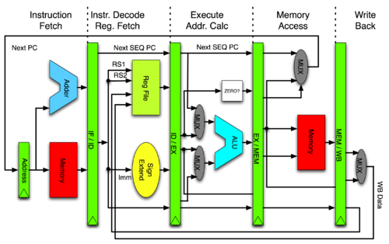
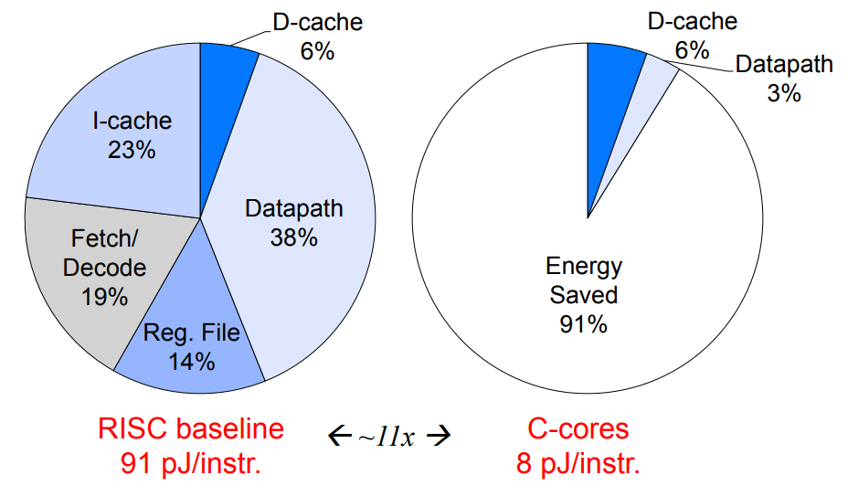
CPU for NN based Intelligent Computing
Current intelligent computing workloads primarily involve neural networks，which highly relies on matrix multiplication and accumulation.
In RISC CPUs, data computation-related power consumption accounts for only 9%. Dedicated hardware tailored for intelligent computing are necessary.
5-stage Pipeline RISC CPU
Ref: Hotta, Taylor, ASPLOS 2012

Slide 16
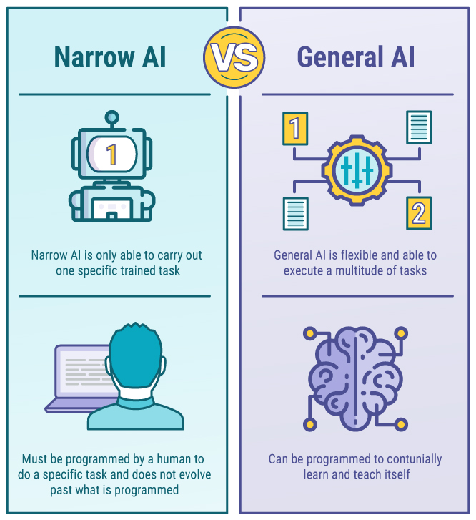
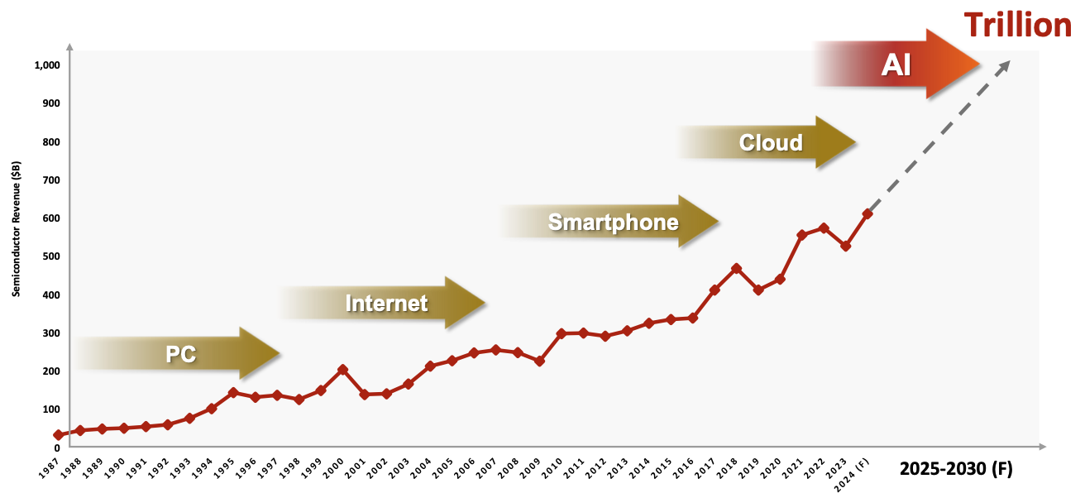
Intelligent Computing Drives Chip Market
Narrow AI: computing systems that are designed/trained to perform specific tasks.
AGI: machines that understand and learn across a wide range of tasks, similar to human cognitive abilities, which also requires 100x+ computing performance.
The success of AGI would drive a trillion-USD market for semiconductor market.
Source: TSMC
Notes:
多举例子

Slide 17
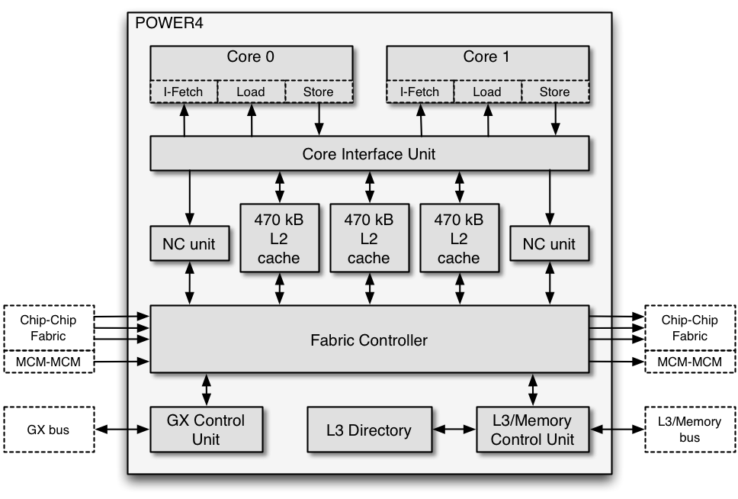
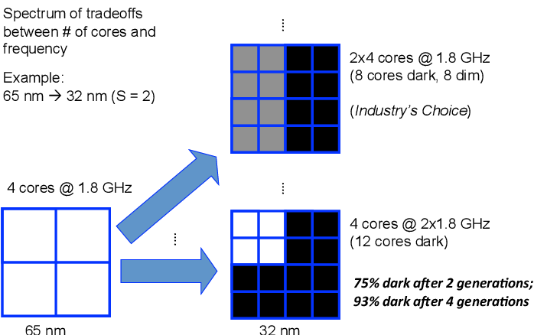
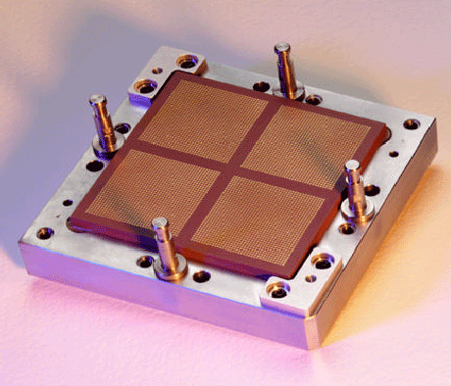
Multi-core Scaling and Dark Silicon
CPUs shifted to multi-core architectures to overcome thermal limitations and performance saturation issues in single-core performance.
Dark silicon: inactive parts of a multi-core chip due to power or thermal.
IBM Power4 @ 2001
First commercial multi-core
Notes:
http://ixbtlabs.com/articles/ibmpower4/

Slide 18
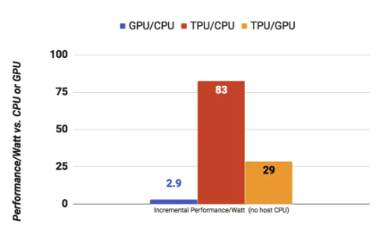
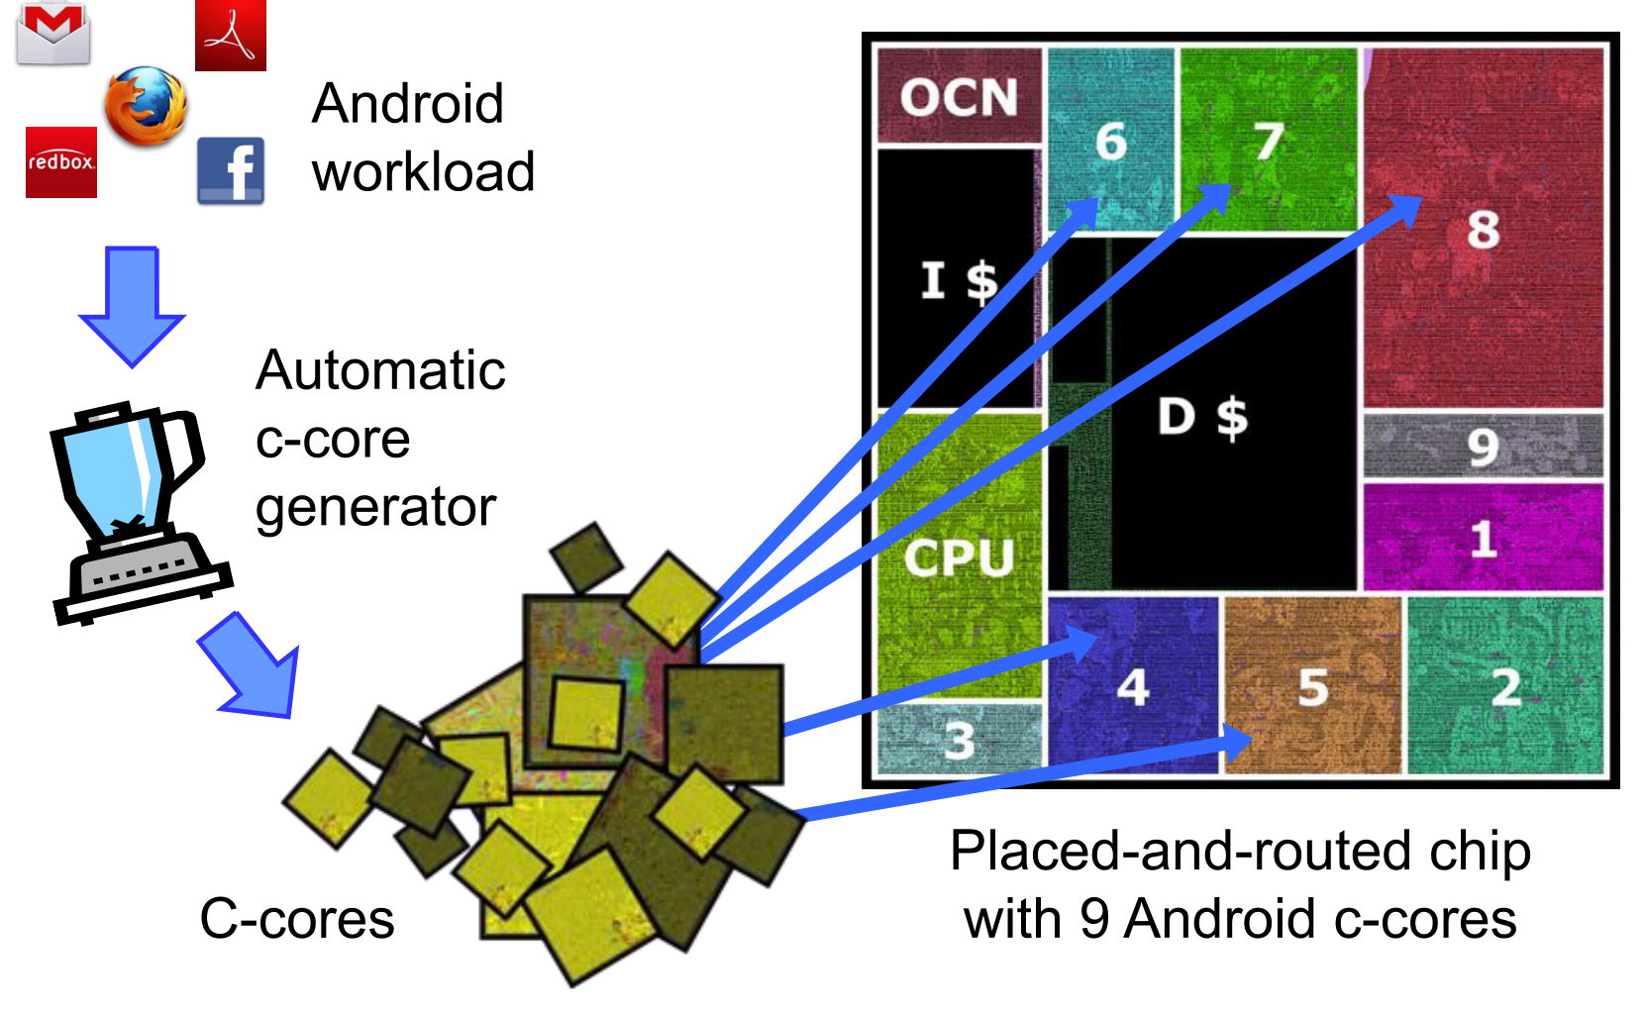
Domain Specific Cores in Dark Silicon Age
Domain-specific architectures (DSAs) enhance efficiency by tailoring designs to specific application domains, but requires domain specific knowledge.
Examples include neural network processors for machine learning, GPUs for graphics, and programmable network switches for networking.
TPU as a domain specific architecture, demonstrating great efficiency than CPU/GPU.
Notes:
https://youtu.be/FSwKCL8A9JQ

