Slide 1


智能片上集成系统设计
Introduction of Intelligent Computing Chip and System
Lecture 3 Deep Learning Basics
Instructor: Shiwei Liu, Assistant Professor

Slide 2
Overview of the Lecture
Objective: introduce the foundational concepts behind neural networks and deep learning algorithms.
Topics:
History of Neural Networks and Biological Nature
The Basic Mathematics of Neural Networks
Convolutional Neural Networks (CNNs)
  A hardware perspective to see massive opportunities for weight reuse and data reuse.

Slide 3
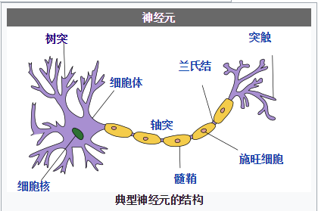
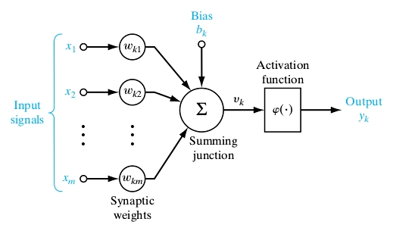
From Bio Neurons to Artificial Neurons
In 1943, Warren McCulloch and Walter Pitts proposed a model of artificial neurons that mimicked the brain's activity.
Neuron = Cell body (soma) + Dendrites (树突) + Axon (轴突) + Synapse (突触)
.

Slide 4
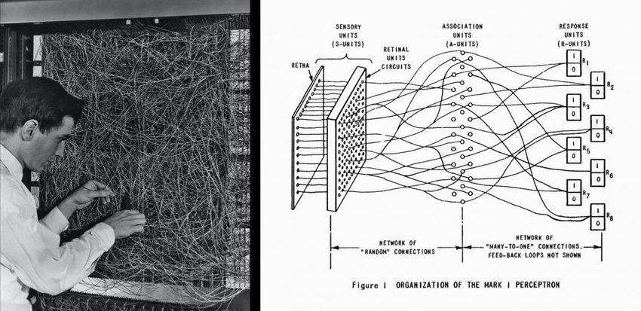
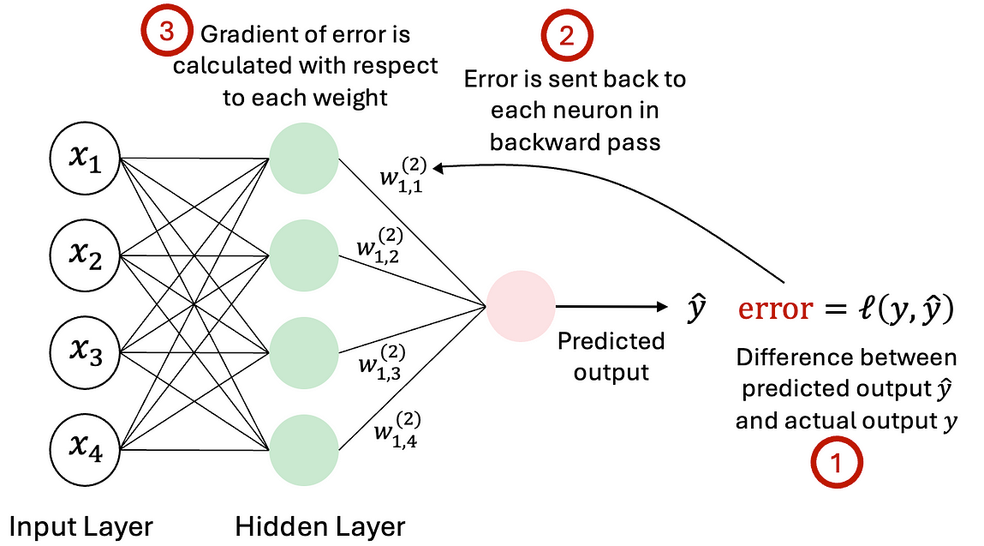
Early Developments in Neural Networks
In 1958, Frank Rosenblatt introduced the Perceptron, a single-layer neural network, serving as the basis for more complex models.
In 1975, Paul Werbos introducing the Multi-Layer Perceptron (MLP), which allowed for non-linear decision boundaries and chain-rule based back-propagation.
Mark I Perceptron

Slide 5
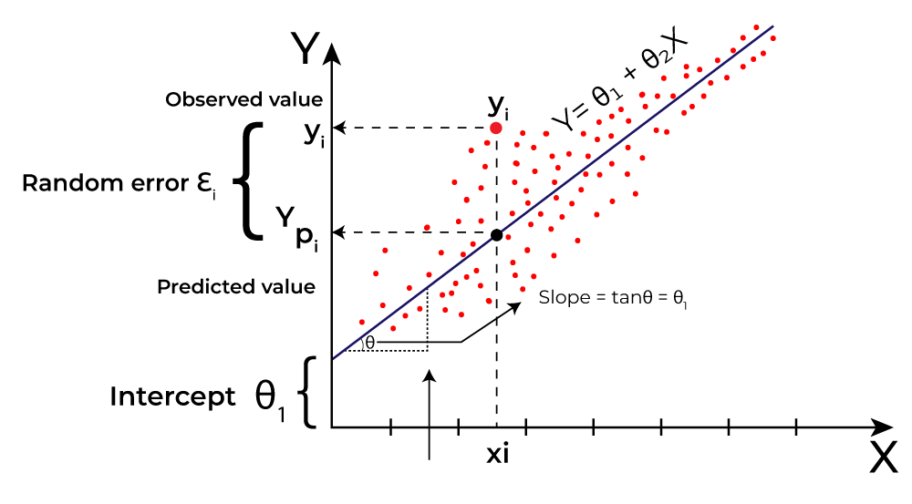

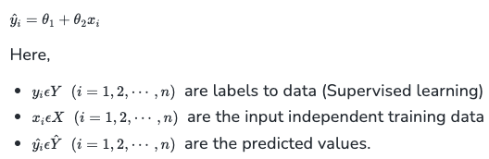

Linear Regression & Machine Learning
Linear regression models the best linear fitting between samples and a straight line.
In Linear Regression, the Mean Squared Error (MSE) cost function is employed, which calculates the average of the squared errors between the predicted values and the actual values.

Slide 6
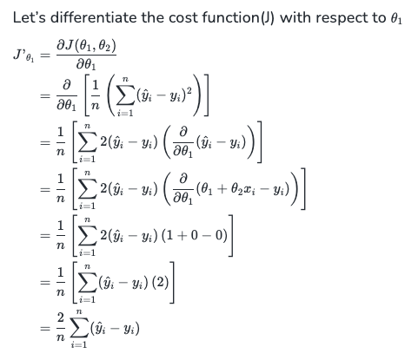
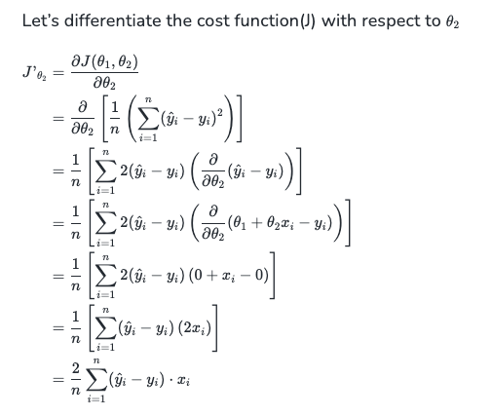
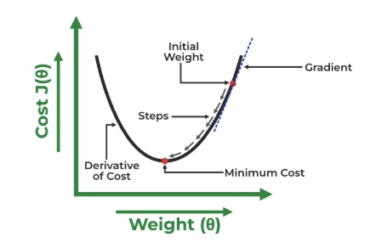
Gradient Descent of Linear Regression
Finding the coefficients with minimum cost is the objective of LR by iterations.

Slide 7
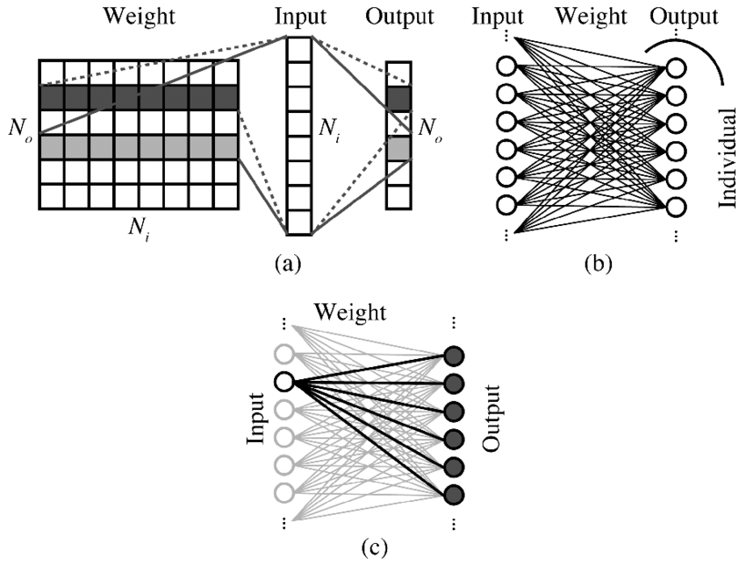
Matrix-Vector Products
Matrix-vector product is the primary computation in Artificial Neural Networks (ANN) from day one, including input features ( also called activations), weights and output features.
Fully-connected layers (linear layers) rely heavily on matrix-vector multiplication for data transformation / projection / up-down sampling .

Slide 8
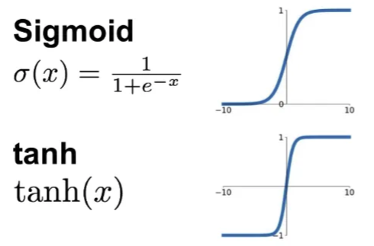
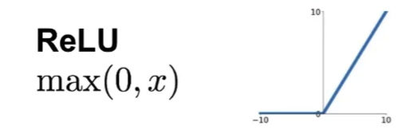
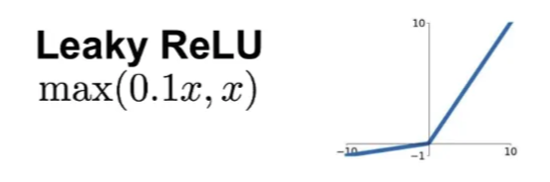
Activation Functions
Activation functions introduce non-linearity to the network, allowing it to model complex relationships..
Common Functions: Sigmoid, ReLU, tanh are commonly used activation functions.

Slide 9
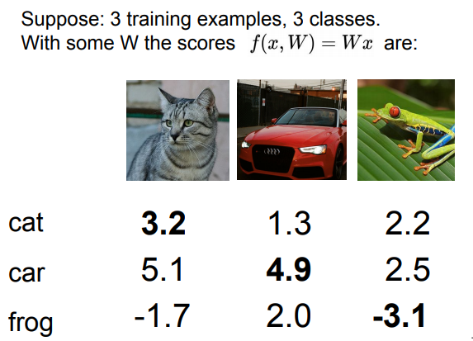
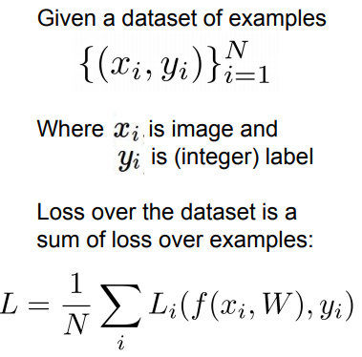

Classifier and Loss Functions
Classifier: A model that assigns input data to predefined categories based on score function’s output, raw value from NN through weighted sums..
Loss function: define the difference between the score function and ground truth label.
Given a dataset and its label, x_{i} is input, y_{i} is label
Score function:
Loss function:
Cross-entropy Loss function:
(Softmax)

Slide 10
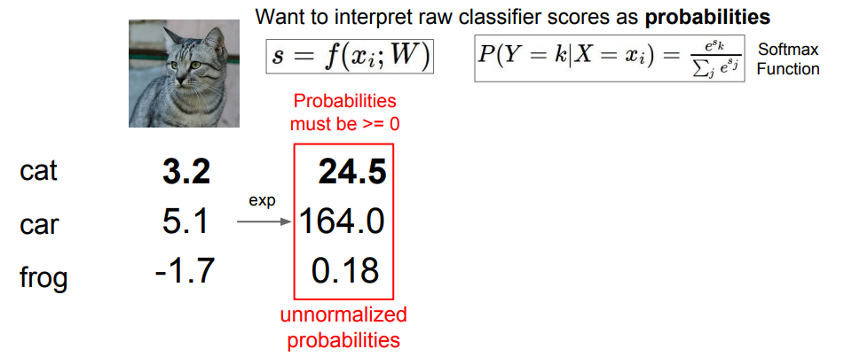
Softmax Classifier

Slide 11
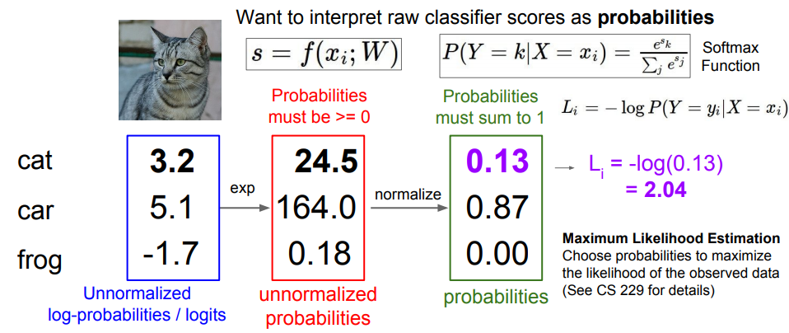
Softmax Classifier

Slide 12
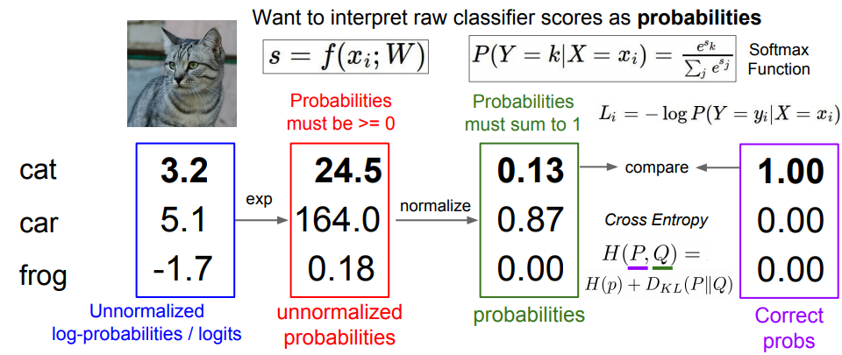
Softmax Classifier

Slide 13
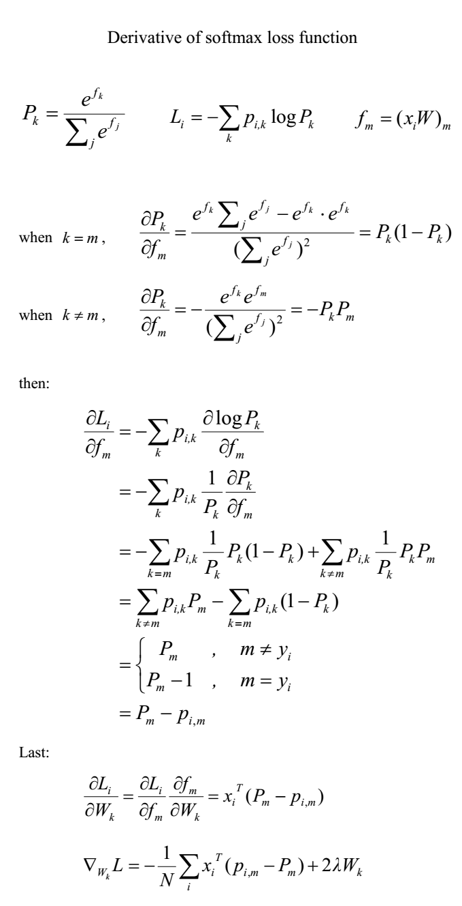
Backpropagation of Softmax Classifier
Score:
Probability:
Cross-Entropy:

Slide 14
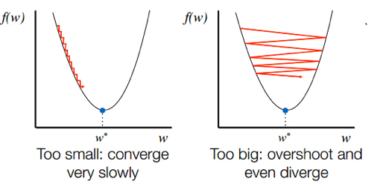
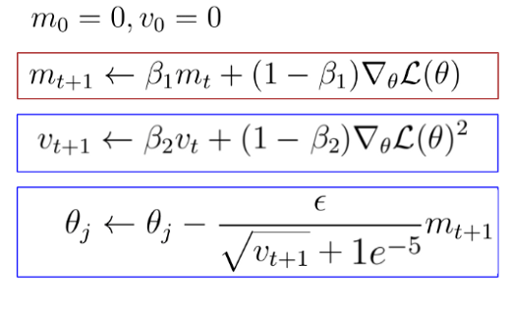
Weight Updating and Adam Optimizer
Momentum: Incorporates past gradient updates to accelerate convergence and reduce oscillations during optimization (faster optimization and less oscillation)
Adam (Adaptive Momentum Estimation) optimizer combines momentum and adaptive learning rates for efficient and stable weight updates.
m_{t} first momentum v_{t} second momentum
Ref: https://artemoppermann.com/optimization-in-deep-learning-adagrad-rmsprop-adam/
Notes:
https://artemoppermann.com/optimization-in-deep-learning-adagrad-rmsprop-adam/

Slide 15
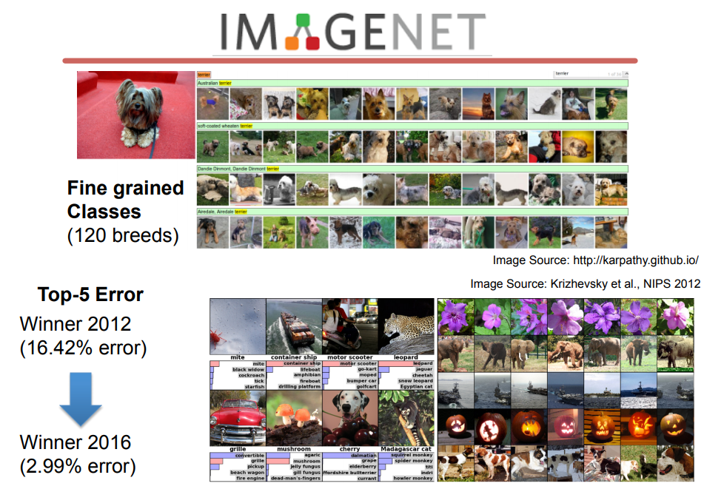
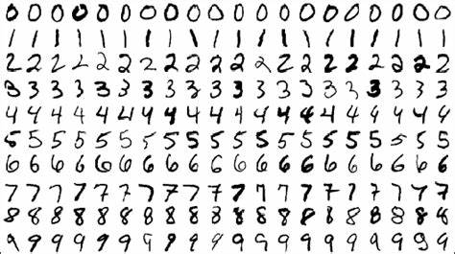
Image Classification Tasks
Image classification is the task of categorizing images into predefined classes using machine learning models. Well-known image classification dataset includes MNIST, CIFAR and ImageNet.
MNIST: A dataset for digit recognition
ImageNet: →
A large-scale dataset with 1000 categories

Slide 16
Convolution and CNNs
Convolution operations apply filters as a sliding window to input image.
Number Denotation
Weight Kernel
  C = Input Channel
  R = kernel size
Input Activation Map
  W = map width
  H = map height
Raw image input of ImageNet:
  H=W=224, C=3 (RGB)
Input Activation Map
(input feature)
C
Weight #1
(filter)
H
R=3
C
W

Slide 17
Convolution and CNNs
Convolution operations apply filters as a sliding window to input image.
Convolve means:
  Dot product between the weight kernel and a small input map chunk with the same size of
  the kernel.
Input Activation Map
(input feature)
C
×
Weight #1
Weight #1
(filter)
H
R=3
C
W

Slide 18
Convolution and CNNs
Convolution operations apply filters as a sliding window to input image.
Convolve means:
  Dot product between the weight kernel and a small input map
  chunk with the same size of
  the kernel.
  Slide over the map spatially.
  The step size is called stride.
Weight Reuse
  One weight multiple input activation
Act
#1
Act
#2
C
×
Weight #1
Weight #1
(filter)
H
R=3
C
W

Slide 19
Convolution and CNNs
Convolution operations apply filters as a sliding window to input image.
Convolve means:
  Dot product
  Slide over
  Output Activation Map
Weight Reuse
  Single weight multiple activation
  In contrast with MLP, Convolution reduces the weight scale.
Act
#1
Act
#2
Act
#N
C
×
Weight #1
Weight #1
(filter)
H
R=3
C
W

Slide 20
Convolution and CNNs
Convolution operations apply filters as a sliding window to input image.
Consider a second weight kernel (green)
  Perform the same convolution with different weight kernel
  Output channel width = Weight kernel number
Input reuse
  Single activation multiple weight
Act
#1
Act
#2
C
Weight #1
H
Output
#1
R=3
Weight #2
Output
Ch #2
C
W

Slide 21
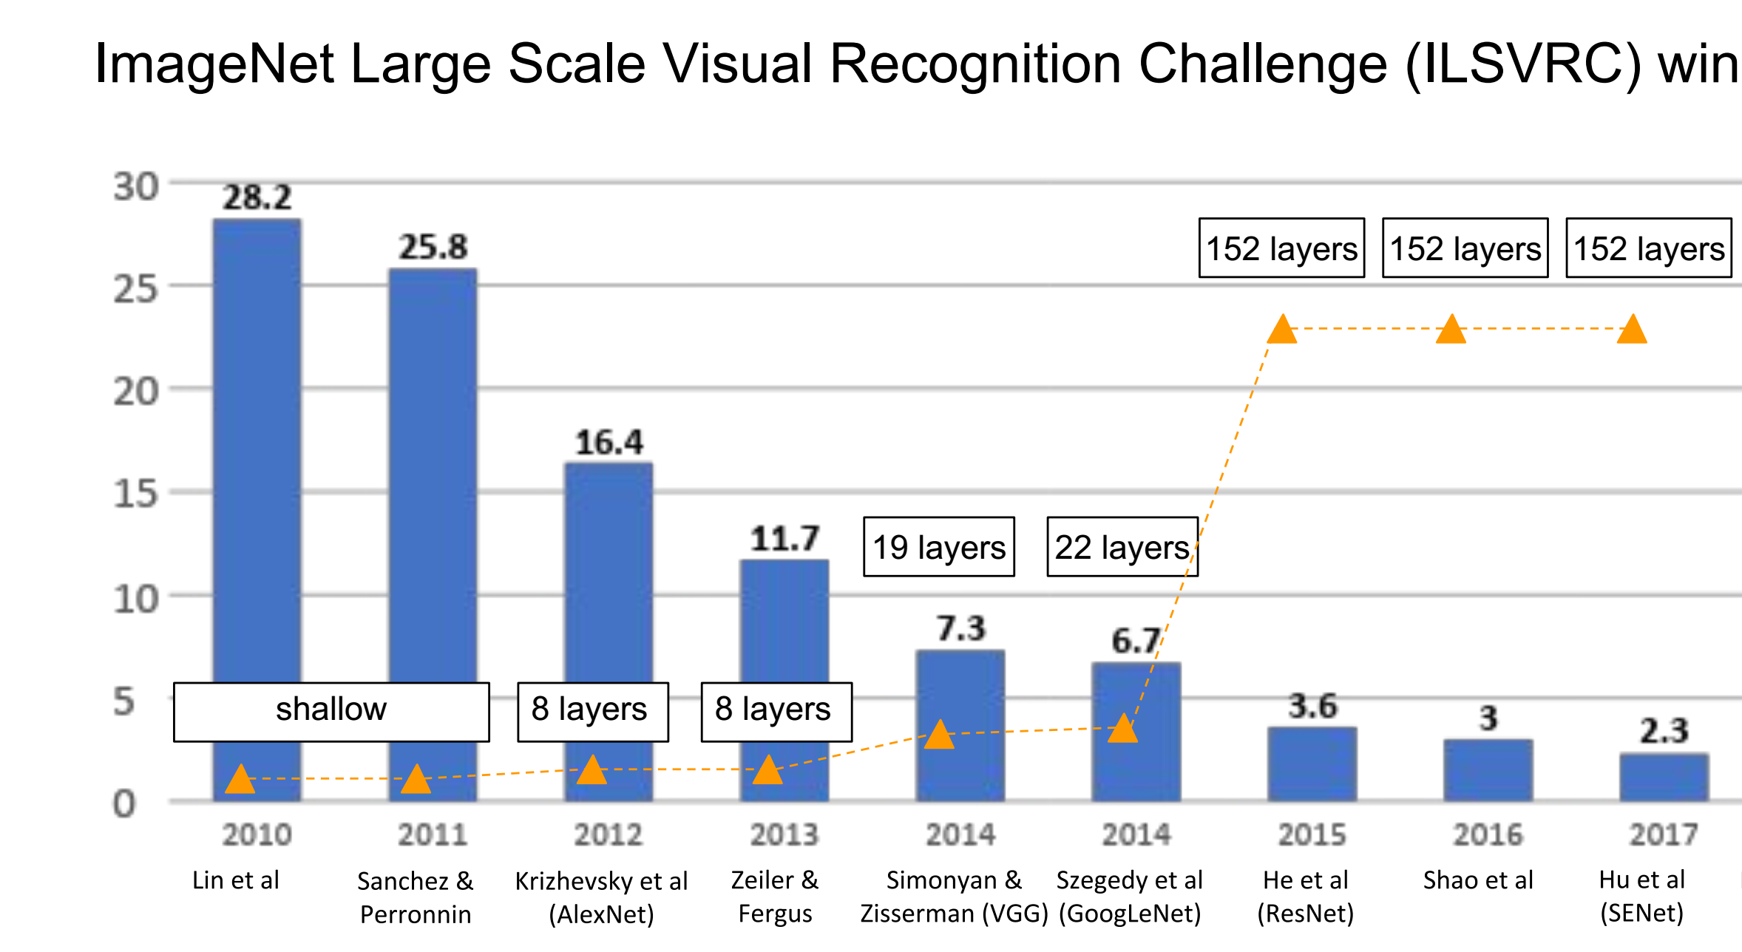
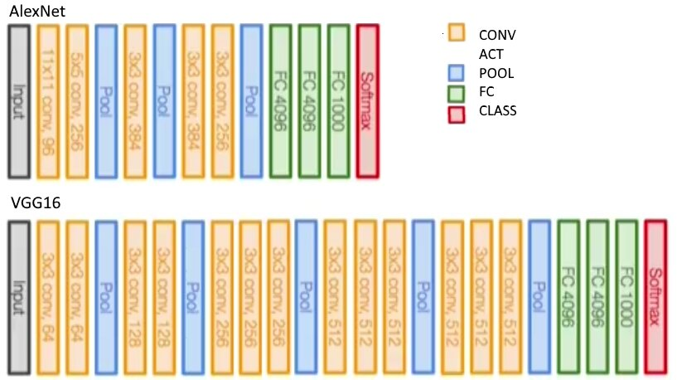
AlexNet and VGG
AlexNet (8-layers) introduced deep CNN with ReLU activation and GPU acceleration, achieving significant improvements in image classification accuracy.
VGG (19-layers) demonstrated that CNN with small 3×3 convolutional filters outperform shallow networks, leading to more accurate image classification.

Slide 22
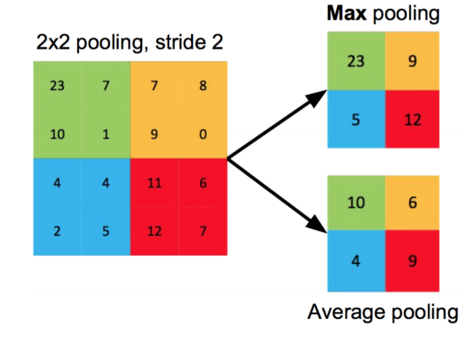
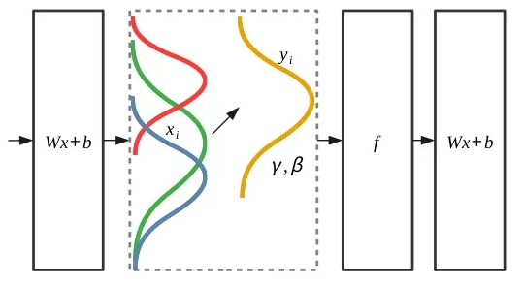
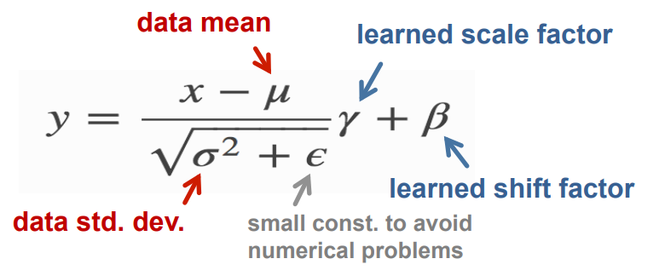
Pooling Layer / Normalization Layer
Pooling reduces the spatial dimensions of data, retaining essential features while decreasing computational load.
Batch Normalization (BN): Activations towards mean=0 and std. dev.=1 based on the statistics of the training dataset, improving training efficiency.

