Slide 1
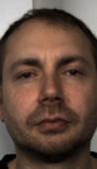
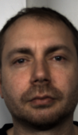
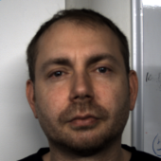
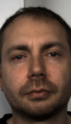

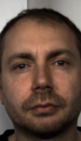
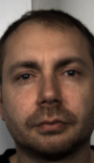
A.
Video evidence is assembled into competing, traceable candidate trajectories
Reference HR and candidate error remain outside inference
Observable Video Evidence
Candidate-Generation Routes
Temporal Candidate Flow
Selection rationale
Each route preserves value, support and source identity
Competing paths remain visible while one observed trajectory persists across windows
Four evidence channels converge
Regional
previous window
current window
next window
0s
4s
8s
12s
16s
20s
dense ROI / local spectra
Signal Quality
Agreement
Temporal Trace
Classical rPPG
GREEN · CHROM · POS · PBV
Relation Topology
source-preserving trajectory
candidate relations
become evidence
Selected Path
Learned
Temporal Support
Source Identity
Spectral Trace
DeepPhys · TS-CAN · EfficientPhys
Quality · Relation · Time · Identity
Transformer
Selected HR
PhysFormer · RhythmFormer
source identity retained
observable evidence remains visible
observed candidates
Face / Regional Support
Correction
SOURCE LINEAGE
optional residual / harmonic variants
Route
Candidate
Identity
Record
vertical position denotes relative candidate HR; alternative paths remain visible
B.
Value, Evidence and Proposed State Remain Linked but Distinct
The state proposal never overwrites the selected estimate
SELECTED VALUE
EVIDENCE PACKET
four traceable evidence specimens
RESEARCH SCORE
PROPOSED RELEASE
selected HR
alternatives
relations
conflict landscape
evidence channels converge before thresholding
value + evidence
numerical estimate
competing candidates
agreement + continuity
lower conflict
review residual
score at/below threshold
source fingerprint retained
ambiguity
provenance
Fused Score
PROPOSED REVIEW
residual conflict
route + model version
value + reason + evidence
Threshold
score above threshold
EVIDENCE BOUNDARY
Inference uses video-derived evidence only. The research score proposes a state but does not establish autonomous clinical release or clinical utility.

