Slide 1
Maven
Riju A Josdas
Rahul Tiwari

Slide 2
Introduction
Maven is a powerful project management tool that is based on POM (project object model). It is used for project build, dependency, and documentation. Maven is a tool that can be used for building and managing any Java-based project. Maven makes the day-to-day work of Java developers easier and generally helps with the comprehension of any Java-based project.

Slide 3
AGENDA
Introduction​
Life Cycle
​Goals
Uses
​Advantages

Slide 4
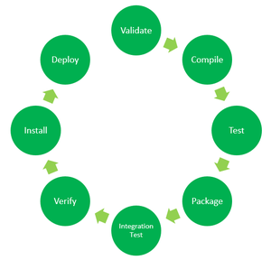
Life cycle

Slide 5
Life cycle
Validate: This step validates if the project structure is correct. For example – It checks if all the dependencies have been downloaded and are available in the local repository.
Compile: It compiles the source code, converts the .java files to .class, and stores the classes in the target/classes folder.
Test: It runs unit tests for the project.
Package: This step packages the compiled code in a distributable format like JAR or WAR.
Integration test: It runs the integration tests for the project.
Verify: This step runs checks to verify that the project is valid and meets the quality standards.
Install: This step installs the packaged code to the local Maven repository.
Deploy: It copies the packaged code to the remote repository for sharing it with other developers.

Slide 6
goals
Each phase is a sequence of goals, and each goal is responsible for a specific task.
When we run a phase, all goals bound to this phase are executed in order.
Here are some of the phases and default goals bound to them:
compiler:compile – the compile goal from the compiler plugin is bound to the compile phase
compiler:testCompile is bound to the test-compile phase
surefire:test is bound to the test phase
install:install is bound to the install phase
jar:jar and war:war is bound to the package phase

Slide 7
USAGE
We can add jars and other dependencies of the project easily using the help of maven.
Maven provides project information (log document, dependency list, unit test reports, etc.)
With the help of Maven, we can build any number of projects into output types like the JAR, WAR, etc without doing any scripting.
Using maven we can easily integrate our project with a source control systems like Git.
Maven also helps in managing the project’s build lifecycle, including tasks like compiling, testing, packaging, and deploying the code.
Maven provides a standard project structure, making it easy for developers to understand the layout of the project and locate specific files.
Maven simplifies the process of managing project dependencies, ensuring that the correct versions of libraries and frameworks are used throughout the project.

Slide 8
advantages
Maven manages all the processes, such as building, releasing, documentation, and distribution of the projects.
Maven automatically includes all necessary dependencies
It is very easy to create projects using jar, war, and so on as per requirements.
Maven allows you to start projects easily in various environments, and you don't have to worry about dependency injection, builds, processing, etc.
The process of adding a new dependency can be extremely easy.

Slide 9
THANK YOU

