Slide 1
MACHINE LEARNING MINI-PROJECT
Aspect-Based Sentiment Analysis on Hotel Reviews
Guessing a hotel review's star ratings (overall + 5 aspects) just from the review text
Presented By :
Shikshith V (PES1UG24AM400)
Sateesh (PES1UG24AM397)
Notes:
(~30 s) Introduce ourselves and the project. We predict the overall star rating and five aspect ratings (value, rooms, location, cleanliness, sleep quality) using only the review text. Our project is based on the Stanford CS229 report on aspect-based sentiment analysis.

Slide 2
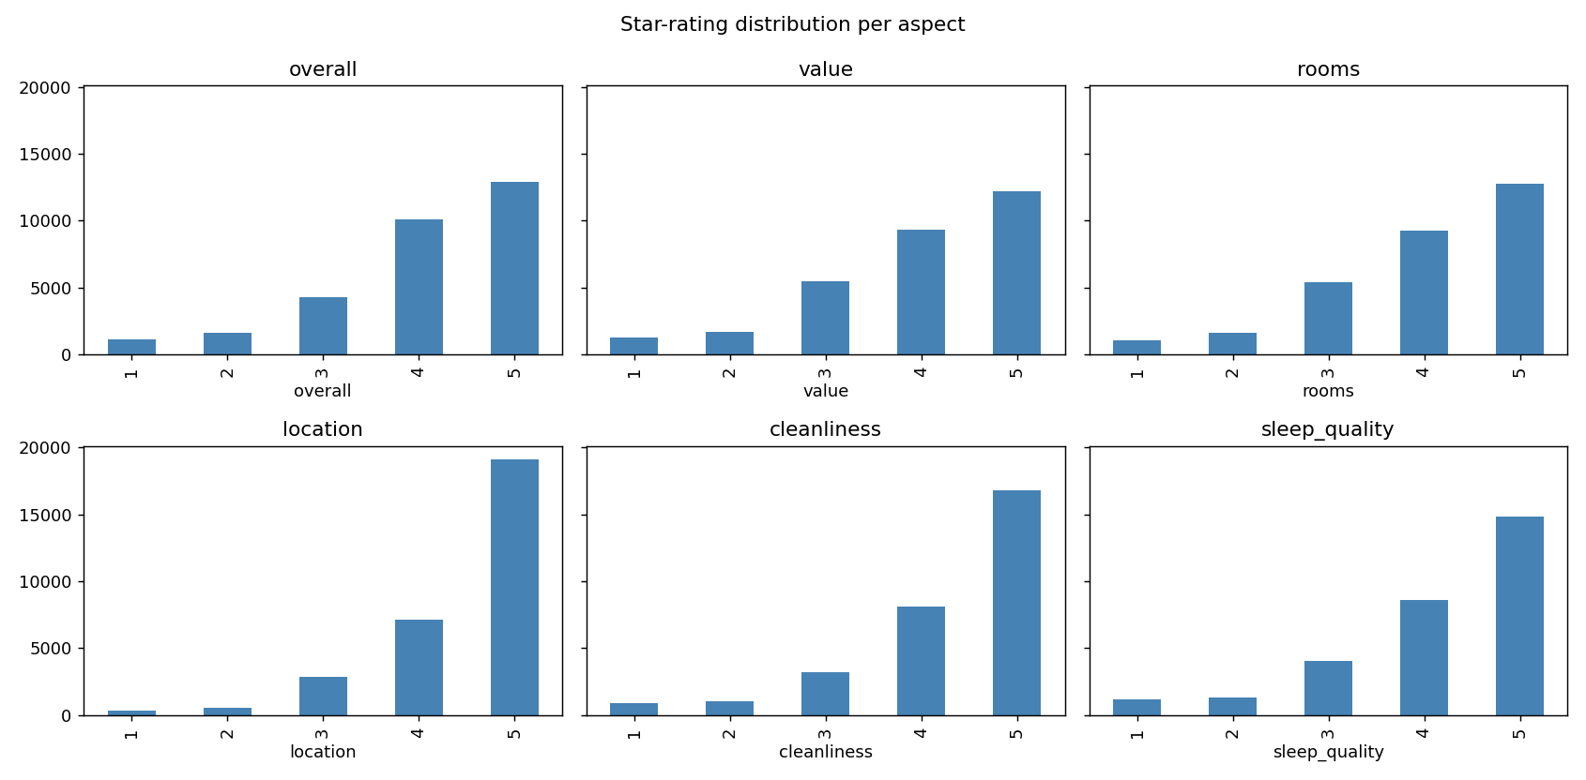



What we are predicting
Input
A hotel review (title + text)
Output
Star ratings (1–5) for overall, value, rooms, location, cleanliness and sleep quality
Polarity
Below 3 = negative, 3 = neutral, above 3 = positive
30,000
20k / 10k
41–64%
reviews sampled
train / test
accuracy if we just guess 5 stars every time
Notes:
(~1 min) Input is the review text, output is six star ratings, and we turn the stars into polarity. We used 30,000 reviews: 20,000 for training and 10,000 for testing. Important point: most ratings are 5 stars, so a model that always says 5 already gets 41 to 64 percent. That's why we compare everything with that baseline. The paper has 7 aspects but our dataset has 5, so we only predict those.

Slide 3
How we did it
1
Features
2
Models
3
Evaluation
Count words and phrases (1 to 3 words)
Drop very rare / very common phrases, keep up to 300k
No TF-IDF (same as the paper)
Linear SVM (balanced class weights)
Multinomial Naive Bayes
Ridge regression (rounded to a star)
Exact accuracy and within 1 star
Macro-F1 and polarity accuracy
Compared with always guessing 5 stars
We train one model per rating: 6 ratings × 3 models = 18 models. The vocabulary comes from the training data only.
Notes:
(~1 min) Features: counts of 1 to 3 word phrases, so 'not good' stays together. We kept stop words and did not use TF-IDF, because the paper says sentiment words are common and TF-IDF would reduce their weight (we did not test this ourselves). We train three models for each rating: SVM with balanced class weights so the rare low ratings aren't ignored, Naive Bayes, and Ridge regression rounded to a star. We report exact accuracy, within 1 star, macro-F1 and polarity accuracy.

Slide 4
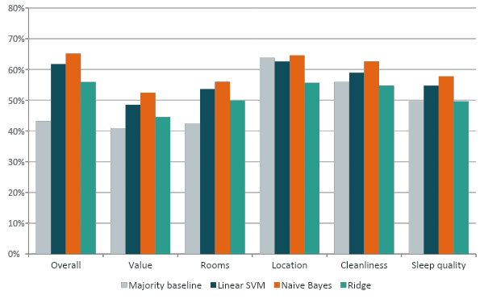
Naive Bayes gave the best accuracy
Test star accuracy, overall rating
65.1%
Naive Bayes, and 97% of its guesses are within 1 star
SVM 61.8%, Ridge 56.0%, always-5-stars 43.2%
We pick Naive Bayes for accuracy. We kept the SVM too because it did better on macro-F1 for rooms and location.
Notes:
(~1.5 min) Main result. Naive Bayes was best on all six ratings: 65.1% on overall, against 61.8% for SVM and 56.0% for Ridge, and 97% of its guesses are within 1 star. We kept the SVM as well because its macro-F1 was higher on rooms and location. The paper found SVM best on its data. Our smaller training set may be one reason Naive Bayes did better here, but we didn't test that.

Slide 5
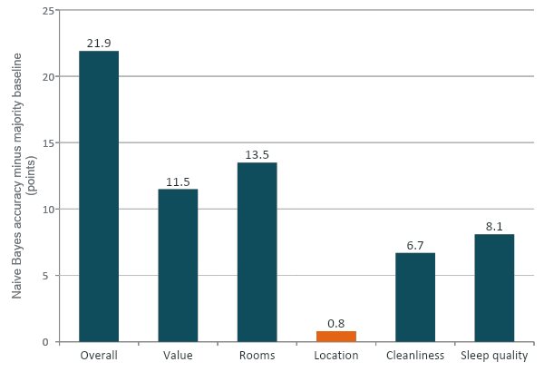
Location: barely better than guessing
+0.8 pts
improvement for location over guessing 5 stars
64% of location ratings are already 5 stars.
For polarity, guessing positive (87.6%) beats all our models (86.1–86.2%).
The other five ratings improve by 6.7 to 21.9 points, so the models do learn from the text there.
Notes:
(~1 min) This is our honest check against always guessing 5 stars. For overall, value, rooms, cleanliness and sleep quality the models clearly learn from the text. For location the gain is only 0.8 points, and for polarity the baseline beats every model, so we don't claim the models understand location.

Slide 6
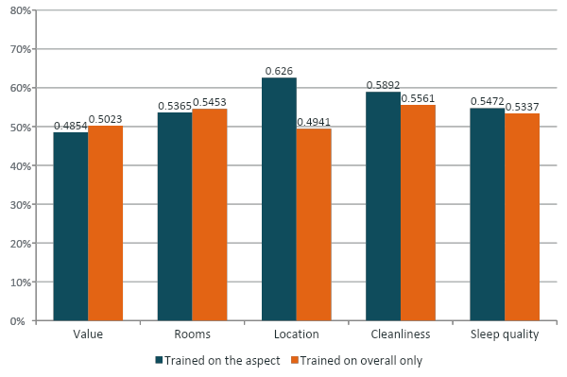
Does training on each aspect's own ratings help?
Linear SVM accuracy: aspect-trained minus overall-trained
Location
+0.132
Cleanliness
+0.033
Sleep quality
+0.014
Rooms
−0.009
Value
−0.017
Helps for 3 of 5. The +0.132 for location is mostly the 5-star skew; cleanliness is the clearest real gain.
Notes:
(~1 min) This is the paper's main experiment: a model trained only on overall ratings versus a model trained on each aspect. Training on the aspect helps for location, cleanliness and sleep quality, but is slightly worse for value and rooms, so we can't say it helps everywhere. If asked about words: overall: great hotel, wonderful, terrible, worst; cleanliness: spotless, very clean, dirty, filthy; location: great location, perfect location, unsafe.

Slide 7
Live demo: predict_review(text)
“The room was spotless and the staff were friendly, but the location was far from everything and noisy at night.”
Where it goes wrong
The model reads the whole review, so it can't tell which part is about which aspect.
The praise pushes location and sleep quality to 5 stars, even though the guest said “far from everything” and “noisy at night”.
Possible fix: match each sentence to an aspect first, then score it.
Target | Stars | Polarity
Overall | 4 | positive
Value | 3 | neutral
Rooms | 5 | positive
Location | 5 | positive
Cleanliness | 5 | positive
Sleep quality | 5 | positive
Notes:
(~1.5 min) Run the demo live in the notebook by changing the text in predict_review. The highlighted rows (location, sleep quality) look wrong for this review, which shows the problem with reading the whole review at once. Backup example: 'Terrible stay. Dirty bathroom, rude front desk...' gives overall 1, cleanliness 1, sleep quality 1. Before presenting, run the whole notebook once so the models are loaded.

Slide 8
Conclusions
What we found
Future work
Simple phrase counts with linear models beat guessing for 5 of the 6 ratings.
Naive Bayes is the most accurate; we kept the balanced SVM for rare low ratings.
Training on an aspect's own ratings helps when that aspect has its own words (like cleanliness).
For location, the models learned little beyond the 5-star skew.
Assign each sentence to an aspect
Ordinal regression / class rebalancing
Try BERT-style transformers
Notes:
(~30 s) Three points: the models learn real signal for five of six ratings, location is the exception, and training on an aspect helps where the aspect has its own words. Limitations: whole-review input, skewed ratings, and only five aspects instead of seven, so we can't compare directly with the paper. Then move to the last slide.

Slide 9
Thank you!
Notes:
Thank the panel and take questions. For code questions, open the notebook. For results, go back to slide 4 (models), slide 5 (location) or slide 6 (aspect vs overall).

