Slide 1
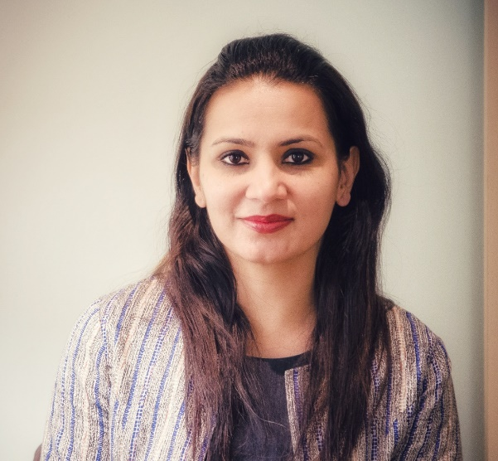
Career Synopsis
WHO AM I
Technology(Automation, AI, IoT) influencer
Team player first then Team Lead
Expert in driving ambiguous projects.
PMP & Agile practitioner & Mentor
Digital & Technology change catalyst
Personal Profile
Friendly husband & naughty daughter
Love Driving, Music, Travelling
Group Lead & Program Manager
What motivates me
What Am I Good at
What Am I Proud of
What are my Power doses
Curiosity & Constant learning from X-divisional Experts & Millennials
Working at eye level with Senior leaders for org initiatives and getting direct mentorship.
Enthusiastic & Lively Team
Building self sufficient team.
Business & Operational acumen
Breaking mechanical routine
Co-creation & collaboration
Mentoring & Coaching
Setting foundation for IoT center.
TDD and RBT implementation for healthcare customer.
Autonomous (in SW lifecycle) vision for Automotive Organization.
Implemented CICTCD in Connectivity projects
Pioneered AI based & Smart Home Custom solutions (along with experts)
Highest Associate Survey (reward for People manager) 2017-2019
Women’s leader award 2021
Best performance awards
Recognized as Innovator for crowd in-sourcing platform for mobile apps & Autonomous Solutions.
Winning Global competitions

Slide 2
Career Synopsis
Business
Strategy & Solution roadmap for Potential Clients
20% growth YoY
On-Time delivery – 98%
Digitize the Core
Autonomous & AI Solutions
IoT Strategy (including simulation)
Scouting Trends & Technologies (Voice enabled connectivity, AI in Defect management, Req Analysis)
CICTCD
2010 – Till now
Talent & Team
Competency Development (in-house CoE)
Scouting for new talents
Platforms & Programs for Talent Growth
Mentoring experts for PMP, ISTQB, UX
Operational Effectiveness
- -
Outcome Based pricing Introduced
Outsourcing for Vanilla activities.
Complaint to ‘Billability’ & ‘Outsourcing’ Goals
Co-creation with regions
2
2004-2010 : Software engineering in Multimedia, Healthcare, Payment domain

