Slide 1

2020 (New Normal Year) The year So FAR in CoC V&V….

Slide 2
Rewind, Play and Evaluate - 2020
Description : Test Automation & AI for V&V
Expected Achievements
- To organize regular exchange meetings for Automation & AI on time with good participation.
- To mentor Element and Workpackage owners for creating strategy & approach for meetings, topics and milestones.
- To define strategy, approach, scope and milestones of work packages along with owners.
- To implement Solutions in pilot projects and to keep Stakeholders apprised of progress and benifits.
Achievements beyond expectations
1. Reach out to multi divisions for pilot implementations & access to project data. Get buy-ins from divisions for successful validation of Automation & AI solutions.
2.Lead and Manage associates/leaders who do not have direct reporting line.
3. Main Stakeholders are in agreement of the developed solutions.
4. Identify available solutions concerning Automation & AI from diff divisions, evaluate and scale-up in agreement with Stakeholders.
5. Involve regions in the element meetings and workpackage solutioning.
6. Regular updates in Bosch connect/Docupedia about element and work package activities.
Vision : Designed Strategic Vision 2025 for Test Automation to reach to the goal of Autonomous Testing. This vision and charter outlines step approach which will help Bosch achieve the expert status. This Strategic Vision has already been approved by the representatives of all divisions of the Bosch, and has a Go-Ahead from Senior Management as well.
Solution Landscape & Maturity Model : Solution landscape is published. Inputs from various regions/divisions have been collected for Maturity Model of Strategic Vision. Progress is in full swing. First version to roll out by Q1’2021.
Highlights from Element meetings – 25 meetings conduced successfully with average of 15 participants.
Multiple problem statements discussed and use cases involving AI identified.
Interest group started for Test case generation Tool harmonization and integration.
Bench marking for Test Execution Tool
BSH, ITK, CC, AA, CM involved For Defect Prediction AI Work Package. Piloting on CM is in discussion (with support of Enes).
Involved in RBEI Fit for future project – Automation and supporting in solution catalogue.
Collaboration model created with Top’98 project (AIKnow)
Actual Achievements

Slide 3

RB-CoC SW V&V – Test Automation & AI for V&V
Strategic Vision’2025 : Autonomous Testing
FOUNDATION
ROBOTIC
INTEGRATED ANALYTICS
Autonomous Testing
Automation scripts created manually
Standard automation process and lifecycle
Test execution is automated using tool
Standard framework & tools connected to continuous pipeline
Script-less and rule based automation
AI possibilities identified
AI enablement strategy
Advance insights, predictions and recommendations
Human controlled decision making
Learning systems with constant feedback loop
Fully integrated Automation
Low human interaction & High degree of AI
High human interaction & Low Degree of AI
On Basis of 3E Philosophy (Early test, early feedback, Early recovery)
Self assessment of projects to check automation status (Maturity Model in progress)
*Agreed by MBoE, Steering members, Top’98
Target - Increase Efficiency, Reduce Efforts & Cost

Slide 4
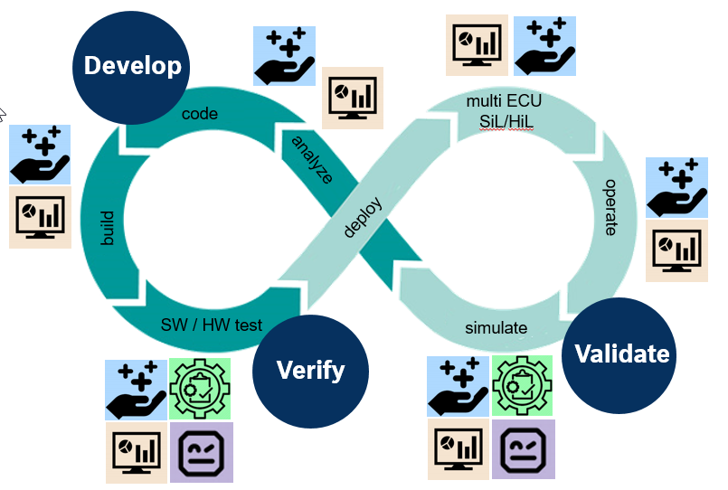
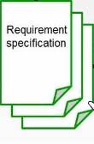






Mapping to Continuous X Lifecycle
RB-CoC SW V&V – Test Automation & AI for V&V
Autonomous Testing
Automated
Test Case Generation
Automated Test Script Generation
Test execution in Simulated Test Environments
Automated Test Report Dashboard
Req2Test,
ReqChecker, RFE,
Smart Test Generator
Enhance Test Generator
fasTest
Test Script Generator,
Generic Test Automation Solution
Robot Framework
Virtual Environments
(SIL, XIL
Robotic Arm)
Live Data Dashboard
Defect Life Cycle
Bosch Integrated Platform
Conceptualize and Developed in RBEI
Co-created by RBEI & DE
Feedback
Feedback
Defect Prediction, Defect Prevention, Defect Correction
*All solutions are in different phases and maturity levels

Slide 5
Rewind, Play and Evaluate - 2020
Description : Strengthening of the element and work package owners at RBEI
Expected Achievements
1. Ensure experience exchange meetings for the element and work package owners (at RBEI) are organized well in advance with several f2f meetings.
2. Assess the problems and identify the root cause. Guide owners to define the measures and help them implementing it.
3. Work with owners to strategize the topics and help them to connect to related stakeholders with required presentations.
4. Collect success stories and success factors for all elements (owners at RBEI)
Achievements beyond expectations
1. Improvements from gap analysis are in place and all elements & WPs are on good track.
2. Multiple divisions are involved and are in agreement of the agenda and topics.
3. Targets are defined for element owners in Q1.
4. V&V expert - regional meet/workshop is planned f2f twice a year to exchange achievements, best practises & challenges.
Individual meeting conduced on regular basis (bimonthly) with element owners and together worked on gaps and put strategy in place e.g understanding of participant's interest level, defined topics based on objective, connect with regions. Success stories captured in docupedia. Example -
Equipment & Tools :
Work Package - Tool Catalogue is closed. Plan in place to sync with CSC.
Process optimization of Central Purchasing of mostly-used tools.
Involving CI/OS team for license monitoring as required by GBs.
Connectivity & IoT:
14 GBs involved, 7 Topics covered, Various connections took place
Success story of Crowd testing by BSH.
Automated Decision Evaluation:
Defect Prediction work package has achieved development milestones for 2020. Piloting – not achieved.
Gaps analyzed and possible use cases identified.
Test Automation for XIL System:
Change of element ownership. Demo on Test Execution tools planned and conducted. Bench marking in progress.
Actual Achievements
Involved Element/WP owners in Collaboration strategy for 2021 and gave accolades to them
F2f meeting moved to Virtual due to pandemic situation.

Slide 6


Collaboration View RB-CoC V&V & RBEI
Integration of Tools
RB-CoC SW V&V
Security Testing
Tools
Security
Involvement in BBM Security Steering group.
VRTE Security Testing PoC
fasTest
Bosch Integrated Platform(BIP)
GTAS
Second PE-VVS Batch kicked off in RBEI
Connect with 1000
Experts from CC, PS, CM, BSH, TT, IO, ITK, MX, VH
Continuous
X
Automation& AI
Collaboration & Co-creation opportunity for Strategy topics SiL, CX, VC, Security, Automation & AI
Frameworks
Core member participation in SC & MboE meetings.
7 Bosch-Wide Leaders – Element & WP Owners.
Inclusion of RBEI SMEs in Strategy groups – SWO, Top Project
Automation
Continuous X
Strategic Vision for Autonomous Testing - 2025
Maturity Model for Strategic vision (to assess automation status of projects)
Integrated success stories from PS,AE & CM
AI powered Intelligent Test Automation –Defect Prediction (PoC), Req2Test (PoS).
Placement of RBEI in-house solutions in V&V Solution landscape.
Global Workshop
MMCD Tool development
CX partner in Software Offensive Program
Frameworks
SIL
Robot Framework

Slide 7
V&V Torch Bearers
RB-CoC SW V&V
Chandrima Sarkar (RBEI/EVV4)
SW Requirement Tests
Darshini K S (RBEI/ECG6)
Connectivity & IoT
Kulkarni Suhas S (RBEI/EVS1)
Equipment & Tools
Ponnalagu Karthikeyan (RBEI/ETM1)
Automated Decision Evaluation
Rohith Chegu Sreeramulu (RBEI/ESD-PJ-CN)
Test Automation for XIL System
Mohammed Sameer Gundloor (RBEI/EBA8)
V&V Strategy for Vehicle Computer*
Gohad Atul (RBEI/ETM2)
Defect Prediction*
Hari Krishnan Balasubramoni (RBEI/EEV5-EC)
Enhanced Test Generator
Sen Avik (RBEI/EVS1)
Automated Test generation
Srinath B C (RBEI/EVV)
Automated Test generation, Maturity Model
Govindaraju T (RBEI/ESD-PP)
Automation Maturity Model
Vidhya Murali (RBEI/ETM1)
Defect Prediction
Palaaniappan Ramaanachalam (RBEI/ECP)
Robot Framework
Bhattacharya Debojyoti (RBEI/ESY1)
Security Testing WP
Ashok Kumar Venkidu Swamy (RBEI/ETB-ALM)
MMCD Tool
Hari Prasad Tilak Swamy (RBEI/ESU5)
Unit & Integration Testing
Bosch-wide leaders for Strategy Topics
(Element & Work Package* Owners)
Behind the scenes

Slide 8


Rewind, Play and Evaluate - 2020
Description : Global Workshop in RBEI
Expected Achievements
To plan and involved RBEI units and teams to organize a well structured Workshop in Q4 of 2020.
Achievements beyond expectations
1. Theme and Agenda to be set well in advance and communication regarding Global workshop is to be done in Q1.
2. Workshop is concluded with concrete outcomes in terms of identified solutions/ideas for next years.
3. Focus topics should be taken for deep dive sessions during and post workshop.
4. Plan and Invite External key speakers & RBEI Board of management.
Actual Achievements
A mega event which has always taken place at onsite seemed not possible amidst Pandemic and economic situation. With lot of uncertainties but huge motivation and commitment, the workshop was conduced virtually in same timeline as defined. Conducting an event brings lot of learnings and networking.
An appreciation mail was received from Jacob, Shenoy for organizing wonderful workshop without loosing focus on strategy topics. :
Structure of the event – Having thread owners.
Constant belief of Thomas Huber and Anupam.
High Interest in participation (~340) from all divisions (19)
Involvement of Senior Management (17) and gamut of topics (12)
2 PoCs, 4 project evaluation, 5 new ideas in 1 day of CX Challenge.
7 topics of deep dive with tangible outcomes and action plans (BC is updated)
Things go well
Could be improved
Restricted participation (and thus better organization of Teams)
External support to organize event should be considered. Only 5 core members contributed in addition to project activities.
Communication could have been better.

Slide 9
Rewind, Play and Evaluate - 2020
Description : Effective usage of the CoC budget for RBEI
Expected Achievements
1. The CoC budget is to be consumed to greater extent. 2. The mode for the prices / cooperation and payment model is clarified with the RBEI management.
3. Overview of the available budget is to be presented time to time to CoC V&V.
4.Ensure all planned deliverables from RBEI are available on time and budget is transferred as planned.
Achievements beyond expectations
The deliverables from RBEI should be of high quality for its widely usage at BOSCH.
The cooperation and payment model (as agreed)is running well.
Plan and organize regular exchange with RBEI management and get their buy-ins.
Consumption of 94.5 Person Month in 2020 worth +310TEuro.
Existing model to use PMO instead of billing rate worked well . Able to consume 35TEuro more. More transparency needed.
Regular meetings with Shenoy, Jacob (twice in year) and V&V Core teams (DH, GrL)
Focus topics for 2021 discussed well in advance with RBEI CoE. Concrete work packages/activities to be planned for RBEI as next steps.
Formulated Budget utilization proposal for 2021.
Support required:
Pilot projects from divisions for implementation of Work packages
Actual Achievements

Slide 10
Rewind, Play and Evaluate - 2020
Description : PE-VVS program initiated in RBEI by Q3'2020
Expected Achievements
To conceptualize and plan PE-VVS localization program for RBEI. Ensure the first class to happen in Q3 of 2020.
Achievements beyond expectations
Co-ordinate with C/TEE-IN for selection of Program management and Education Manager in Q1.
Restimation for localized program available in Q2 and new cost is acceptable to main stakeholders. More than 12 nominations received for PE-VVS program and right candidates are selected for the program. Participants are happy with the quality and content of the program.
PE-VVS first localization batch started successfully in RBEI in early Nov with delay due to Covid-19.
Re-estimated to ~13 TEuro for the entire program of 18 months.
Special buy-in taken from Jacob (RBEI Board of Management) for special discounts on the program if needed by any unit.
Applications were overwhelming – 32 out of which 19 candidates selected for the education program.
Education Manager finalized from external (Testing guru in India)
Overcame challenges in timely manner : a. Hiccups to identify right Stakeholders amidst Org changes. b. Overall price didn't fly in RBEI Steering meeting. Lot of objections on content, budget, duration etc. c. Delay in onboarding of Education Manager
Actual Achievements

Slide 11
Additional activities of 2020
Rewind, Play and Evaluate - 2020
Leading a work stream in DAN network (Testing Culture)
Core member of RBEI Fit for Future Initiative
Involved in creating Vision for M/NET
Managed Roadmap activities of CoC from RBEI:
a) VRTE Security Testing
b) MMCD Tool
Conceptualized and Supported Integrated Automation pipeline for PS.
Req---Test Design ---Test Case---Test Script ----Test Execution
A1 and A2 German Language Course

