Slide 1
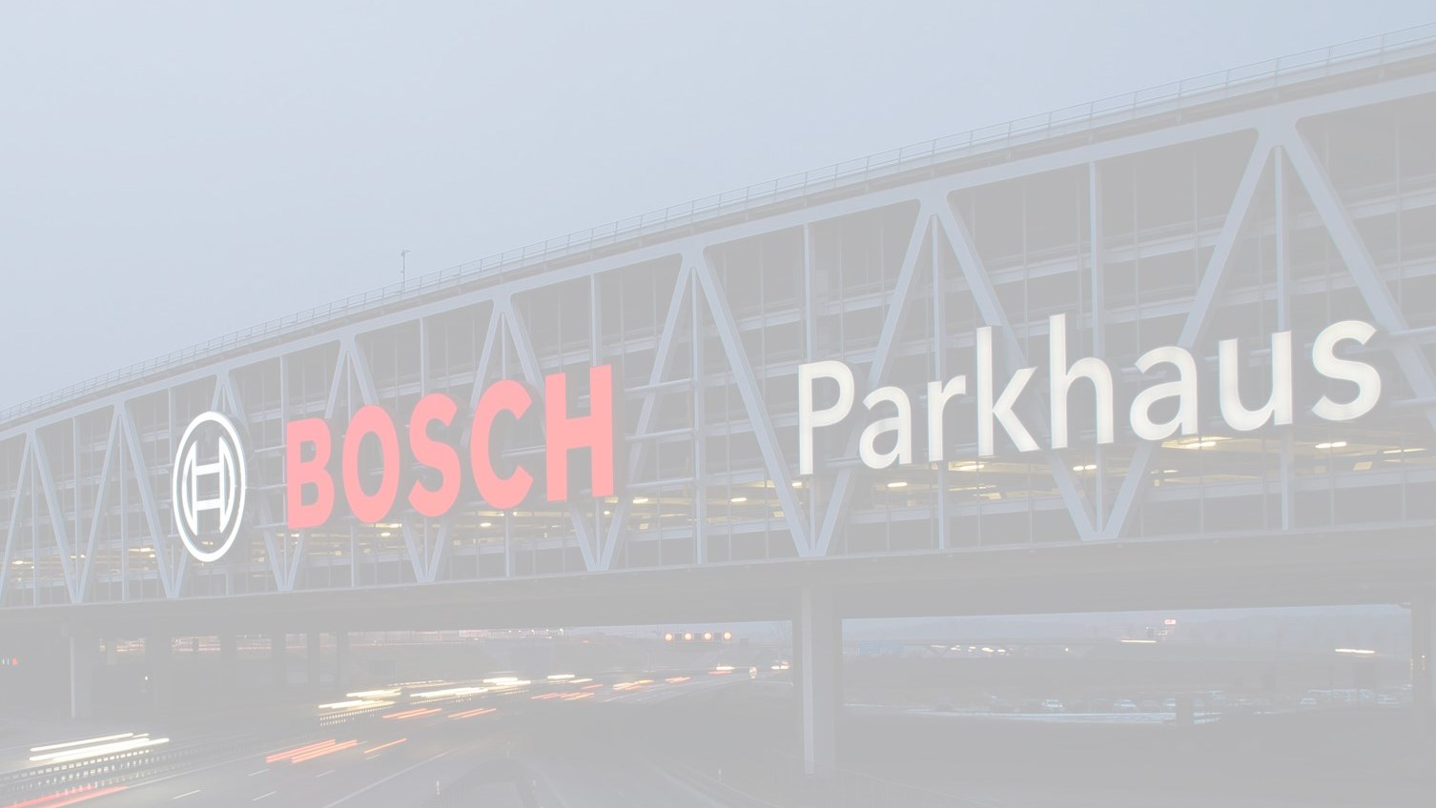
2018 …the year So FAR….

Slide 2
The Synopsis
Business Revenue
(40% growth from 2017)
2.5+ mi USD achieved
278 T USD RBMX revenue achieved
Rewind, Play & Evaluate
Operational Effectiveness
96% + Utilization/DE achieved
10% outsourcing valued.
Goals 2018
Digitize the Core
- 2 FTE efforts saved owing to Automation.
2 POCs on AI successful and 1 implemented in project.
Talent & Team
- -
Building 17 intermediate expertise in Automation & Performance
2
Internal | RBEI/BSD4 | 2018-12-18
© Robert Bosch Engineering and Business Solutions Private Limited 2018. All rights reserved, also regarding any disposal, exploitation, reproduction, editing, distribution, as well as in the event of applications for industrial property rights.

Slide 3

Beyond the Goals
2018 Performance Evaluation
Account Mining and New acquisitions in Bosch.
Account opened for NetApp – Global
Customer connect across CI.
Collaboration within department and cross-functional teams (CoC, ARISE)
Stepping towards New-Gen Testing – Achievements in AI, Cloud, ALM
Building Automation expertise.
~ 3000 hrs of efforts saved and utilized in new and horizontal technologies.
Test factory model implemented in multiple projects/work-packages.
3
Internal | RBEI/BSD4 | 2018-12-18
© Robert Bosch Engineering and Business Solutions Private Limited 2018. All rights reserved, also regarding any disposal, exploitation, reproduction, editing, distribution, as well as in the event of applications for industrial property rights.

Slide 4

What could have been done better
2018 Performance Evaluation
Personal development
Team strength vs Various focal points
Collaboration with RBMX and Smart City Team.
Test management practises
Increased Operational/Administrative efforts
Associate connect.
Service catalogue published but not implemented.
Work-Life Balance
4
Internal | RBEI/BSD4 | 2018-12-18
© Robert Bosch Engineering and Business Solutions Private Limited 2018. All rights reserved, also regarding any disposal, exploitation, reproduction, editing, distribution, as well as in the event of applications for industrial property rights.

