Slide 1













Cybersource & Infinity Corp : Case study Understanding
Migrated Payment System – ‘CyberSource’
Acquirer
VisaNet
Acquirer
Payment methods
Issuer
Other Networks
Legacy Payment System – ‘ABC’
VisaNet
Acquirer
Issuer
Payment methods
‘ABC’ Payment system
Other Networks

Slide 2
Cybersource & Infinity Corp : Case study Assumptions
01
Initial Migration Readiness Pre-assessment is done (viability check)
02
Purchase Order & Licenses, subscription, Payment Methods in place
03
Migration is required predominantly at back-end with limited impact on front-end (Merchant’s CRM/SAP/ERP)
04
CyberSource payment system is inherently compliant with PCIDSS & no changes are required in its or Acquirer’s system.
05
CyberSource’s partner ecosystem covers the existing partners of Infinity Corp (payment methods, payment networks etc)
06
CyberSource has pre-built integrations with various payment channels.
07
Infinity Corp’s payment terms with ABC payment system organization is on ‘per transaction’

Slide 3

Project Alpha

Slide 4
Project Alpha : Agenda
Migration
Strategy
Project
Dashboard
Governance
& Change Management
Scope
03
02
04
Vision
05
Risk Model
01
06
07
Next Steps
Notes:
Presenting the guiding principles of this program in terms of Vision and Scope
We’ll then have a quick look at the proposed Migration Strategy & High Level Plan
To secure the Project lifecycle, we’ll have a little discussion on the Handshake scenarios, Key Go-Live considerations, and overall Governance aspect of the program – stressing upon the Reporting, Risks, Change & Communication.

Slide 5

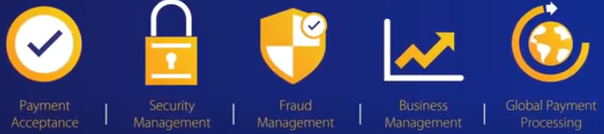
Partnering the infinity Corp’s vision
Infinity Corp’s Vision
To serve as a trusted partner to our clients by responsibly providing financial services that enable growth and economic progress
Cybersource Payment Management System – A modular Payment platform
We keep up with Consumer’s demands and stay ahead in payment technology & innovation
We take care of all your payment need & process it security and leave you to take care of your core business
Notes:
Our program would revolve around the foundation of establishing a long term partnership with your organization, resulting in your business and financial growth enablement via the activation of Cybersource solutions.
So, I would consider Migration Project as first and imp stepping stone in our long term relationship
Also, Being the industry leaders in providing Payment solutions/services, Cybersource is a natural fit for your business aspirations.

Slide 6
Partnering Infinity Corp & Cybersource Expanded Portfolio
Modular Framework
Accelerate Digital Capabilities
Globalization
Customer Focused
Secure & Innovative Digital Payment Arena
Seamless Payment Experience
Futuristic &
Innovative
Speed of Response
Compliance Requirements
Security by Visa
Legacy Payment System
Notes:
What I meant from ‘being a natural fit’ is that – our solution encompasses the true sense of becoming a globalised business by benefitting from our own coverage across 190 countries and vast payment channels. The Modular framework further helps in accelerating the digital transformation commerce through seamless payment experience. And the whole digital experience also stands at the strong pillars of Information & Data Security, and Legal Compliance requirements.

Slide 7
Partnering Infinity Corp & Cybersource Project CharteR
Objective
Migration of existing legacy payment system to flexible and modular Payment management system which will also cater to Infinity Corp’s unique payment needs.
Switching ‘ABC’ Payment System to CyberSource Visa Payment management System.
Scope
Deliverables
Seamless migration of Payment Management system with zero downtime.
Maintaining Data integrity & Data privacy of existing & new subscribers (Merchants)
Secure the payment flow from frauds.
Scaling the needs of Merchants to accept all online, in-person, via mobile payments from around the world.
Provide an insight of various payment methods & shopper’s preferences.
Successful migration of Payment system for entire APAC region with ‘0’ downtime.
Integrated Anti-fraud solutions and prevention tools.
Complaint system (PCI, GDPR)
Expanded reach to payments across channels and geographies within ‘2 sec’
Dashboard for multi-channel payment view for reconciliation & Shopper's preference.
Stakeholders
Infinity Corp
ABC Payment System
Issuers
Existing & Potential Subscribers
Notes:
A glimpse on the Project Charter. We are calling out the Objective of the program as Migration of Payment Mgmt System, along with some inclusions of Scope and Deliverables.
The Scope largely highlights the needs of having a seamless migration with Zero business disruption, secured payment flow covering Data integrity & privacy. The migrated payment system should additionally support fraud management, compliance with PCI , customer information management and advance reporting.
Deliverables defined are in-line with the agreed scope.
Key stakeholders as per initial understanding would be
IT team of infinity corp handling Merchant’s data and ABC payment system.
Program Management & IT Team of ABC payment systems
Issuer Banks
Also we would be considering all existing & potential Merchants of Infinity corp as our stakeholders too.

Slide 8




Partnering infinity Corp & Cybersource Migration Strategy
Amalgamation of multiple Migration approaches
Synchronization
Strategy 04
01 - Big Bang Cutover
Authorization
Data Migration
- Synchronisation approach of Cyber source & ‘ABC’ payment system
01
02
04
Iterative Approach 03
03
02 - Parallel Running
Phased approach Region wise:
South East Asia
Middle East
North Asia
South Asia
Work streams for Payment Methods
Integration with Infinity Corp’s system
Notes:
Moving to the core of the presentation - I would be covering the Migration Strategy in three folds. Presenting the high level strategy in this slide which is the amalgamation of Big Bang, Parallel and Iterative cutover.
Strategy is to take one region at a time (in iterative mode), migrate the data and enable new payment system for as-is features (in a big bang and parallel way) and once the CyberSource payment system is up and running, integrate other required features like anti-fraud solution, advanced reporting etc
We will consider Synchronization with legacy payment system for exceptional scenarios, and that would be for a certain duration post the cutover.
And iterative plan is made for geographies across APAC. This division is considered based on the assumption of # of merchants in that region, Shopping index, footfall in mcommerce and digital commerce and overall commerce revenue figures (till date)

Slide 9











Assessment
Migration Factory
Hyper Care
Partnering infinity Corp & Cybersource Iterative Migration Plan
Pre-Migration
Migration
Steady State
Authorization
CyberSource
Planning & Assessment
Key Go-Live Considerations
Migration Blueprint as per business requirement (covering detailed scope, configuration management, security requirements)
Decommission ‘ABC’ for Card
Migration approach
Tools & Environments
Data Migration
Decommission ‘ABC’ for Other Payment Methods
Decommission ‘ABC’ for Digital Wallet
Decommission the old system
Hybrid whole
Team Requirement
Fall Back Approach
Activate Fall Back Approach & Sync with Legacy System
anti-Fraud Solutions
Legacy Wrapper Approach
Training & Communication Approach
Other services
(Reporting, Data Insights etc)
100% SLA Ownership
Integration with Acquirer System
Constant Monitoring & Controlling
legends
D
B
T
R
I
Notes:
Moving on, I would also like to give you a bird’s eye view on how the Plan per region will move ahead in an Iterative way. Our team is working on the finer details of the plan as we speak, but this is to give you a fair idea of what to expect when we start the core migration.
For every region, we will do our extended study & planning in Pre-migration phase. In Migration factory, we would be starting with creating Migration blueprint based on technical analysis and then follow the SW life cycle process of design, build, test and roll out.
On the top are the set of boxes depicting the Big Bang roll-out, sliced per the ‘Payment Method’. While this foundation is being readied, the Data Migration will kick in for Cards, followed by Digital Wallet, and finally concluding with all other payment methods. The roll-out’s are sequenced, but the preparatory activities are all happening in parallel.
The advantage offered by the approach is the efficient and fast-tracked go-to market which would help in
derisking
maintaining agility & speed
Constant learning from previous & taking immediate actions for next
Financial savings and
Zero business disruption

Slide 10



Partnering infinity Corp & Cybersource Project Schedule Plan
 | 2021 |  |  |  | 2022
 | Sep | Oct | Nov | Dec | Jan | Feb | Mar | Apr
Go-Live Factors
Middle East
South East Asia
North Asia
South Asia
Monitoring & Control – Scope, Cost, Time, Quality, People, Stakeholder
Risk Management – Mitigation & Contingencies
Change Management, Governance, Communication & Training
Sync with ABC Payment System of Other regions
Hyper Care
Migration factory
Decommission “ABC”
Fraud management & Reporting
Pre-Assessment
Monitor & Hand-over
Sync with ABC Payment System of Other regions
Hyper Care
Migration factory
Decommission “ABC”
Fraud management & Reporting
Pre-Assessment
Monitor & Hand-over
Sync with ABC Payment System of Other regions
Hyper Care
Migration factory
Decommission “ABC”
Fraud management & Reporting
Pre-Assessment
Monitor & Hand-over
Hyper Care
Migration factory
Decommission “ABC”
Integrate Fraud management
Pre-Assessment
Go-Live
Cards
Go-Live
Other Payment Channels
Monitor & Hand-over
Go-Live
Digital Wallet
Notes:
This is another glimpse of the timeline plan covering the phases of the project for each region, and showing the interconnectivity between them as well so that the macro level activities like Monitoring, Risk & Change mgmt., and Communications are being injected and tracked at the right times throughout the project lifecycle.
The overall schedule plan is devised based on our agreement during SoW.

Slide 11
Partnering Infinity Corp & Cybersource Handshaking Scnearios
Migration Readiness Assessment & Planning
Pre-Assessment
Understand Security, Compliance & special requirements
Ensuring Migration is viable
Migration approach & Schedule
Determining the Scope
Understand Business model (Merchants, Payment networks)
Initial insights on data (volume, peak load etc)
Mapping of all existing & potential dependencies
Master Plan for all of the PMP knowledge areas.
Configuration management (inc Artifacts)
Ensuring Communication, Change, Risk & Governance plans are functioning
Staging Environment
Small scale simulations run with Infinity Team
SLA’s & Tolerance
Change management within Infinity
Fall Back & Legacy Wrapper Plan
Sign offs from designated/Substitutes
Change Management for Merchants, Payment Networks
Migration Factory
Constant reporting on KPIs & SLA’s
Communication plan for Go-Live
Indication for Decommissioning Legacy System
Mitigation Strategies
Pre & Post validation Outcome result
Activate Communication Plan for Fall Back
Go-Live
Constant reporting on traffic statistics & KPIs post migration
Steady State
Success Party
Notes:
While we lay down the principles of project approach and migration plans, one thing which we must keep into consideration for Detailed Planning is the constant bridging of information between Infinity Corp and Cybersource teams.
As both the teams collaborated in the Pre-assessment phase to draw the scope and viability guidelines, the same association would continue across the project lifecycle.
In the phase of Readiness Assessment & Planning, we would need to agree on the schedules, dependencies and SLA’s. During the Actual Migration phase, we’ll have to start rolling out the Communications, Change Plans, Simulation Runs with you and your team in the driving seat. Towards the Steady state phase, while we would ensure a stabilised migration outcome, we’ll need your sign-off’s on achieved milestones

Slide 12
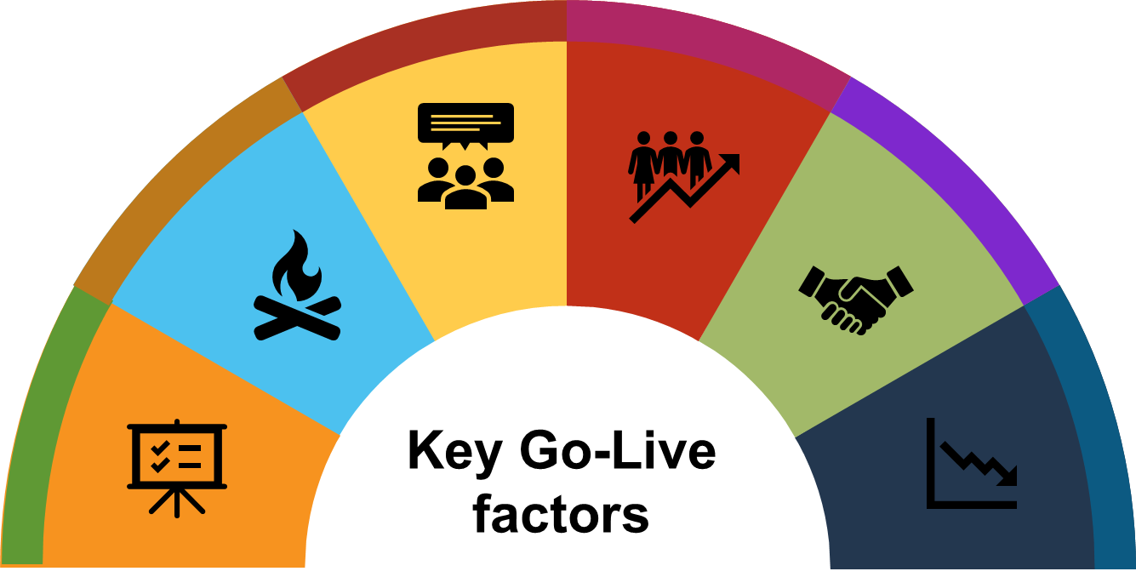
Partnering infinity Corp & Cybersource Go-Live Considerations
Interfaces ready?
(e.g digital wallets)
Are the users ready?
Changes analysed & Communicated.
Change Management employed.
Regular Reporting on SLAs & Risks
Sufficiently trained Users on new system.
Are the timings for cutover schedule reasonable.
Do interfaces need dry runs.
Is the infrastructure ready?
Is the plan to handle early warnings ready?
Cyber Source & Infinity Corp’s
Network, processing speed
Storage capacity
Continuous monitoring
Mitigation & Contingency Plans
Is there fall back plan?
Is the System ready?
Workaround processes.
Cutover abortion plan Cutover extension plan
Fall back plan tested.
Health of project.
Entry Exit criteria’s met
Test & Defect Reports
Sign off parameters

Slide 13
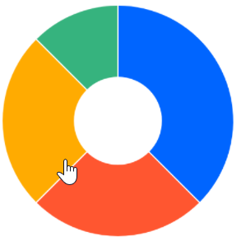
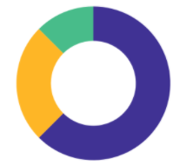


Partnering infinity Corp & CYbersource Project Dashboard
Migration Status Dashboard
Phase wise % completed
South Asia
Data Migration
- Cards
South Asia
Data Migration
- Digital Wallet
Project Performance
5441
45254
0.95
SPI
(Schedule Performance Index)
$20,000.00
Planned Value
0.98
CPI
(Cost Performance Index)
$18,000.00
Planned Value
South Asia
Cads Transaction successful Rate
North Asia
Simulation
Success for Cards
Region Wise Completion Status
Phase wise completion status of “South Asia”
99.5%
100%
Highlights
South Asia : Data Migration for Cards Successful. Sign off received.
South Asia : Data Migration for Digital Wallet is successful.
Assessment & Planning completed for all regions
Lowlights
South Asia : Delay of 2 business days in data migration of Cards
South Asia : Unsuccessful transaction on first day.
Notes:
This is just a sample Dashboard designed for this project. On regular basis we will be showing you the actual status of the migration with real numbers and success %age. I willensure to maintain transparency with everyone on progress, activemenets as well as lowlights.

Slide 14
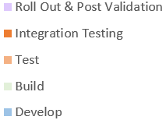

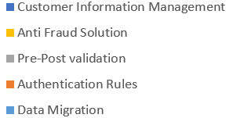
Partnering infinity Corp & Cubersource Effort Estimation & Distribution Plan
Notes:
Let me also take you through the effort estimation for this project. As we see, Migration factory takes up maximum of our effort. However on other hand, we will be able to maintain the pace of this program as our inherent features like Authorization, Anti-Fraud Solution, and Customer information management would take rather less effort.
The another graph depicts the effort requirements from Infinity Corp for this successful collaboration

Slide 15

Partnering infinity Corp & Cybersource Governance & communication management
Strategic
Steering Committee(Bi-Monthly)
Set Strategic Direction
Strategic & Business risk assessment & monitoring
Discuss overall relationship & Service-level performances
Business Sponsor
Business Leads
Business Leads,
IT Track Leads
Engagement Review (Bi-Weekly)
Evaluate Performance on service levels & Review health of Project.
Current & Future Risk Profile
Program CR Tracker
Schedules and cost controls
Review of Change, Risk management Plan
IT Head, Project Manager, Leads
Program & Project Managers, Leads
Huddle (Daily)
Track individual activities
Resolve transactional & migration issues
Validation & Defect Status
Operational, projects, Functional risk assessment & mitigations.
IT Track Leads
Project Manager, Leads
Tactical
Project Manager & IT Teams
Comm Teams
Merchants
Push Communication (Milestone)
To Merchants, Payment Networks
Dry Run Schedule
Updates to install
Migration Go-Live Schedule
HyperCare Plan
Post Go Live support
IoT Testing Team
Infinity Corp
CyberSource
Proposed Governance Model
Notes:
We’ll incorporate a well-established governance process for the whole duration of the programme. We have identified all stakeholders at different levels of hierarchy, and their counterparts in our organisation have been mapped together. We’ll be running different forums at each level to ensure proper cadence and tracking.
The steerco will be run between the Business sponsor/lead from Infinity and Programme lead of Cybersource, once a month.
The Engagement or the Project review between the Head of IT and our Program/Project Leads will be a fortnightly affair, covering project health, schedules and cost review, and discussion on roadblocks if any
Each communication layer would include risk identification, assessment and tracking as part of the agenda.
Not to forget the Push communications that would be sent to all Partners & Stakeholders on every milestone as per the communication plan. Idea is to keep them informed & at times involved in Dry run schedules, Post-Go Live Support etc.

Slide 16





Partnering infinity Corp & Cbersource Change management Strategy
Why the Change
Current Challenges
Need, Challenge, Opportunity
Quality & Compliance
Restricted payment channel options
What will Change
Infosec vulnerabilities
Transaction rejection across networks
Interface, Payment Flow,
Opportunity
Impact per Role
UI, Access, Additional Authentications
Benefit Realisation
Fraud Management
Greater Tax Jurisdiction Coverage
Change Approach
Major Card Network Support
Training, Tutorials, Self Help, Hypercare
1
Real-time Global Tax Calculation
Recurrent Payment Acceptance
Notes:
Moving to the next slide which is an overarching strategy for Change Management, this is also one of the most important activities that has to run throughout the entire program starting with fundamental thought process - Why this change. Having buy-ins from key stakeholders is equally important for success as the success of migration itself.
So, underneath Change management process, we will be focusing on evaluating the impact on stakeholders.
And to make them aware about what kind of changes are planned, how it would impact and what benefits can be reaped with this migration.
Some of the planned approaches for change management are - Training, Tutiorial and self –help documentation for Merchants and Partners. The plan would be monitored and measured on regular basis and if needed timely amendment will be proposed.

Slide 17
Partnering infinity Corp & Cybersource Risk Management Plan
Identification of Risks
Questionnaire as tool
Deck-based risk assessment, Facilitated workshops, Management review
Identify Cause & Qualitative consequences
Registering risk in qualitative term
Assessment of Risks
Risk Assessment Matrix &
Risk Rating
Identifying & assessing effectiveness of controls
Residual risks & its consequences.
Risk Review Board
Treatment of Risks
Analyse Risk Appetite
Risk Response plan
(Threat & Opportunities)
Forecast risk analysis
Re-assess Risk Funding
Monitoring of Risks
Re-assessment
(Secondary, New Risks)
Periodic reviews
(Governance Plan)
Analysis of risks
(Variances, Contingency reserves)
Continuous Improvement
Notes:
By now, We have covered the high level approach – a very hgih level projet schedule, change management and comm startegies which is getting detailed out as we speak.
Now we also need to understand the need of de-risking the whole project while doing Risk management activities. This is going to be one of the most crucial activity for overall project life cycle and for that both the teams will jointly work on identifying, assessing, responding and monitoring the first hand risks, secondary risks and also residual risks.

Slide 18
Partnering infinity Corp & Cybersource project Alpha : Beginning the Journey…..
01
Detailed Project Plan & Vetting with Infinity Corp’s Project Team
02
Workstream – Migration Groups & define RASIC
03
Ramping the Team & Resources (Environment, Tools etc)
04
Pre-Migration Validation Preparation
Notes:
Before I move on to the next steps, I would seek your feedback on this high level project plan so that we can formally kick off the Migration project with you.

Slide 19
Thank You!
Shilpa Narang
(123) 456-7890
CyberSource Visa
Notes:
© Copyright PresentationGO.com – The free PowerPoint and Google Slides template library

