Slide 1













Cybersource & Infinity Corp : Case study Understanding
Migrated Payment System – ‘CyberSource’
VisaNet
Acquirer
Issuer
Payment methods
Other Networks
Legacy Payment System – ‘ABC’
VisaNet
Acquirer
Issuer
Payment methods
‘ABC’ Payment system
Other Networks

Slide 2
Cybersource & Infinity Corp : Case study Assumptions
01
Purchase Order & Licenses, subscription, Payment Methods in place
02
Initial Migration Readiness Pre-assessment is done (viability check)
03
Migration is required predominantly at back-end with limited impact on front-end (Merchant’s CRM/SAP/ERP)
04
CyberSource payment system is inherently compliant with PCIDSS & no changes are required in its or Acquirer’s system.
05
CyberSource’s partner ecosystem covers the existing partners of Infinity Corp (payment methods, payment networks etc)
06
CyberSource has pre-built integrations with various payment channels.
07
Infinity Corp’s payment terms with ABC payment system organization is on ‘per transaction’

Slide 3


Slide 4
Agenda
Migration
Strategy
Project
Dashboard
Governance
& Change Management
Scope
03
02
04
Vision
05
Risk Model
01
06
07
Next Steps

Slide 5
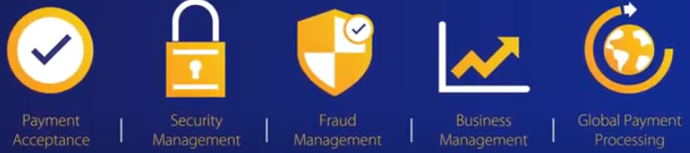
Partnering the infinity Corp’s vision
Infinity Corp Vision
To serve as a trusted partner to our clients by responsibly providing financial services that enable growth and economic progress
Cybersource Payment Management System – A modular Payment platform
We keep up with Consumer’s demands and stay ahead in payment technology & innovation
We take care of all your payment need & process it security and leave you to take care of your core business

Slide 6
What is in store for you:
Expanded Portfolio of solutions with rich partnership
Modular Framework
Accelerate Digital Capabilities
Globalization
Customer Focused
Secure & Innovative Digital Payment Arena
Seamless Payment Experience
Futuristic &
Innovative
Speed of Response
Compliance Requirements
Security by Visa
Legacy Payment System
Notes:
Business to products to customers : Enabling of better products and customer insights
Business to Assets : Enabling transformational optimization
This helps in
Manage, Analyze & Correlate
Collect, Store and Manage multi-faceted data from variety of test points
Transform test and defects data into customer, product, service insights
Use analytics to create self aware, auto healing, intelligent systems and optimize performance of overall product.
Institutionalize & Optimize
Transform testing from reactive to predictive preventive
Institutionalize remote product management, predictive and preventive maintenance
Optimize Operations continually

Slide 7
Partnering Infinity Corp & Cybersource Project CharteR
Objective
Migration of existing legacy payment system to flexible and modular Payment management system which will also cater to X’s unique payment needs.
Switching to X payment system to Cybersource Visa Payment management System.
Scope
Deliverables
Seamless migration from A payment system with zero downtime.
Maintaining Data integrity & Data privacy of existing & new subscribers (Merchants)
Scaling the needs of Merchants to accept all online, in-person, via mobile payments from around the world.
Secure the payment flow from frauds.
Provide an insight of various payment methods & shopper’s preferences.
Provides 24/7 support for the implemented payment management system.
Successful migration of ‘ABC’ payment system with ‘0’ downtime of entire APAC region
Integrated Anti-fraud solutions and prevention tools.
Expanded reach to payments across channels and geographies within ‘2 sec’
Dashboard for multi-channel payment view for reconciliation & Shopper's preference.
Complaint system (PCI, GDPR)
Stakeholders
All existing Subscribers
All new subscribers
‘A’ payment system
X
Issuer Banks

Slide 8


Pre-Assessment
Migration Readiness Planning & Assessment
Understand Security, Compliance & special requirements
Ensuring Migration is viable
Get initial insights on data (volume, peak load etc)
Master Plan for all of the PMP knowledge areas.
Determining the Scope
Understand Business model (Merchants, Payment networks)
Mapping of all existing & potential dependencies
Migration approach & Schedule
Tools to monitor health of system & agreed SLA’s.
Risk management
Configuration management (inc Artifacts)
Pre-Migration Tests as required/planned
Fall Back & Legacy Wrapper Plan
Migrate
Ensuring Communication, Change & Governance plans are functioning
Ensuring monitoring systems function as expected
Migration Factory
Sign offs from designated
Monitor & Ensure SLA’s are met
Risk management
Hyper care
Steady State
Back-up of data from Legacy system
Go-Live – Phase wise
Decommission Legacy System
Integrate new, special features
Hyper care
Notes:
Master Plan : Designated sign-offs plan

Slide 9





Partnering infinity Corp & Cybersource Migration Strategy
Amalgamation of multiple Migration approaches
Synchronization
Strategy 04
01 - Big Bang Cutover
For Authorization
For Visa Implementation
- Synchronisation approach of Cyber source & ‘A’ payment system
01
02
04
Iterative Approach 03
03
02 - Parallel Running
Phased approach Region wise & Payment Method wise (Cards, Digital wallet, Other Payment Methods)
South East Asia
Middle East
North Asia
South Asia
Data in both the systems.
Transition from Staging Area to final Target production state
End to End validations in parallel

Slide 10
Partnering Infinity Corp & Cybersource Handshaking Scnearios
Migration Readiness Assessment & Planning
Pre-Assessment
Understand Security, Compliance & special requirements
Ensuring Migration is viable
Migration approach & Schedule
Determining the Scope
Understand Business model (Merchants, Payment networks)
Initial insights on data (volume, peak load etc)
Mapping of all existing & potential dependencies
Master Plan for all of the PMP knowledge areas.
Configuration management (inc Artifacts)
Ensuring Communication, Change, Risk & Governance plans are functioning
Staging Environment
Small scale simulations run with Infinity Team
SLA’s & Tolerance
Change management within Infinity
Fall Back & Legacy Wrapper Plan
Sign offs from designated/Substitutes
Change Management for Merchants, Payment Networks
Migration Factory
Constant reporting on KPIs & SLA’s
Communication plan for Go-Live
Indication for Decommissioning Legacy System
Mitigation Strategies
Pre & Post validation Outcome result
Activate Communication Plan for Fall Back
Go-Live
Constant reporting on traffic statistics & KPIs post migration
Steady State
Success Party
Notes:
Master Plan : Designated sign-offs plan

Slide 11











Assessment
Migration Factory
Hyper Care
Partnering infinity Corp & Cybersource Iterative Migration Plan
Pre-Migration
Migration
Steady State
Authorization
CyberSource
Planning & Assessment
Key Go-Live Considerations
Migration Blueprint as per business requirement (covering detailed scope, configuration management, security requirements)
Decommission ‘ABC’ for Card
Decommission ‘ABC’ for Digital Wallet
Migration approach
Tools & Environments
Data Migration
Decommission ‘ABC’ for Other Payment Methods
Decommission the old system
Hybrid whole
Team Requirement
Fall Back Approach
Activate Fall Back Approach & Sync with Legacy System
anti-Fraud Solutions
Legacy Wrapper Approach
Training & Communication Approach
Other services
(Reporting, Data Insights etc)
100% SLA Ownership
Integration with Acquirer System
Constant Monitoring & Controlling
Notes:
Considerations : Volume of Data, Speed of data, Peak load, Bandwidth to serve all customers.
Also considered leading practices from other migration projects to come up with timeline

Slide 12



Partnering infinity Corp & Cybersource Project Schedule Plan
 | 2021 |  |  |  | 2022
 | Sep | Oct | Nov | Dec | Jan | Feb | Mar | Apr
Go-Live Factors
Middle East
South East Asia
North Asia
South Asia
Monitoring & Control – Scope, Cost, Time, Quality, People, Stakeholder
Risk Management – Mitigation & Contingencies
Change Management, Governance, Communication & Training
Sync with ABC Payment System of Other regions
Hyper Care
Migration factory
Decommission “ABC”
Fraud management & Reporting
Pre-Assessment
Monitor & Hand-over
Sync with ABC Payment System of Other regions
Hyper Care
Migration factory
Decommission “ABC”
Fraud management & Reporting
Pre-Assessment
Monitor & Hand-over
Sync with ABC Payment System of Other regions
Hyper Care
Migration factory
Decommission “ABC”
Fraud management & Reporting
Pre-Assessment
Monitor & Hand-over
Hyper Care
Migration factory
Decommission “ABC”
Integrate Fraud management
Pre-Assessment
Go-Live
Cards
Go-Live
Other Payment Channels
Monitor & Hand-over
Go-Live
Digital Wallet

Slide 13
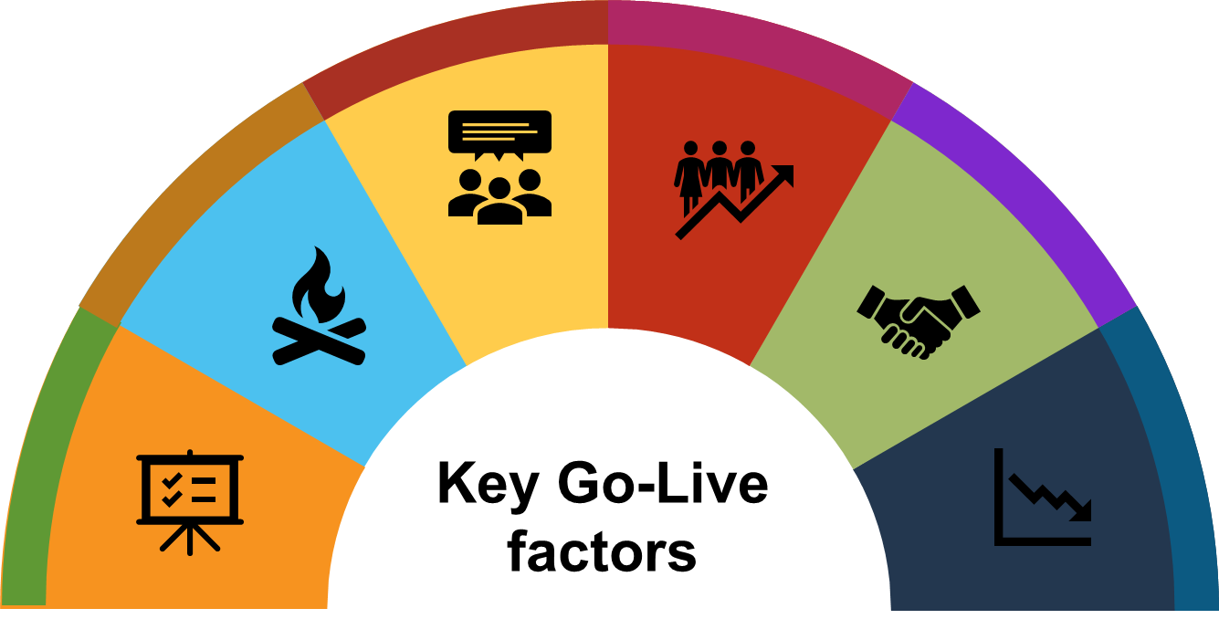
Partnering infinity Corp & Cybersource Go-Live Considerations
Interfaces ready?
(e.g digital wallets)
Are the users ready?
Changes analysed & Communicated.
Change Management employed.
Regular Reporting on SLAs & Risks
Sufficiently trained Users on new system.
Are the timings for cutover schedule reasonable.
Do interfaces need dry runs.
Is the infrastructure ready?
Is the plan to handle early warnings ready?
Cyber Source & Infinity Corp’s
Network, processing speed
Storage capacity
Continuous monitoring
Mitigation & Contingency Plans
Is there fall back plan?
Is the System ready?
Workaround processes.
Cutover abortion plan Cutover extension plan
Fall back plan tested.
Health of project.
Entry Exit criteria’s met
Test & Defect Reports
Sign off parameters

Slide 14

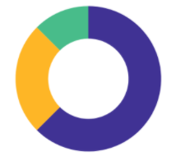


Partnering infinity Corp & CYbersource Project Dashboard
Migration Status Dashboard
Phase wise % completed
South Asia
Data Migration
- Cards
South Asia
Data Migration
- Digital Wallet
Project Performance
5441
45254
0.95
SPI
(Schedule Performance Index)
$20,000.00
Planned Value
0.98
CPI
(Cost Performance Index)
$18,000.00
Planned Value
South Asia
Cads Transaction successful Rate
North Asia
Simulation
Success for Cards
Region Wise Completion Status
Phase wise completion status of “South Asia”
99.5%
100%
Highlights
South Asia : Data Migration for Cards Successful. Sign off received.
South Asia : Data Migration for Digital Wallet is successful.
Assessment & Planning completed for all regions
Lowlights
South Asia : Delay of 2 business days in data migration of Cards
South Asia : Unsuccessful transaction on first day.

Slide 15
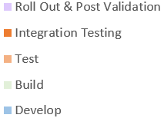

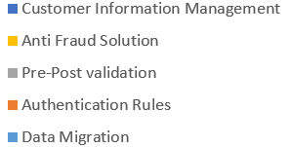
Partnering infinity Corp & Cubersource Effort Estimation & Distribution Plan

Slide 16

Partnering infinity Corp & Cybersource Governance & communication management
Strategic
Steering Committee(Bi-Monthly)
Set Strategic Direction
Strategic & Business risk assessment & monitoring
Discuss overall relationship & Service-level performances
Business Sponsor
Business Leads
Business Leads,
IT Track Leads
Engagement Review (Bi-Weekly)
Evaluate Performance on service levels & Review health of Project.
Current & Future Risk Profile
Program CR Tracker
Schedules and cost controls
Review of Change, Risk management Plan
IT Head, Project Manager, Leads
Program & Project Managers, Leads
Huddle (Daily)
Track individual activities
Resolve transactional & migration issues
Validation & Defect Status
Operational, projects, Functional risk assessment & mitigations.
IT Track Leads
Project Manager, Leads
Tactical
Project Manager & IT Teams
Comm Teams
Merchants
Push Communication (Milestone)
To Merchants, Payment Networks
Dry Run Schedule
Updates to install
Migration Go-Live Schedule
HyperCare Plan
Post Go Live support
IoT Testing Team
Infinity Corp
CyberSource
Proposed Governance Model

Slide 17





Partnering infinity Corp & Cbersource Change management Strategy
Why the Change
Current Challenges
Need, Challenge, Opportunity
Quality & Compliance
Restricted payment channel options
What will Change
Infosec vulnerabilities
Transaction rejection across networks
Interface, Payment Flow,
Opportunity
Impact per Role
UI, Access, Additional Authentications
Benefit Realisation
Fraud Management
Greater Tax Jurisdiction Coverage
Change Approach
Major Card Network Support
Training, Tutorials, Self Help, Hypercare
1
Real-time Global Tax Calculation
Recurrent Payment Acceptance

Slide 18
Partnering infinity Corp & Cybersource Risk Management Plan
Identification of Risks
Questionnaire as tool
Deck-based risk assessment, Facilitated workshops, Management review
Identify Cause & Qualitative consequences
Registering risk in qualitative term
Assessment of Risks
Risk Assessment Matrix &
Risk Rating
Identifying & assessing effectiveness of controls
Residual risks & its consequences.
Risk Review Board
Treatment of Risks
Analyse Risk Appetite
Risk Response plan
(Threat & Opportunities)
Forecast risk analysis
Re-assess Risk Funding
Monitoring of Risks
Re-assessment
(Secondary, New Risks)
Periodic reviews
(Governance Plan)
Analysis of risks
(Variances, Contingency reserves)
Continuous Improvement

Slide 19
Partnering infinity Corp & Cybersource Beginning the Journey…..
01
Detailed Project Plan & Vetting with Infinity Corp’s Project Team
02
Workstream – Migration Groups & define RASIC
03
Ramping the Team & Resources (Environment, Tools etc)
06
Pre-Migration Validation Preparation

Slide 20





Collaboration for Test Activities
CI/CES52
RBEI/BSW4
Daimler
Purchase order
Billing
Project Sponsor
Sr Project Manager
Proposal
Resource coordination
Monthly feedback
Test Consultant
RBEI Coordinator
Test Case Design
Test Execution.
Defect retesting
Regression Testing
Customer
Coordinator
Requirements,
Tool Licenses and Environments.
Project Management
Task prioritization
Test Lead
Overall Test coordination
Test and Defect review & Tracking
Test Planning & Closure activities
Test Consultant
Test Case Design
Test Execution.
Defect retesting
Regression Testing
External Developers
Service Designers
Bosch Developers
Service Designers
Prototyping
UI Design
Development
Unit Testing
Prototyping
UI Design
Development
Unit Testing
Test Execution and Defect Logging
Internal | BSW | 09/04/2015 | © Robert Bosch Engineering and Business Solutions Private Limited 2015. All rights reserved, also regarding any disposal, exploitation, reproduction, editing, distribution, as well as in the event of applications for industrial property rights.

Slide 21
Partnering infinity Corp & Cybersource Governance & communication management
Steering Committee
Financial Performance
Program Status
Huddle
Push Communication
Frequency
Monthly
Monthly
Weekly
Daily
Milestone
Organizer
Sr. Program Manager
Project Manager
Sr. Program Manager w/ ICs Comm Team
Sr. Program Manager
Project Manager (PjM)
CS & IC’s:
Business Sponsors
Business Leads
IT Track Leads
CS & ICs
Program & Project Managers
IT Track Leads
CS’s & IC’s
Project Manager & IT Teams
Comm Teams
Merchants
Payment Network Teams
CS:
Business Leads
IT Track Leads
PjM & IT PMO
CS’s
Project SME’s
Project Team members
Audience/
Recipient
Strategic partnership & direction
Program Dashboard (RoI, SLA, KPIs)
Thought Leadership
Resolve critical escalations
Scrutinize program finances
Track program expenses
Analyze benefits realized
Program Status
Track specific RAID Log
Program CR Tracker
Schedules and cost controls
Track individual activities
Resolve transactional issues
Dry Run Schedule
Updates to install
Migration Go-Live Schedule
HyperCare Plan
Post Go Live support
Objective

Slide 22
Cybersource & Infinity Corp : Case study Assumptions
01
Purchase Order has been received by CyberSource for the Migration & Added Services. Licenses, Subscription, payment method has been agreed on.
02
Initial Migration Readiness Pre-assessment is done (viability check)
01
There is an established agreement in place between Infinity Corp & Merchants and there is no direct connection between CyberSource & Merchants
Migration is required mainly for back-end migration and has limited impact on front-end (at Merchant’s end)
ERP system used by Merchants is managed by Infiinity Corp
02
CyberSource payment system is inherently compliant with PCIDSS & no changes are required in its or Acquirer’s system.
03
CyberSource’s partner ecosystem already covers the existing partners of Infinity Corp (payment methods, payment networks etc)
05
Infinity Corp’s payment terms with XYZ payment system company is on ‘per transaction’
06
Ready-to-use integrations are available from the CyberSource platform into the online and ecommerce tools that our customers already use

Slide 23

Governance Framework
Unilever
Vendor Partner
Deliverable: Steering Committee Report
Objective:
Strategic partnership and direction
Assess program status, ROI, risks, critical milestones
Thought Leadership
Resolve critical escalations
Business Sponsors
Business Leads
IT Track Leads
IT PMO
Engagement Manager
Steering Committee Meeting
Monthly
Deliverable: Status Reports
Objective:
Status and key metrics reporting
Escalation and risk management
Change management
Schedules and cost controls
Business Leads
IT Track Leads
IT PMO
Project Manager
Weekly
PMO Meetings
Business SMEs
Project Manager
Project Team Members
Deliverable: Project Tracker
Objective:
Track individual activities
Resolve transactional issues
Coordinate with required stakeholders
Escalate as required
Daily
Huddles

Slide 24
Partnering infinity Corp & Cybersource Risk Management Plan
Identification of Risks
Sources of Risks
(Workshops,
Follow Governance Plan
Assessment of Risks
Risk Review Board
Severity & Priority Scale (3*3)
Registering the risk
Risk Funding
Risk Assessment Matrix
Risk Response
Risk Appetite
Response for Opportunities
Periodic Review as per Governance Plan
Monitoring the Risk
Residual, Secondary, New Risks
Analysis – variances, Contingency reserves

Slide 25
Assumptions:
Agreement with ‘A’ payment system for migration of existing subscribers
Limited to Back-end migration & has no impact on front-end
Cybersource is partnered with existing .parners of X
“There is an inherent credibility that comes from working with Visa
Ready-to-use integrations from the Cybersource platform into the online and ecommerce tools that our customers already use
Value add:
We’ve been able to establish relationships with new services and organizations that are part of the Visa ecosystem, including other resellers, integration specialists and add-on technology partners

Slide 26
Partnering infinity Corp & Cubersource Cost Distribution Plan

Slide 27
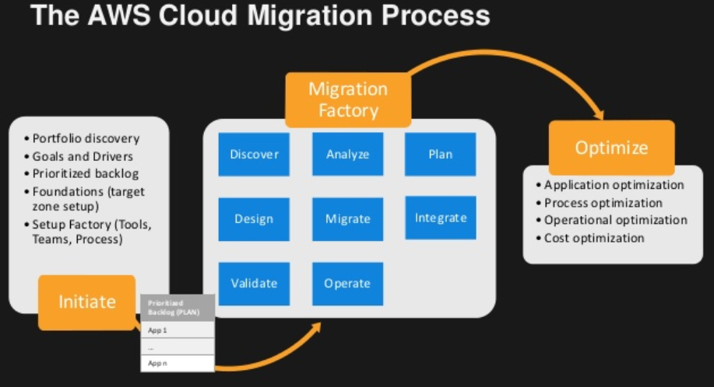
Transition Approach

Slide 28
Cybersource & Infinity Corp : Case study Understanding
Migrated Payment System – ‘CyberSource’
Acquirer
VisaNet
Acquirer
Payment methods
Issuer
Other Networks
Legacy Payment System – ‘ABC’
VisaNet
Acquirer
Issuer
Payment methods
‘ABC’ Payment system
Other Networks
Notes:
This case study talks about a potential acquirer which, I would be referring by the name of “Infinity Corp” in my presentation. Infinity Corp wants to migrate away from their existing payment system i.e ABC payment system to ‘CyberSource” payment management system.
The entire payment flow would remain same in the migrated payment system. However CyberSource enables a single platform and has pre-built integrations with payment methods and payment networks. So, it acts as a Modular payment management system and supports extensive range of payment methods and international currencies, along with few value added services like Fraud management, PCI compliance
Infinity Corp is really looking forward for the success of this migration to a single platform as currently this acquirer is handling multiple issues across interconnected software’s and payment flow through complex integrated system.

Slide 29


Pre Migration
IOT Test Center Build
Steady State
Iterative Migration Plan
Discover Business needs:
Business models of X acquirer.
Agreements with Merchants
Existing Payment System
Identify Migration Bubbles:
right Migration Approach
factors influencing switch migration.
proper tools
Team
Training requirements
Week 1
Week 2-3
Week 4-6
Week 7-8
Week 8 onwards..

Slide 30
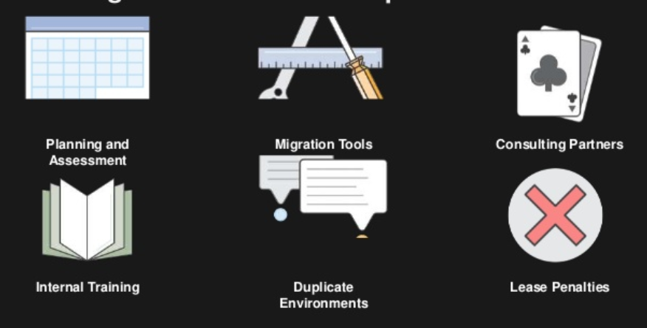
Pre Migration
Migration Factory
Steady State
Iterative Migration Plan
Phase –I (South Asia)
Phase –II (South-east)
Phase –III (North)
Week 1
Phase –III (Middle East)
Assessment ---Build ---Testing ---Implementation

Slide 31



Pre Transition
Knowledge Acquisition
Handover & Stabilization
IOT Test Center Build
Steady State
Signed-off Transition Governance Model
Training plan, access/licenses/tools requirements
Transition plan and schedule
Test Strategy
Handover of existing documentation and test plans
Staffing plan
Shadow & Reverse KT
Test Plan detailing
Test data setup and documentation
Baselining the test strategy
Implement Automation and Performance Test suites
Design and implementation of new test cases
Approved OLA/SLA
Process and Traceability Set up
Data analysis
Signed-off Engagement Model
Hybrid model
Independent Handling
Crowdsourcing framework in place
Piloting SLA Monitoring
Validating Test Cases and Test Results
SLA/KPI Tracking,
Implementation of governance and communication models
Monthly dashboard - Availability, SLA/ KPI,
Signed off test plan
Execution of test cases as per agreed timelines
Establish offshore connectivity and validate access
Study Existing Process, guidelines, standards & policies and automation framework
Identify critical tasks
Finalize staffing requirements
Ramp-up capacity
Training plan implementation
Testing tools and test env. setup

Slide 32
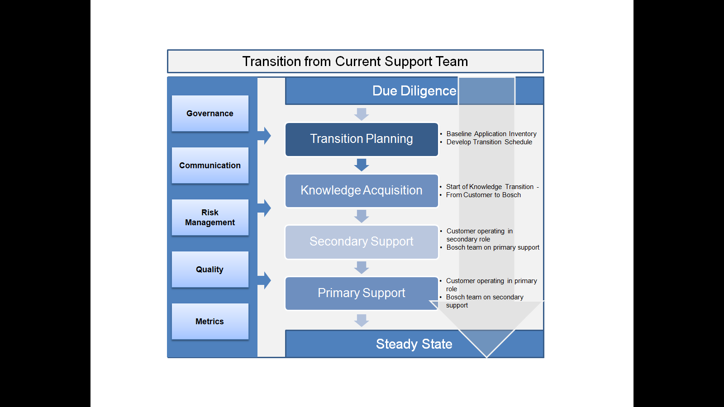
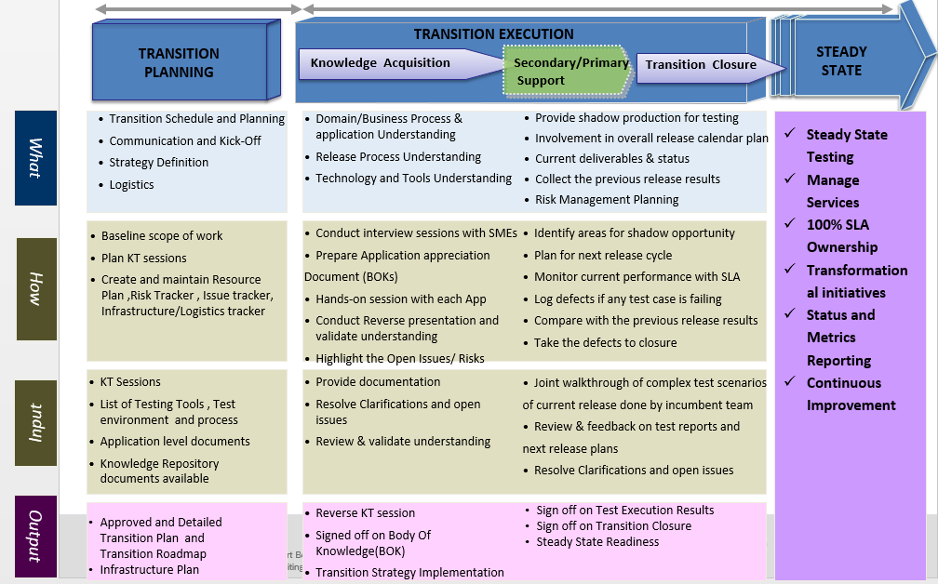

Slide 33
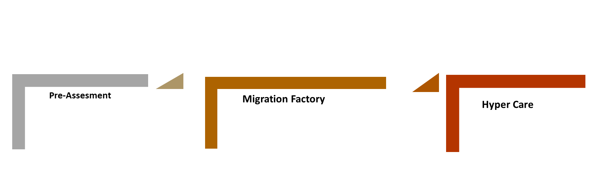
Key Go-Live Considerations
Is the System ready?
Health of project
Entry Exit criteria’s met
Test & Defect Reports
Sign off parameters
Are the users ready?
Changes analysed & Communicated.
Sufficiently trained on new system
User knows how to deal with unforeseen issues,
Is the plan to handle early warnings ready?
Continuous monitoring
Mitigation & Contingency Plans
Are the Stakeholders ready?
Regular Reporting on SLAs & Risks
Communication Plan implemented.
Change Management employed.
Is the infrastructure ready?
Acquirer’s network, processing speed and storage capacity to connect to Cybersource
Is there fall back plan?
Workaround processes.
Cutover abortion plan (exceptional case)
Cutover extension plan
Fall back plan tested.
Interfaces (digital wallets) ready?
Are the timings for cutover schedule reasonable.
Do they need dry runs.

Slide 34
Pre-Assesment
Migration Factory
Hyper Care
Iterative Migration Plan
Pre-Migration
Migration
Steady State
Cybersource
Big Bang (Authorization)
Planning & Assessment
Key Go-Live Considerations
Tool requirements
Migration Blueprint as per business requirement
Parallel (Data Migration)
Migration approach
Decommission the old system
Hybrid whole
Team Requirement
Fall Back Approach
Big Bang
(anti-Fraud Solutions)
Activate Fall Back Approach & Sync with Legacy System
100% SLA Ownership
Legacy Wrapper Approach
Training & Communication Approach
Parallel (End to End)
Constant Monitoring & Controlling
Fall back scenarios
Legacy wrapping approach

Slide 35
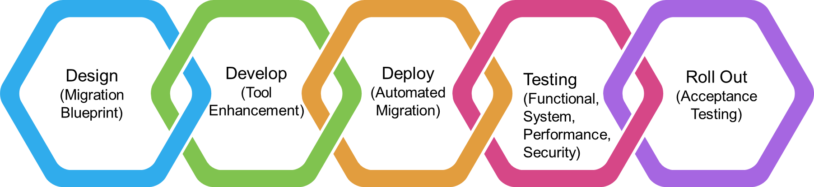
Project Schedule Plan
 | 2021 |  |  |  |  |  |  |  | 2022
 | Sep | Oct | Nov | Dec | Jan | Feb | Mar | Apr | May | Jun
Go-Live Factors
Middle East
South East Asia
North Asia
South Asia
Monitoring & Control – Scope, Cost, Time, Quality, People, Stakeholder
Risk Management – Mitigation & Contingencies
Change Management, Governance, Communication & Training
Migration factory
Sync with A Payment System
Decommission “A”
Pre-Assessment
Hyper Care
Monitor & Hand-over
Migration factory
Sync with A Payment System
Decommission “A”
Pre-Assessment
Hyper Care
Monitor & Hand-over
Migration factory
Sync with A Payment System
Decommission “A”
Pre-Assessment
Hyper Care
Monitor & Hand-over
Sync with A Payment System
Decommission “A”
Migration factory
Pre-Assessment
Hyper Care
Monitor & Hand-over

Slide 36
Pre-Assesment
Migration Factory
Hyper Care
Iterative Migration Plan
Pre-Migration
Migration
Steady State
Phase –I (Authorization)
Planning & Assessment
Key Go-Live Considerations
Hybrid whole
Migration approach
Tool requirements
Phase –II (Visa Interface)
Decommission the old system
Team Requirement
Fall Back Approach
Phase –III (Data Migration)
Activate Fall Back Approach
Cybersource
100% SLA Ownership
Legacy Wrapper Approach
Training & Communication Approach
Phase –IV (Overall)
Fall back scenarios
Legacy wrapping approach

Slide 37

Project team
Roll Out
(Acceptance Testing)
Design
(Migration Blueprint)
Develop
(Tool Enhancement)
Deploy
(Automated Migration)
Testing (Functional, System, Performance, Security)

Slide 38
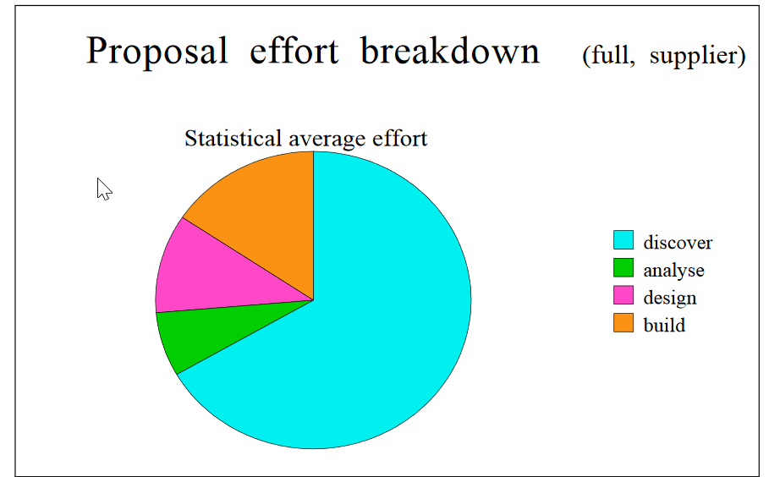
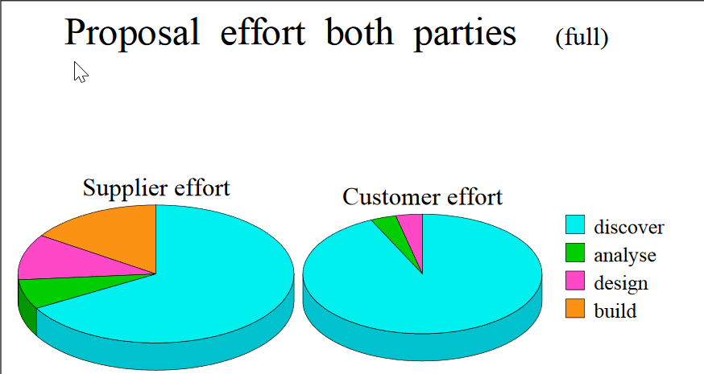
Effort Estimation

